Slide 1
OPS535 Virtual Lab
Routing Configuration
on
each Virtual LAN Segment (VLS)
by Raymond Chan
March, 2021

Slide 2
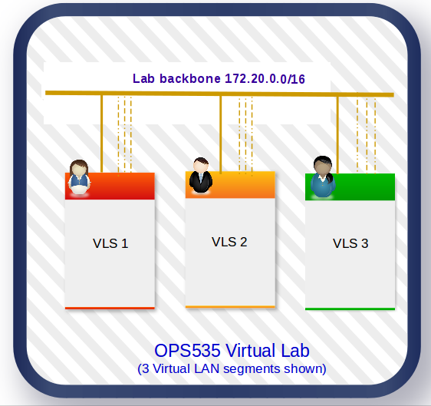
Network Diagram

Slide 3
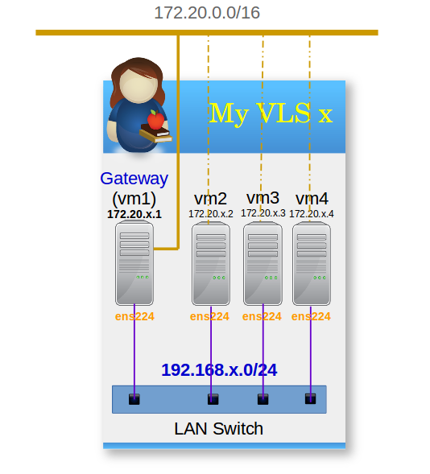
SVL – Virutal LAN Segment

Slide 4
The network environment
Treat the OPS535 Virtual Lab environment as the our INTERNET.
The default gateway (172.20.255.1) for all the VM2 to VM4 in each VLS to the REAL Internet is temporary blocked (either by de-activate ens224 on VM2 to VM4, or block the out-going traffic by firewall)
Configure routing on your four VMs so that all your VMs may communicate with all other Vms in the VL.
No Network Address Translation on VM1, only pure routing.

Slide 5
routes on gateway
Need one route per each VLS with network number y in SVL.
On your gateway (VM1) 172.20.x.1, add route to 192.168.y.0/24 network using 172.20.y.1 as the gateway
nmtui utility:
See the online demo.
ip route command:
Ip route add 192.168.y.0/24 via 172.16.y.1 dev ens192

Slide 6
routes on each VM
Need one route for each VLS with network number y (192.168.y.0/24) in SVL via your own gateway (172.20.x.1)
On each of your vm 192.168.x.m, add route to 192.168.y.0/24 via your own gateway 192.168.x.1
route command:
route add -net 192.168.y.0 netmask 255.255.255.0 gw 192.168.x.1
nmtui utility
See online demo

Slide 7
Testing
Don’t forget to test the connectivities between your own VMs and at least one other student’s VMs. However, the more that better. If time permitted, test on ALL other students’ VMs.
Capture evidence to proof that ALL your VMs can reach the network interface ens224 of all your classmate’s Vms.
If you could not find another student to work with you, try testing the Vms with VLS number 2.
  192.168.2.1, 192.168.2.2, 192.168.2.3, 192.168.2.4
  Gateway to 192.168.2.0/24 network: 172.20.2.1

