Slide 1
DATA SCIENCE CAPSTONE PROJECT Diabetes Prediction

Slide 2

Aim
Objective
Background
New Zealand’s Diabetes Status

Slide 3

Methodology
Missingness and Duplicates
Hot Encoding
Data Imbalance

Slide 4

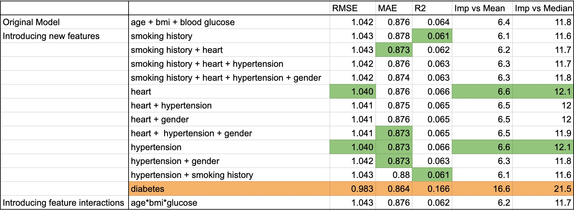
HbA1c Levels Prediction

Slide 5
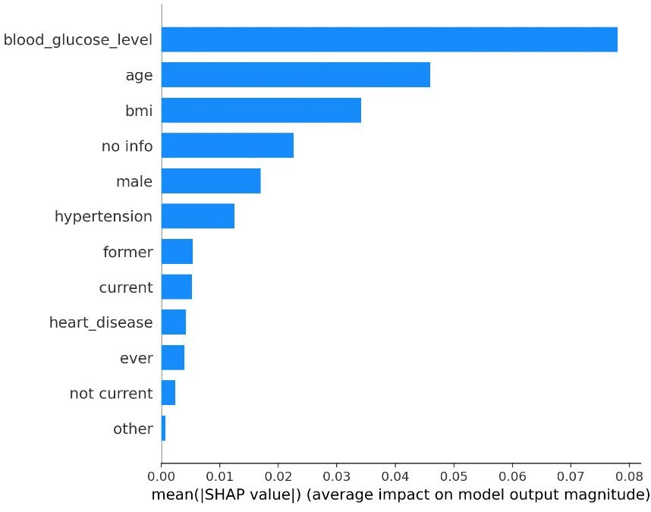
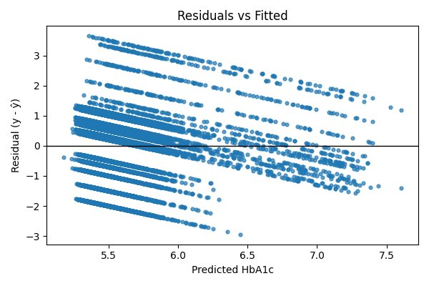

Slide 6
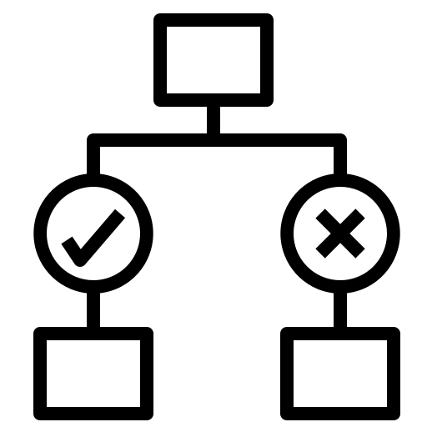
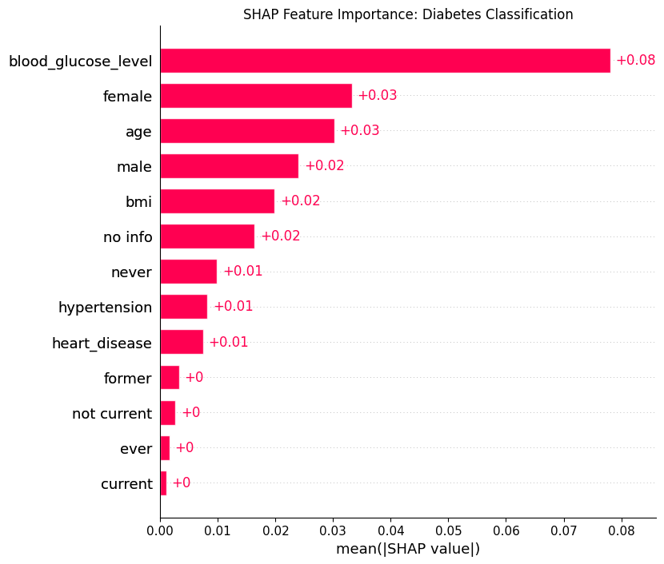
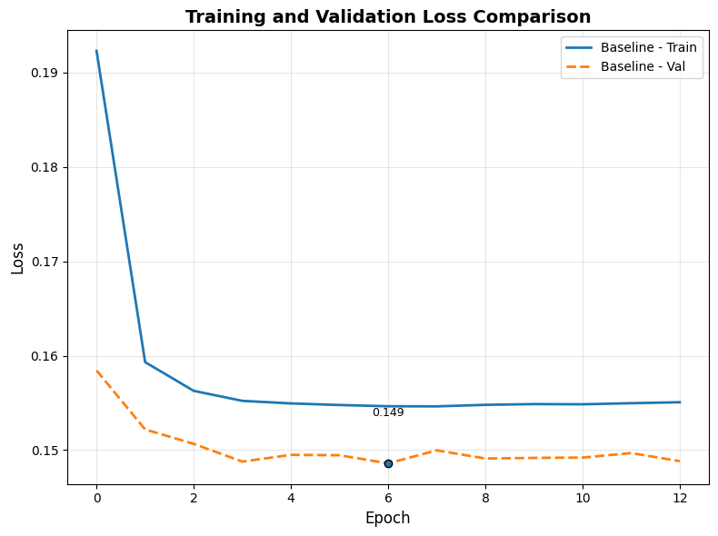
Diabetes Classification
Performance
Notes:
Baseline model SHAP (all predictors except HbA1c), why removed only smoking history and kept heart disease and hypertension
Experiment 2 is the best (removed smoking history and RMSprop optimizer)
Talk about the performance
After ANN, did logistic regression and both models were evaluated.
Discuss the evaluation table, explain what is sensitivity and specificity, and conclude that ANN performed better

Slide 7
ANN and Logistic Regression Test Evaluation
- What is Specificity and Sensitivity?
Classification Table
 | ANN | Logistic
Accuracy​ | 0.83​ | 0.83​
Specificity​ | 0.83​ | 0.78​
Sensitivity​ | 0.83​ | 0.83​
AUC​ | 0.92​ | 0.91​

Slide 8

Gender Differences
Same predictors dropped and threshold​
Males better sensitivity​
Females overall perform better
Classification Table
​ | ANN |  | Logistic
 | Male​ | Female​ | Male | Female
Accuracy​ | 0.82​ | 0.86​ | 0.80​ | 0.85​
Specificity​ | 0.82​ | 0.87​ | 0.81​ | 0.85​
Sensitivity​ | 0.84​ | 0.80​ | 0.79​ | 0.76​
AUC​ | 0.93​ | 0.93​ | 0.90​ | 0.91​
Notes:
Talk about the classification table
What does sensitivity and specificity mean in this context
Conclusion to why female model is better than male model

Slide 9

Real World Application
Diabetes ANN model
Features of High Importance
​
HbA1c Level ANN Model​
Blood Glucose
Early flagging
BMI
Age

Slide 10

Conclusion
ANN performs better than logistic regression
Weak model
Gender based: female model is better

Slide 11

Thank you
Any Questions?

