Slide 1
DATA SCIENCE CAPSTONE PROJECT Diabetes Prediction
By Matthew Madriaga, Ray Gomez, Brayden Davies, Seavchhun Teng
Notes:
For our Capstone Project we chose to do the Diabetes Prediction Project. I'm Matthew, this is x, y, z.

Slide 2

Overview
Matthew
Objective
Background
Statistic
Predicting HbA1c and Diagnosing Diabetes
Validity of ANNs
What is HbA1c and Diabetes?
New Zealand (2024)
348,000
Diabetic cases

Slide 3

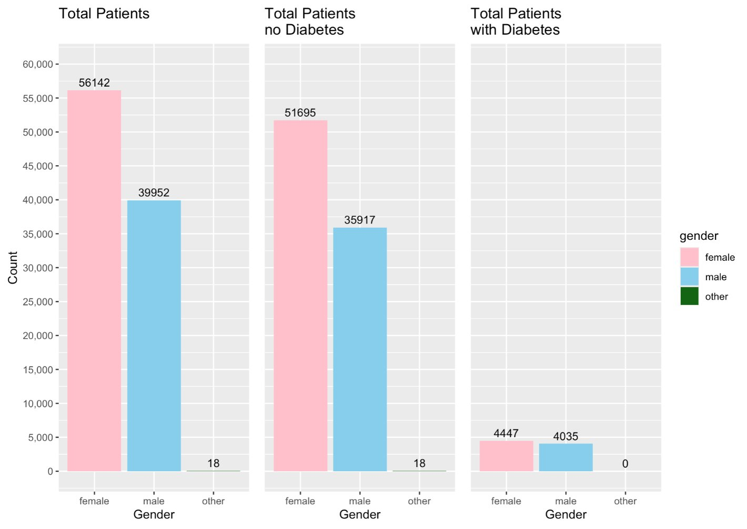
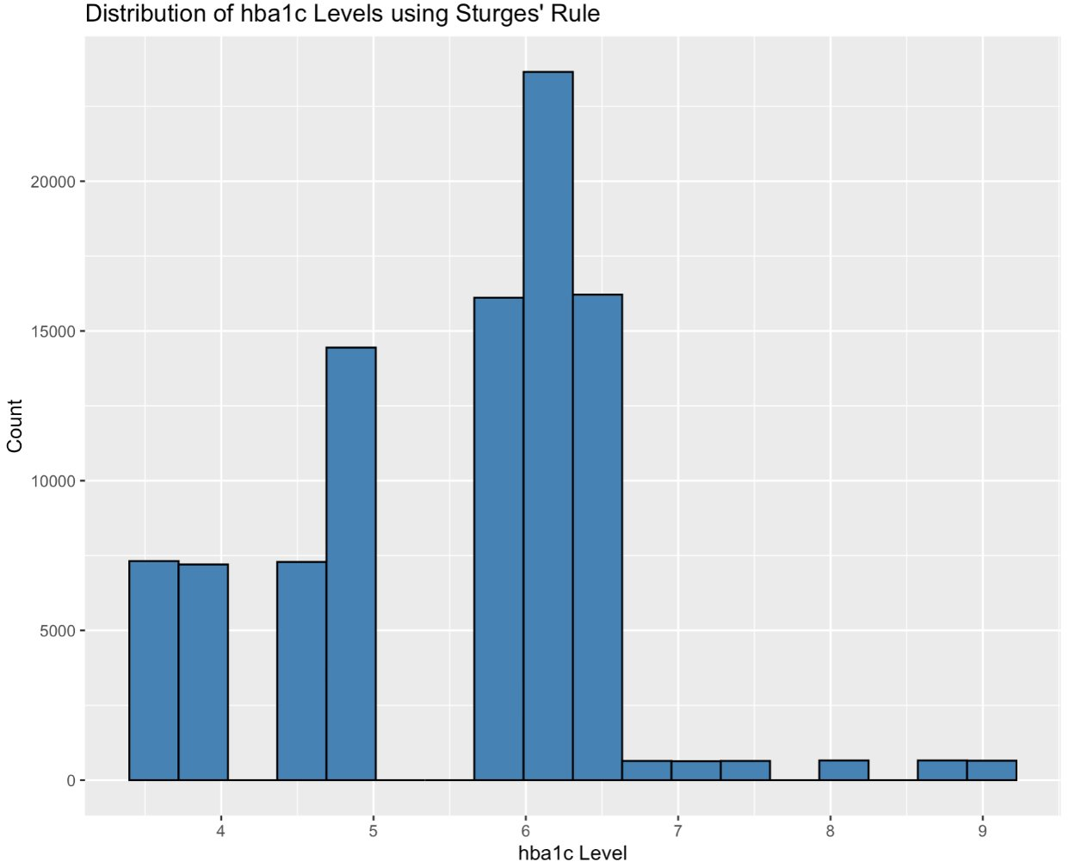
Methodology
Ray
No Missing Data
Approximately 8% Duplicates
Class Imbalance Categorical Data
Right-Skewed Numerical Variable

Slide 4

HbA1c Levels Prediction
Ray
ANN Model |  | RMSE | MAE | R2 | Imp vs Mean | Imp vs Median
Original Model | age + bmi + blood glucose level | 1.042 | 0.876 | 0.064 | 6.4 | 11.8
Adding Features | smoking history | 1.043 | 0.878 | 0.061 | 6.1 | 11.6
 | smoking history + heart disease | 1.043 | 0.873 | 0.062 | 6.2 | 11.7
 | smoking history + heart disease + hypertension | 1.042 | 0.876 | 0.063 | 6.3 | 11.7
 | smoking history + heart disease + hypertension + gender | 1.042 | 0.874 | 0.063 | 6.3 | 11.8
 | heart disease | 1.040 | 0.876 | 0.066 | 6.6 | 12.1
Best Model | heart disease + hypertension | 1.041 | 0.875 | 0.065 | 6.5 | 12
 | heart disease + gender | 1.041 | 0.876 | 0.065 | 6.5 | 12
 | heart disease + hypertension + gender | 1.041 | 0.873 | 0.065 | 6.5 | 11.9
 | hypertension | 1.040 | 0.873 | 0.066 | 6.6 | 12.1
 | hypertension + gender | 1.042 | 0.873 | 0.063 | 6.3 | 11.8
 | hypertension + smoking history | 1.043 | 0.88 | 0.061 | 6.1 | 11.6
Feature Interaction | age * bmi * blood glucose level | 1.043 | 0.876 | 0.062 | 6.2 | 11.7
Chosen Model, RMSE = 1.041, MAE = 0.875, R-Squared = 6.5%

Slide 5
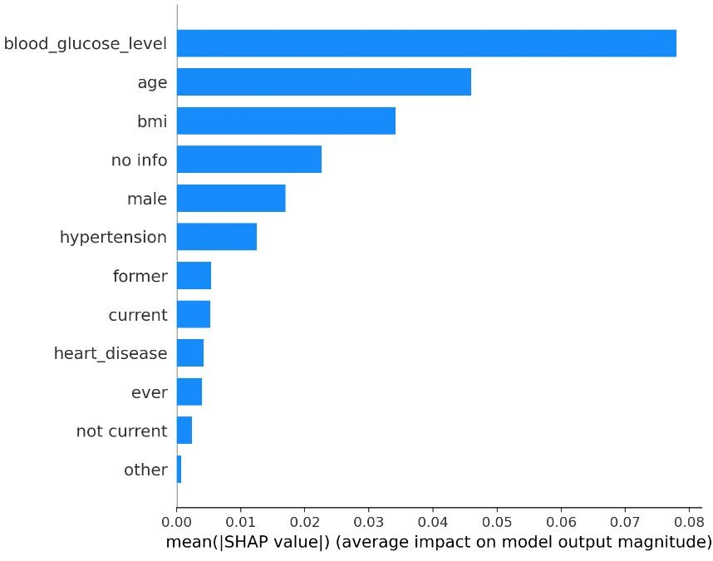
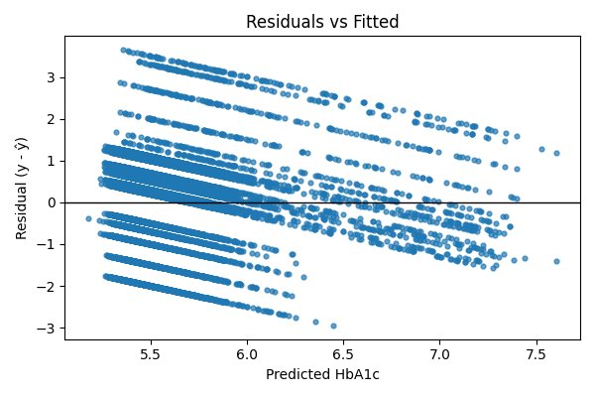
HbA1c Levels Prediction (Continued)
Ray
SHAP Feature Importance (ANN)
Optimal Model's Performance

Slide 6
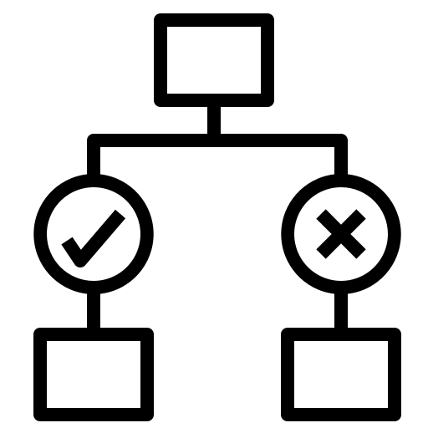
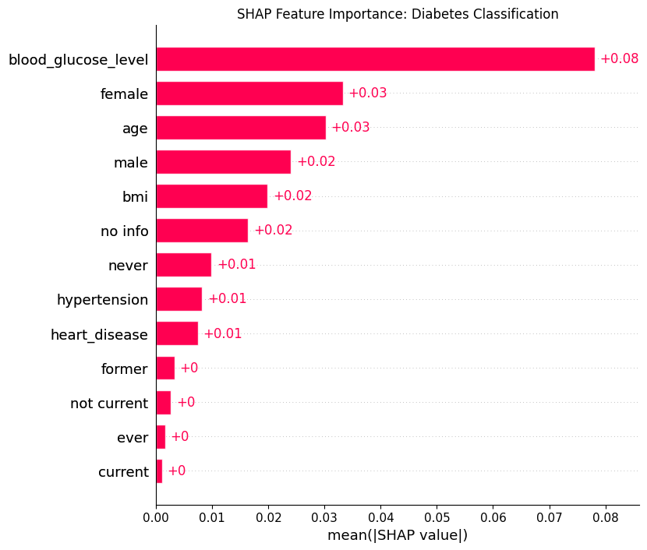
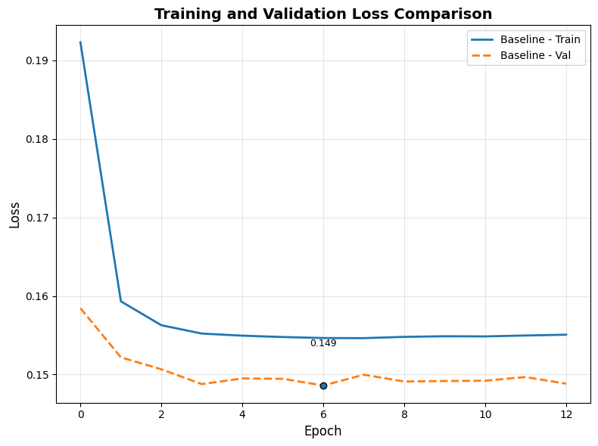
Diabetes Classification
Chhun
SHAP Feature Importance (ANN)
Optimal Model's Performance
Notes:
Baseline model SHAP (all predictors except HbA1c), why removed only smoking history and kept heart disease and hypertension
Experiment 2 is the best (removed smoking history and RMSprop optimizer)
Talk about the performance
After ANN, did logistic regression and both models were evaluated.
Discuss the evaluation table, explain what is sensitivity and specificity, and conclude that ANN performed better

Slide 7


Diabetes Classification (Continued)
Brayden
ANN and Logistic Regression were evaluated using
Accuracy, Specificity, Sensitivity, and AUC
What is Specificity and Sensitivity?
Classification Table
 | ANN | Logistic
Accuracy​ | 0.83​ | 0.83​
Specificity​ | 0.83​ | 0.84
Sensitivity​ | 0.84 | 0.78
AUC​ | 0.92​ | 0.91​
Notes:
Made a traditonal logistic regression. For consistency we dropped the same variables that was dropped in ANN.
Created a classification table and used 4 key metrics: a,b,c,d
Define sensitivity, specificity, and maybe accuracy.
Tell the metrics and which one was better overall.

Slide 8


Gender Differences
Brayden
Gender-Based analysis used same predictors and threshold as optimal ANN model
Classification Table
​ | ANN |  | Logistic
 | Male​ | Female​ | Male | Female
Accuracy​ | 0.79 | 0.84 | 0.81 | 0.85
Specificity​ | 0.78 | 0.84 | 0.81​ | 0.86
Sensitivity​ | 0.86 | 0.85 | 0.80 | 0.77
AUC​ | 0.92 | 0.93​ | 0.90​ | 0.91​
Male Model: Better Sensitivity
Female Model: Better Specificity
Notes:
Talk about the gender-based topic why we are doing this. Talk about predictors dropped.
Talk about the classification table.
Conclusion to why female model is better than male model. Refer to methodology.
Conclude with which method is best overall/ group.

Slide 9


Real World Application
Matthew
HbA1c Prediction ANN Model’s Key Usage
​Early Flagging, Preventative Measure
Diabetes ANN Model’s Features of High Importance
Blood Glucose, BMI, and Age​

Slide 10


Conclusion
Matthew
HbA1c Prediction: Weak Prediction Model
Diabetes Prediction: ANN performed better than logistic regression
Gender Based Analysis: Female performed better

Slide 11

Thank you
Any Questions?

