Slide 1

DESIGN AND PERFORMANCE ANALYSIS OF A 3D-PRINTED CYCLOIDAL ACTUATOR
SUPERVISOR
CANDIDATE DETAILS
Dr. M.D. Vijayakumar M.E, Ph.D.
Associate Professor,
Dept. of Mechanical Engineering,
Chennai Institute of Technology,
Kundrathur – 600 069
Dept. of Mechanical Engineering
Rayhaan T – 23ME079
S Niranjan Babu – 23ME087
Chennai Institute of Technology,
Chennai – 600 069

Slide 2
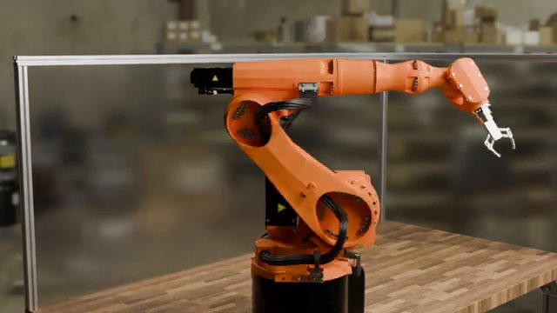
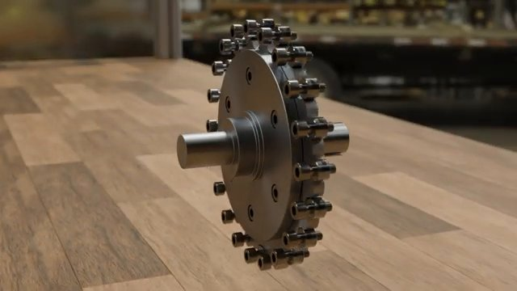
INTRODUCTION
Background & Motivation
Robotics, prosthetics & precision automation demand compact, high- torque, low-backlash actuators.
Spur gears: high backlash | Planetary: multi-stage | Harmonic drives: expensive.
Cycloidal drives: high reduction in ONE stage, very low backlash, compact.
Why 3D Printing?
FDM (Fused Deposition Modeling) is affordable & accessible to researchers.
PETG: combines PLA printability with ABS-like strength & durability.
This project: design, print & test a full PETG cycloidal actuator.
Cycloidal Drive Principle
Eccentric input shaft drives a lobed disc rolling inside fixed ring pins.
Output rotation is opposite to input with Reduction = Ring Pins – 1
Fig: Industrial robot using cycloidal actuators
Fig: Cycloidal drive assembly

Slide 3
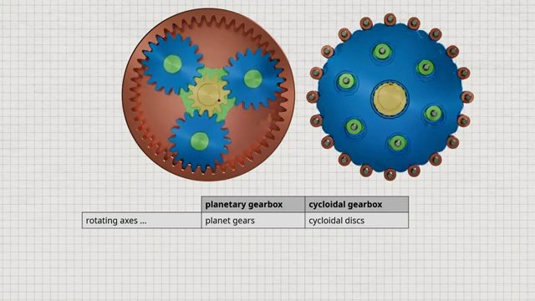
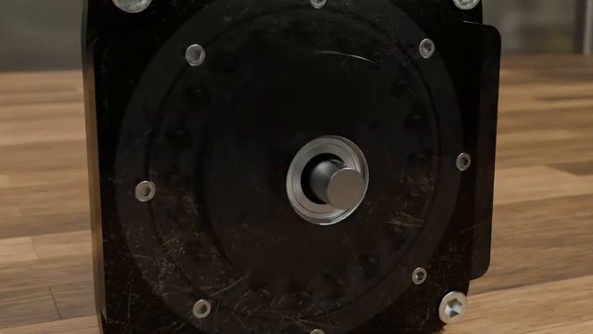
Problem Statement
Conventional cycloidal drives require precision CNC machining (15000 Rs–50000 Rs) — inaccessible for research &
education.
Limited data on torque capacity, efficiency & service life of 3D-printed cycloidal actuators.
PLA: brittle & temperature-sensitive | ABS: warps during printing | PETG: insufficiently studied.
Research Question:
Can a functional cycloidal actuator be fabricated using PETG via FDM 3D printing, and how does it perform in reduction accuracy, torque transmission, efficiency & backlash?
Fig: Planetary gearbox vs Cycloidal gearbox comparison
Fig: Metal cycloidal drive unit

Slide 4
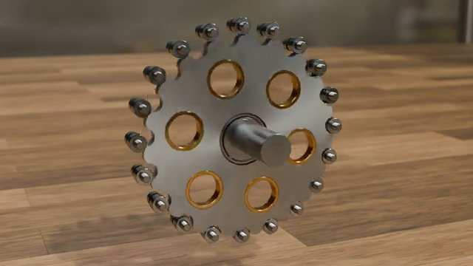
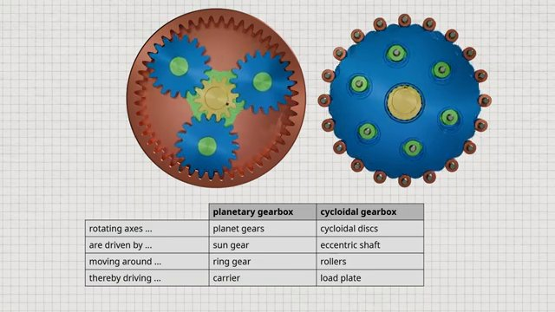
Literature Survey
[1] Tymrak et al. (2014)
FDM-printed PLA & ABS: layer adhesion strongly affects strength. Vertical prints are 30–40% weaker.
[2] Garcia-Plaza et al. (2018)
PLA gears survive ~10^5 cycles at 20% UTS. Heat generation is the key limiting factor.
[3] Llanos et al. (2020)
3D-printed PLA cycloidal confirmed kinematics; torque limited to 2 Nm. Suggested PETG.
Research Gap:
No systematic study of PETG-based full cycloidal actuator under controlled loading.
Fig: Cycloidal disc with ring pins
Fig: Cycloidal vs Planetary gearbox — component comparison (video)

Slide 5
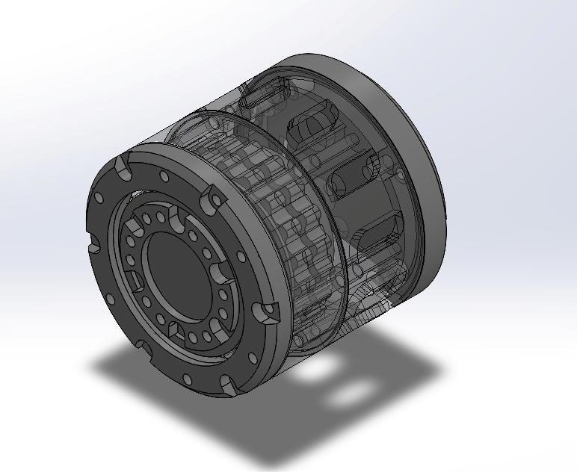
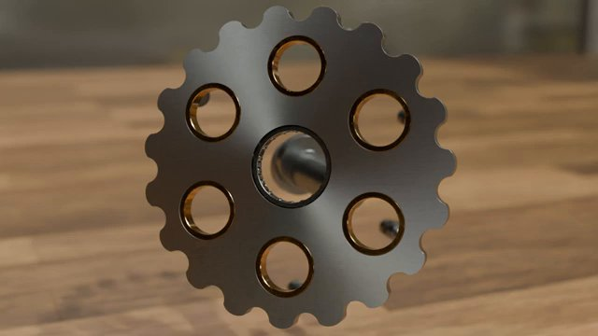
Objectives
1. Design & Modelling: Design a cycloidal drive with 19:1 reduction ratio using CAD.
2. Geometric Calculations: Apply parametric equations to verify reduction ratio & torque.
3. Fabrication using PETG: 3D-print all components with optimized FDM parameters.
4. Mechanical Evaluation: Test kinematic accuracy, torque capacity, efficiency & backlash.
5. Microstructure & Failure Analysis: Inspect print quality and failure modes under load.
6. Validation: Compare experimental results with theoretical predictions.
Fig: Full Assembly CAD Model (SolidWorks)
Fig: Cycloidal disc geometry

Slide 6
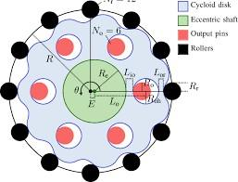
Methodology
Design Specifications
Reduction: 19:1 | Input Speed: 100 RPM | Input Torque: 1.0 Nm | Outer Dia.: 80 mm | Height: 40 mm
Geometric Parameters
E = 2 mm | R = 40 mm | Zr = 20 | Zd = 19 | Pin dia = 5 mm | Disc thickness = 8 mm
Reduction Ratio:
i = Zr / (Zr - Zd) = 20 / (20-19) = 19 : 1
Torque Analysis:
Ideal: T_out = 1.0 x 19 = 19 Nm | With 65% efficiency: T_out = 12.35 Nm (theoretical)
Cycloidal Profile (Parametric Eqs.):
x(theta) = R*cos(theta) - E*cos(Zd*theta) - (E/R)*cos((Zd-1)*theta)
y(theta) = R*sin(theta) - E*sin(Zd*theta) - (E/R)*sin((Zd-1)*theta)
Fig: Geometric parameters of cycloidal drive

Slide 7
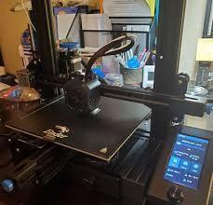
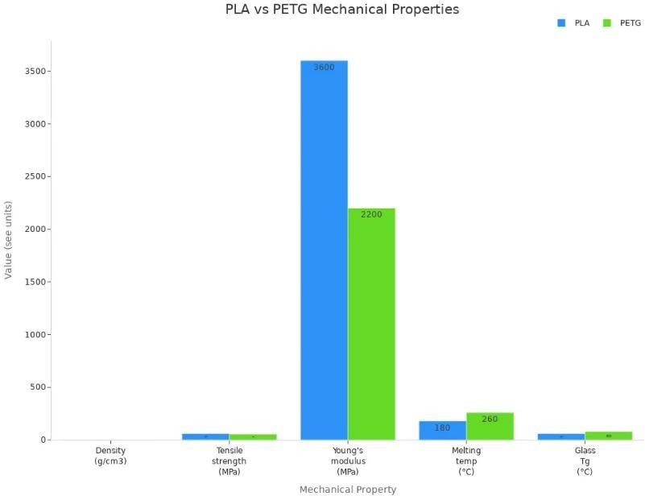
Materials and Methods
PETG Material (Tensile: 48 MPa | Modulus: 1.9 GPa | Elongation: 18% | Tg: 80 deg C)
Best balance of strength, flexibility & printability vs PLA & ABS. Low warping.
3D Printing Parameters
Nozzle: 240 C | Layer: 0.16 mm | Infill: 100% Gyroid | Walls: 4 | Speed: 40 mm/s
Total print time: ~25.5 hrs | Filament: ~285 g (Cycloidal disc: 4.5 hrs | Housing: 11.5 hrs)
Assembly Steps
1. Press 6202 bearings 2. Mount cycloidal disc 3. Press ring pins 4. Insert output pins
5. Mount output flange 6. Close housing (M3 screws) 7. Couple NEMA 17 stepper motor
Fig: FDM 3D Printer Setup
Fig: PLA vs PETG Properties Chart

Slide 8
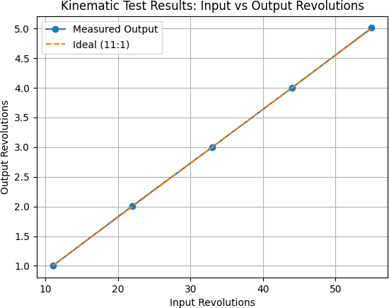
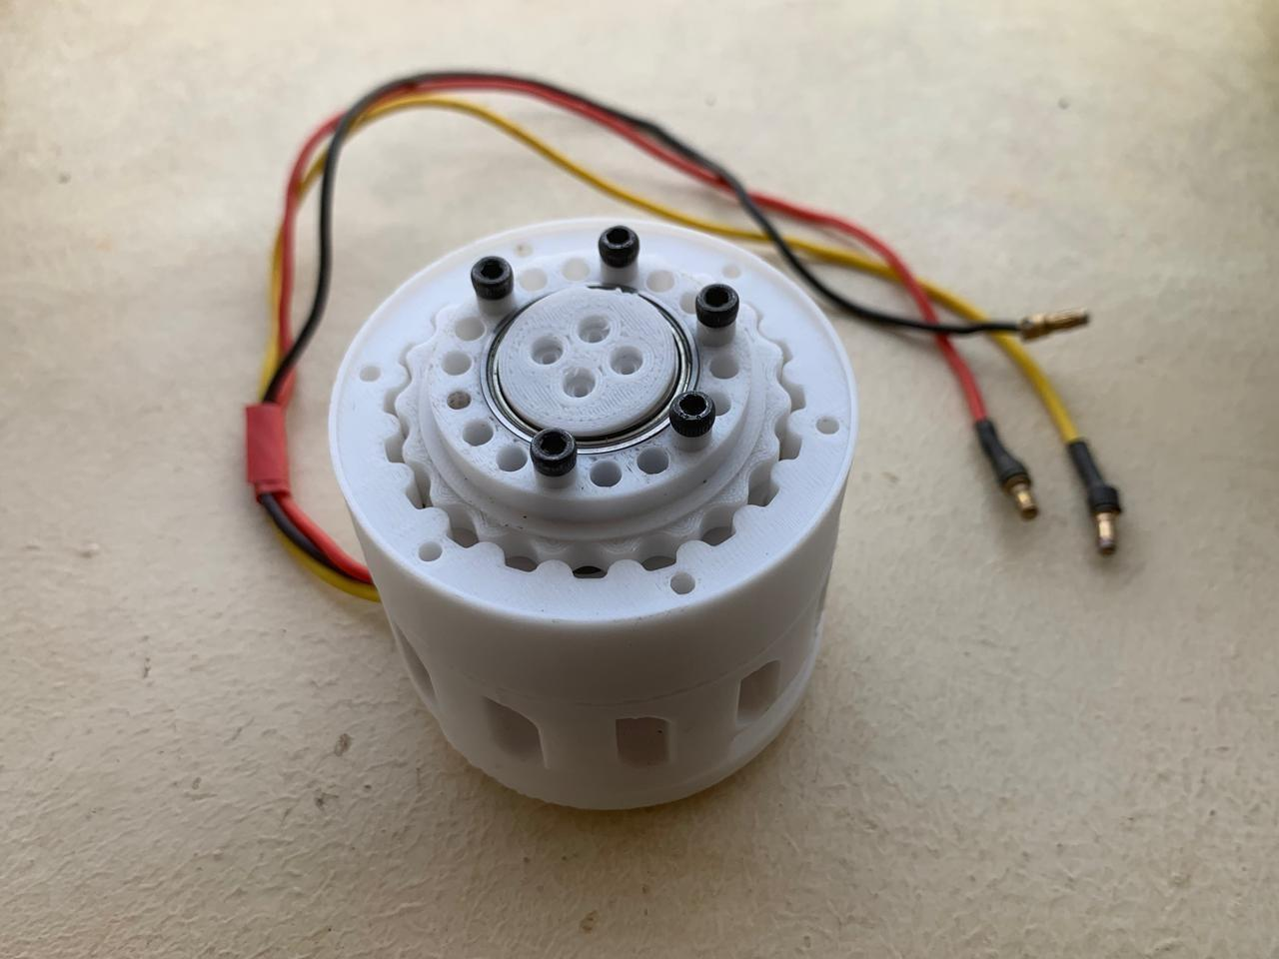
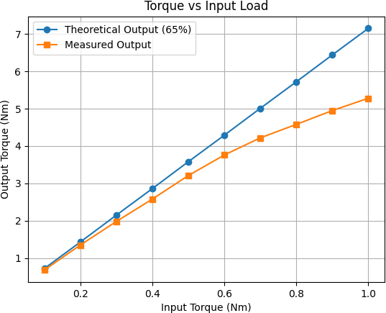
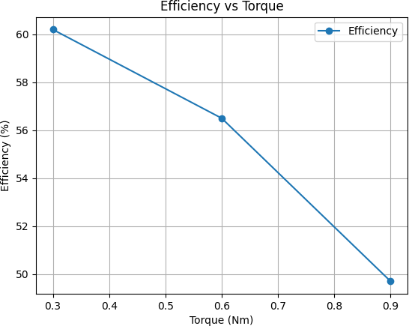
Results and Discussion
Dimensional Accuracy: All deviations within +/-0.1 mm (FDM acceptable)
Cycloidal disc OD: 79.92 mm (dev -0.08) | Ring pin radius: 39.95 mm (dev -0.05)
Kinematic Verification: Measured 18.99:1 (Target 19:1 — 0.09% error)
Torque Transmission: Peak 5.28 Nm @ 1.0 Nm input (amplification x5.28)
Efficiency: 61.8% (light load) to 48% (full load)
Backlash: 0.24 deg vs 1-3 deg for typical spur gears
Failure Modes: Disc lobe deformation at T_in > 1.4 Nm | Pin shear at 1.8 Nm | Complete disc fracture at 2.5 Nm
Fig: Kinematic Test Results
Fig: Assembled PETG Actuator
Fig: Torque vs Input Load
Fig: Efficiency Curve

Slide 9
Conclusion
1. Kinematic Precision:
Reduction ratio confirmed at 18.99:1 (target 19:1). FDM achieves sufficient cycloidal geometry accuracy.
2. Torque Capacity:
Peak output torque: 5.28 Nm at 1.0 Nm input (torque amplification x5.28, friction-limited).
3. Efficiency:
Range: 61.8% (light load) to 48% (full load) — acceptable for low-to-medium torque use.
4. Backlash:
Measured at 0.24 deg — far better than spur gears (1-3 deg), comparable to harmonic drives.
5. PETG Suitability:
Well-suited for low-to-medium torque applications. Limited above 80 deg C glass transition temperature.
6. Failure Mechanism:
Progressive plastic deformation of cycloidal disc lobes is the dominant failure at T_in > 1.4 Nm.
Fig: Final Assembled 3D-Printed PETG Cycloidal Actuator

Slide 10
Future Work
Material Optimization:
CF-reinforced PETG | Polycarbonate (higher temp) | Annealing to improve crystallinity
Design Improvements:
Integrated cooling channels | Metal inserts at high-stress zones | Optimized infill for strength/weight
Printing & Processing:
Continuous fibre printing | Multi-material bearings | Vapour smoothing to reduce friction
Application-Specific Testing:
10^5 cycle durability test | Robotic arm integration | PETG vs PLA vs ABS comparison
Fig: Robotic arm — target application
Fig: Cycloidal disc with output pins

Slide 11
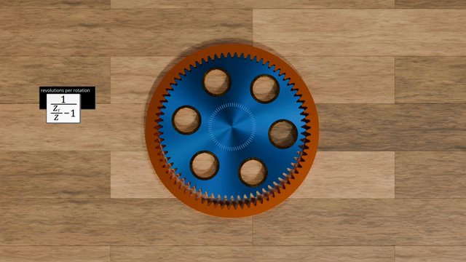
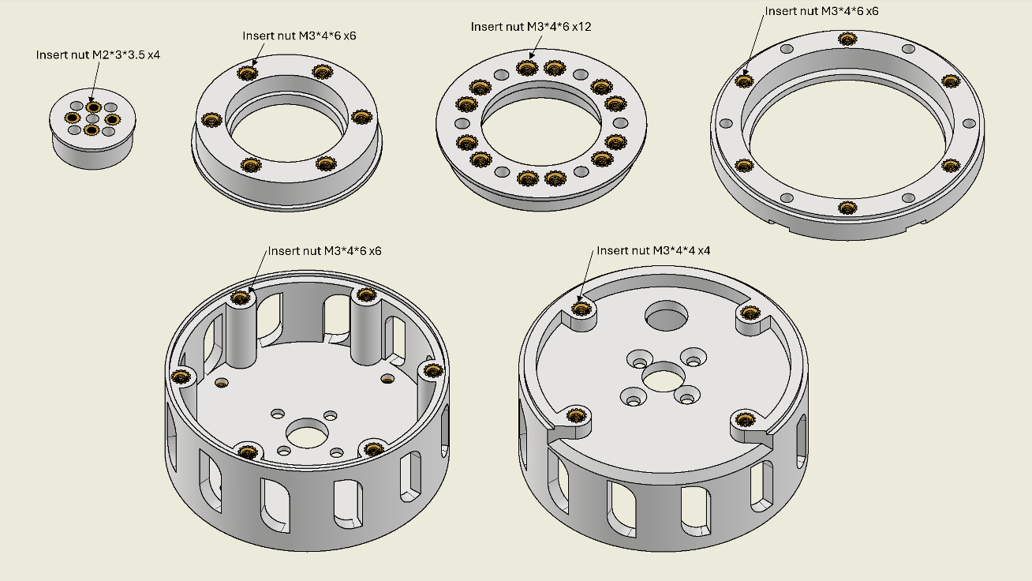
Reference
[1] Tymrak, B. M., Kreiger, M., & Pearce, J. M. (2014). Mechanical properties of FDM-printed components. Materials & Design, 58, 242-246.
[2] Garcia-Plaza, E., Nunez, P. J., & Sanz-Lobera, A. (2018). Fatigue behavior of FDM-printed PLA gears. Procedia Manufacturing, 13, 694-701.
[3] Llanos, J. F., Giraldo, J. A., & Gonzalez, D. (2020). Design of a 3D-printed cycloidal drive. Journal of Mechanical Engineering, 66(3), 145-152.
[4] Callister, W. D., & Rethwisch, D. G. (2018). Materials Science and Engineering: An Introduction (10th ed.). Wiley.
[5] Hashim, J., et al. (1999). Metal matrix composites by stir casting. Journal of Materials Processing Technology, 92-93, 1-7.
[6] Miracle, D. B. (2005). Metal matrix composites — From science to significance. Composites Science and Technology, 65(15-16), 2526-2540.
[7] Prasad, S. V., & Asthana, R. (2004). Aluminum metal-matrix composites for automotive applications. Tribology Letters, 17(3), 445-453.
Fig: Transmission ratio formula
Fig: Assembly component drawings

Slide 12
THANK YOU

