Slide 1
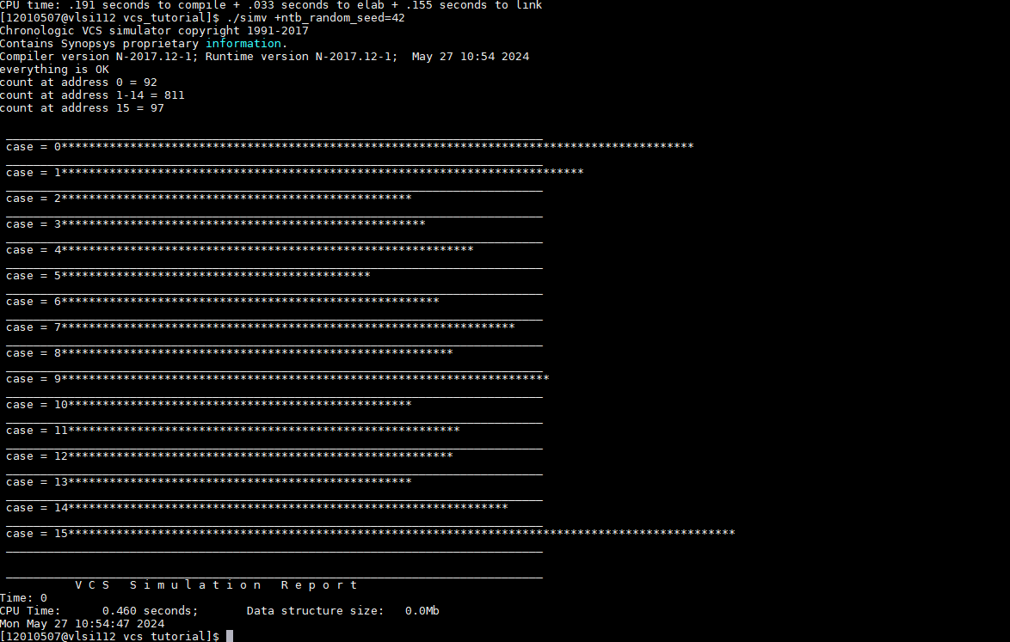
Exercise 6
Seed = 42

Slide 2
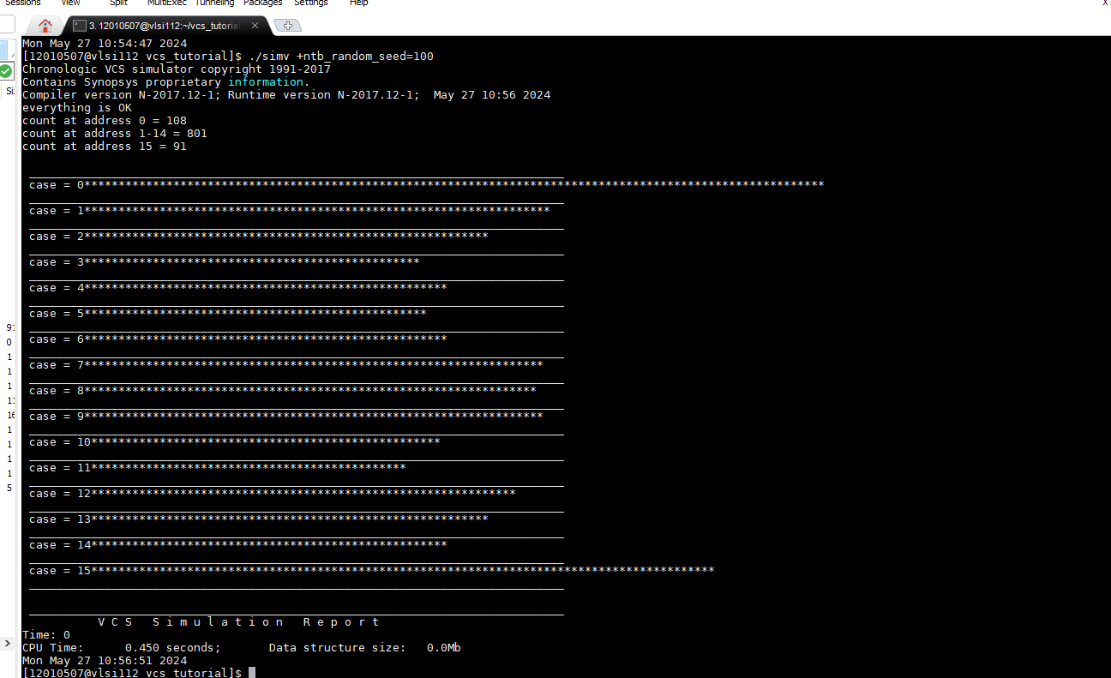
Exercise 6
Seed = 100

Slide 3
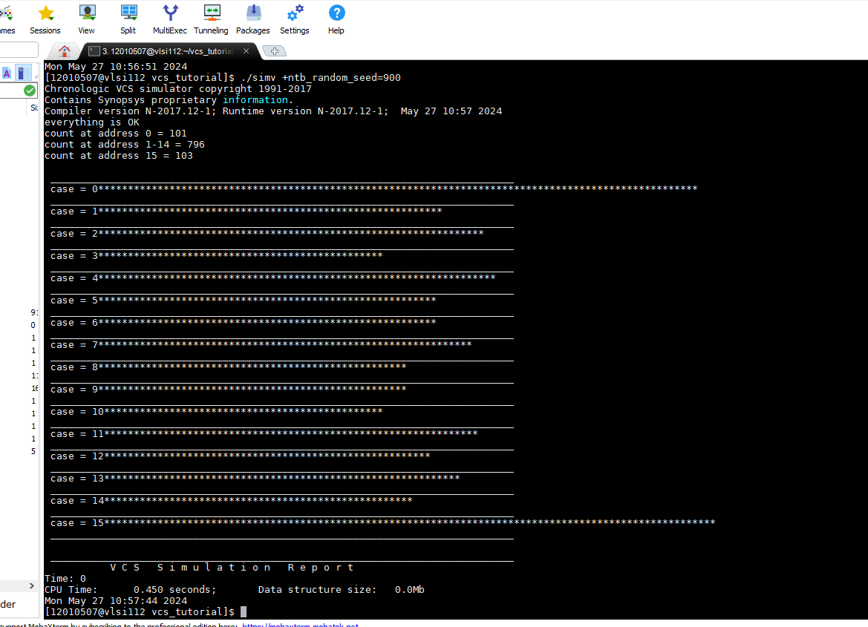
Exercise 6
Seed = 900

