Slide 1



xv6 Operating System
A Small Unix-like Teaching OS for Understanding Real Operating System Concepts
Presenter: Md. Abu Rayhan
Student ID: 220125
Department: Computer Science & Engineering
Pabna University of Science and Technology

Slide 2
Agenda
A structured walkthrough of xv6 — from architecture and boot sequence to memory management, I/O, and hands-on extension.
01
02
Introduction to xv6
Key Features
03
04
OS Architecture
Boot Flow
05
06
System Calls
Process Management & Lifecycle
07
08
Scheduling & Sleep/Wakeup
Memory Management
09
10
I/O & File Descriptors
Compilation & Execution Flow
11
12
Adding a New Command
Conclusion

Slide 3


INTRODUCTION
What is xv6?
xv6 is a small teaching operating system written in C and RISC-V assembly, developed at MIT. It is a re-implementation of the classic Unix Version 6, modernized for the RISC-V architecture.
Unlike production-grade systems such as Linux or Windows, xv6 is intentionally minimal — making it ideal for bridging theoretical OS concepts with real implementation.
xv6 is used in MIT's 6.S081 course and serves as a hands-on laboratory for understanding real kernel internals.

Slide 4

CORE CAPABILITIES
Key Features of xv6
Process Management
Virtual Memory
fork, exec, and wait provide full process creation, execution, and lifecycle control.
Per-process address spaces isolated via page tables mapping virtual addresses to physical RAM frames.
File System
System Calls
A simple Unix-like file system using inodes to manage persistent storage and directory hierarchies.
A compact, well-defined interface between user programs and kernel services.
Scheduling
Device Interaction
Preemptive round-robin CPU scheduling with context switching via swtch().
Uniform device access through file descriptors, unifying files, consoles, and pipes.

Slide 5
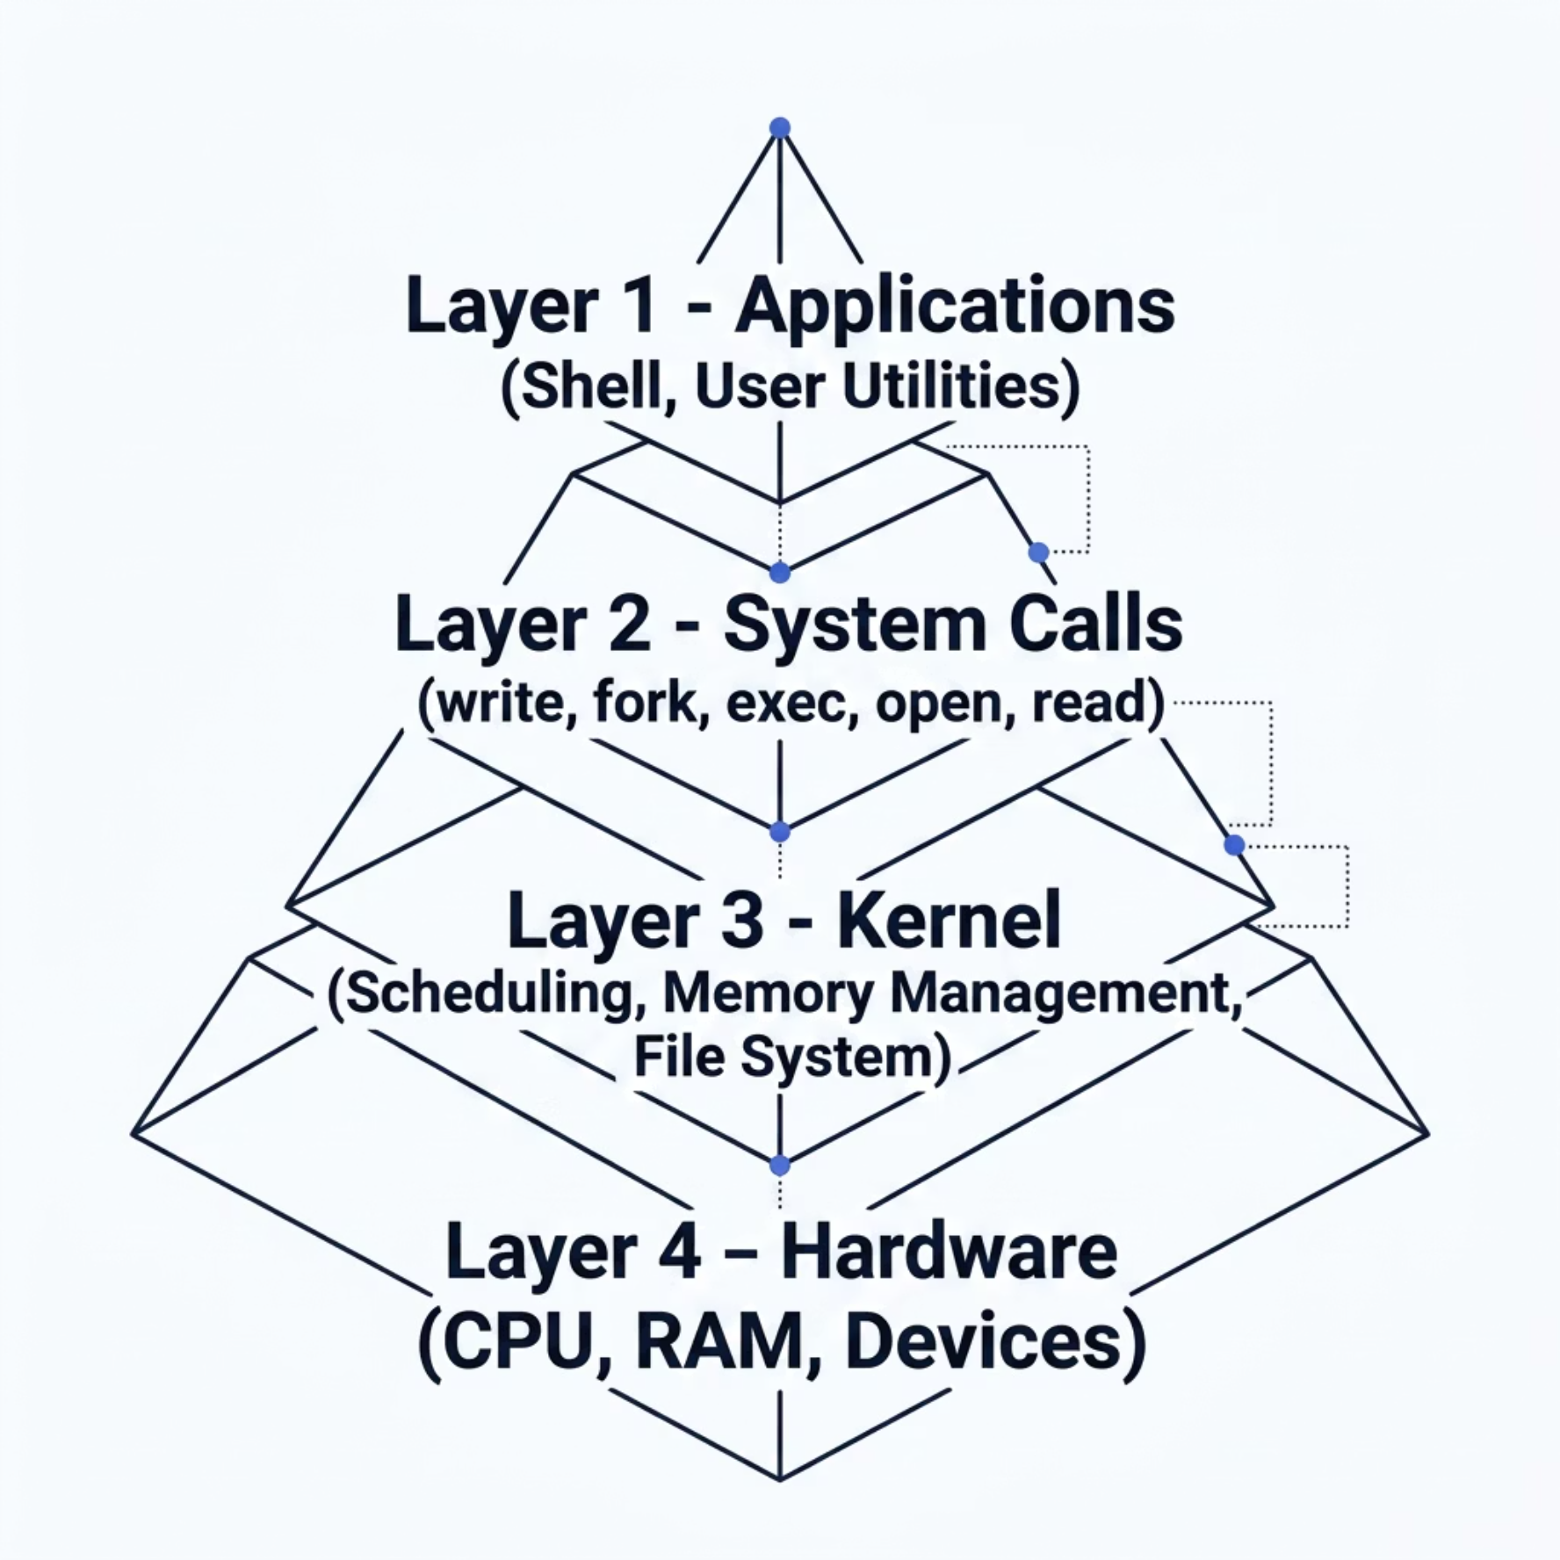
ARCHITECTURE
Operating System Architecture
xv6 enforces a clean layered architecture. Each layer interacts only with adjacent layers, ensuring
abstraction, protection, and modularity.
Resource Management — CPU, memory, and I/O allocation
Protection — User/kernel mode isolation via privilege levels
Abstraction — Files, processes, and devices as uniform interfaces
Coordination — Synchronization between concurrent processes

Slide 6

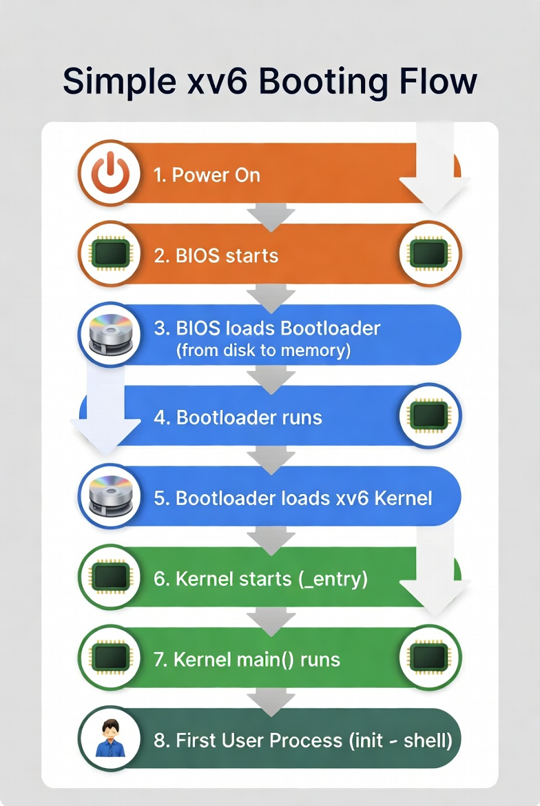





BOOT SEQUENCE
Boot Flow of xv6
On startup under QEMU, xv6 executes a deterministic boot sequence transitioning from real-mode assembly to a fully operational multi-process kernel.
QEMU Emulator
Simulates RISC-V hardware
entry.S
Assembly entry point; sets up stack
start()
Initializes kernel memory
main()
Initializes devices and console
userinit()
Spawns first user process
init → Shell
Launches /init, then sh

Slide 7
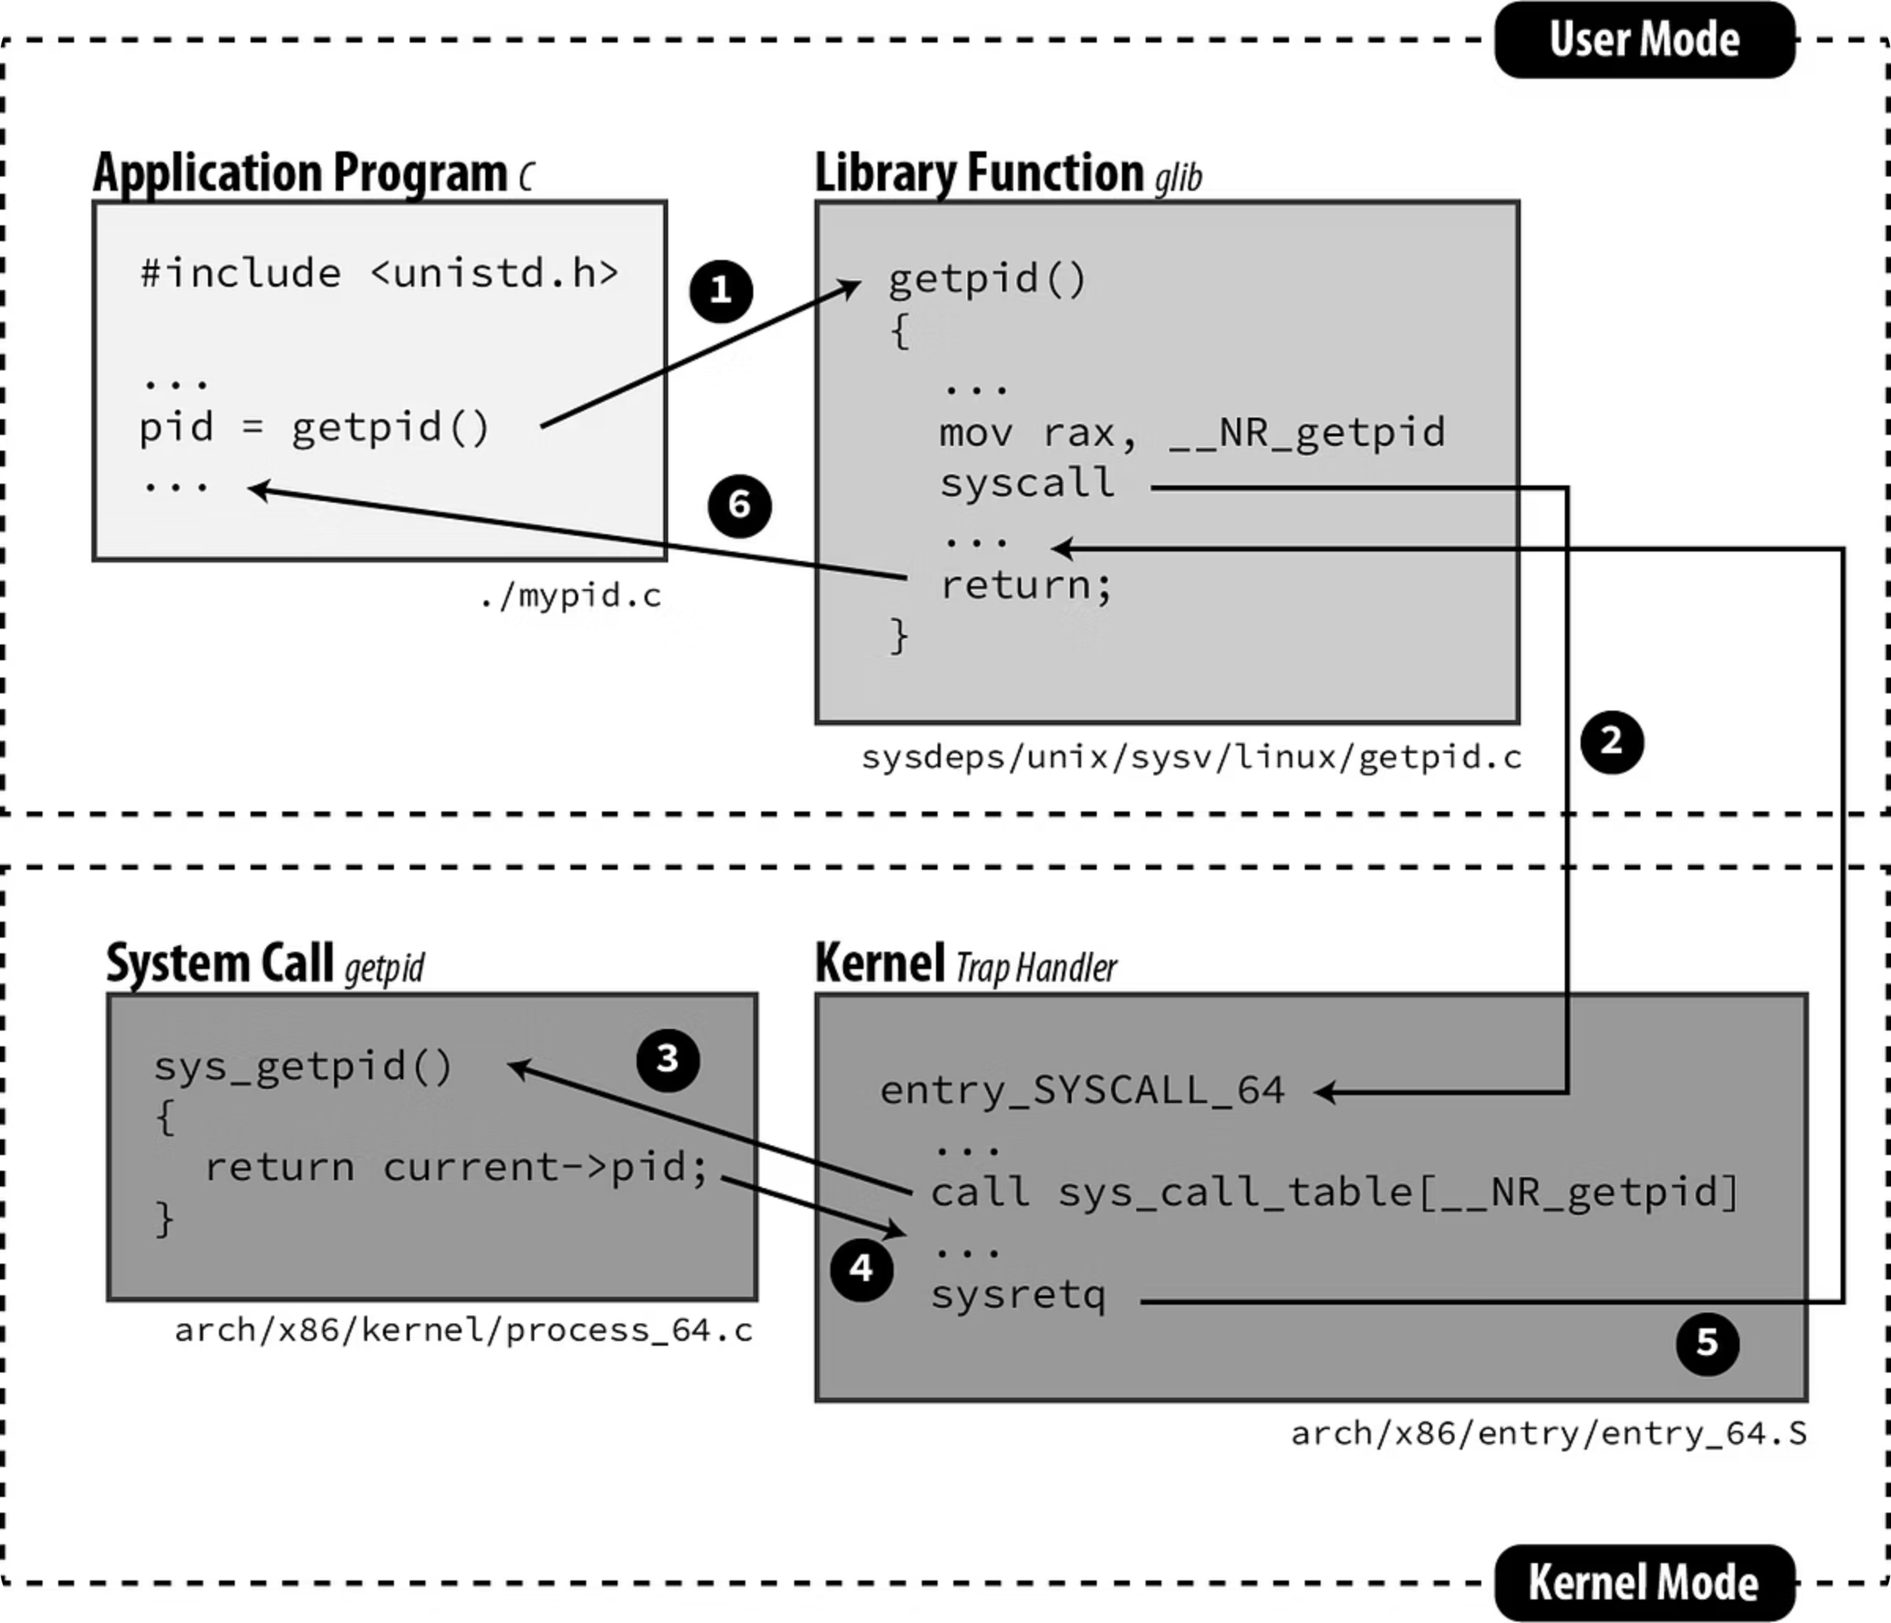
KERNEL INTERFACE
System Calls Essentials
System calls are the sole interface between user programs and the kernel. xv6 defines a compact set of calls that collectively enable all user-level functionality.
Process Control
I/O Operations
Memory Control
fork() · exec() · wait() · exit()
open() · read() · write() · close()
sbrk() — dynamically grows the process heap

Slide 8
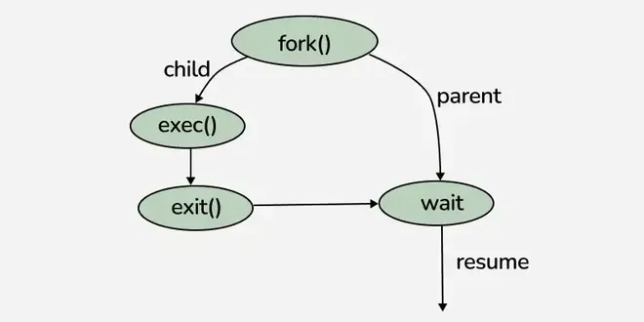
CONCURRENCY
Process Lifecycle
Process Lifecycle
Create
Run
fork() duplicates the parent's address space and page tables
exec() replaces the memory image with a new program
Reap
exit() marks process ZOMBIE; parent's wait() frees resources

Slide 9
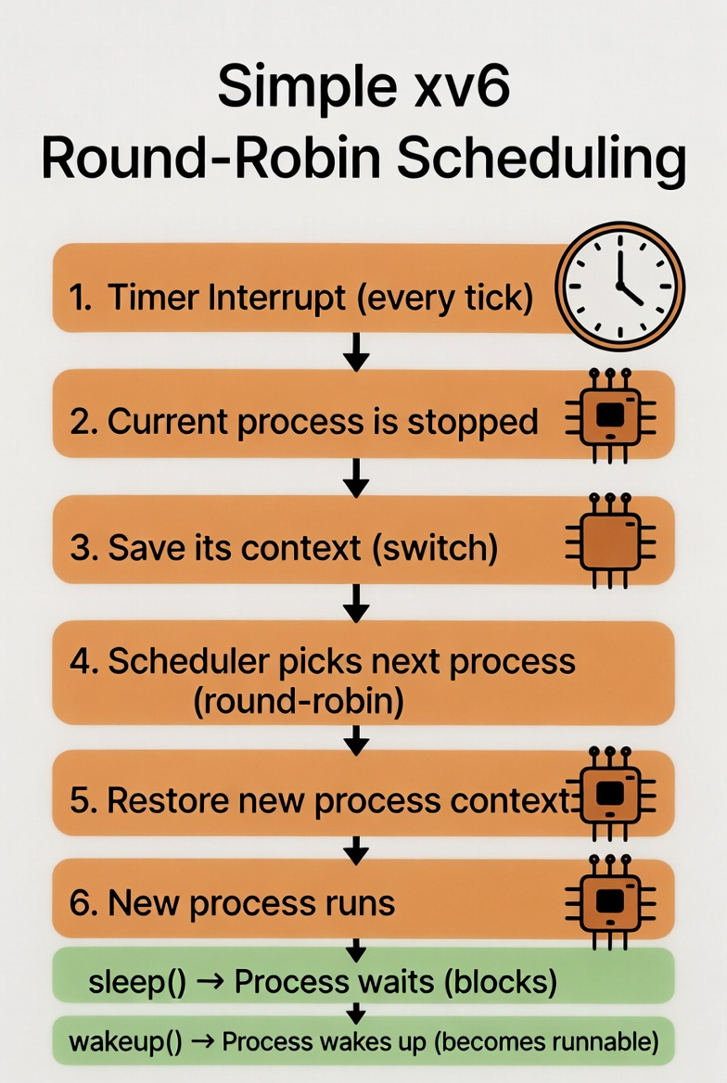
CONCURRENCY
Process Scheduling
Round-Robin Scheduling
xv6 uses preemptive round-robin scheduling. The timer interrupt triggers swtch() to save and restore CPU context, cycling through runnable processes.
sleep() and wakeup() coordinate blocking and signaling on kernel channels, enabling efficient wait queues without busy-waiting.

Slide 10
MEMORY & I/O
Memory Management & File Descriptors
Virtual Memory
File Descriptors
Each process has an isolated virtual address space. Page tables map virtual addresses to physical RAM frames, enforced by RISC-V hardware.
Small integers referencing kernel-managed streams — unifying files, devices, and pipes.
0 = stdin, 1 = stdout, 2 = stderr
Inherited across fork(); redirected via open()/close()
Kernel and user spaces separated by privilege modes
sbrk() grows the heap for dynamic allocation
Example: cat file > out — shell reopens fd 1 to "out" before exec().

Slide 11

BUILD & EXTEND
Compilation Flow & Adding a New Command
Embed fs.img
xv6 boot & run
Write .c
Compile .o
Link ELF
To add a custom command: (1) Create mycommand.c with a main() function. (2) Add it to UPROGS in the Makefile. (3) Run make qemu to rebuild. (4) Execute the new command from the xv6 shell.

Slide 12
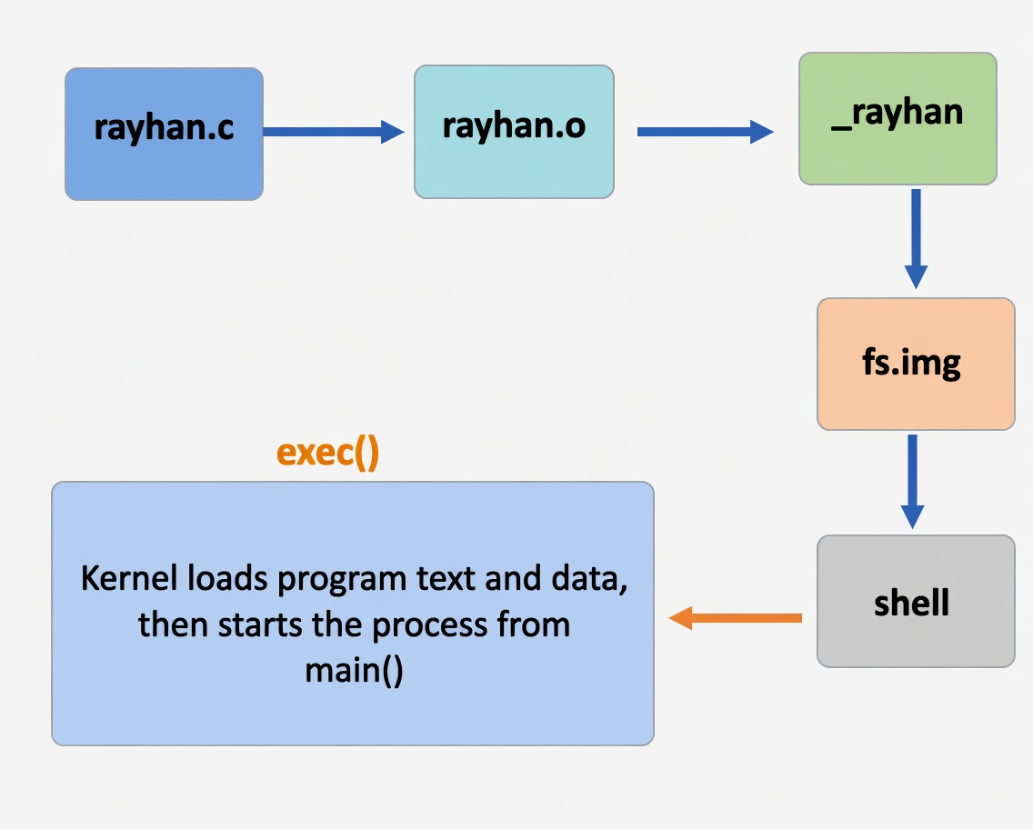
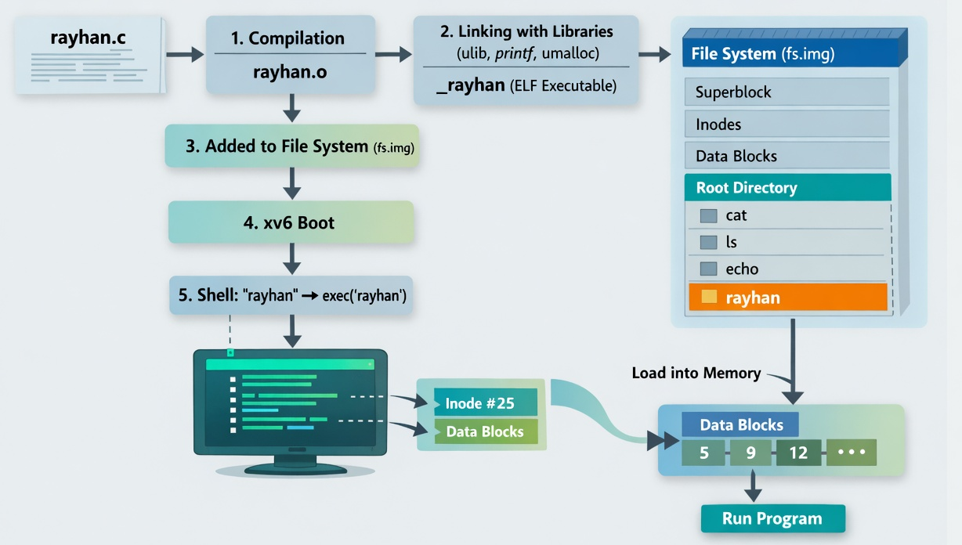
BUILD & EXTEND
XV6 Life Cycle Overview

Slide 13

Conclusion
xv6 bridges the gap between academic theory and real-world operating system design.
It is an excellent platform for practical OS learning, experimentation, and research.
Key takeaway: understanding xv6 provides deep insights into how modern operating systems work.

Slide 14

Thank You
Thank you for your time and attention throughout this presentation.
Questions and discussion are very welcome.
Contact: aburayhan.pust14@gmail.com
If you'd like to continue exploring xv6, I encourage you to dive deeper into the source code and documentation.

