Slide 1
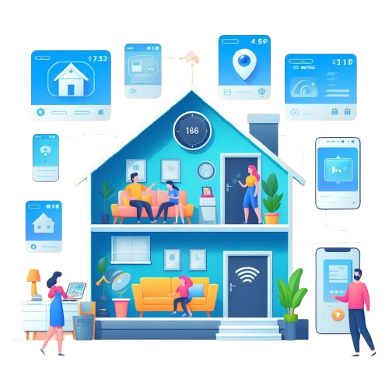

Smart Sage: IoT-Driven Home Automation Framework with Predictive Machine Learning
Course Teacher:
Dr. Khondaker Abdullah -Al-Mamun
Professor , Dept. of CSE
Presented By:
Rayhan Al Shorif – 0122410022
Dept. of CSE
United International University (UIU), Dhaka, Bangladesh.
Page No: 01

Slide 2
Objectives
Establishing proper management of unplanned power flows to address power shortages.
Analyzing historical data and predicting future patterns using machine learning algorithms will help ensure sustainable energy use.
To Integrate energy consumption data and predictive analytics to optimize energy usage, reducing utility costs and environmental impact.
Designing the framework to be scalable and adaptable to accommodate future technological advancements and expansion of the IoT ecosystem.
United International University (UIU), Dhaka, Bangladesh.
Page No: 02

Slide 3
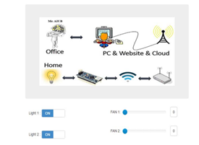
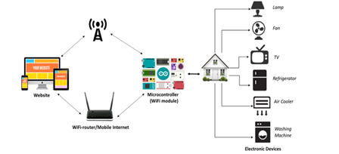
Related Works
S. Mahmud, S. Ahmed, and K. Shikder [ 1 ] developed a smart low cost home automation system with a metering system using IOT for user-controlled and monitored electronic devices.
Fig 1: System Architecture
Fig 2: Website Image for Smart Home
United International University (UIU), Dhaka, Bangladesh.
Page No: 03

Slide 4
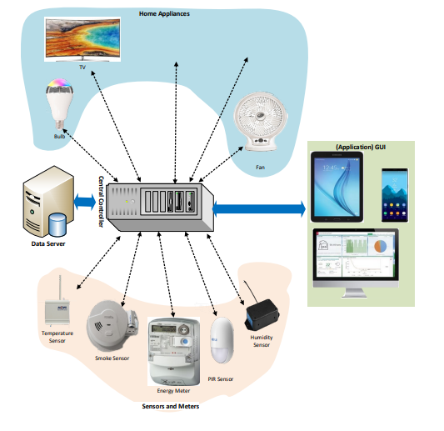
Related Works
A portable wifi, low-cost, and user-friendly IOT-based home automation system was proposed by Jabbar, W. A., Kian, T. K., Ramli, R. M., Zubir, S. N., Zamrizaman, N. S. M., Balfaqih, M., Alharbi, S [2]
Fig: SH environment.
United International University (UIU), Dhaka, Bangladesh.
Page No: 04

Slide 5
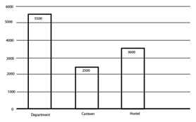
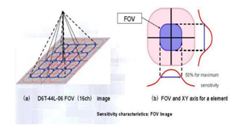
Related Works
An android application was connected with the control system through Wi-Fi across a cloud network. To fight the rising costs of electricity bills and the scarcity of resources type of system was implemented by T. Dhanush, B. Aswin Ramnath, M. Krishnakanth, and N. Bhalaji [3]
Fig 1: Energy wasted
Fig 2: FOV image
United International University (UIU), Dhaka, Bangladesh.
Page No: 05

Slide 6
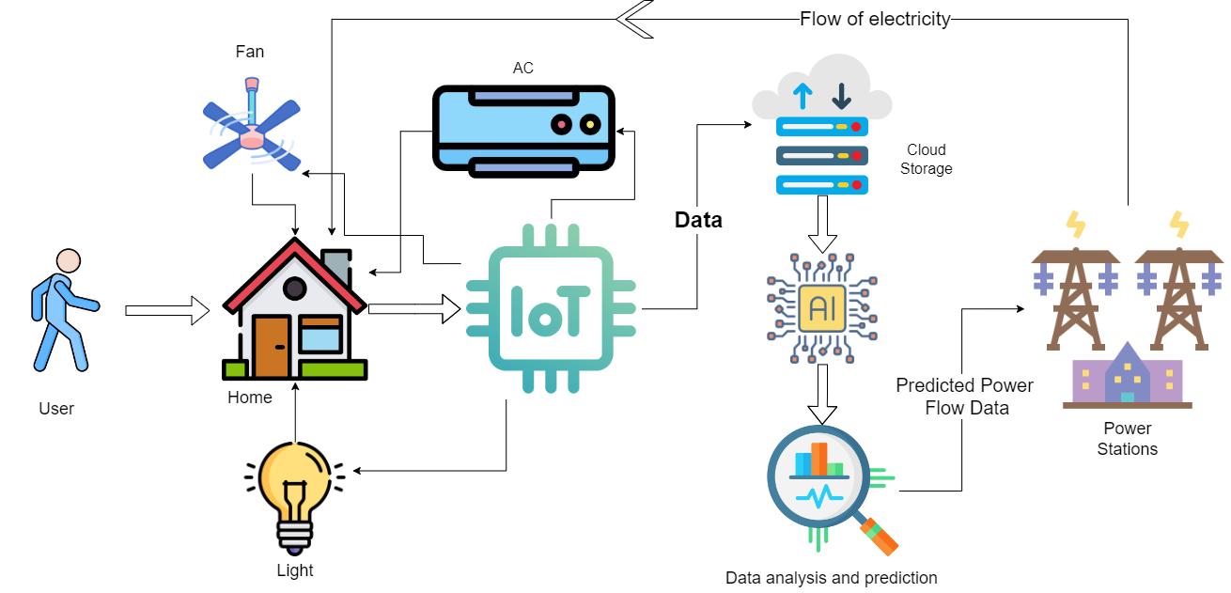
Methodologies
Fig: IoT-Driven Home Automation Future Predictive Proposed Framework
United International University (UIU), Dhaka, Bangladesh.
Page No: 06

Slide 7
Reference
[ 1 ] Mahmud, S., Ahmed, S. and Shikder, K., 2019, January. A smart home automation and metering system using internet of things (IoT). In 2019 International Conference on Robotics, Electrical and Signal Processing Techniques (ICREST) (pp. 451-454). IEEE.
[ 2 ] Jabbar, W.A., Kian, T.K., Ramli, R.M., Zubir, S.N., Zamrizaman, N.S., Balfaqih, M., Shepelev, V. and Alharbi, S., 2019. Design and fabrication of smart home with Internet of Things enabled automation system. IEEE Access, 7, pp.144059-144074.
[ 3 ] Dhanush, T., Ramnath, B.A., Krishnakanth, M. and Bhalaji, N., 2018, July. Smart Rooms Automation System by Thermal Sensing. In 2018 International Conference on Inventive Research in Computing Applications (ICIRCA) (pp. 596-600). IEEE.
United International University (UIU), Dhaka, Bangladesh.
Page No: 07

Slide 8
Thanks
United International University (UIU), Dhaka, Bangladesh.
Page No: 08

