Slide 1
ProTutorBD
Course Teacher:
Dr. Suman Ahmmed
Associate Professor, CSE Director, Center for Development of IT Professionals (CDIP)
Presented By:
Rayhan Al Shorif – 0122410022
Iftekharul Islam - 0122410013
F. M. Shefat Hossain Niloy-0122310011
Arnab Protim Mondal-0122320014

Slide 2

Introduction
Platform to find out reliable study assistant
Proper Training and Guidance
Request a Tutor
Find a Tutor
Nearest Tuitions
Monitoring and
Evaluation
United International University (UIU)
Page: 01

Slide 3
Motivation
Always existing demand for experienced tutor
Parents and students are worried about fraud and sources to find to tutor
Increasing internet accessibility and available online tools
Students and many varsity graduates are in quest of tuition
Comfortable and convenient for all
United International University (UIU)
Page: 02

Slide 4





Existing Products
We have selected some of the top-tier products on the market to benchmark our products.
United International University (UIU)
Page: 03

Slide 5
Features of Existing Products
Tutor Request
Hire tutor
Payment System
Request a tutor(specific requirements)
Quick Chat
Online tuition
Become tutor
Available Tuitions
Premium tutor
Tuition Post
Payment
United International University (UIU)
Page: 04

Slide 6
Features of Existing Products
Hire tutor
Hire tutor
Become tutor
Become tutor
Tuition Post / Job board
Tutor List
Today Available Tuition
Request for tutors
Available Tuitions
Payment
Quick Chat
Review & Rating
United International University (UIU)
Page: 05

Slide 7
Benchmark Products
Features |  | tutorsheba.com | bdtutors.com | caretutors.com | dhakatutors.com | deshtutor.com | Our Product
Roles | Admin
 | Tutor
 | Students
 | Guardian
Available Tuitions
Payment System
Premium Tutors Search
Affiliate Partner
Notifications System
FAQ
Contact Us
Tutor Request
Quick Chat
Online tuition
Review & Rating
About us
Default auto search & suggest tutor
Blog Post
Download Books
Suggested nearest tutors or students
Provides suggestions
United International University (UIU)
Page: 06

Slide 8
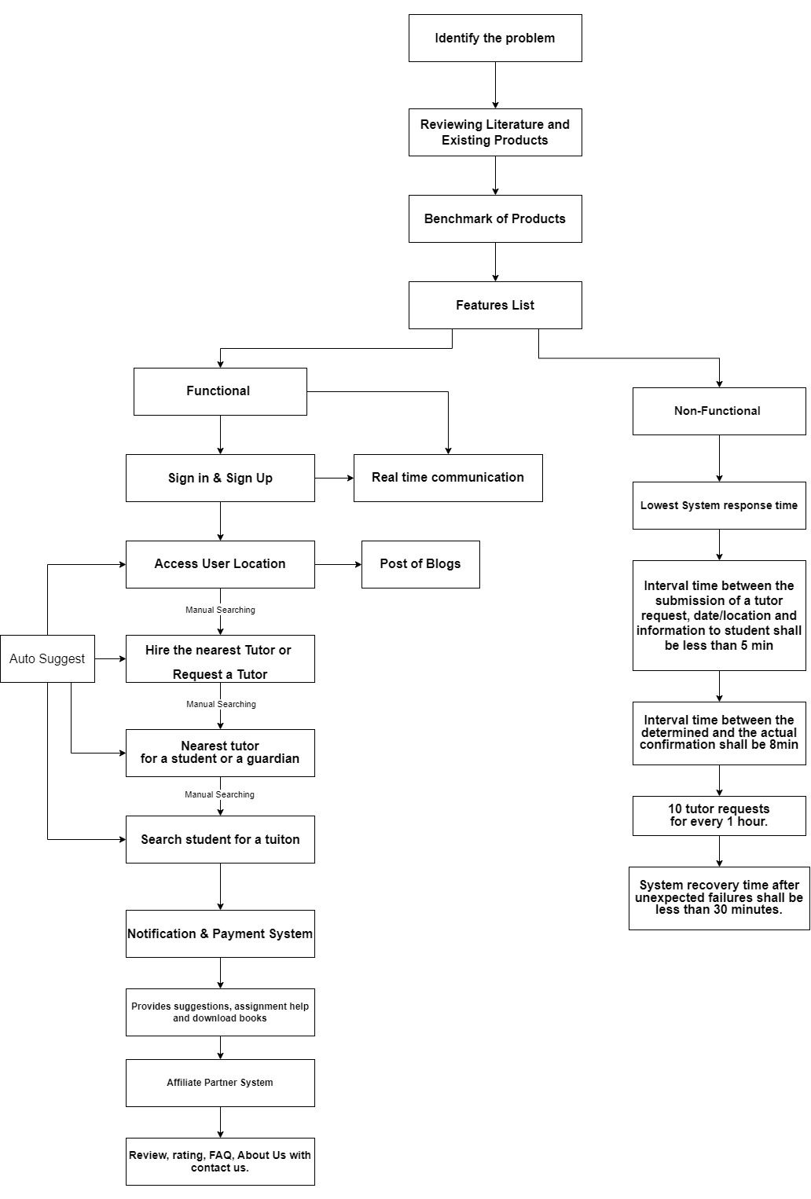
Methodology
United International University (UIU)
Page: 07

Slide 9
Features List
(Functional & Non-Functional)
Functional Requirements:
Users (teacher and student) can register, log-in to the system and update their proﬁle.
Teacher can create post by ﬁlling up the post related information and giving a certain amount for creating a post (if he/she has no free posts. After creating their proﬁle tutor will get 3/n-numbers of free posts.)
Tutor can search for tuition and send request to a corresponding tutor searching post(posted by any student)
Tutor and student both can give ratings and reviews to each others
Tutor and student both will be able to download books
Tutor and student both will be able to create, read, edit, delete blogs
Admin can delete/block any user (student and Teacher) if the admin gets multiple complaints against the user
Admin will be able to upload, download and delete books
A searching mechanism will be provided by the system to get the post
The system will be accessible to online users
United International University (UIU)
Page: 08

Slide 10
Features List
(Functional & Non-Functional)
Non - Functional Requirements:
Users’ privacy should be protected
The system should be workable on diﬀerent cross-platform web browsers like (e.g. Chrome, Safari, Mozilla, Opera, Edge)
The system should have high availability
The system should be easy to learn by both sophisticated and novice users
The system should be user friendly so that both sophisticated and inexperienced users can learn to use it at ease
The system should have a maximum of 3 clicks to reach any content
The system should have a single login to access all content
The system should have a consistent user interface(UI)
The system should have a UI which is intuitive (the behavior of the system is according to the intuition of a standard end user)
The system should have a standard graphical user interface that allows for the on-line data entry, editing, and deleting of data with much ease
United International University (UIU)
Page: 09

Slide 11
Research paper Study
The issue of private tuition: an analysis of the practice in mauritius and selected south-east a
sian countries
What they Found:
Prevalence: Private tuition is widespread at both primary and secondary levels across Mauritius and Southeast Asian countries.
Motivations: Competitive exams, pressure for success, and perceived shortcomings in formal education drive demand.
Financial Burden: Significant cost burden on families, potentially widening social inequalities.
Mixed Effects: Some students benefit, others experience stress and decreased motivation.
Teacher Involvement: Raises ethical concerns, potential conflicts of interest, and exploitation of students.
Ineffective teaching-learning processes , Insufficient Regular Class Instruction, Students seek private tuition for better understanding and individual attention.
Teachers, often demotivated in regular classes, become more engaged in tuition as they work for themselves.
Class Size Challenges: Large class sizes, Financial constraints, inadequate infrastructure, and a shortage of qualified teachers
Students opt for private tuition due to peer pressure and competition
Other findings:
Limited data availability on specific impacts and student outcomes.
Difficulty isolating true effects of private tuition from other factors.
Generalization of findings across diverse countries and contexts.
United International University (UIU)
Page: 10

Slide 12
Research paper Study
The more, the better? Intensity of involvement in private tuition and examination performance
What they Found:
There is no significant advantage to taking private tuition, even for students who took a lot of it.
This suggests that other factors, such as a student's natural ability and attitude towards learning, may be more important for exam success than private tuition.
Limitations:
The study was conducted in Ireland, so the results may not be generalizable to other countries.
The study relied on self-reported data, which can be subject to bias.
The study did not control for all possible factors that could affect exam performance
United International University (UIU)
Page: 11

Slide 13
Feasibility Analysis
Feasibility Type | Description
Cultural and Political | Our project does not contradict any political or cultural code
Technical | Our project can be done by already exists hardware and software in the market.
Economic Feasibility | Our project can be done with minimal budget and earn benefit in long run.
Organizational or operational | In our team, we have the required technical knowledge and resources to implement the project. So no external training would be required.
Legal Feasibility | Our project does not break any social media lows. It hides users private data from public.
United International University (UIU)
Page: 12

Slide 14
References
[1]_https://www.tandfonline.com/doi/full/10.1080/13803610802246395
[2]_https://www.researchgate.net/publication/349213058_The_Demand_for_Shadow_Education_Socioeconomic_Determinants_and_Implications
United International University (UIU)
Page: 13

Slide 15
Any Questions?

Slide 16
THANK YOU
Thanks for your valuable time.

