Slide 1
TECHNICAL TEST
Rayhan Kimi Nabiel Athallah

Slide 2
Question 1 :
Build a backend service (language/framework of your choice) that lets you record subscriber usage and retrieve what's been recorded. A usage record captures: subscriberId, callMinutes, smsCount, dataUsageMB.
Design the endpoints, HTTP methods, and request/response shapes yourself, and document them in your README. Storage can be in-memory. A simple frontend that consumes this API is not required, but will be viewed as a plus.

Slide 3
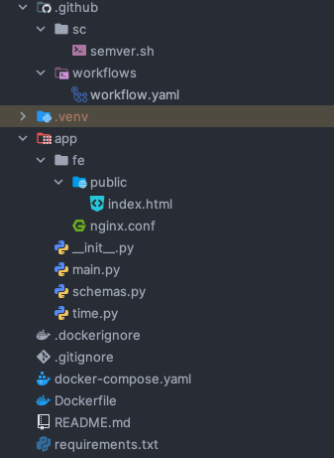
Question 1 Solution
Project Structure :
Tools used :
  Backend : FastAPI, Pydantic
  Frontend : Plain html
Quick Start :
Requirement : Docker with Compose Plugin.
`docker compose up -d --build ` to start.
`docker compose down` to stop.
Frontend → http://localhost:8080
API → http://localhost:8000
Swagger → http://localhost:8000/docs
Github actions pipeline
Frontend
To serve the frontend
Main app
Pydantic req/res model
Timezone Helpers

Slide 4
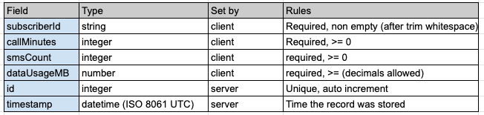
Question 1 Explanation
Architecture :
Browser → Nginx (:8080) → “/” → static html
→ “/api/*” → api:8000/*
curl → api (:8000)
Data Model :
Endpoints :
GET /health → Liveness check (used by docker) → Res : 200
POST /usages → Record usage entry → Res : 201
GET /usages → Retrieve recorded usages with filter → Res : 200

Slide 5
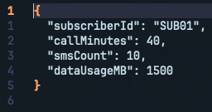
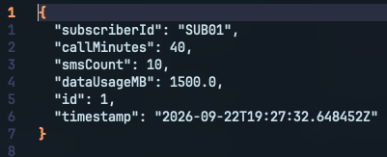
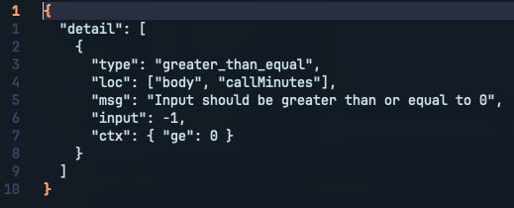
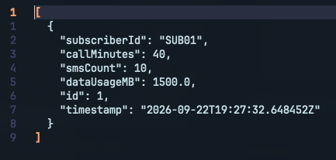

Question 1 Explanation
POST /usages (record usage) :
Request Body :
Response Body :
Error example :
GET /usages (retrieve usage) :
Parameter :
  subscriberId (string)
  from (datetime)
  to (datetime)
datetime timezone format :
Example response (200 ok) :

Slide 6
Question 1 Explanation
Decision in building :
  One retrieval with filter instead specialized one (like /subscribers/id/usages). Filters compose freely, keep API surface small, and give the Q2 snapshot job exactly what it needs (to record for specific time window).
  Separate input and output model. UsageCreate define what client may send and UsageRecord add server owned (which id and timestamp). API contract is therefore explicit in code and in the generated swagger docs.
  In memory store + single worker, keep application simple but safe for concurrent request. ID generation guarded by lock, and with only one worker keeps the data consistent because only using in memory store.
Known Limitation :
  Data will be lost when restart & only using one api worker. Reason : drawback because of memory store. Solution : using persistent storing such as shared database then add more api worker.
  No auth. Reason : to keep application simple. Solution : add API keys or oauth2.
  No pagination. Reason : to keep application simple and because there will be not much data because in memory store. Solution : cursor parameter or limit.

Slide 7
Question 2 :
Write a cron job that calls your own retrieval endpoint from Q1 3 times a day (08:00, 12:00, 15:00 WIB) and saves the response as a CSV file. Choose and document your own file naming convention. Write a separate script that removes CSV snapshots older than 30 days.

Slide 8
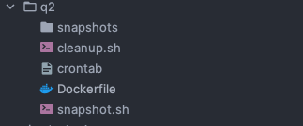
Question 2 Solution
Tools used :
  Docker (run alongside other container using compose as scheduler container using Alpine with busybox crond)
  Other tools : jq, curl, tzdata, bash
Quick Start :
Requirement : Docker with Compose Plugin.
(Run alongside Q1)
`docker compose up -d --build ` to start.
`docker compose down` to stop.`
Manually Run :
  Take a snapshot for the most recent slot:
docker compose exec scheduler /app/snapshot.sh
  Take a snapshot for a specific slot, e.g. to include records you just created:
docker compose exec -e SNAPSHOT_AT="2026-09-23 12:00" scheduler /app/snapshot.sh
  Preview the cleanup without deleting anything:
docker compose exec -e DRY_RUN=1 scheduler /app/cleanup.sh
  Run the cleanup:
docker compose exec scheduler /app/cleanup.sh
  View job output:
docker compose logs scheduler
Project Structure :
Binded volume in host to store snapshot
Snapshot cleanup script
Cron schedule
Scheduler image
Snapshot script

Slide 9
Question 2 Explanation
Architecture :
  crond run as the container main process and read crontab
  snapshot.sh will be run 3 times a day with filter that has been built before.
  Result will be written to /data/snapshots (container) which binded to q2/snapshots on the host.
  Everyday at 00:30 cleanup script will be executed
  Job output also goes to stdout, so it shows up in docker compose log.
Naming :
File naming convention:
usage_snapshot_YYYYMMDD_HHMM_WIB.csv
Example: usage_snapshot_20260923_1200_WIB.csv
  HHMM is the end of the exported window (08:00, 12:00 or 15:00), not the time the script ran.
  The format sorts chronologically, so ls lists snapshots in time order.
  Re-running the same slot overwrites the same file instead of creating a duplicate.
  The cleanup script reads each file's age from its name, not from its modification time.
Model :
  If the scheduler run at 08:00, time window that will be exported are 15:00 in yesterday and 08:00.
  If the scheduler run at 12:00, time window that will be exported are in 08:00 and 12:00.
  If the scheduler run at 15:00, time window that will be exported are in 12:00 and 15:00
  Exit codes for script : 0 success, 1 API req/csv conversion failed, 2 invalid input caused by malformed variables.
CSV Format :
  Columns: id, subscriberId, callMinutes, smsCount, dataUsageMB, timestamp, the same fields as a Q1 usage record.
  Timestamps are in WIB with an explicit offset, e.g. 2026-09-23T07:12:05+07:00.
  An empty window still produces a file containing only the header, so "no usage" can be told apart from "the job failed".

Slide 10
Question 2 Explanation
Decision :
  Container instead host cron so reviewer don’t have to configure anything.
  One window per snapshot to avoid duplications.
  Write snapshot in tmp before writing, there is never a half written csv. Failure means no file (csv never contains an error message).
  Windows derived from the schedule (idempotent) re running a slot overwrite the same file.
Known Weakness:
  BusyBox crond runs as root. Supercronic is an alternative to BusyBox but requie installing additional binary.
  CSV(s) are stored only on local disk. Solution : store it also in object storage such as in AWS S3.
  On a linux host, CSV(s) are created as root. Regular user needs sudo to delete them.
  File that doesn’t match naming convention will never be deleted by cleanup script.

Slide 11
Question 3 :
Assume the CSV snapshots produced by your Q2 script have been loaded into a usage table with the same fields as your Q1 API's usage records (subscriberId, callMinutes, smsCount, dataUsageMB, timestamp). Write SQL to:
1. Insert a new subscriber named Fajar, Basic plan, activated 24 January 2024.
2. Update Fajar's plan to Premium.
3. Calculate the total data usage (sum of dataUsageMB across all snapshots) for all Premium-
plan subscribers.
4. Sort and display the top 3 subscribers by total data usage across all snapshots.
5. Write a subquery to find subscribers whose average call minutes per snapshot is less than or
equal to 30

Slide 12
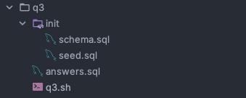
Question 3 Solution
Quick Start :
Image to run sql query already included in docker compose including its schema and seeder query.
Requirement : Docker with Compose Plugin.
(Run alongside Q1)
`docker compose up -d --build --wait` to start.
`docker compose down` to stop.
`docker compose up -d --force-recreate -V db` to reset database.
“q3/q3.sh” is a script to run answer query after db has been initialized
Schema and seeder. Binded to initdb in container (automatically run)
Query to answer the question
Script to inject answer to db in container

Slide 13
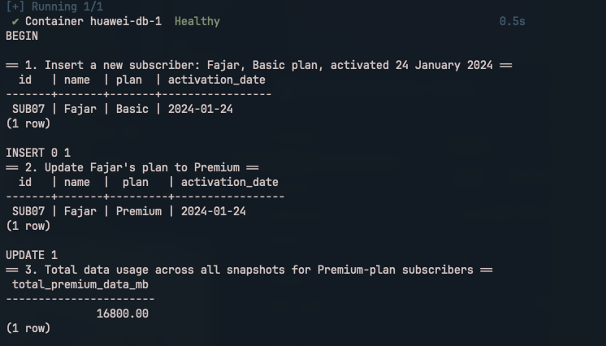
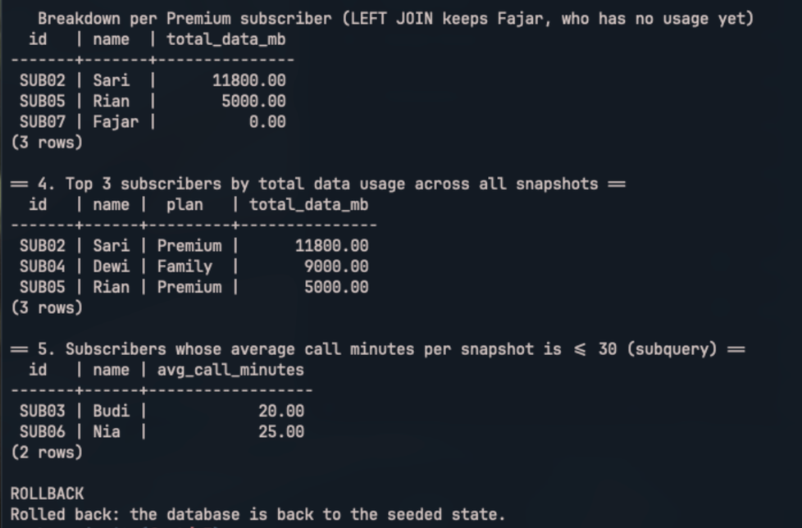
Question 3 Solution
Result Output :

Slide 14
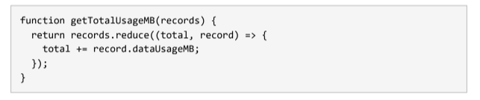
Question 4 :
Identify the root cause of the bug, fix it, and explain in writing why it broke and how you would prevent this class of bug in the future.

Slide 15

Question 4 Solution
Root Cause :
  The callback has no return. With braces { }, an arrow function returns undefined unless it returns explicitly. total += ... only changes a local variable, and reduce uses the callback return value as the next total.
  There is no initial value. Without the second argument, reduce starts with the first array element (a record object) instead of 0.
Why its fatal? :
  For two or more records, JavaScript throws no error. The function silently returns undefined, and the problem only surfaces later, for example as NaN or a blank value on a dashboard, far away from its cause.
Fix :
  Arrow function without braces, so that result expression automatically returned.
  Add initial value of 0 so that math operation always start as a number
Prevention :
As a DevOps, the best way to prevent this :
  Integrate linter. ESLint linter will catch precisely this bug. (Callback using reduce, map, filter without returning value).
  Typechecking. Adding interface for such type to avoid type mismatch.
  Integrate unit test and adopting TDD.
  Integrate point 1-3 as gate in CI pipeline and run it on every PR check.

Slide 16
Thank You

