Slide 1
Professionalism, ETHICS (and Cyber) Seminar Week 2
Andrew Peck

Slide 2

Week 2: Hands Up
I know what information about me is available online
I have chosen which information about me is available online
I have been involved in disputes, arguments or embarrassment about information about me available online
I worry about my safety and privacy due to information available about me online

Slide 3
Consent
This workshop will involve OSINT/Researching a colleague – if you are uncomfortable being researched by your colleague, please say so now.
Once the exercise starts, what is discovered may not be within your control.
Notes:
https://www.computerweekly.com/news/366637835/Fujitsu-boss-falls-on-his-sword-before-settling-with-Post-Office-scandal-victims
https://www.justice.gov/usao-ndca/pr/former-netflix-executive-sentenced-30-months-bribes-and-kickbacks-netflix-vendors
https://www.theguardian.com/business/2025/mar/28/trump-pardons-nikola-founder

Slide 4
Task 1
Move around the room, and find a partner you don’t normally work with.
Exchange your full, legal names only. You now know only their name and that they study here:
Google your partner:
What data do you discover?
Ask ChatGPT about your partner:
What new information do you discover?
Are there any hallucinations in the data?
Notes:
https://www.computerweekly.com/news/366637835/Fujitsu-boss-falls-on-his-sword-before-settling-with-Post-Office-scandal-victims
https://www.justice.gov/usao-ndca/pr/former-netflix-executive-sentenced-30-months-bribes-and-kickbacks-netflix-vendors
https://www.theguardian.com/business/2025/mar/28/trump-pardons-nikola-founder

Slide 5
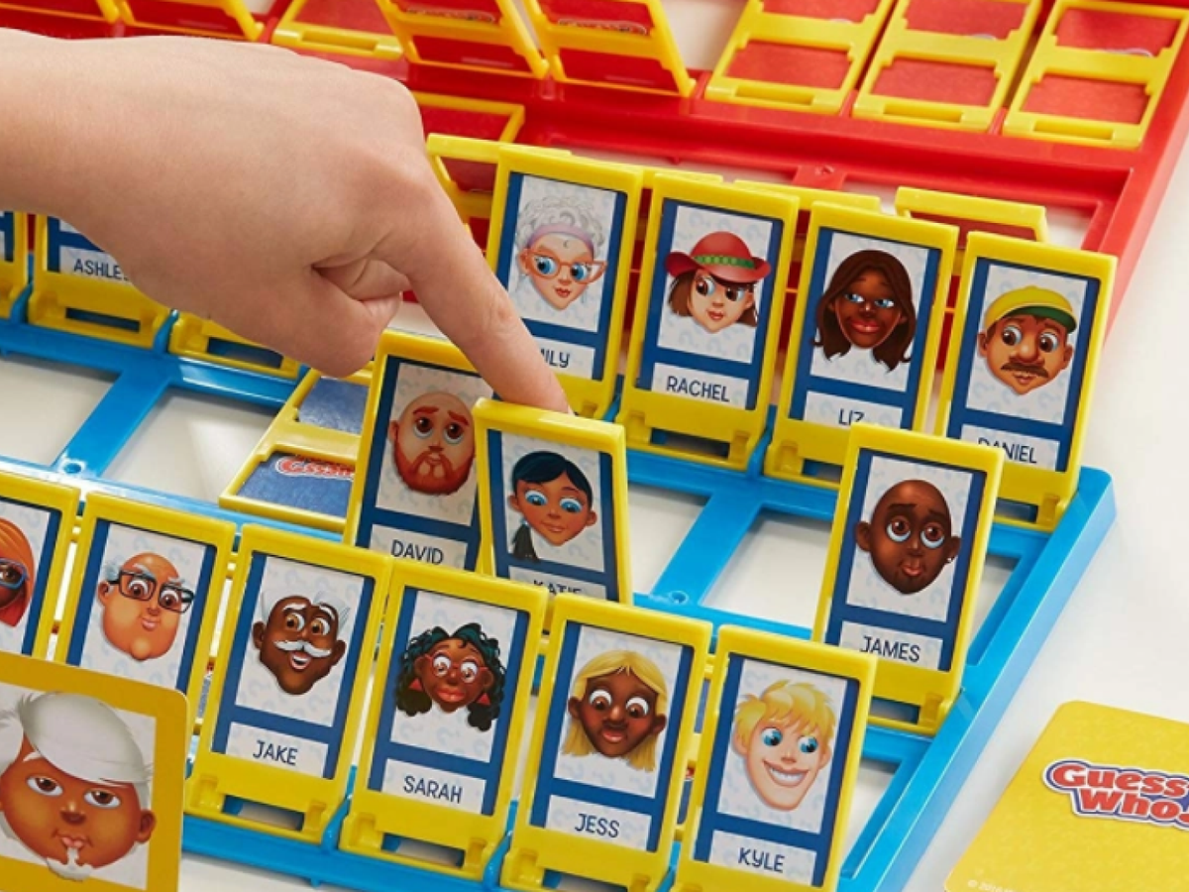
Task 2
Add your partner’s home town to your search criteria:
What new information do you discover?
Do you think you can find your partner’s birth certificate/parents birth certificates? Photos/plans of the inside of their home?

Slide 6
Task 3
Identify which items in your search history would have:
Enabled you to embarrass/blackmail your partner
Target your partner for other crimes
Change your opinion of your partner as a job candidate
Which data discovered is covered by GDPR 2018 in some way
Notes:
https://www.computerweekly.com/news/366637835/Fujitsu-boss-falls-on-his-sword-before-settling-with-Post-Office-scandal-victims
https://www.justice.gov/usao-ndca/pr/former-netflix-executive-sentenced-30-months-bribes-and-kickbacks-netflix-vendors
https://www.theguardian.com/business/2025/mar/28/trump-pardons-nikola-founder

Slide 7
Task 4
Did you know this information was online about yourself?
Pick some of the information and identify how you would have it removed from public view or the internet.
Notes:
https://www.computerweekly.com/news/366637835/Fujitsu-boss-falls-on-his-sword-before-settling-with-Post-Office-scandal-victims
https://www.justice.gov/usao-ndca/pr/former-netflix-executive-sentenced-30-months-bribes-and-kickbacks-netflix-vendors
https://www.theguardian.com/business/2025/mar/28/trump-pardons-nikola-founder

Slide 8
Task 5
We’re now going to consider the former Prime Minister Rishi Sunak.
Using nothing but google/the internet, see if you can identify:
His north Yorkshire home address
Which electricity substations control the power to his home
News stories about the power to his home
Discussion: Why is this data being public problematic?

Slide 9
Task 6
Read:
https://www.gov.uk/government/news/government-leads-global-fight-against-deepfake-threats
DEBATE

Slide 10
Week 2: Hands Up (2)
I was wrong about what data was available about me online
I would worry if I found this amount of data about a family member I consider vulnerable (child/grandparent/sibling)
The further embellishment of my data online worries me

Slide 11
Reflection TIME

Slide 12
Reflection
How much consent is required for data to be shared?
Should social media firms follow similar ethical rules to academics?
Is it ever “just information”? What harms could be committed by a suitably motivated individual?
What are my potential responsibilities as an AI/Data/Cyber/CS practitioner regarding the data of others?

Slide 13
Additional Tools

Slide 14
Filmography
What films do you wish your colleagues had watched to understand this topic area better?

