Slide 1
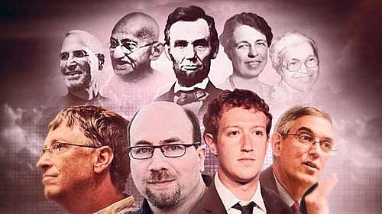

Slide 2
Ethics Week 9 – LeAdership
Andrew Peck

Slide 3

Hands Up (Week 9)
I see myself as a leader
There is a difference between a “leader” and a “manager”
I have experienced bad leadership in the past
I want to lead in the future

Slide 4
Leadership
Leadership is one of the most important topics in the human sciences and historically one of the more poorly understood; it is important for two reasons. First, leadership solves the problem of how to organize collective effort; consequently, it is the key to organizational effectiveness. With good leadership, organizations (governments, corporations, universities, hospitals, armies) thrive and prosper. When organizations succeed, the financial and psychological well-being of the incumbents is enhanced.
Second, and more important from a moral perspective, bad leaders perpetrate terrible misery on those subject to their domain.
Hogan, Robert, and Robert B. Kaiser. "What we know about leadership." Review of general psychology 9.2 (2005): 169-180.

Slide 5
Self Assessment and Reflection
You will need 2 pieces of paper and honesty
1. Read and Choose the leadership style that best suits you.
https://professional.dce.harvard.edu/blog/how-to-determine-what-my-leadership-style-is/

Slide 7
Self Assessment and Reflection
2. Complete the quiz and measure your leadership capabilities
https://rm.coe.int/16806f362d

Slide 8
Pair-Mentoring
Identify 2 things you need to learn
These are the weakest elements from your “neutral” survey
Try to break down why you WANT to learn these things
If you have time (at home??) identify ways you can learn these things (online courses/volunteering/etc)
Identify 2 things you need to train
These are the things that suffered the most between your “neutral” and “stressed” responses
Have your partner give you a plan to practice these things
KEEP THESE NOTES, THESE ARE THE OUTPUT FROM THIS SEMINAR SESSION

Slide 9
Self Assessment and Reflection
3. What leadership style do you aspire to? Why?
4. Which leadership style do you resist? Why?

Slide 10
Any Questions?
Any Questions

