Slide 1


Analytical Information Systems
Titanic: Machine Learning from Disaster
Present By : Rayhan Patoary

Slide 2
Problem Goal:
It is My job to predict if a passenger survived the sinking of the Titanic or not. For each in the test set, I must predict a 0 or 1 value for the Target variable.

Slide 3


Datasets:
Train.csv [891 rows x 12 columns]
Test.csv [418 rows x 11 columns]

Slide 4
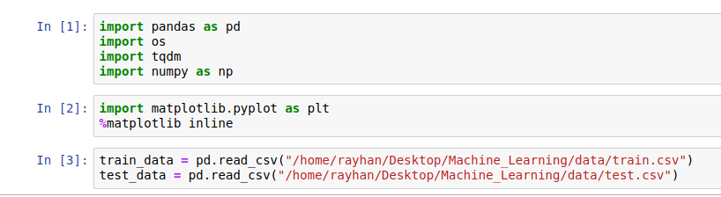
Load data

Slide 5

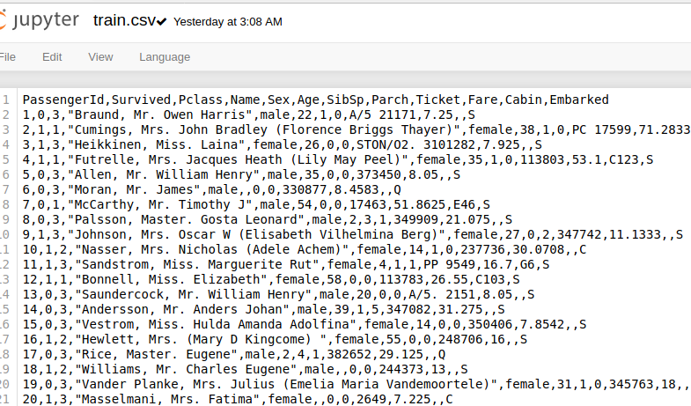



Slide 6
Description of data:
PassengerId :Unique Identification number
Survived: Dead or Alived
Pclass: Passenger Class (1 = 1st; 2 = 2nd; 3 = 3rd)
Name:Name
Sex: Gender
Age: Numaric Value
SibSp:Number of Siblings/Spouses Aboard
Parch:Number of Parents/Children Aboard
Ticket:Ticket Number
Fare:Passenger Fare
Cabin:Cabin
Embarked:Port of Embarkation (C = Cherbourg; Q = Queenstown; S = Southampton)

Slide 7
Feature Selection
Choosing informative, discriminating and independent features is a crucial step for effective algorithms in pattern recognition, classification and regression.
['Pclass', 'Sex', 'Parch', 'SibSp', 'Survived']

Slide 8
How I choose the features?
PassengerID don't Effect on Survival .
Some Colums Containing the missing values.
Pclass is contributing to a persons chance of survival.
high probabilty of survival with 1 to 3 realitves.
Females had more possibility of Survive.
Another reason is, this 4 features gave me the best outputs.

Slide 9
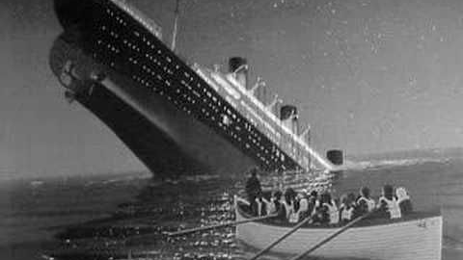
Training Target
['Survived'] ?

Slide 10
Bias
Bias is a constent term in ML. It does help us generalize better and make our model less sensitive to some single data point.

Slide 11
Split Train Data
70% Data for Training
30% for testing

Slide 12
Fitting The Model
I Used Perceptron as my Training Algorithm.

Slide 13
About Perceptrons
basic operational unit of artificial neural networks
It employs supervised learning
It employs supervised learning rule
able to classify the data into two classes.
It also consists of a bias whose weight is always 1.

Slide 14
Why Perceptrons?
Compututionaly Efficient.
Guranteed to Learn a Linearly Separable Problem.
It Produce 0/1 as output .
It is easy to code from scratch.

Slide 15
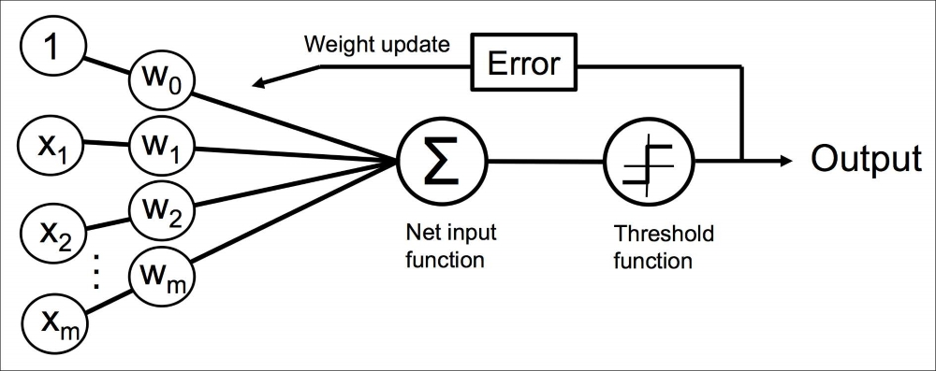
Perceptron Mechanism

Slide 16
How it Works ?
Step1: Initialize the weights as 0
Step2: For each example in our Dataset:
Do a Prediction
Dot Product Between Weights & inputs
sigmoid function for Prediction result
Update weight
Perceptron Learning rule
Step3: repeat step2 as loop condition.

Slide 17
Use of Dot Product
Multiplication row in left matrix with column in right matrix
line is expressed between the coordinate axes

Slide 18
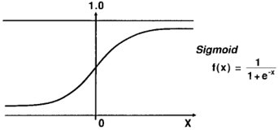
Sigmoid Function
The main reason why we use sigmoid function is because it exists between (0 to 1).
Since probability of anything exists only between the range of 0 and 1, sigmoid is the right choice

Slide 19
Perceptron Learning rule
As being supervised in nature, to calculate the error, there would be a comparison between the desired/target output and the actual output. If there is any difference found, then a change must be made to the weights of connection.

Slide 20
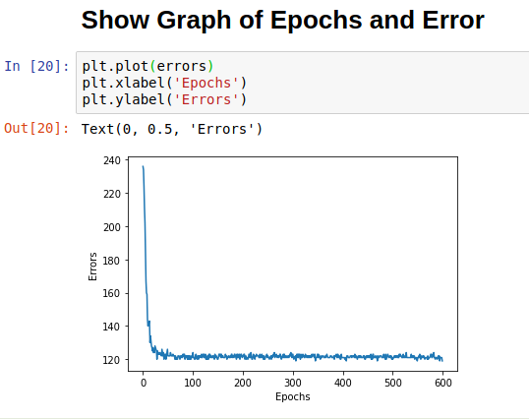

Slide 21
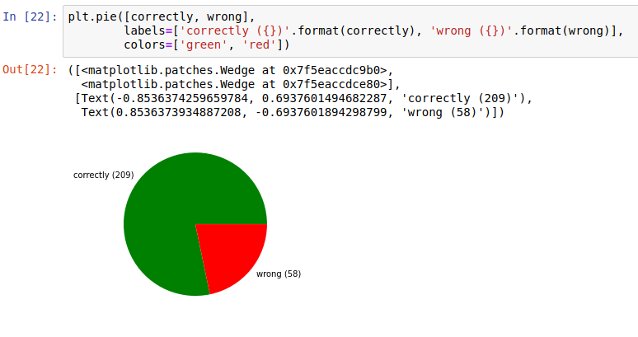
Accuracy of the Model

Slide 22
Submission Score
0.77272

Slide 23


