Slide 1

DME Tire Shop
4 major observations
from DME dataset
Team 5
Siyao Liu, Jiayu Li, Jinqi Mao, Shulin Zuo, Yipeng Liu, Wen Sun
Notes:
Animation

Slide 2
Key Findings
Vehicle Information: manufactured years, retail price, brand, model
Consumer Persona: gender, age, race, income, etc.
Purchasing Behaviors: tire purchase by automobile type, credit range, retail price
Source: DME Transaction Data of Tires
DME Tire Shop

Slide 3
Most of customers’ automobiles are manufactured between 2015 and 2017, and priced at 5k to
15k
Vehicles Manufactured in a Particular Year
Vehicles Sold in a Particular Retail Price, %
Low retailing price
High retailing price
Source: DME Transaction Data of Tires
DME Tire Shop

Slide 4
Japanese and American automobiles are more popular among customers; most of them drive sedans and light trucks
Customers’ Vehicles by Automobile Manufacturers
Customers’ Vehicles by Model
Vehicle Quantity of Certain Brand
Cumulative Percentage of Vehicles’ Share
Percentage %
Sedans
A: Sedan 4 DR
B: Hatchback 4 DR
Light Trucks
A: 4 Door Wagon/Sport Utility
B: Van
C: Crew Pickup
American Manufacturers
A: Ford B: Chevrolet C:Dodge
Japanese Manufacturers
A: Toyota B: Honda C: Nissan
Source: DME Transaction Data of Tires
DME Tire Shop

Slide 5





Working-Age English Male With Stable Income Are Our Major Customers
66%
34%
Education Levels
Male
Female
40 – 65
Years old
Credit Range
English & European
Race / Ethnicity
$50k - $75k
Income Level
Vista Segment
Source: DME Transaction Data of Tires
DME Tire Shop
Notes:
Reorganize the PPT Format - done
Change the title
presentation order: gender → age → Race → income → education → credit range → vista

Slide 6
Customers Who Drive Sedan And SUV Or With High Credit Purchase Most of Tires
Tires Purchased by Consumers by Automobile Type
Tires Purchased by Consumers by Credit Range
Tires Purchased by Consumers
Cumulative Percentage of tires purchased
Credit Levels
High Credit
Medium Credit
Low Credit
Source: DME Transaction Data of Tires
DME Tire Shop
Notes:
1. Need a visualization for relationship between retails_bins and tire quantity(2,4) - next slide
2. Color changed on the credit range bar chart (Grey chart is not visible in the classroom) - finished
3. Change the title

Slide 7
Majority of customers purchase four-tires at once, especially those who drive expensive cars
Number of Customers by Retailing Price of Vehicles and
Tire Quantity
Tire Quantity: 2
Tire Quantity: 3
Tire Quantity: 4
Retail Price Range
Relative Change Rate
Low retailing price
(1,100 , 15,000]
6%
(15,000 , 30,000]
75%
(30,000 , 45,000]
125%
High retailing price
(1,100 , 15,000]
(15,000 , 30,000]
(30,000 , 45,000]
Retail Price of Vehicles
$$Relative Change Rate =\frac{Number of {Customers}_{4−tires}−Number of {Customers}_{2−tires}}{Number of {Customers}_{2−tires}}$$
Source: DME Transaction Data of Tires
DME Tire Shop
Notes:
4-tire purchase is the major option, but the gap between 4-tire customers and 2-tire customers is widening with increasing retailing prices of vehicle
In any quantitative science, the terms relative change and relative difference are used to compare two quantities while taking into account the "sizes" of the things being compared.
”The right chart shows difference between number of 4-tires customers and number of 2-tires customers, we can see relative change rate is increasing from 6% to 127%, we can conclude that those who drive luxury cars are more likely to buy 4 tires at once.”

Slide 8
Summary
Most of automobiles are manufactured between 2015 and 2017, and priced at 5k to 15k
Economy Japanese and American automobiles are more popular among customers
Working-age English males with stable income are our major customers
Customers who drive Sedan or light truck and those with high credit scores are chief contributors to sales of tires
Majority of customers purchase four-tires at once, especially those who drive more expensive cars
Source: DME Transaction Data of Tires
DME Tire Shop

Slide 9
DME Tire Shop
4 major observations
from DME Dataset
Team 5
Siyao Liu, Jiayu Li, Jinqi Mao, Shulin Zuo, Yipeng Liu, Wen Sun
Email
Shadowriseup3@gmail.com

Slide 10







(SHULIN)
This is a Sample Title, please put your title here.
Gender
Consumer Persona
40 - 65
Years old
66%
34%
English & European
Race / Ethnicity
Male
Female
$50k - $75k
Income Level
Education
Level
Some College
High School
Completed College
Graduated School
750-799
Credit Range
52%
36%
11%
2%
Source: DME Transaction Data of Tires
DME Tire Shop
Notes:
Reorganize the PPT Format
Change the title

Slide 11
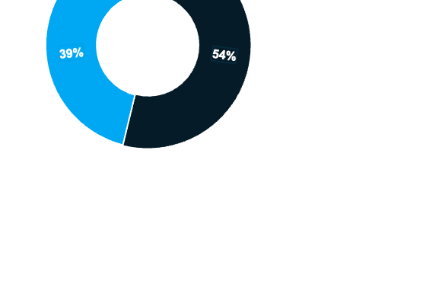

Reorganize the PPT DESIGN
Change the Title
This is a Sample Title, please put your title here.
(SHULIN)
Young people
(20-30)
English and European
66% Male
40 - 65 years old
Rustic Families and Thriving Suburbanites
$50,000 - $75000
High school and Some college degrees
Credit Range 750-799
Working-age
People(30-60)
Elderly people
(60+)
Notes:
Reorganize the PPT Format
Change the title

Slide 12

Title
右边的两幅图data应该有出错的，占比完全一样， 需要重新确定
图1 应该不需要line chart，不用看出来是增长还是下降趋势
Change the Title
Vehicles Manufactured in a Particular Year
Vehicle Retail Price, % of customers
Brands to Which Vehicles of Customers Belong, number of customers
Top Models of Vehicles, % of customers
Notes:
右边的两幅图data应该有出错的，占比完全一样
图1 应该不需要line chart，不用看出来是增长还是下降趋势
Change the Title

Slide 13
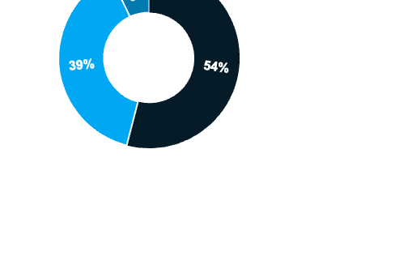
Most DME consumers are Male English and European, in elderly age, aged from 40-65 years, from rustic families and thriving suburbanites, income level range from $50,000 – $75000, owned high school and some college degree.
Young people
(20-30)
66%
34%
English and European
66% Male
40 - 65 years old
Rustic Families and Thriving Suburbanites
$50,000 - $75000
High school and Some college degrees
Working-age
People(30-60)
Elderly people
(60+)
Male
Female
Some College
High School
Completed College
Graduated School
52%
36%
11%
2%
Notes:
Reorganize the PPT Format
Persona Card 需要体现出什么信息 (% of English and European)
比重过大, 减少viz，

Slide 14
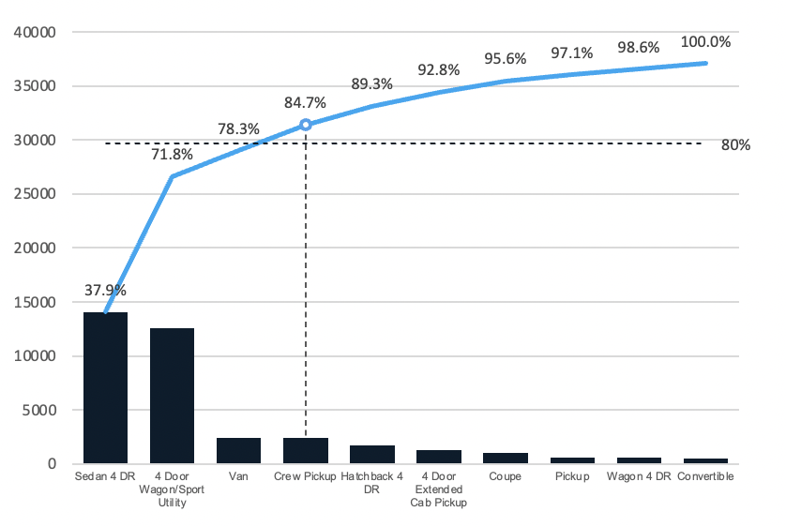
Male and Sedan Owners with High Credit Score Buy More Tires
Tires purchased by consumers by gender
number of tires per person
Tires purchased by consumers by automobile type
thousand of tires
Male
Female
Tires purchased by consumers by credit range
thousand of tires
750-799
700-799
650-749
800+
600-649
Tires Purchased by Consumers
550-599
Cumulative Percentage of tires purchased
500-540
499 & less

Slide 15
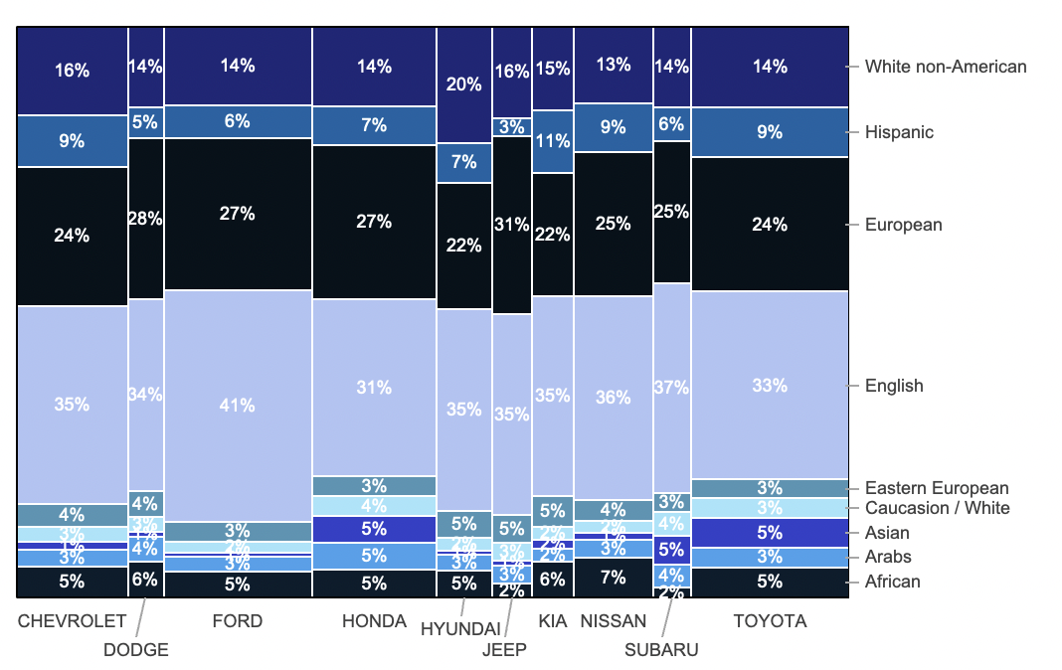
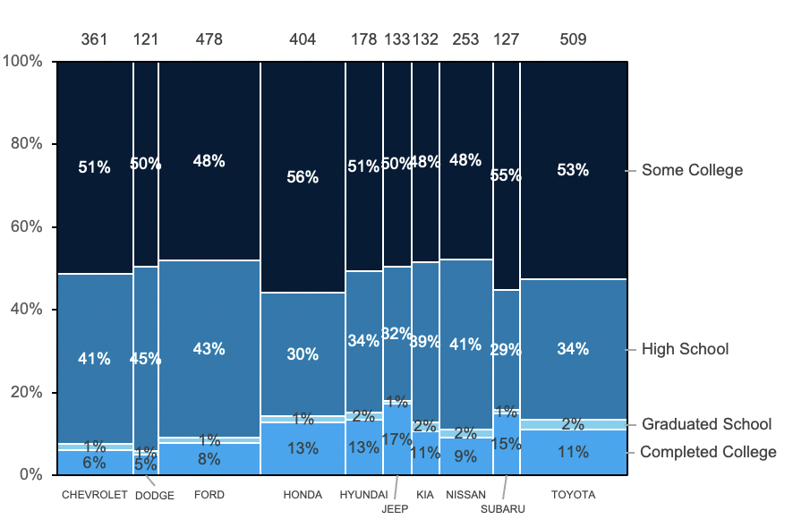
CHEVROLET, FORD, HONDA And TOYOTA are primary vehicles brands for DME customers to choose based on their education level, gender, and race
Female
Male
Vehicle Brand Preference by Gender, number of customers
Vehicle Brand Preference by Race, percentage of customers
Vehicle Brand Preference by educational level, percentage of customers
Notes:
DME Consumer Preference on Vehicle Brand (Shulin)
Japanese and American automobiles are the main options for DME customers.
Educational Level : People obtaining college degree and high school drives FORD, GMC and Tesla, High school group loves FORD and Tesla
Gender: Both male and female drives Chrysler, Honda, Ford, and Toyota.
Race: Toyota
---
日系和美系车是我们DME客户的主要选择，我又将insight具体化指出chrysler,ford,honda,toyota是我们客户的主要受众，
最后依照次序解释在不同factor下顾客是如何呈现对不同品牌汽车的选择使得他们对轮胎购入量的不同。

Slide 16
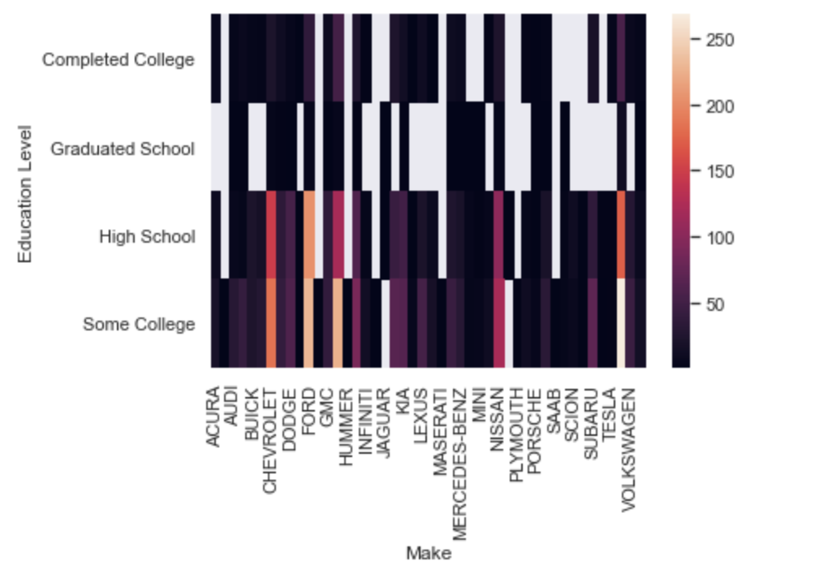
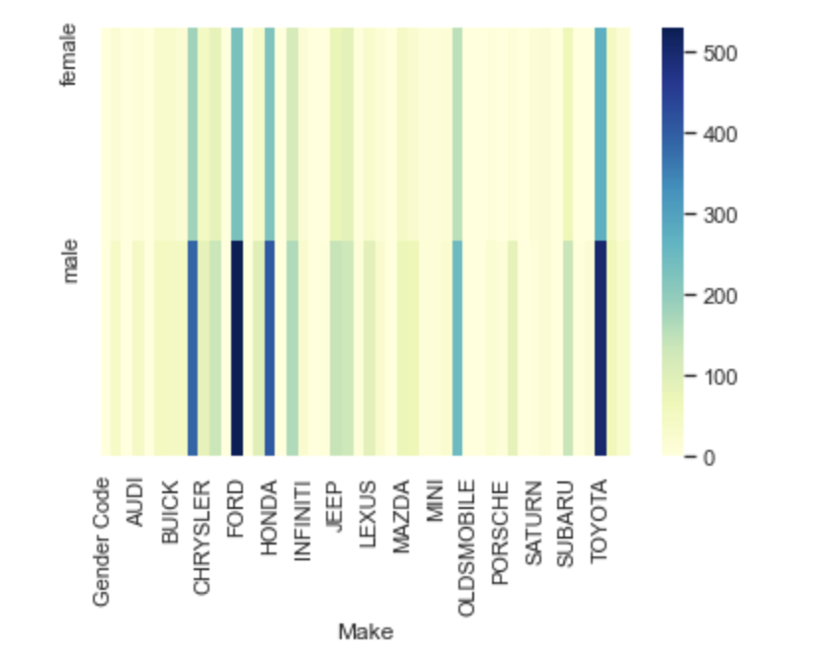
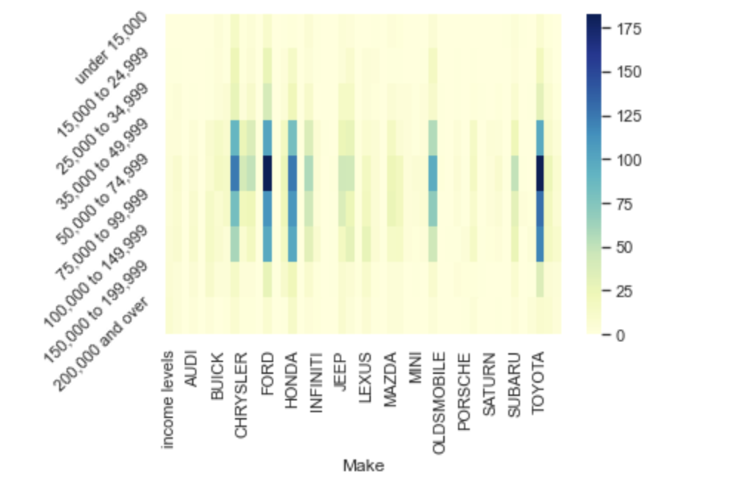
CHRYSLER, FORD, HONDA And TOYOTA Are Primary Car Brands For DME Customers To Choose Based On Their Education Level, Gender, And Income Level
Education level to car brand on Number of Tire Consumption
Gender to Car Brand on Number of Tire Consumption
Income level to Car Brand on Number of Tire Consumption
DME Consumer Preference on Vehicle Brand
Notes:
DME Consumer Preference on Vehicle Brand (Shulin)
Japanese and American automobiles are the main options for DME customers.
Educational Level
People obtaining college degree have higher preference for FORD, GMC and Tesla, High school group loves FORD and Tesla
Gender
Both male and female have high preference for Chrysler, Honda, Ford, and Toyota.
Media income level
A range from $50,000 to $100,000, these DME customers are basically concentrated still on the American and Japanese automobile manufacturers, including CHRYSLER, FORD, HONDA and TOYOTA.
---
日系和美系车是我们DME客户的主要选择，我又将insight具体化指出chrysler,ford,honda,toyota是我们客户的主要受众，
最后依照次序解释在不同factor下顾客是如何呈现对不同品牌汽车的选择使得他们对轮胎购入量的不同。

Slide 17
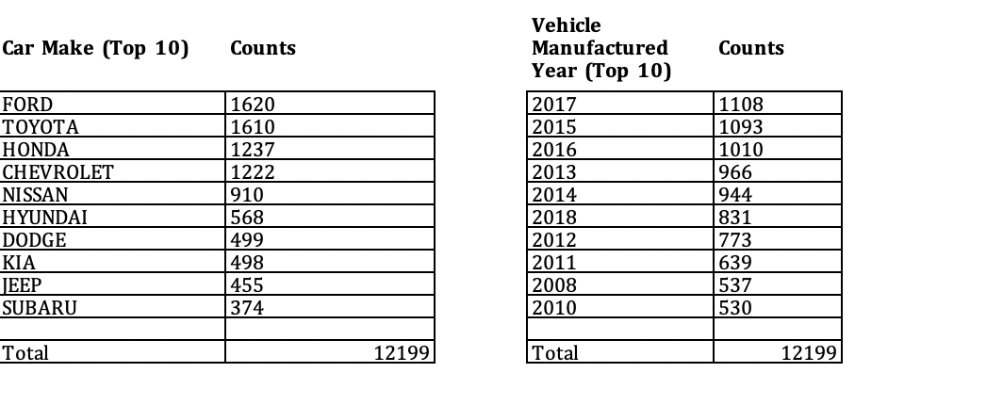
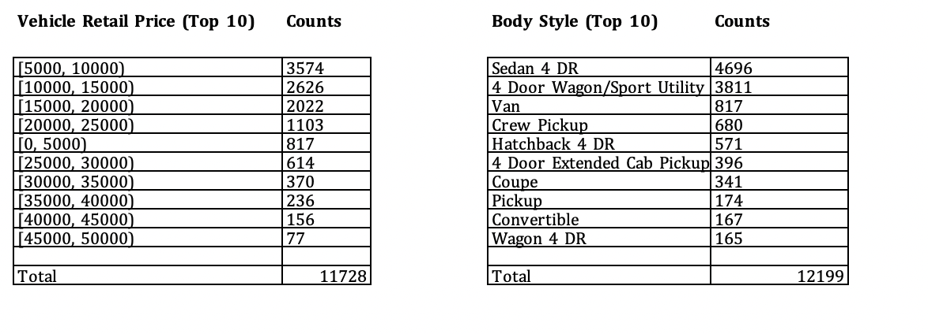
Most DME Customers owns relatively inexpensive Japanese and American brand, basically body style in Sedan 4DR and SUV Cars, built from 2008 to 2017.
DME Consumers’ Vehicle Information
Notes:
DME Consumers’ Vehicle Information (Laoli)
What effects on retail price? (common sense)
The earlier manufacture year of the car, the lower price is
The more distance the car travels, the lower price is.
The more previous owners owned, the lower price is.
Optional:
Car Retail Price is negatively impacted by number of odometer and length of previous ownership and manufacture year in days.

Slide 18
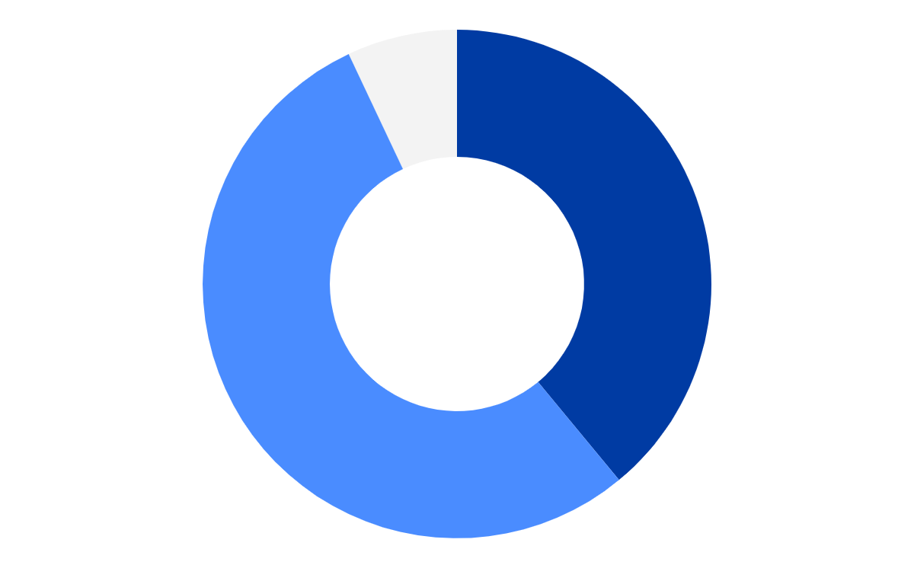
Most DME customer are 40-65 years old English and European, with relatively high income
DME main Customer Persona
Young people
(20-30)
English and European
66% Male
40 - 65 years old
From Rustic Families and Thriving Suburbanites
Income level: $50,000 - $75000
Education: high school and some college degrees
7%
39%
Elderly people
(60+)
Working-age
People(30-60)
54%
放图
DME Customer Composition
DME Consumer Persona

Slide 19
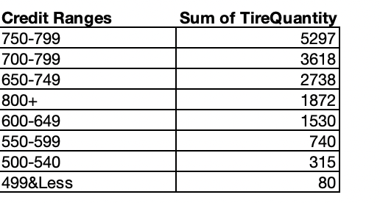
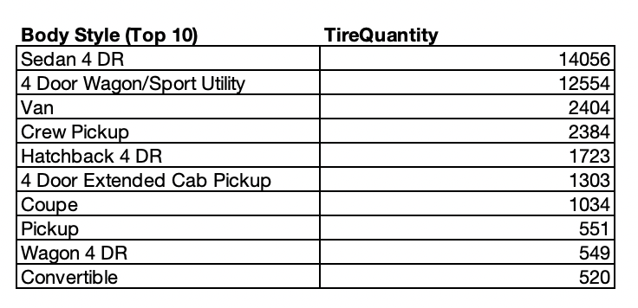
DME Consumer Purchasing Behavior regarding Tires Quantity
1. Male customers purchase more tires than female customers do.
2. High credit range (score in 650-799) DME customers purchase most tires.
3. Customers whose vehicle prices are between $5000-$15000 often purchase tires at DME.
4. Consumers who drive sedan vehicle purchase most tires at DME, the following group are 4 Door Wagon/SUV Owners.

Slide 20
Summary
1. Industry: Trends and prospects
2. Consumer profile: Low brand awareness and price sensitive
3. Consumer Journey: Most frequent search behaviors
4. Consumer Journey: Driving factors on purchase behaviors

