Slide 1
Point Defects in Gallium Nitride (GaN) ---
Presented By: Md. Rayid Hasan Mojumder
Department of Engineering Science and Mechanics,
The Pennsylvania State University – University Park, PA, USA

Slide 2
Outline
Introduction
Results and Discussion
Conclusion and Future Works

Slide 3
Introduction
Background on GaN (hexagonal):
Wide direct bandgap (~3.5 eV) – high power and high frequency
High electron mobility (~2000 cm²/Vs)
High breakdown voltage (~3.3 MV/cm)
Doping – p type (Mg) and n type (Si)
Applications – LEDs, lasers, power electronics, solar cells
Issues with GaN:
Lower thermal conductivity (~1.3 W/cmK)
MOCVD Growth issues - defects, unintentional contaminants, and impurities
Lyons et al., Appl. Phys. 129, 111101 (2021)
Freysoldt et al., Rev. Mod. Phys. 86, 253 (2014)
Freysoldt et al., Phys. Rev. Lett. 102, 016402 (2009)

Slide 4
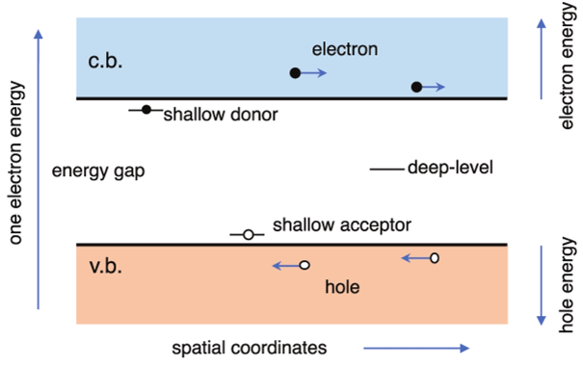
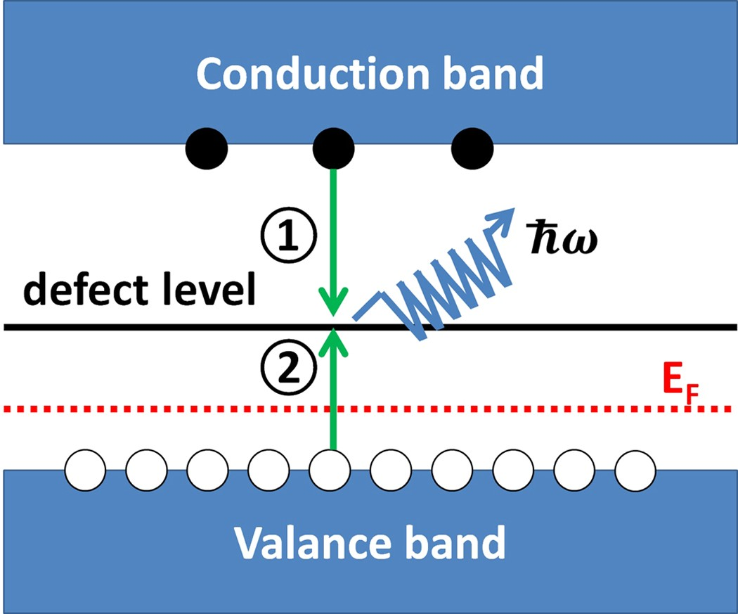
Introduction _{cntd.}
Important defect properties in GaN:
Decreased efficiency
Slower response times
Heat loss
Performance instability
Nonradiative (SRH) recombination centers¹
Deep donor level defects in III-V compound alloys – DX center²
¹Yang et al., Sci. Rep. 6, 21712 (2016)
²Shinozuka, Jenny Stanford Publishing (2021)
Lyons et al., npj Comp. Mat. 3, 12 (2017)
Van der Walle et al., Appl. Phys. 95, 3851–3879 (2004)
Lyons et al., Appl. Phys. 129, 111101 (2021)
(+) Trapping localized holes by acceptors – Polaronic

Slide 5
Introduction _{cntd.}
This work
Defect Investigation in GaN:
Theoretical – DFT (point defects, impurities, deep defects)/MD (dislocations)
Experimental – Photoluminescence (PL) and Deep Level Transient Spectroscopy (DLTS)
Formation energies for impurities, vacancies, and interstitials calculated and compared with literature
[VASP + PyDefect – PBE]
Reshchikov et al., J. Appl. Phys. 97, 061301 (2005)
Narita et al., AIP Pub. (2020)
Abou-Ras et al., Wiley-VCH (2016)

Slide 6

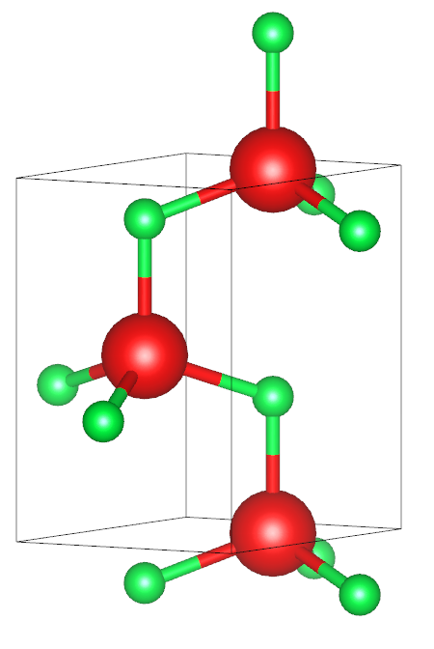

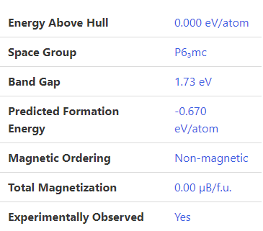
GaN Defect Investigation with PyDefect
Ga
a = b = 3.19 Å, c = 5.19 Å (materials project)
Hexgonal wurtzite, 4 atoms, 6 mm
N
Relaxed GaN Unit Cell –
a = b = 3.197 Å, c = 5.2 Å, BG = 1.8442 eV (PBE) – prev.
a = b = 3.219 Å, c = 5.242 Å, BG = 1.7 eV (PBE) – current
¹a = b = 3.22 Å, c = 5.24 Å, BG = 1.71 eV (PBE)
²a = b = 3.22 Å, c = 5.22 Å, BG = 1.71 eV (PBE)
³a = b = 3.19 Å, c = 5.19 Å, BG = 3.51 eV (exp.)
¹González-Hernández et al., App. Surf. Sci. 314, 794-799 (2014)
²Lyons et al., npj Comp. Mat. 3, 12 (2017)
³Vurgaftman et al., J. Appl. Phys. 94, 3675–3696 (2003)

Slide 7
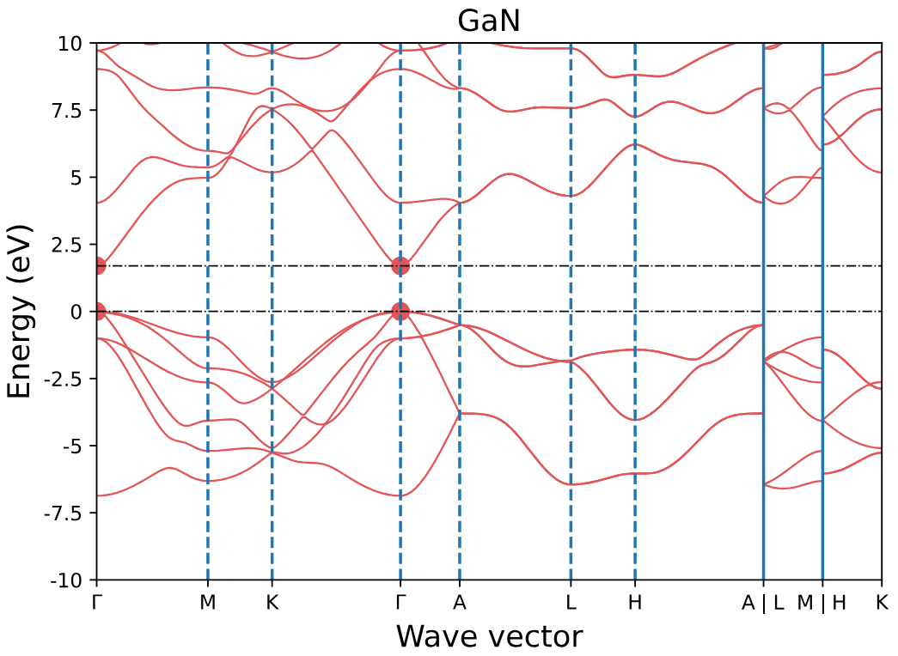
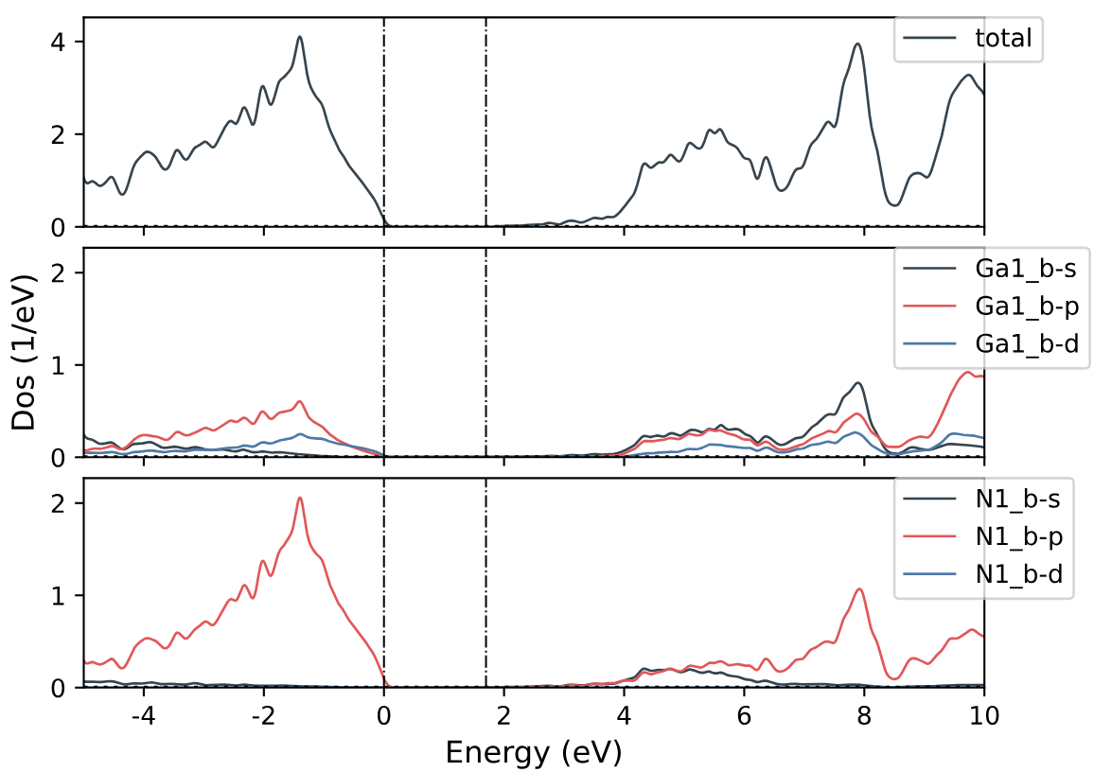
GaN Defect Investigation with PyDefect _{cntd.}
GaN unit cell band diagram (BG = 1.7 eV)
GaN unit cell DOS and PDOS (BG = 1.7 eV)

Slide 8
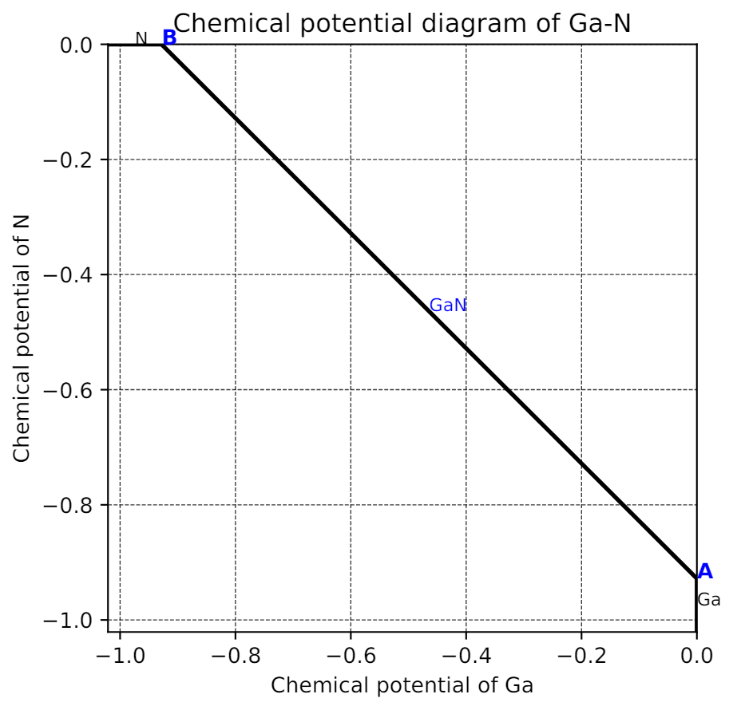
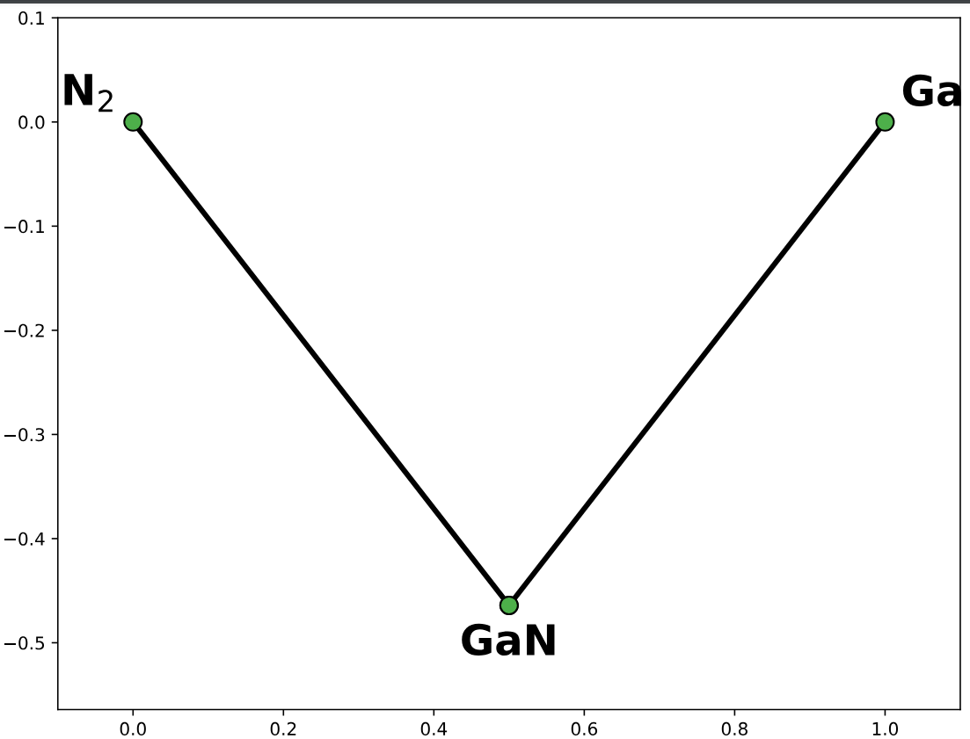

GaN Defect Investigation with PyDefect _{cntd.}
Formation Energy (eV/atom)
$μ$_{Ga} –$μ$_{Ga(bulk)} = - 0.9 eV¹
Fraction
Convex hall diagram
Chemical potential diagram
¹Feenstra et al., J. Vac. Sci. Technol. B 23, 1174–1180 (2005)

Slide 9
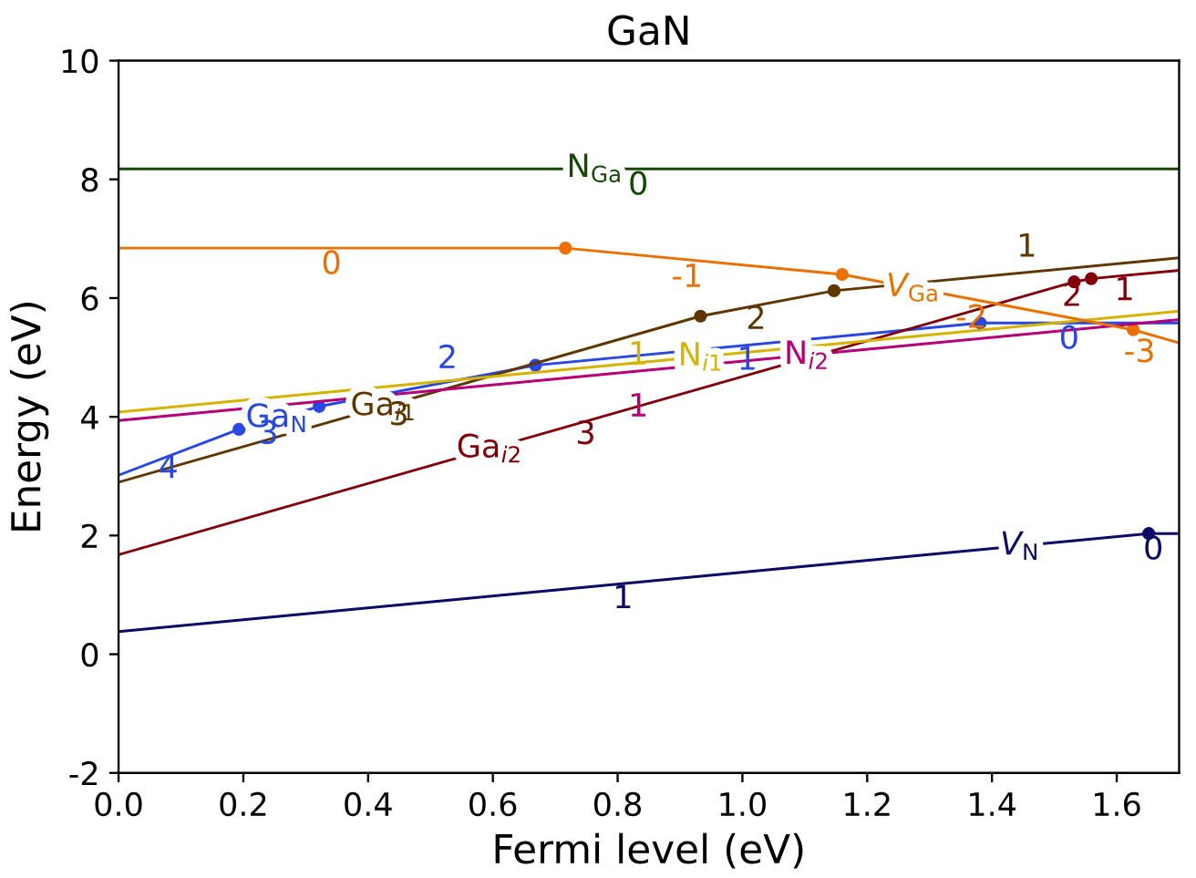
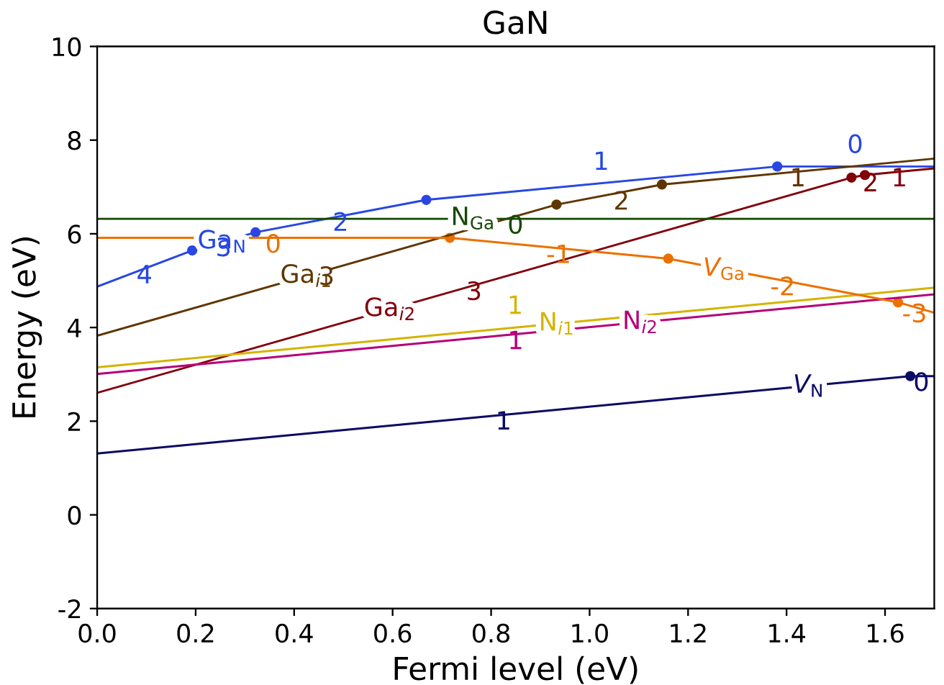
GaN Defect Investigation with PyDefect _{cntd.}
Defect elements: vacancy, interstitials, and anti-sites
Ga-rich
N-rich
Formation Energy Diagram
Ga_i1: [-1, 0, 1, 2, 3]
Ga_i2: [-1, 0, 1, 2, 3]
N_Ga1: [-6, -5, -4, -3, -2, -1, 0]
Va_Ga1: [-3, -2, -1, 0, 1]
N_i1: [-3, -2, -1, 0, 1]
N_i2: [-3, -2, -1, 0, 1]
Va_N1: [-1, 0, 1, 2, 3]
Ga_N1: [0, 1, 2, 3, 4, 5, 6]

Slide 10
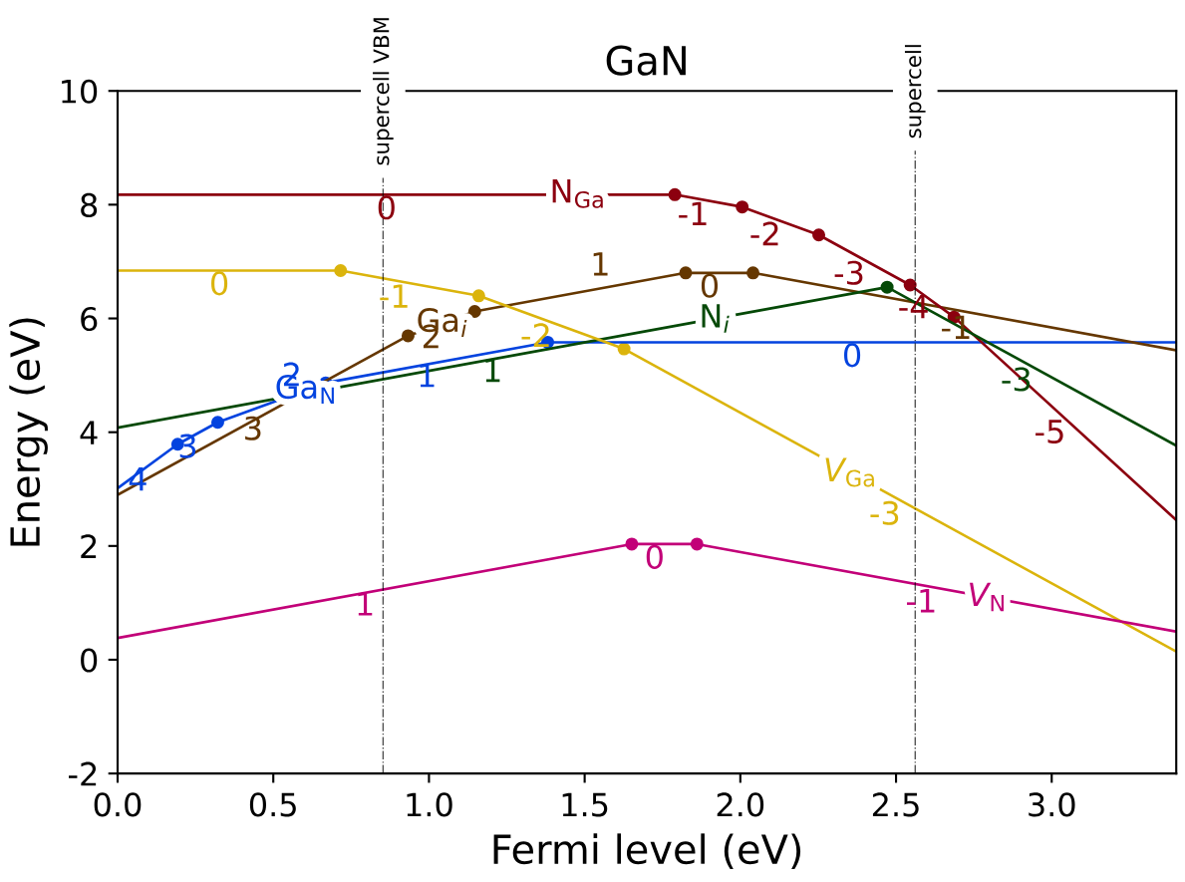
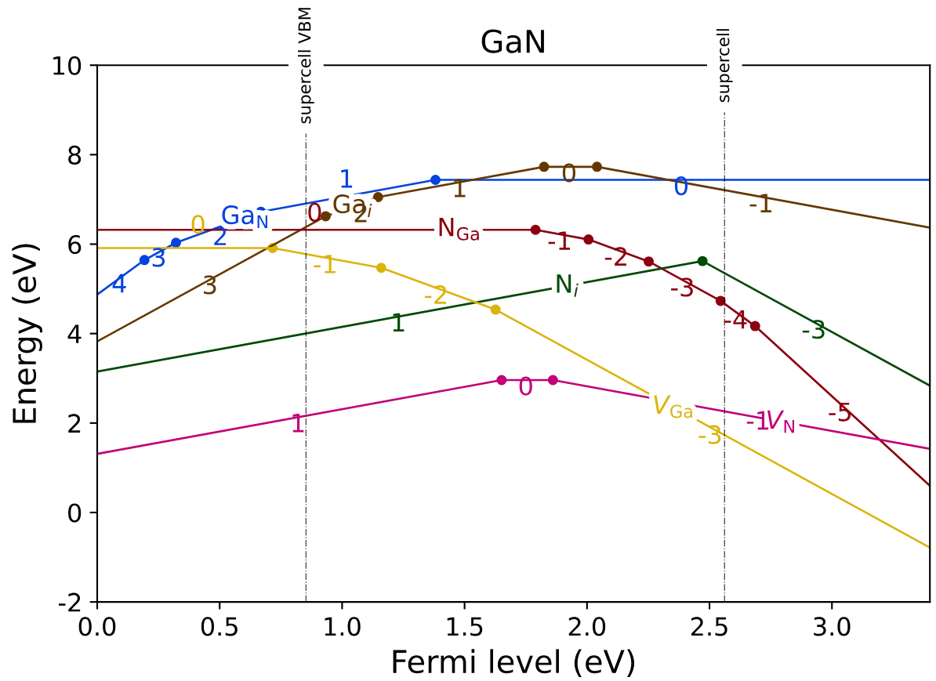
GaN Defect Investigation with PyDefect _{cntd.}
Defect elements: vacancy, interstitials, and anti-sites
Ga-rich
N-rich
Formation Energy Diagram (extended to HSE BG = 3.45 eV)
Ga_i1: [-1, 0, 1, 2, 3]
Ga_i2: [-1, 0, 1, 2, 3]
N_Ga1: [-6, -5, -4, -3, -2, -1, 0]
Va_Ga1: [-3, -2, -1, 0, 1]
N_i1: [-3, -2, -1, 0, 1]
N_i2: [-3, -2, -1, 0, 1]
Va_N1: [-1, 0, 1, 2, 3]
Ga_N1: [0, 1, 2, 3, 4, 5, 6]

Slide 11
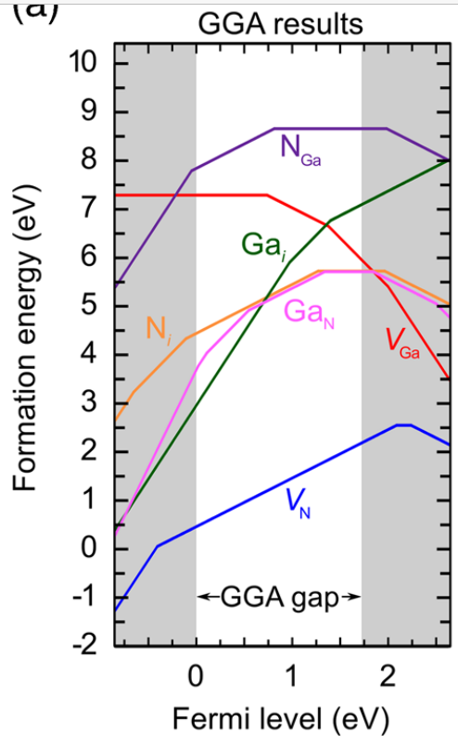
Results and Discussion _{cntd.}
Comparative Analysis
(this work, BG = 1.7 eV)
(BG = 1.71 eV¹)
¹Lyons et al., npj Comp. Mat. 3, 12 (2017)

Slide 12
Conclusion
Properties co-doping or p-n junction in GaN:
Defect captures free e⁻ capture
Electrical and optical properties altered
Future considerations:
GaN with vacancy, interstitials, antisites
GaN with vacancy, interstitials, antisites and Si (n-type)
GaN with vacancy, interstitials, antisites, and Mg (p-type)
Other impurities:
Shallow dopants:
Donor dopants: Si, Ga, O
Acceptor dopants: Mg
Deep dopants:
Cation-site acceptors: Zn, Cd, Be, and Ca
C
Rear earth dopants
Unintentional – Fe, H, C

Slide 13
Additional Works
Defect formation energy – DOPED package
Potential file generation – ML + AIMD

Slide 14
Thank you all!
Q&A

Slide 15
Backup slides
Copyright belongs to the respective sources, demonstrated purpose only

Slide 16
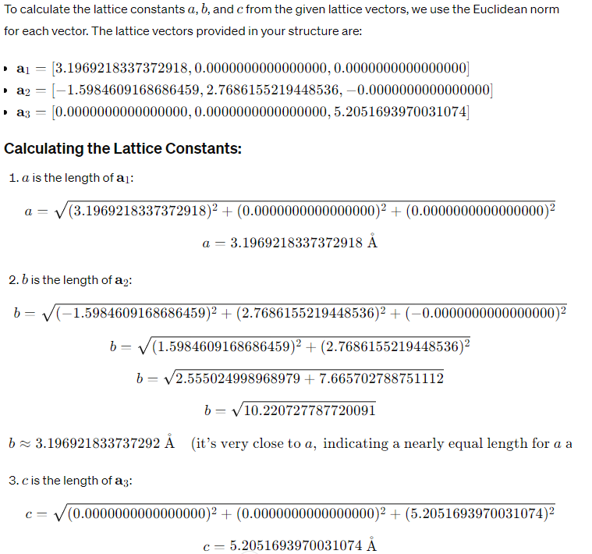
Calculation of Lattice constants

Slide 17
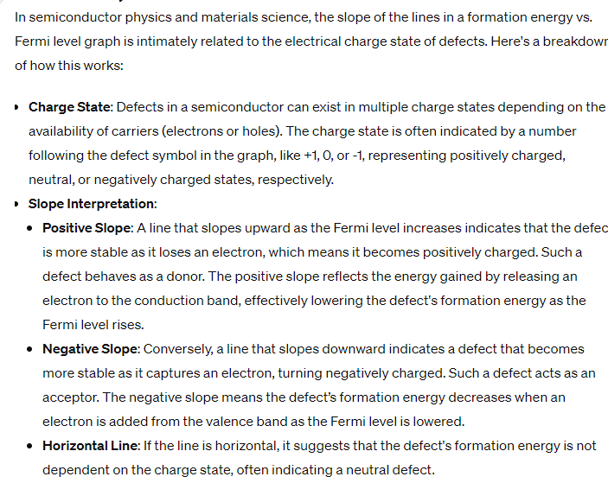
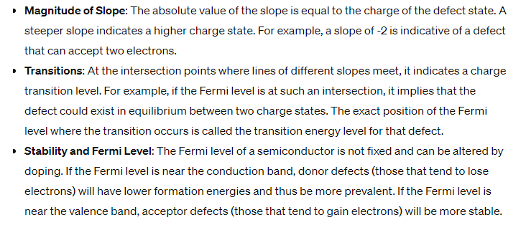
Reading Formation Energy Diagram

Slide 18
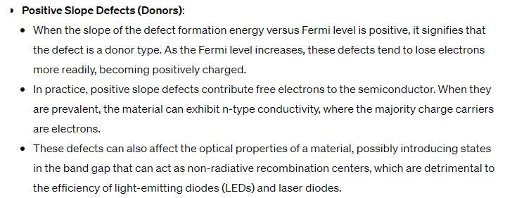
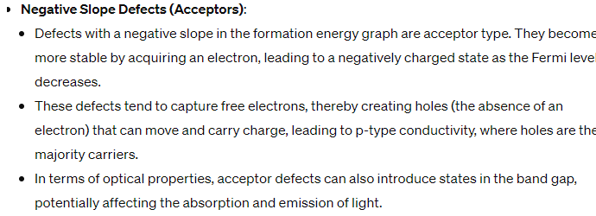
Reading Formation Energy Diagram _{cntd.}

Slide 19
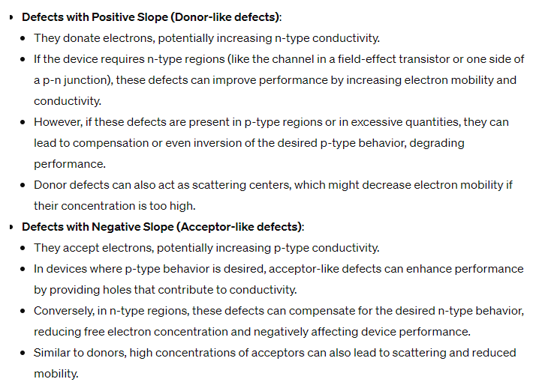
Reading Formation Energy Diagram _{cntd.}

Slide 20
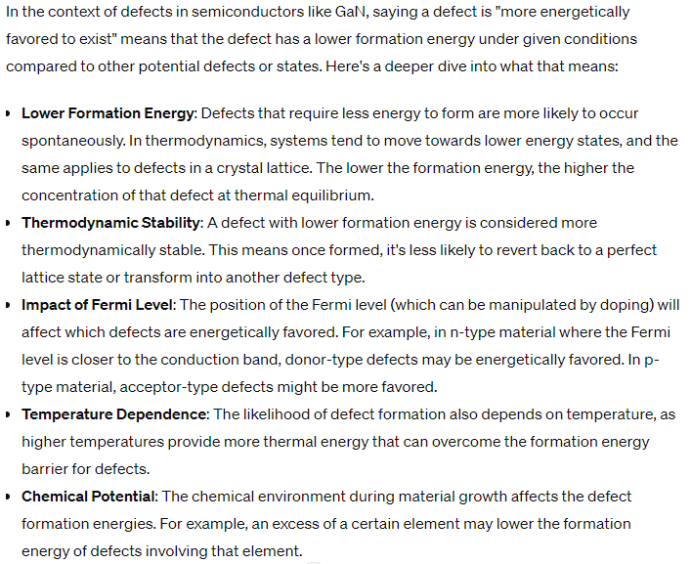
Reading Formation Energy Diagram _{cntd.}

Slide 21
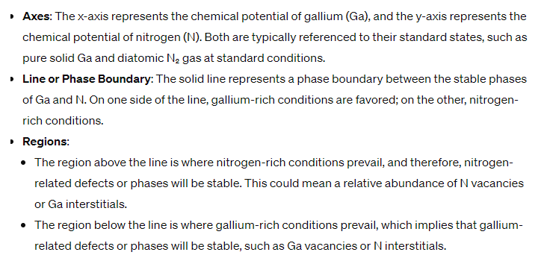
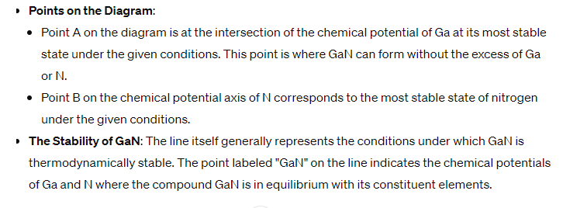
Reading Chemical Phase Diagram

Slide 22
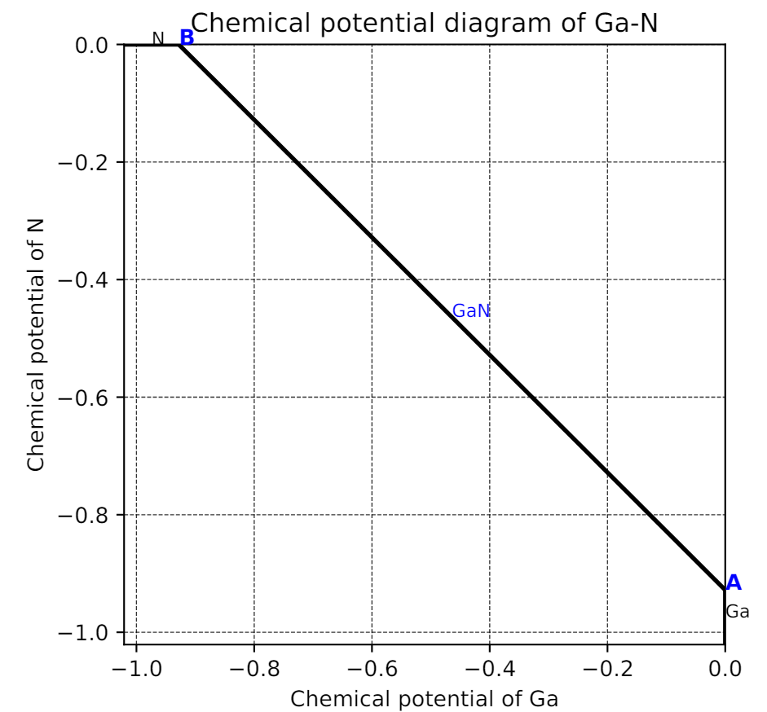
Reading Chemical Phase Diagram
N-rich, because poten of N is higher than of Ga
Ga-rich, because poten of Ga is higher than of N

Slide 23
Reading Chemical Phase Diagram
In this diagram, the x-axis represents the chemical potential of Ga and the y-axis represents the chemical potential of N. The line connecting points A and B represents the set of chemical potentials where GaN is stable. To the right of the line (toward point A), the conditions are Ga-rich because the chemical potential of Ga is higher and that of N is lower. To the left of the line (toward point B), the conditions are N-rich because the chemical potential of N is higher relative to that of Ga.
Point A, located at the intersection of the x-axis and the GaN stability line, would represent the most Ga-rich conditions under which GaN is stable. At this point, the chemical potential of Ga is at its highest possible value without forming metallic Ga, and the chemical potential of N is at its lowest.
Point B, at the intersection of the y-axis and the GaN stability line, represents the most N-rich conditions under which GaN is stable. Here, the chemical potential of N is at its highest possible value without forming molecular N2, and the chemical potential of Ga is at its lowest.
The slope of the line is determined by the stoichiometry of GaN. For every point along this line, the sum of the chemical potentials of Ga and N equals the chemical potential of GaN. This line essentially is a graphical representation of the reaction: GaN (solid)↔Ga (solid or liquid)+12N2(gas)GaN (solid)↔Ga (solid or liquid)+21​N2​(gas)
So, if you're performing a calculation or an experiment under conditions where you're along this line but closer to point A, you would say you are under Ga-rich conditions. If you're closer to point B, then you're under N-rich conditions. This concept is key when predicting the types of defects and their concentrations during the growth of GaN crystals.

