Slide 1
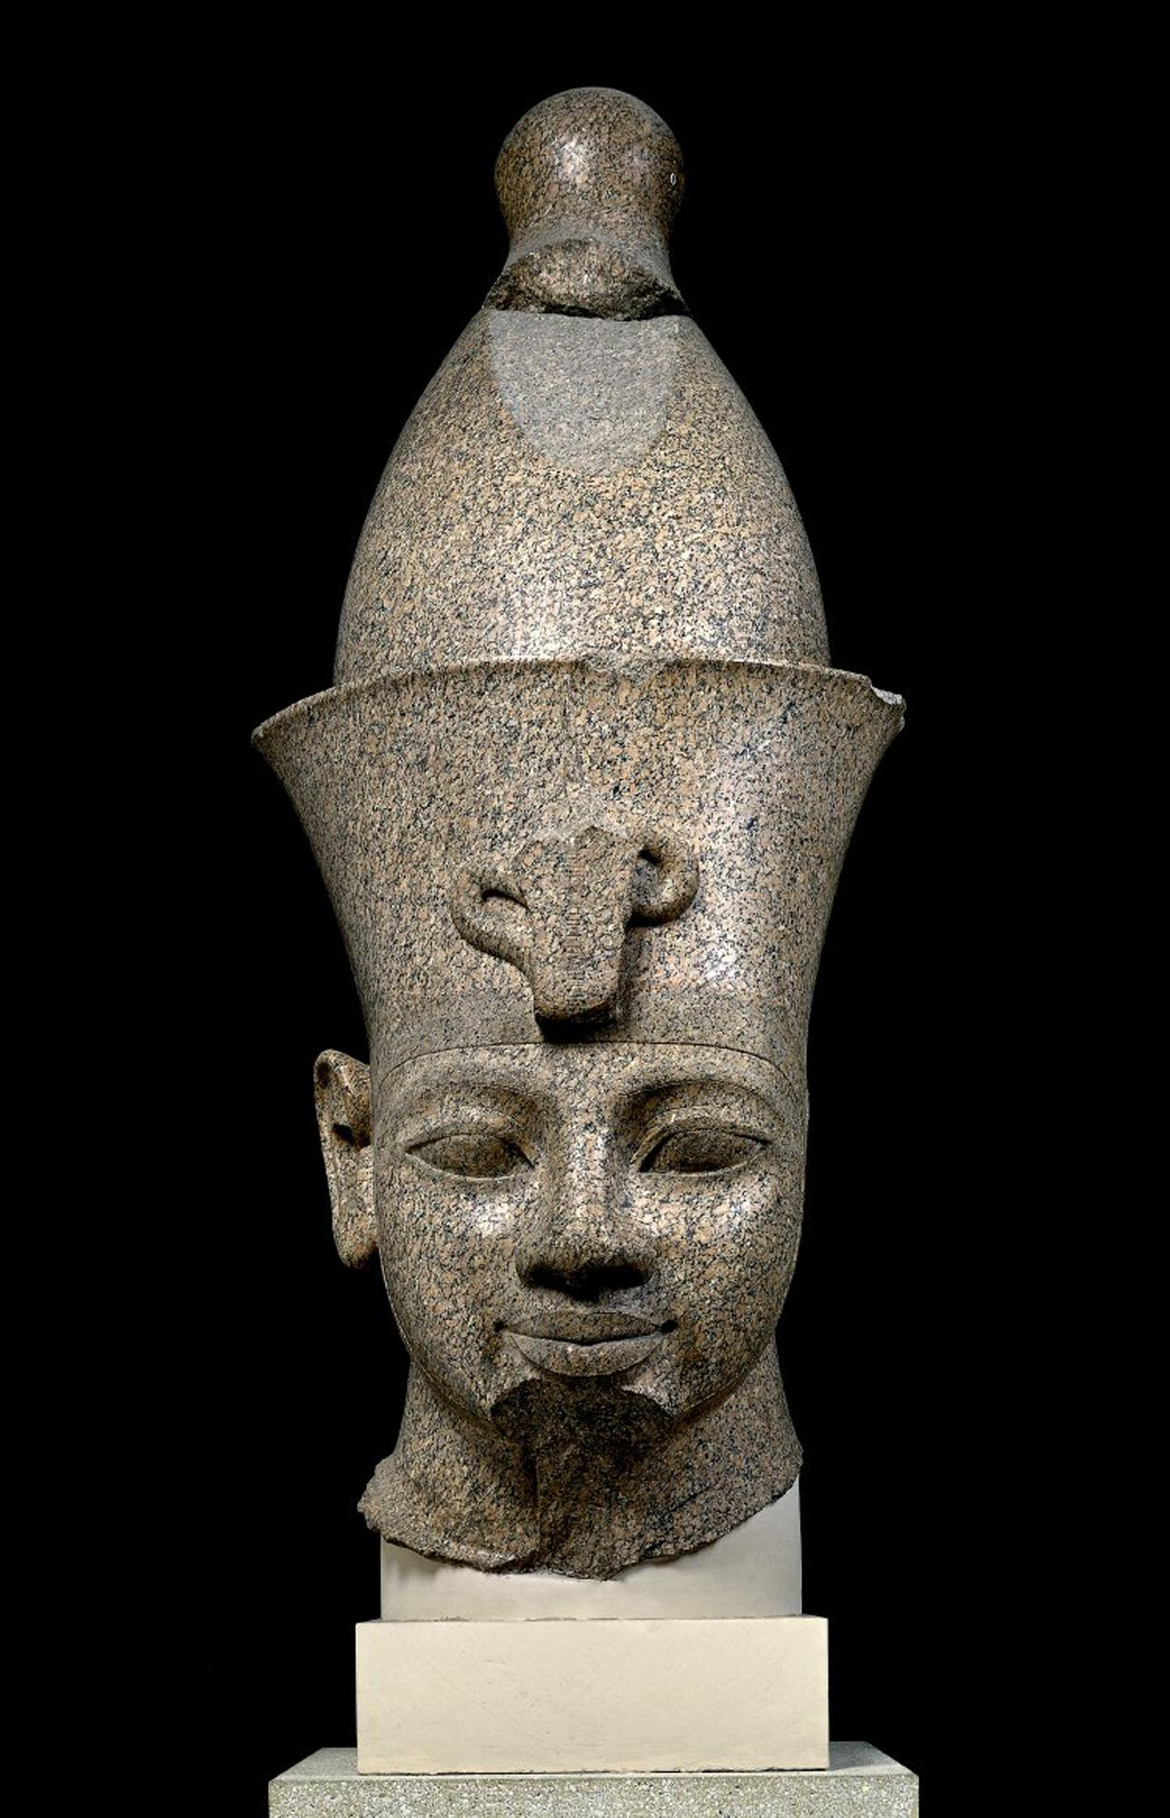
King Amenhetop II
Colossal granite head, from Karnak (Thebes), Egypt, about 1370 BC.
Possibly the King whose dreams Yosef interpreted
Beraishis Chap 41
And Pharaoh said to Joseph, "I have dreamed a dream, and there is no interpreter for it, but I have heard it said of you [that] you understand a dream, to interpret it."
16And Joseph replied to Pharaoh, saying, "Not I; God will give an answer [that will bring] peace to Pharaoh.“
41So Pharaoh said to Joseph, "Look, I have appointed you over the entire land of Egypt
King Amenhotep III commissioned numerous statues of himself, especially for his temples in Thebes, then Egypt's capital. His peaceful reign was a time of opulence and outstanding artistic refinement, often displayed on a grand and ambitious scale. The complete sculpture showed him striding. This and a slightly smaller colossus flanked a doorway in the temple of Mut in Karnak. The head of the second statue is also in the British Museum, but the bodies remain in Karnak.
https://www.britishmuseum.org/collection/galleries/egyptian-sculpture#&gid=1&pid=3

Slide 2
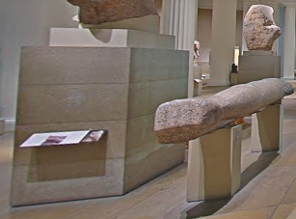
King Amenhetops Arm, as viewed in Google Street

Slide 3
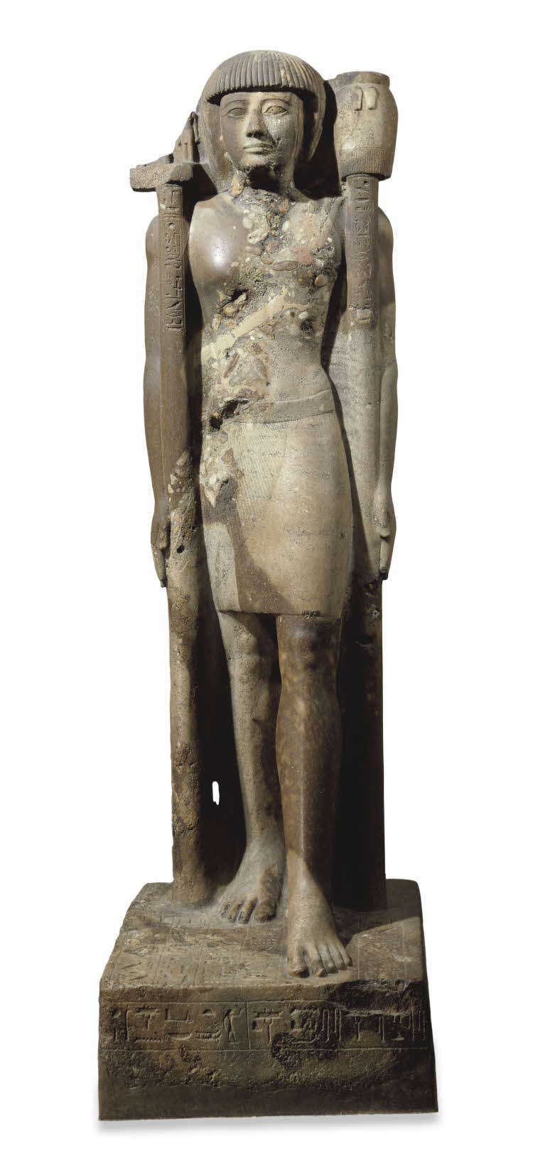
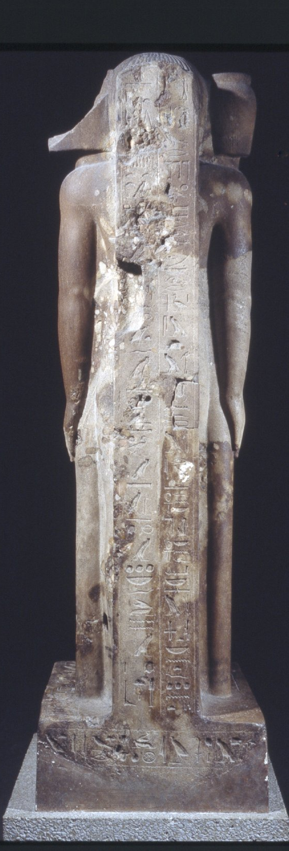
Prince Khaemwaset
Inscriptions of prayers and epithets to Ramses II
Possible peer of Moshe
Exodus Chapter Two
The child grew up, and she brought him to Pharaoh's daughter, and he became like her son. She named him Moses, and she said, "For I drew him from the water.“
After Moshe was famously saved, Princess Batya adopted him and Moshe grew up in the Egyptian palace.
Despite his luxurious life he would physically help his fellow Jews in their labor and would support their moral with words of encouragement.
Sandstone conglomerate statue of Khaemwaset: depicted wearing a short wig and kilt and standing with left foot advanced and holding two standards: the right (now damaged) was probably surmounted by a representation of the Osirian triad and is inscribed with the prenomen and epithets of Ramses II …
https://research.britishmuseum.org/research/collection_online/collection_object_details/collection_image_gallery.aspx?partid=1&assetid=398727001&objectid=6311

Slide 4
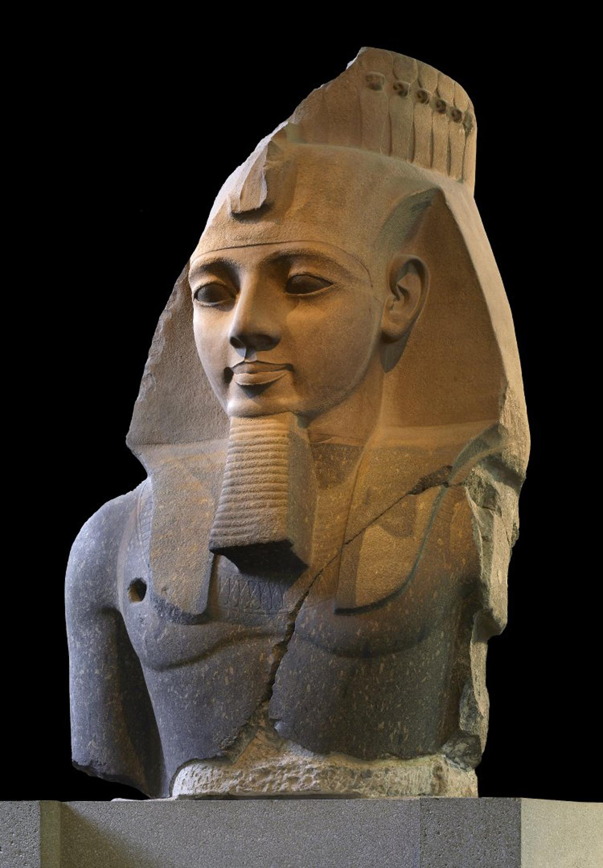
Ramesses II
Ruler of Rulers, reigned through most of the 13th century BC
King Pharoah who commissioned the Jews to intense slave labor.
Exodus Chapter One
11: So they appointed over them tax collectors to afflict them with their burdens, and they built store cities for Pharaoh, namely Pithom and Raamses.
The largest Egyptian sculpture in the British Museum is an image of Ramesses II, whose prosperous pair that flanked a gate in the king's mortuary temple (the 'Ramesseum'). The statue was carved from one block, quarried at Aswan almost 124 miles (200km) further south. Roughly shaped and weighing some 20 tonnes, it was transported on sleds over land and on a purpose-built boat down the river Nile. Once erected, the statue's finer sculpting was completed. Like all Egyptian statues, it was originally painted. Traces of the pigments remain.
https://www.britishmuseum.org/collection/galleries/egyptian-sculpture#&gid=1&pid=2

Slide 5
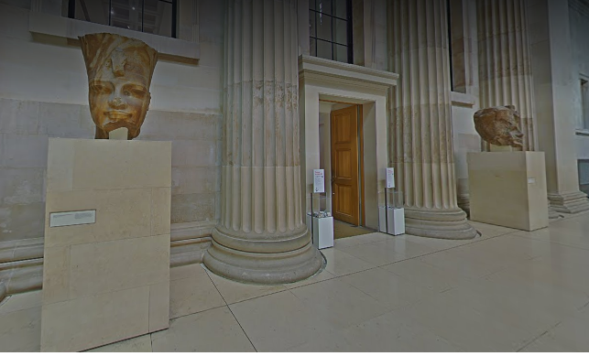
Two Egyptian heads, as seen in the British Museum, street view https://artsandculture.google.com/streetview/british-museum/AwEp68JO4NECkQ?sv_lng=-0.1272956987031648&sv_lat=51.51921726998366&sv_h=259.54304445788244&sv_p=2.939128950808467&sv_pid=ObNdlduSG3c4MruJlaObcg&sv_z=0.8825186401771719

Slide 6
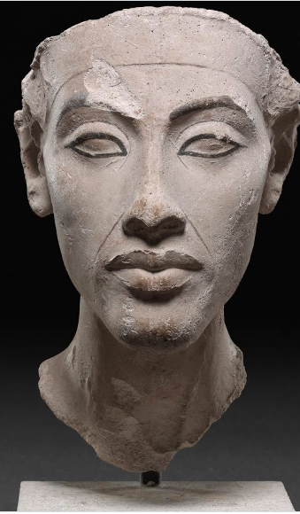
Pharaoh Akhenaten
The Pharoah erased from history –my own inference, not proven
Exodus Chapter Fourteen
And the waters returned and covered the chariots and the horsemen, the entire force of Pharaoh coming after them into the sea; not even one of them survived.
29But the children of Israel went on dry land in the midst of the sea, and the water was to them like a wall from their right and from their left.
30On that day the Lord saved Israel from the hand[s] of the Egyptians, and Israel saw the Egyptians dying on the seashore.
Typical of a sculptor’s modelis the limestone bust of the king, on which the facial features have been marked in colour. These finds indicate that the workshop stopped activity quite suddenly.
Around 1350 BC, Pharaoh Amenhotep IV decided that all the gods of Ancient Egypt were a lie, except for one: the sun God Aten. He build a new capital for him in the desert 200 miles south of Cairo, and changed his name to Pharaoh Akhenaten (“Of great use to Aten”). His rule must have been strong, his fame widespread and his power seemingly unquestioned. And yet just fifty years after his death, his name had been deleted from the royal lists, his buildings razed ...
https://www.britishmuseum.org/collection/galleries/egyptian-sculpture#&gid=1&pid=2

Slide 7
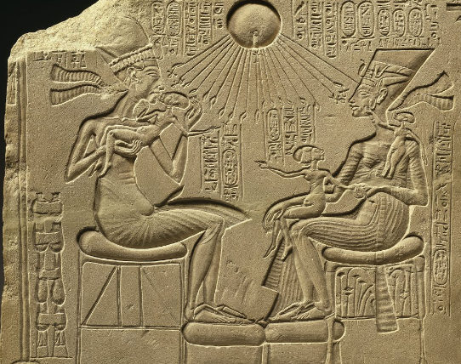
…and this house altarpiece, which shows Akhenaten and Queen Nefertiti with their three eldest daughters under the sun disc Aten. His rule must have been strong, his fame widespread and his power seemingly unquestioned. And yet just fifty years after his death, his name had been deleted from the royal lists, his buildings razed…
https://artsandculture.google.com/exhibit/the-pharaoh-erased-from-history/9QISgLrWPLdZIg

Slide 8
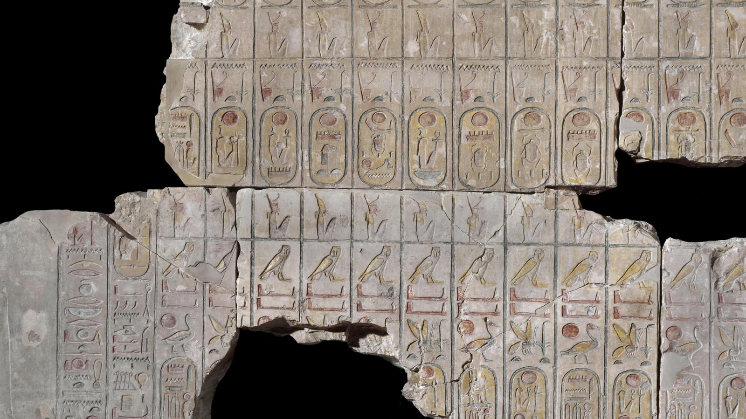
List of Kings. Abydos, Egypt circa 1270 BCE https://www.britishmuseum.org/collection/galleries/egyptian-sculpture#&gid=1&pid=4

Slide 9
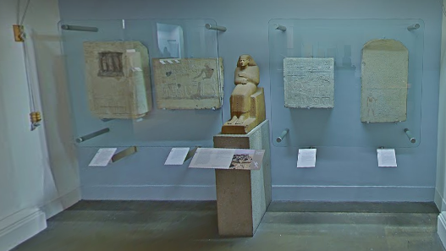

Slide 10
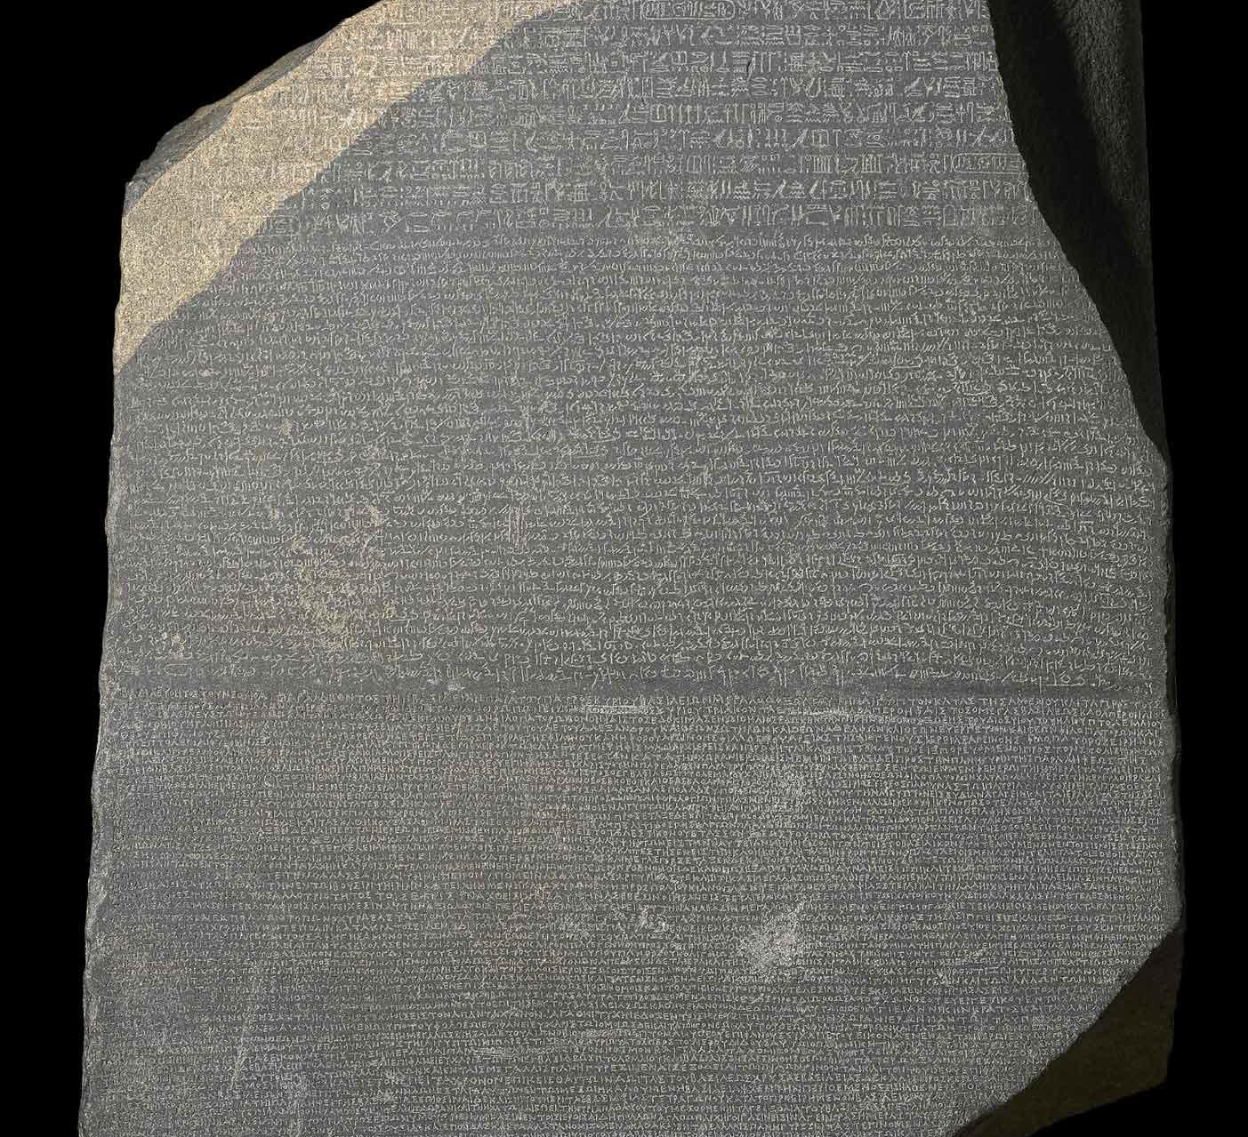
The Rosetta Stone
https://www.britishmuseum.org/collection/galleries/egyptian-sculpture#&gid=1&pid=1

