Slide 1
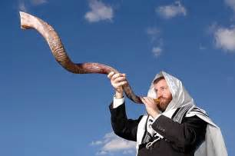
Messages of the Shofar

Slide 2
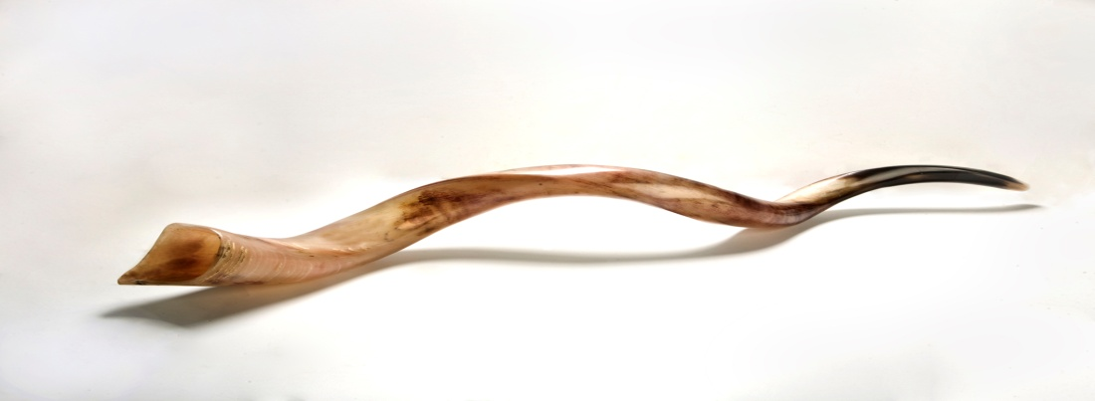
What is a shofar?
The horn of a ram
It is curved
It can be tan or black
It is blown at the narrow end; the sound comes from the wide end

Slide 3

The Torah Instructs:
“On the seventh month, on the first day, shall be declared holy for you…It shall be a day of sounding the ram’s horn.” (Numbers 29:1)

Slide 4


Message #1
“Sound the shofar to G-d with a cry of joy. For G-d is supreme, awesome; a great king over all the earth.” (Psalms 47:2-3)
Declaring G-d King of the world

Slide 5
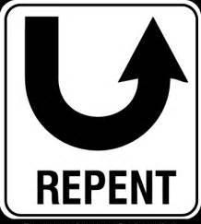
Message #2
“Blow the shofar in Zion and sound the trumpet on My holy mountain! Let all the inhabitants of the land tremble; for the day of G-d has come.” (Joel 2:1)
A call to repentance

Slide 6
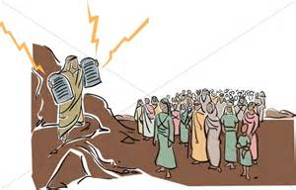
Message #3
“The sound of the shofar grew much stronger; Moses spoke, and G-d responded with a firm voice” (Exodus 19:19)
Receiving the Torah at Mount Sinai

Slide 7
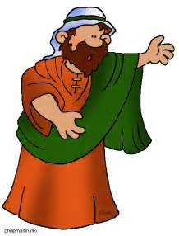
Message #4
“I appointed watchmen (prophets) over you who warned, ‘Hearken to the sound of the shofar’ ” (Jeremiah 6:17)
The admonitions of our prophets

Slide 8
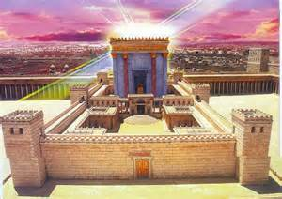
Message #5
“You shall blow on the trumpets, by your burnt offerings and by your peace offerings” (Numbers 10:10)
The Beit Hamikdosh / Holy Temple in Jerusalem

Slide 9
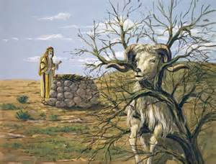
Message #6
“He saw a ram, behind, caught by its horns in the thicket. Abraham went, took the ram, and offered it as an offering in place of his son” (Genesis 22:13)
The Binding of Isaac

Slide 10

Message #7
“Would a shofar be blown in the city, and the people not tremble?” (Amos 3:6)
Fear of G-d

Slide 11

Message #8
“The great day of G-d is near…a day of fury is that day…a day of shofar sounds” (Tzefania 1:14-16)
The Day of Judgement

Slide 12
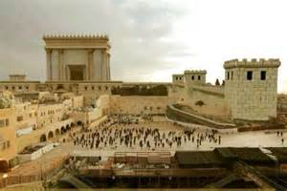
Message #9
“It will be on that day, a great shofar will be blown, and those who are lost in the land of Assyria, and those cast away in the land of Egypt, will come….to G-d on the holy mountain in Jerusalem” (Isaiah 27:13)
Gathering of the exiles, arrival of Mashiach

Slide 13
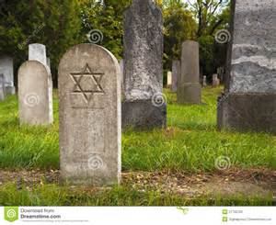
Message #10
“All you inhabitants of the world and dwellers of the earth…when the shofar sounds you will hear” (Isaiah 18:3)
Revival of the dead

Slide 14
Additional Message
“From the tight spot I call to G-d; G-d answered me with expansiveness” (Psalms 118:5)
The shofar is blown at the narrow end, and the sound comes from the wide end.
A person who feels blocked in and contrite, inspires a response of wideness and open-handedness

