Slide 1

6,000 Years of History
B”H
Produced by
Beit Jabad Uruguay
Special thanks to Mrs. Ella Lerman
Notes:
Bienvenido

Slide 2
The Six Days of Creation

Slide 3

The Six Days of Creation
1st day
Light

Slide 4

The Six Days of Creation
2nd day
Separation between the superior and inferior waters

Slide 5

The Six Days of Creation
3rd day
* Dry land appears
* Vegetation.

Slide 6
The Six Days of Creation
4th day
* Sun
* Moon
* Stars

Slide 7
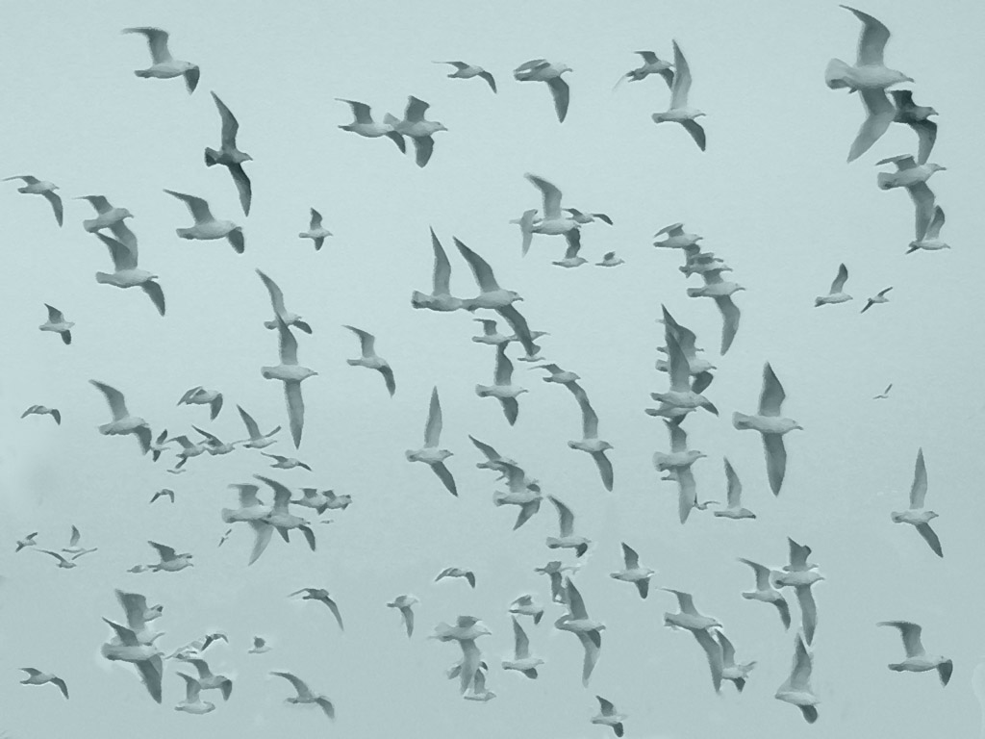
The Six Days of Creation
5th day
* Fish * Birds

Slide 8
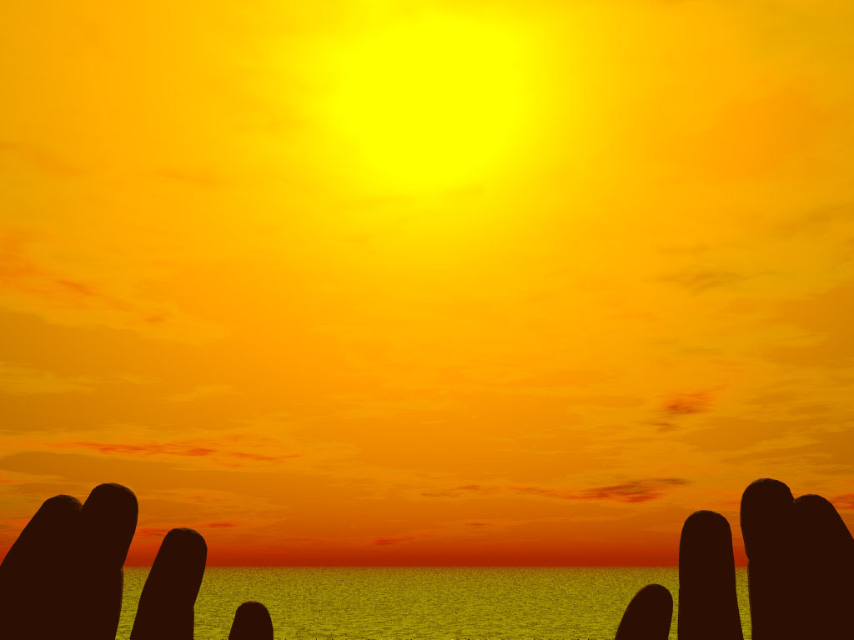
The Six Days of Creation
6th day
* Animals
* Man

Slide 9
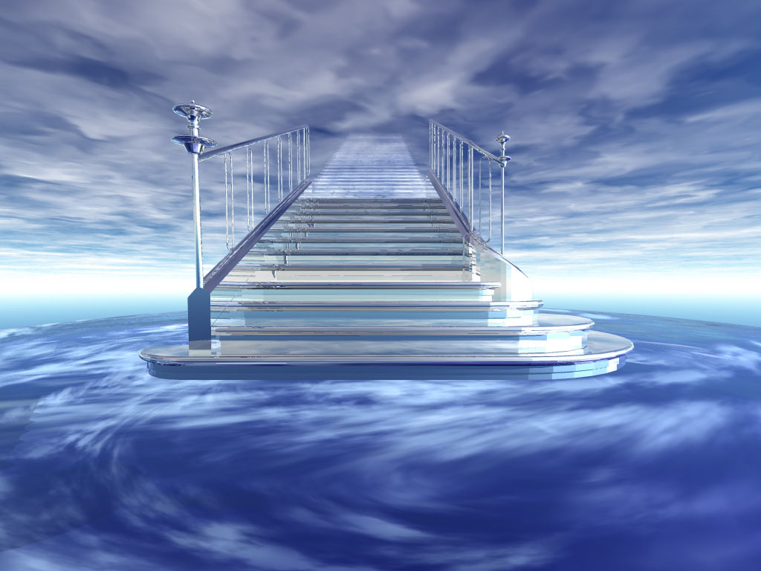
The Six Days of Creation
7th day
Rest

Slide 10

6,000 Years of History
1-1.000 3.760 - 2.760 B.C.E
1.001 - 2.000 2.760 - 1.760 B.C.E.
2.001 - 3.000 1.760 - 760 B.C.E.
3.001 - 4.000 760 B.C.E. - 240 C.E.
4.001 - 5.000 240 - 1.240 C.E.
5.001 - 6.000 1.240 - 2.240 C.E.
(5.767 – 2.007)
6.001 - 7.000 2.240 - 3.240

Slide 11
First Millennium
1 - 1.000
(3.760 - 2.760 B.C.E.)
10 generations between Adam and Noah

Slide 12
Second Millennium
1.001 - 2.000
(2.760 - 1.760 B.C.E.)
10 generationes between Noah and Abraham

Slide 13
Third Millennium
2.001 - 3.000
(1.760 - 760 B.C.E.)
Jewish People
Jewish People in the Land of Israel

Slide 14
Fourth Millennium
3.001 - 4.000
(760 A.E.C. - 240 C.E.)
First and second Temples

Slide 15
Fifth Millennium
4.001 - 5.000
(240 EC – 1.240 C.E.)
Continuation of Judaism in exile

Slide 16
Sixth Millennium
5.001 - 6.000
(1.240 EC – 2.240 C.E.)
Preparing for Moshiach

Slide 17
Seventh Millennium
6.001 - 7.000
(2.240 EC – 3.240 C.E.)
Moshiach

Slide 18
The Seven Sefirot

Slide 19
The Seven Sefirot
1. Chesed Kindness | 2. Gevurah Discipline, Justice | 3. Tiferet Beauty, Harmony
4. Netzach Victory | 5. Hod Humility, Praise | 6. Yesod Conection
 | 7. Malchut Royalty

Slide 20
1. Chesed (Kindness)
1st day of Creation
Light
Longevity.
Adám illuminates the world.
Exaggerated sizes of animals and humans.
*Enosh.

Slide 21
2. Gevurah (Justice, Discipline)
2do día de la Creación
Separation of waters
Flood.
Tower of Babel.
Noach and family separated from rest of generation.
Generation of Tower of Babel separated and disperesed.
* Avraham Avinu born.

Slide 22
3. Tiferet (Beauty, Harmony)
3rd day of Creation
Dry land appears. Vegetation
Patriarchs and Matriarchs.
Egyptian slavery and Exodus.
Receiving the Torah.
Entering the Land of Israel.
Judges
Saul, David, Salomon
1st Temple inaugurated

Slide 23
4. Netzach (Victory)
4th day of Creation
Sun, Moon, Stars
First Temple (Sun).
Babilonian exile.
2nd Temple (Moon).
Great Assembly.
Tanaim.
Mishná (stars).
* Destruction of 2nd Temple.

Slide 24
5. Hod (Humility, Praise)
5th day of Creation
Creation of Birds and Fish
Amoraim
Talmud
Rabanan Savorai
Geonim
Rishonim
Naciones of the world like birds and fish.
Jewish people suffers.
Much Torah literature produced.
G-d appreciated and praised.

Slide 25
6. Yesod (Conection)
6th day of Creation
Animals. Man.
Rishonim
Inquisition
Ajaronim
Chmelnitzki Massacres
Baal Shem Tov
Industrial Revolution
Animal behavior.
Superpower born.
Preparing for Moshiach through Chassidus.

Slide 26
7. Malchut (Royalty)
7th day of Creation
Rest
Moshiach
The whole world will recognize and accept G-d’s unity.
History will find its end and meaning.

Slide 27
“In the six hundredth year in the life of Noah... all wellsprings of the great deep burst open, and the windows of heaven were opened...”
Genesis 7:11

Slide 28
In the six hundredth year in the life of Noah... all wellsprings of the great deep burst open, and the windows of heaven were opened...
Génesis 7:11
“In the sixth century of the sixth millennium, the gates of supernal wisdom will be opened, as will the springs of earthly wisdom, preparing the world to be elevated in the seventh millennium."
The Zohar

Slide 29
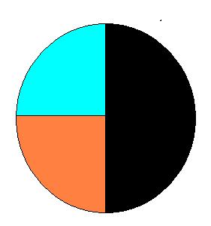
5.500 (1.740 C.E.)
Sixth century
250
5.750
500
(1.990 C.E.)
250
5767 (2007)
Sixth Millennium
X
5.000 (1.240)

Slide 30
5.458 (1.698) The Baal Shem Tov was born
5.494 (1.744) Reveals Chassidus

Slide 31
The period of time covered by the Industrial Revolution varies with different historians.Eric Hobsbawm held that it 'broke out' in the 1780s and was not fully felt until the 1830s or 1840s, while T. S. Ashton held that it occurred roughly between 1760 and 1830.
- Wikipedia

Slide 32
Third Industrial Revolution
The Third Industrial Revolution originated in the forties followed by a second wave of scientific and technological discoveries in the eighties and nineties.
It was a true “Intelligence Revolution”. Today, 85% of all scientista that have ever lived are alive and have at their disposal more advanced tools and more creativity. That has caused the increasing speed of scientific and technological development. It has been said that scientific knowledge presently duplicates itself approximately every 5 years.
The areas that have seen the most technological innovations are Nuclear Energy, Computers, Robots, biotechnology, telecommunications, and space research.

Slide 33
“the world will be filled with the knowledge of G-d as the water covers the sea”
Isaías 11:9

