Slide 1


Jewish
Personalities & Communities
בס”ד
Yeshivah College - Melbourne
Years 9 & 10
Notes:
Welcome
test every 3 weeks
exam

Slide 2

The Jews of Spain

Slide 3

Some historians calculate that the Romans sent 80.000 Jews to Spain as slaves
Jews lived in Spain. since at least 305CE
Notes:
there are assumptions that Jews lived there before.
Herod was exilied to spain in the year 69CE

Slide 4
Early good relations with their neighbours.
Notes:
While Spain was ruled by the Romans.
Before the church was established (the population was pagan), the Jews got on well with their non-Jewish neighbours.

Slide 5
First Decrees against the Jews
Council of Elvira 305CE
Notes:
It seems that by this time the presence of Jews was of greater concern to Catholic authorities than the presence of pagans;
Canon 16, which prohibited marriage with Jews, was worded more strongly than canon 15, which prohibited marriage with pagans.
Canons 48 and 50 forbade the blessing of Christian crops by Jews and the sharing of meals with Jews, respectively.

Slide 6
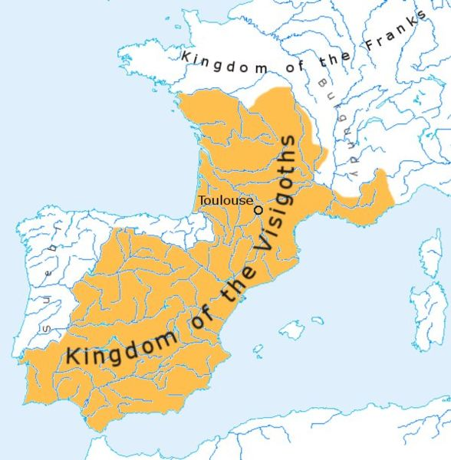
Visigoth rule
Greatest extent of the Visigothic kingdom of Toulouse, c. 500
Notes:
the Visigoth, conquered spain by the beginning of the 5th century
were divided in to different kingdoms.

Slide 7
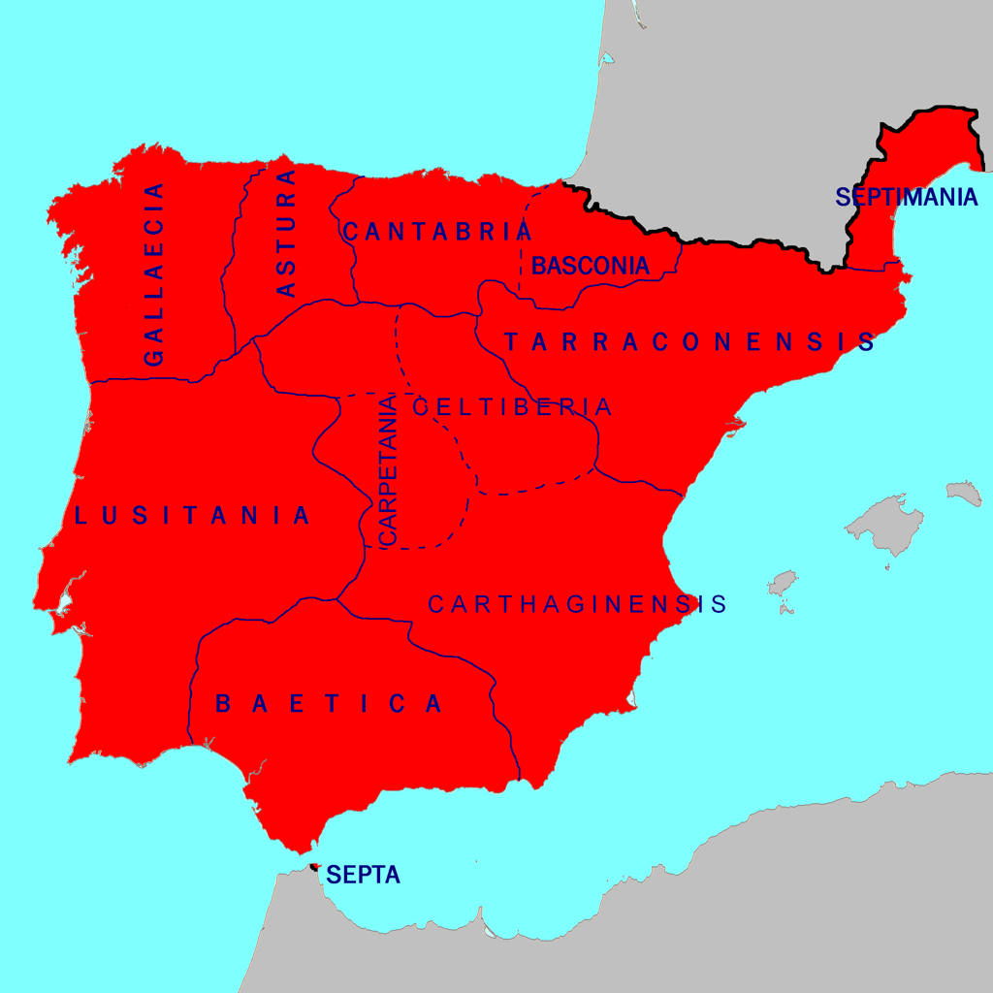
Visigothic Hispania and its regional divisions in 700CE, prior to the Muslim conquest.
Notes:
It corresponds almost exactly to modern spain

Slide 8
In 587 the Visigothic royal family under Recared from converted Arianism to Catholicism.
They made decrees to oppress the Jews.
Notes:
Then the Jews started to be prosecuted

Slide 9
Christian Decrees against the Jews
613CE Jews expelled from Spain
638 Only Catholics are allowed to live in Spain.
658 All Jewish rites forbidden (including Shabbos & Bris Milah)
672-680 more expulsions from Spain.
694 Jews declared traitors. All Jews (including baptized ones) found their property confiscated and themselves enslaved.
Notes:
all converted Jews had to promise to put to death, either by burning or by stoning, any of their brethren known to have relapsed to Judaism.
The decree of 694 exempted only the converts who dwelt in the mountain passes of Septimania, who were necessary for the kingdom's protection.

Slide 10
The Golden Age
711CE - 12

Slide 11
When Captured, Cordoba was left in the hands of Jews to garrison.
Cordoba, was made the capital in 755CE

Slide 12
Life in Muslim Spain
Jews were tolerated, not given equal rights.
as dhimmis (as non muslims had to pay a special tax)
Helped garrison towns.
Could do any job, anywhere.

Slide 13
Some Famous Jews of the Golden Age
Abraham ibn Ezra
Hasdai Ibn Shaprut
Bachya ibn Pakuda
Judah HaLevi
Rambam
Shmuel HaNagid

Slide 14
The End of the Golden Age

Slide 15
Granada massacre of 1066
The Almohads 1172 Extremely intolerant of Jews
Notes:
Granada massacre of 1066 - 4000 Jews killed

Slide 16
The Re-conquest
11 Century the christians in the north started to drive the Muslims out.
It took until 1492, 400 years.

Slide 17
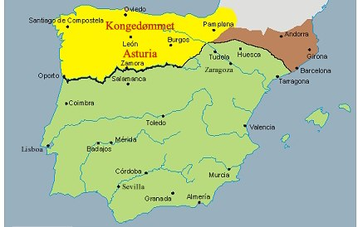
790CE

Slide 18
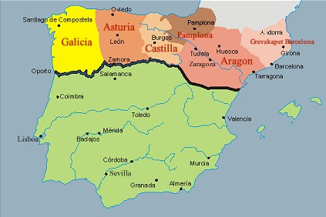
900CE

Slide 19
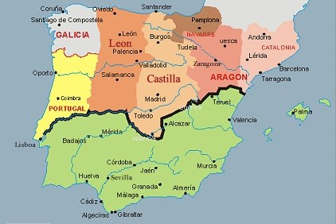
1150CE

Slide 20
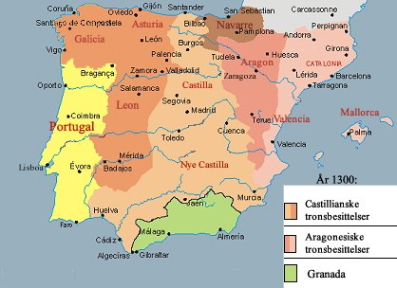
1300Ce

Slide 21
During the re-conquest, the Christens tolerated the Jews in the areas that were under Christen rule.
Then they drove out the Jews.

