Slide 1
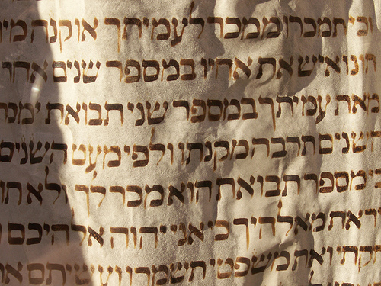
The Torah
Beit Chabad Manaus
5 de Shvat 5772

Slide 2

What is the Torah?
Torah literally means lesson coming from the Hebrew word “HORA’AH”.
TaNach- Torah, Neviim, Ketuvim
Torah- Bereishit, Shemot, Vayikra, Bamidbar, and Devarim.
Neviim - Joshua, Judges, 1st and 2nd Samuel, 1st and 2nd Kings. The Latter Prophets include the "Major" prophets of Isaiah, Jeremiah and Ezekiel and "Minor" prophets or "The Twelve" books of Hosea, Joel, Amos, Obadiah, Jonah, Micah, Nahum, Habakkuk, Zephaniah, Haggai, Zechariah and Malach
Ketuvim- Tehillim , Mishlei, Iyov , Shir Hashirim, Rut, Eichah, Kohelet Esther, Daniel, Ezra, Nechemiah , Divrei Hayamim I & II

Slide 3
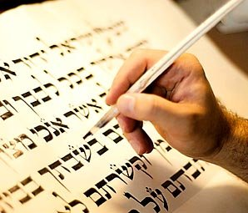
Who wrote the Torah?
There is not title page so it allows for a debate who wrote it.
Torah is written in third person so it is difficult to know who wrote. As opposed to the prophets that it says I said.
Talks about birth and death of Moses.
Moses was the most humble person on the earth.
Repeating sections & similar sections (Ex. Creation, 10 commandments)

Slide 4
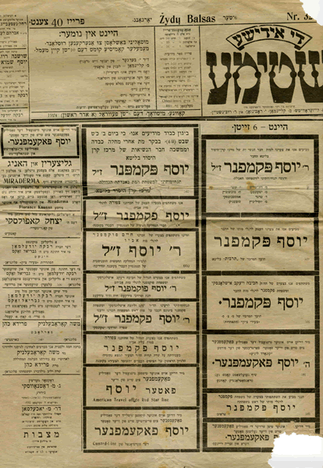
Who wrote the Torah?
“And Moses wrote all the words of G-d.”
Ex. 24:4.
Rashi: Moses wrote from Bereishit until Matan Torah and some laws that were given in Mara. Rest was written by Moses in sections. Or taught orally, and then after 4 years written down.

Slide 5
Who wrote the Torah?
Moses & his Death A) Wrote it with tears – “wrote it until the end.”
B) Yehoshua wrote it.
Same but different sections
Ex. 10 Commandments
Iben ezra -Difference b/w first and second time was that in Shemot he gave it over, but in Devarim he worded in different way so that we would say it to
them.

Slide 6
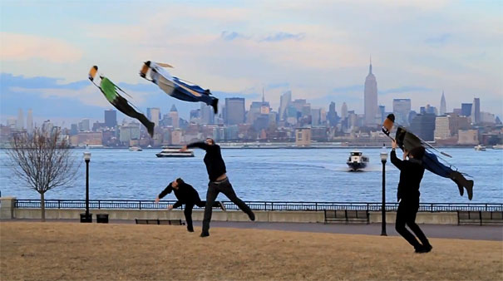
True Torah
Whenever you do something that requires effort or expense you do not evaluate if there will be results, but look at what others have done.
For example:
Flying to New York.

Slide 7
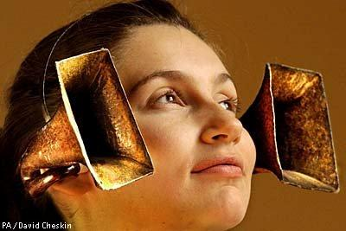
True Torah
History-
I need to rely on the reports of others, as long as they are trustworthy. Even if it is a matter of life and death like a surgery. You want to know about the surgeon, where he learned who did by him. You need to hear more witnesses.

Slide 8

True Torah
In History - Who do you trust?
Most popular opinion.
Matan Torah is a story we have heard for years and all the details have been agreed by all historians including the non-Jewish ones. Even if someone came up with a new version a generation later nobody would believe it.

Slide 9
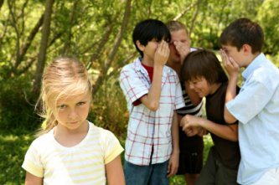
True Torah- Let’s Keep it!
If Torah is so real, why doesn’t everyone keep it, but science proof which are ever changing people belief?
Free Choice – Part of the person’s
power to choose
Now world – We want to win now
, and not later
Reward in future – The Torah
speaks about reward in another world
Pressures of the world – We are 250 amongst 2 million
Minority against the world- Our population is .1 percent
LS 11:257

Slide 10
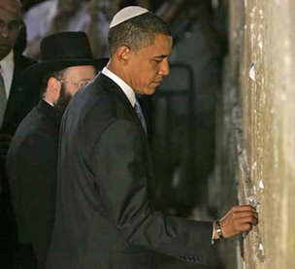
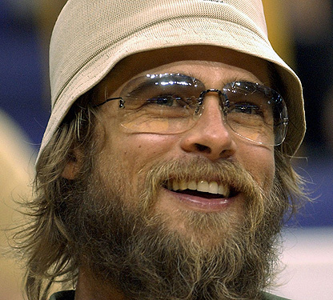
Why be embarrassed to…

Slide 11
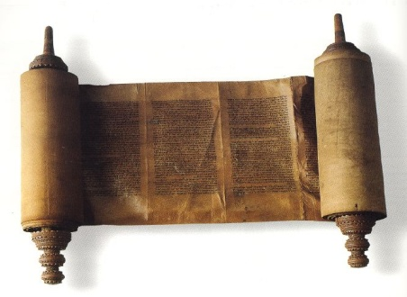
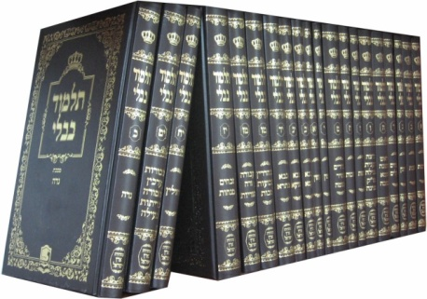
Two Torahs
Oral
Torah
Written Torah
Which one came first?

Slide 12
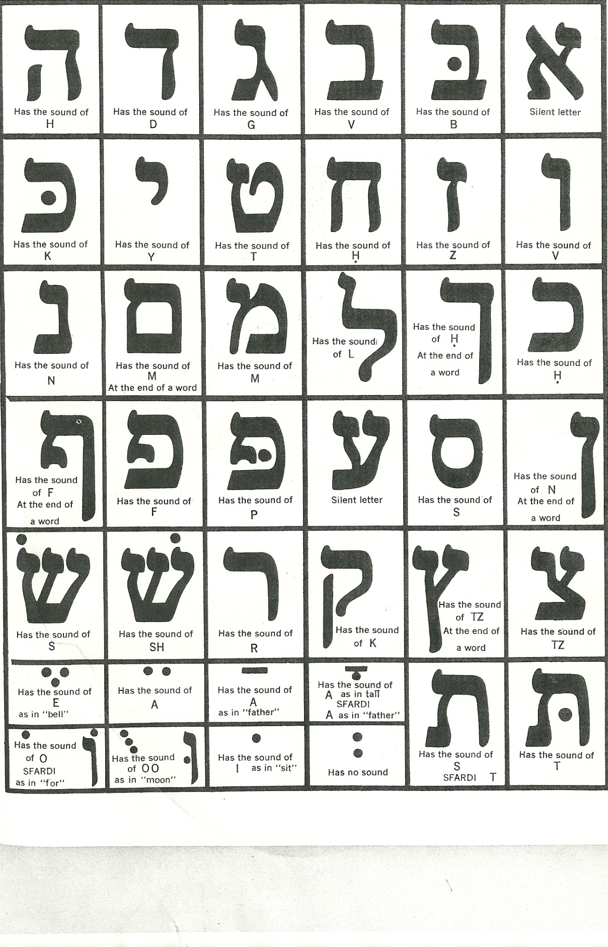

Slide 13
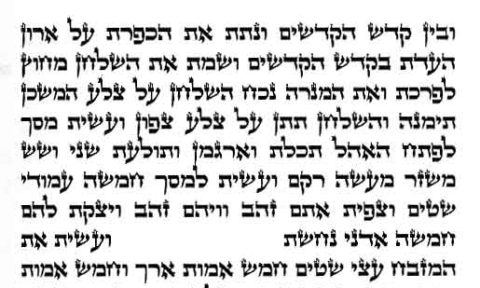
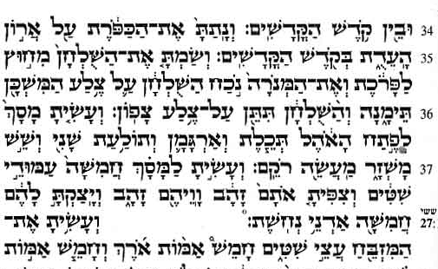
Oral Torah
If no oral tradition then how do we read the Torah, and how do we know our mitzvot?

Slide 14
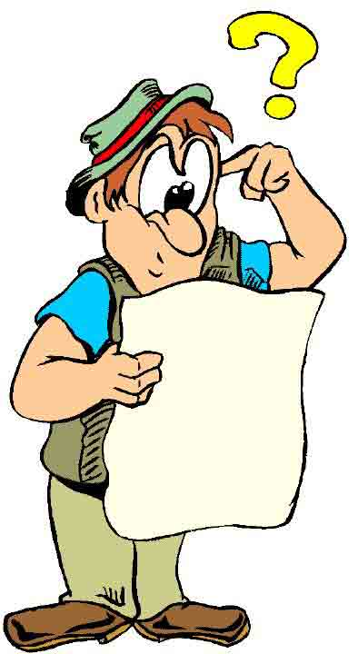
Oral Torah
Shabbat -"zachor ve’shamor" – "lembra e guarda" o Shabat
“Por seis dias deverás trabalhar e cumprir todas tuas tarefas, mas o sétimo dia é Shabat de teu D-us”
Brit Milah- Orlah-
1) orlah of the heart (Deut. 10:16)
2) orlah of the ears (Jer. 6:10)
3) fruit of a tree's first three years orlah (Lev. 19:23).
4) v'ani oral sfataim -- "I whose lips are uncircumcised."
(Ex. 6:12).
5) You shall circumcise the flesh of your Orlah, (Bereishit
17:11)

Slide 15
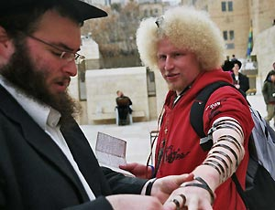
Oral Torah
Tefillin – "Será um sinal em tua mão e uma lembrança entre teus olhos para que toda a Torá esteja em tua boca..."
Shechita - "Abaterás (degolarás) teu gado e rebanho... como Eu te ordenei" (Devarim 12:21).
Notes:
Teacher to student- clarify doubts, make one not interpert Torah on own interpertation.

Slide 16
Torah Two: Mishna
Rabbi Yehudah Hanasi compiled the Mishna, 1700+ years ago (3948).
Rav redigiu a Sifra e o Sifri, que são comentários sobre três dos livros da Torá Escrita: Levítico, Números e Deuteronômio.
O Rabi Chiya escreveu a obra Tosefta que elucida alguns dos conceitos da Mishná.
O Rabi Hoshia e Bar Kapara escreveram Beraitot para explicar as palavras da Mishná.
Rabi Yochanan redigiu o Talmud de Jerusalém, ou Talmud Yerushalmi.

Slide 17
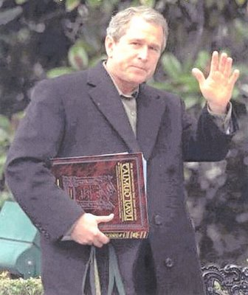
Oral Torah: Talmud
A Guemará foi transmitida oralmente e preservada durante cerca de 300 anos após ter sido escrita a Mishná. Quando surgiu claramente o perigo de que a Guemará fosse esquecida, os dois maiores eruditos da época sobre Torá – Ravina e Rav Ashi – redigiram a Guemará por escrito.
Later generations the spiritual level of the people fell, and they needed to understand the Mishna in depth. These are their discussions.

Slide 18
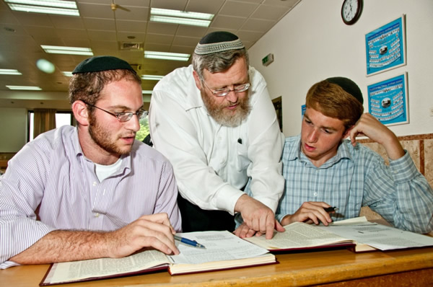
Oral Torah: Talmud
A Torá Oral tinha por objetivo cobrir a infinidade de casos que haveriam de surgir com o decorrer do tempo. É impossível que qualquer código de lei cubra,
explicitamente, qualquer caso
ou situação que surja durante os
milênios.
"Segundo mandado da lei que te
ensinarem e de acordo com o
juízo que te disserem, farás; da
sentença que te anunciarem não
te desviarás nem para a direita nem para a esquerda" (Deut.17:11).

Slide 19
Oral Torah: Halacha
A proxima aula
Bible Codes
Halacha – Created by Man?

Slide 20
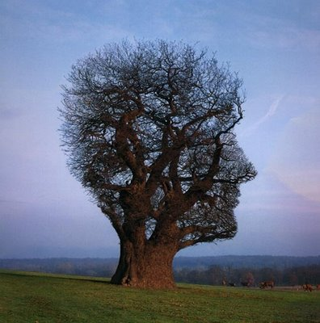
Oral Torah: Halacha
Hayom Yom - 6 Shevat
My father wrote that he heard in the name of the Alter Rebbe that all rabbinic authors until and including the Taz and Shach, composed their works with Ruach Hakodesh, the Divine Spirit.

Slide 21
Oral Torah: Hoje
Daily Blessing – G-d has given us his Torah. We can be prophets.
All the prophet does is catch those words of G-d as they are a little less condensed and crystallized, up in a higher world-less static, more signal. And from there those prophets get an idea of what's coming down--before it actually gets here.
"Every Torah teaching that any conscientious Torah student is destined to extrapolate was already taught to Moses at Mount Sinai" (Midrash Rabbah: Leviticus 22:1; ibid. Eccl. 1:2 and 5:2).
Story of “Tatteh Shik Gelt”
Nenhum sábio ou profeta, muito menos um auto-proclamado Messias, pode modificar ou anular nem a Torá Escrita nem a Oral.

