Slide 1


Rabbi Avrohom’s Year 8
Mt Scopus College

Slide 2

What is the maximum height that a Sukkah can be?
5 meters
18 arm lengths
10 meters
20 arm lengths

Slide 3

Shcach can be:
Anything natural
Natural and unprocessed
Something that is respectful
Anything that grows

Slide 4
Which food types are we obligated to eat in the Sukkah?
all foods
only kosher food
grains and wine
all proteins

Slide 5
The festival of Sukkot commemorates:
The Jews leaving Egypt
Jewish poverty on Israel
The torahs attitude to nature
The clouds that protected the Jewish people in the desert

Slide 6
What is the blessing that is said when we eat in the Sukkah?
Leshev B’sukah
Al Achilat Sukkah
Al Netilat Lulav
Shehechiyanu

Slide 7

The English word for Etrog is:
Lemon
Citron
Grapefruit
Pomegranate

Slide 8
The Lulav is from a:
Date tree
Cedar tree
Apple tree
Pine tree

Slide 9
The guiding rule to the amount of Schach required is
At least some sunlight
More shade than sun
It can rain through
The neighbours cant see through

Slide 10
In the Torah it says that we must dwell in the Sukkah for ________days
6
7
8
9

Slide 11
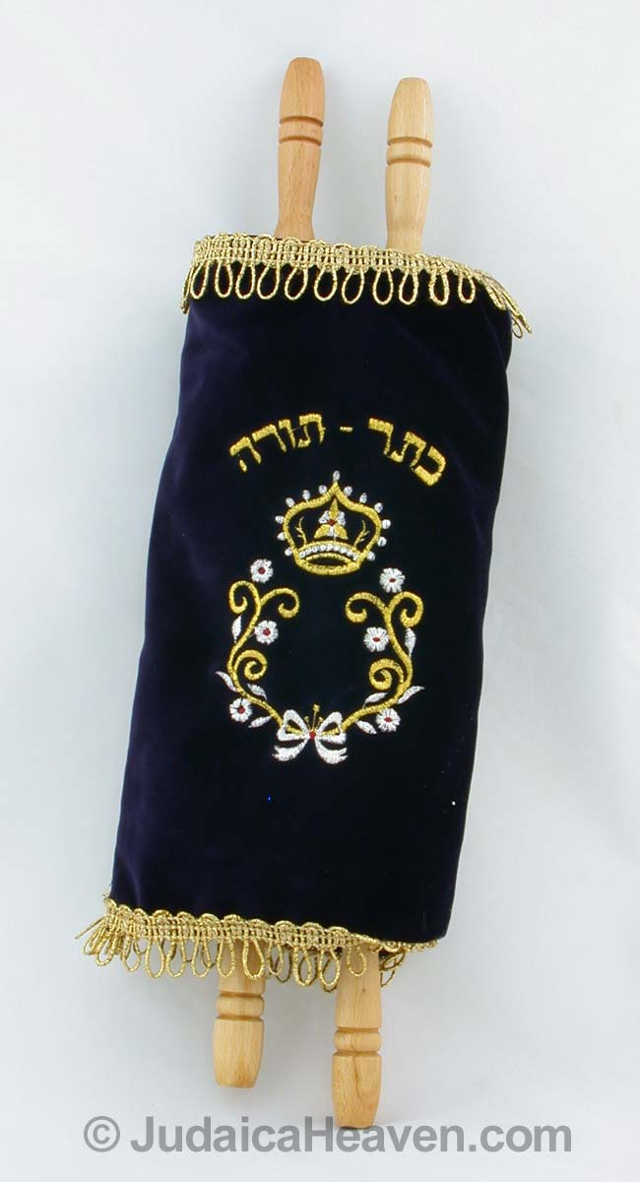
On Simchat Torah we celebrate
the giving of the torah
the end of the torah
the beginning of the torah
the beginning and the end

Slide 12
The Hebrew word for willow is
Hadassim
Aravot
Temarim
Sukkot

Slide 13
The ritual of walking around the Bimah/Torah in Shul with the Lulav is called
Hoshanot
Selichot
Teshuvah
Chag Hasukkot

Slide 14

The spiritual guest that come visit our Sukkot are called
Avot
Ushpizin
Sanhedrin
Beth Din

Slide 15
The Etrog
Smells nice
Tastes nice
Both
Neither

Slide 16

The Willow - Aravot
Both
Neither
Smells nice
Tastes nice

Slide 17

A Jew that is very leaned and does many Mitzvot is compared to the
Etrog
Lulav
Hadassim
Aravot

Slide 18
How do you spell Rabbi Avrm’s name
Avraham
Avram
Avrohom
Avroham

Slide 19
We shake the Lulav in ____ directions
4
5
6
7

Slide 20
The extra prayer said on the Chag & Chol Hamoed is called
Mincha
Neilah
Mussaf
Rosh Chodesh

Slide 22
The Beracha said on the Lulav and Etrog is
Al Netilat Lulav
Al Netilat Yadayim
Al Mitzvat Lulav V’etrog
Leshev B’Sukkah

Slide 23
How many Berachot are said the first time we shake the Lulav
1
2
3
4

Slide 25
We do not shake the Lulav, when Sukkot is on a
Sunday
School holiday
Shabbat
On a Chag

Slide 26
What lesson do we learn from brining together the four kinds with the Lulav?
Only people that are religious count
You don’t have to be religious
All Jews count
You must keep at least four mitzvoth

Slide 27

Who is the Ushpizin on the fourth night?
Moshe
Yaakov
Aaron
Yosef

Slide 28
How many sacrifices were brought in the Bet Hamikdash on the festival of Sukkot?
18
180
70
13

Slide 29
The tree in the garden can be used for Schach if
It’s a palm tree
The leafs are green
It covers the whole Sukkah
It cannot be used at all

Slide 30
Which materials can be used for the walls of the Sukkah?
Only wood
Only natural fabrics
Anything that’s firm
As long it has nothing from a non kosher animal

