Slide 1
Very Deep Convolutional Networks
For Large-Scale Image recognition
Karen Simonyan∗ & Andrew Zisserman
Visual Geometry Group, Department of Engineering Science, University of Oxford
rayjang111@gmail.com
HyunSukJang

Slide 2
CONTENTS
01
02
03
04
Introduction
VGGnet Model Architecture
Train&test method
Evaluation

Slide 3
01
Introduction

Slide 4
01.
Introduction
What is ILSVRC???
Imagenet Large Scale Visual Recognition Challenge
More than 14 million images have been hand-annotated by the project to indicate what objects are pictured
Testbed for a few generations of large-scale image classiﬁcation systems, from high-dimensional shallow feature encodings to deep ConvNets

Slide 5
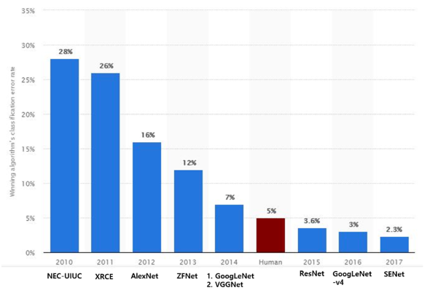
01.
Introduction
Winners of ILSVRC challenge

Slide 6
01.
Introduction
Before 2012 ILSVRC=> feature extraction by hand
Frame of classification
Data Acquisition
Preprocessing
Dimension reduction& optimal feature selection
Classfication
Image
Video
Audio
Noise reduction
Image enhancement
PCA(Principal component Analysis)
LDA(Linear Discriminal Analysis)
LBP(Local Binary Pattern)
Logistic Regression
SVM

Slide 7
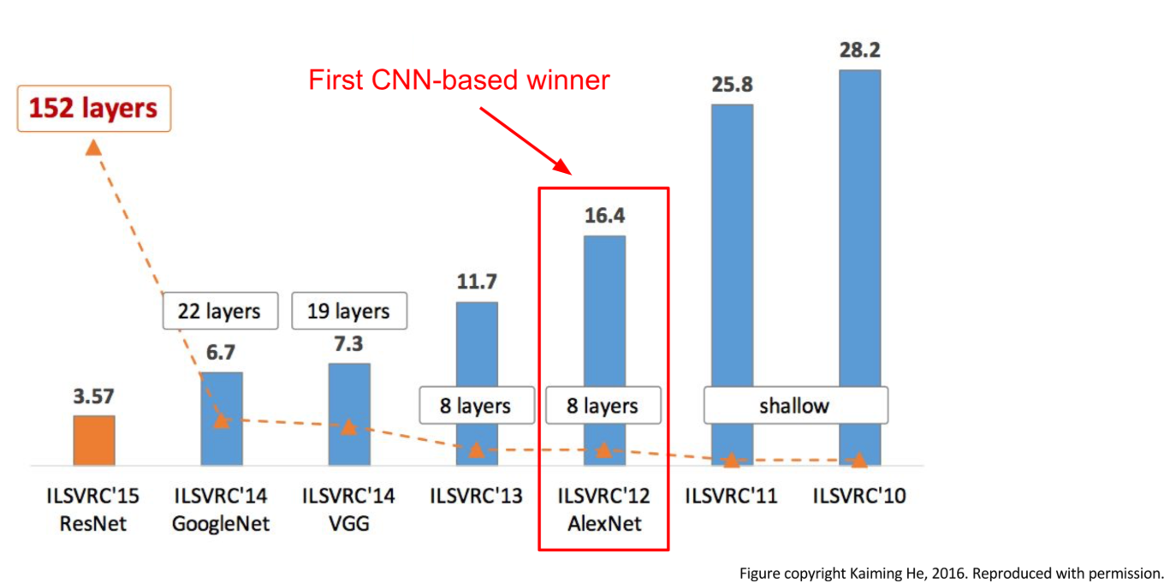
01.
Introduction
After ILSVRC 2012
To train deep layers and many parameters=> data augmentation, regulation

Slide 8
02
Vggnet Model architecture

Slide 9
02.
Model Architecture
Main Disussion
What if we simply increase the depth of Nets?
We address another important aspect of ConvNet architecture design – its depth. To this end, we ﬁx other parameters of the architecture, and steadily increase the depth of the network by adding more convolutional layers, which is feasible due to the use of very small (3 × 3) convolution ﬁlters in all layers.

Slide 10
02.
Model Architecture
what have we gained by using, for instance, a stack of three 3×3 conv. layers instead of a single 7×7 layer?
First, we incorporate three non-linear rectiﬁcation layers instead of a single one, which makes the decision function more discriminative.
Second, we decrease the number of parameters

Slide 11
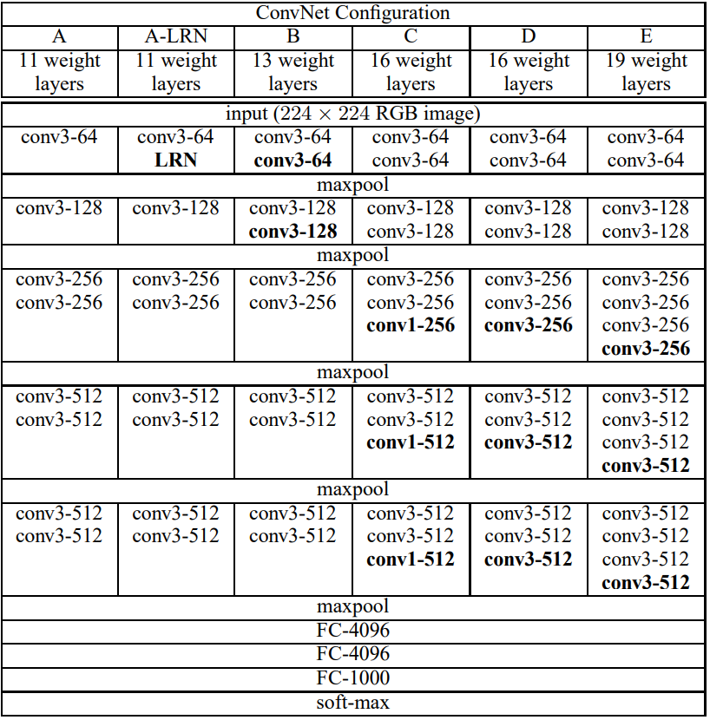
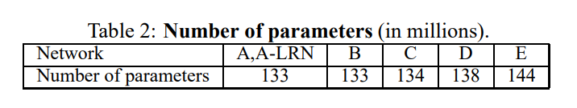
02.
Model Architecture
A vs A-LRN:
Local Response Normalization
B vs C:
Use of 1*1 conv layer
To add Nonlinearity

Slide 12
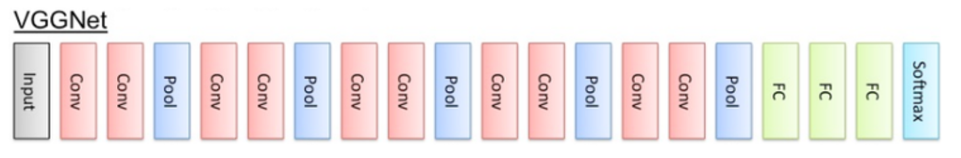
Model B: Number of parameters
(3*3*3)*64+(3*3*64)*64+(3*3*64)*128+(3*3*128)*128+(3*3*128)*256+(3*3*256)*256+(3*3*256)*512+(3*3*256)*512+(3*3*512)*512+(3*3*512)*512+(7*7*512*4096)+4096*4096+4096*1000=133m

Slide 13
03training&test method

Slide 14
03.
training&test method
ILSVRC-2012 has 1000images for each 1000classes
=>not enough image (overfitting)
Need Data Augmentation

Slide 15
03.
training&test method
Training Scale: S
Single Scale=> S=256, 384 fixed
Cropped 224*224 image from each fixed size image
Multi Scale=>Scale jittering
After training with S=384 fixed image,
Select S from Smin=256 Smax=512 => do fine tuning
PCA Color Augmentation
is designed to shift those values based on which values are the most present in the image.

Slide 16
03.
training&test method
Test Scale: Q
Convert image size to Q
Single test scale=> use only one Q
Multi test scale=> use multiple Qs
If test Scale S is fixed to single scale
Q is {S-32,S,S+32} since too much scale difference from trainset can lead worse performance

Slide 17
04 evaluation

Slide 18
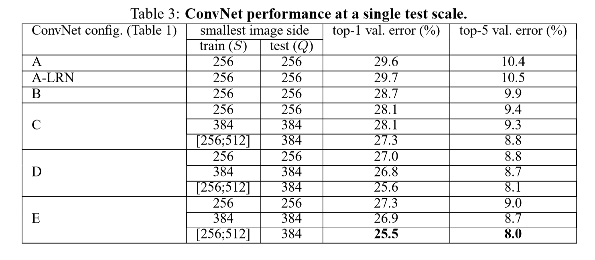
04.
evaluation
Single test scale

Slide 19
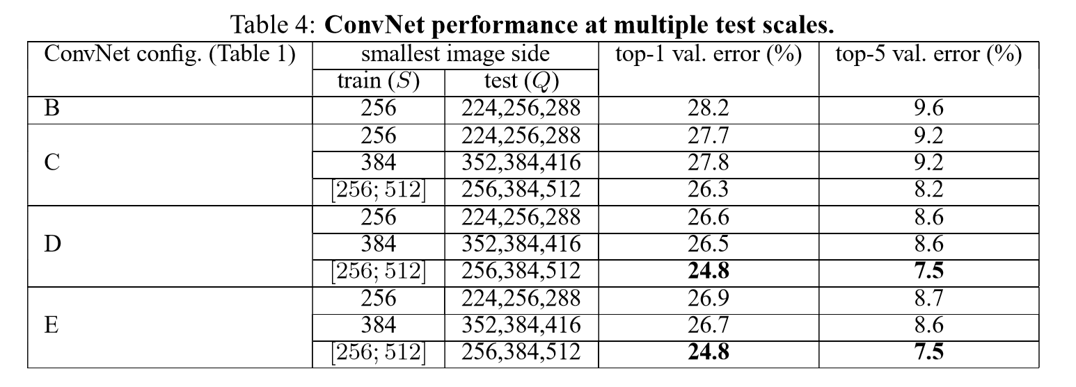
04.
evaluation
Multiple test scale

Slide 20
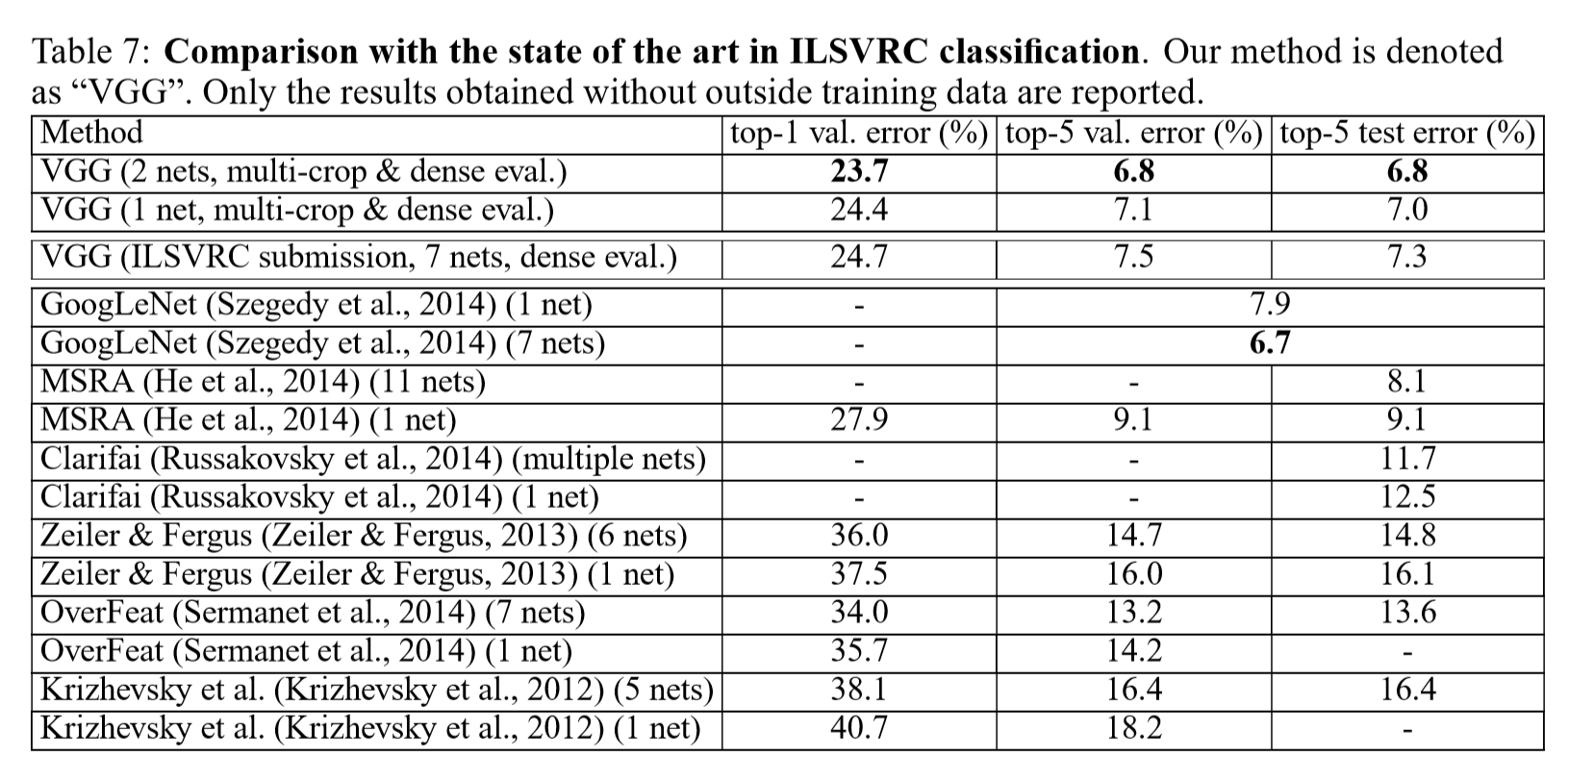
04.
evaluation
Comparison to other models

Slide 21
Thank you

