Slide 1

Fully Convolutional Networks for Semantic Segmentation (FCN)
Jonahan Long Evan Shelhamer Trevor Darrell
UC Berkeley
Sunwoo Kim
swkim@dongguk.edu

Slide 2
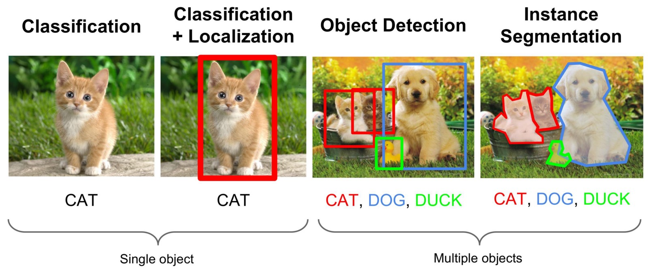
Computer Vision Task
Sunwoo Kim
May 03, 2019

Slide 3
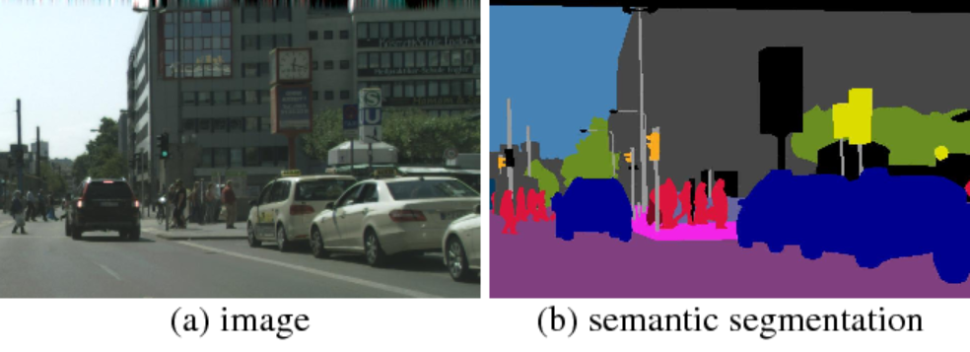
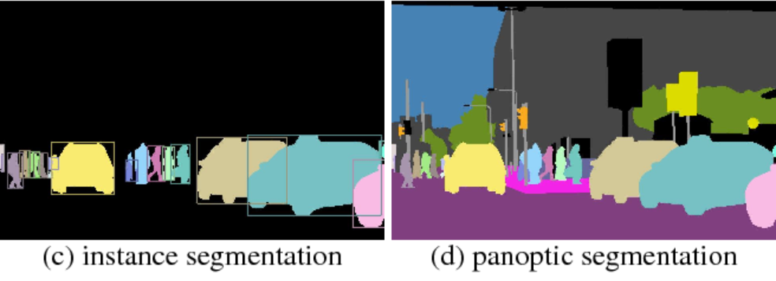
Kinds of the segmentation
Sunwoo Kim
May 03, 2019
Notes:
https://mc.ai/panoptic-segmentation/

Slide 4
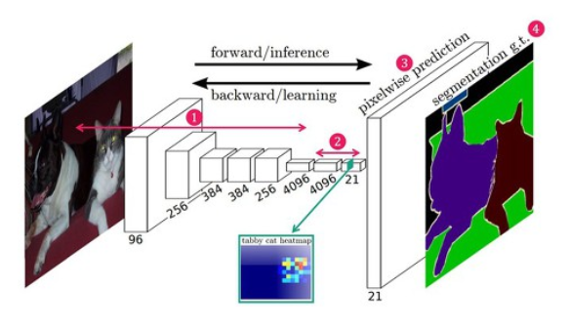
Overview structure of FCN
Sunwoo Kim
May 03, 2019

Slide 5
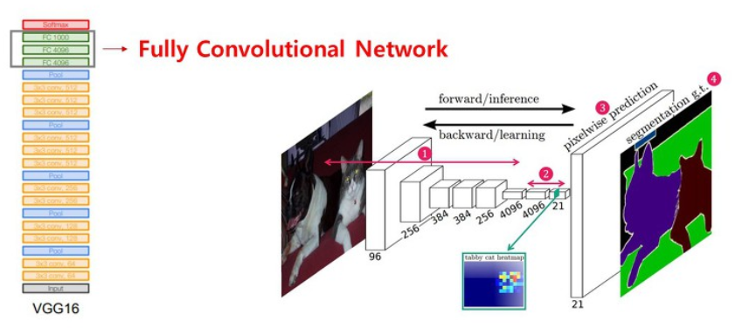
Feature Extraction – VGG 16
Sunwoo Kim
May 03, 2019

Slide 6
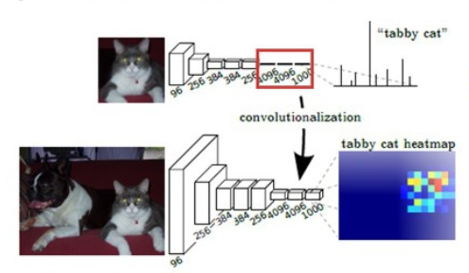
What is the problem of FC layer in Segmentation?
Sunwoo Kim
May 03, 2019

Slide 7
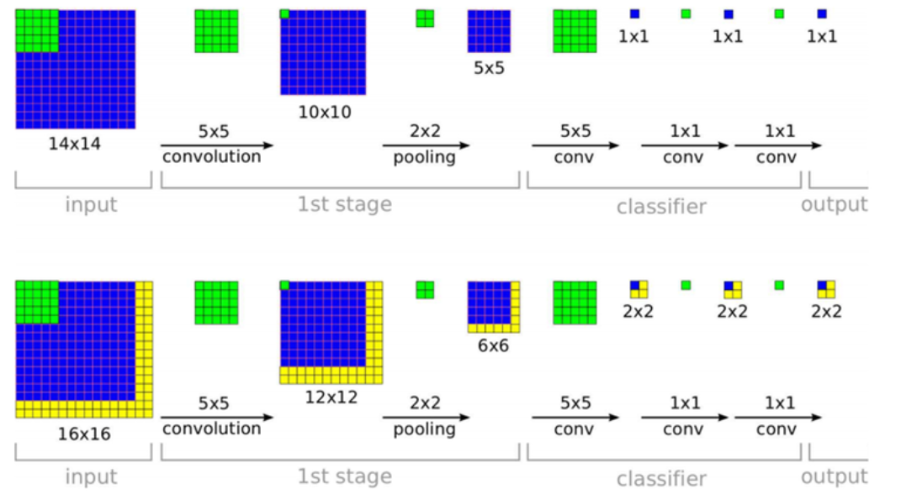
The answer is ‘ 1x1 Convolution ’
Sunwoo Kim
May 03, 2019

Slide 8
How can we upsampling?
Sunwoo Kim
May 03, 2019

Slide 9
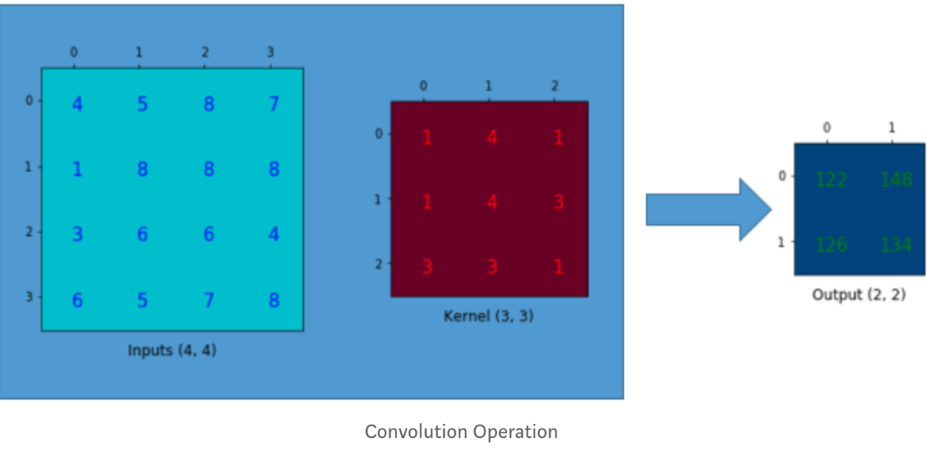
Step1 – see original convolution
Sunwoo Kim
May 03, 2019

Slide 10
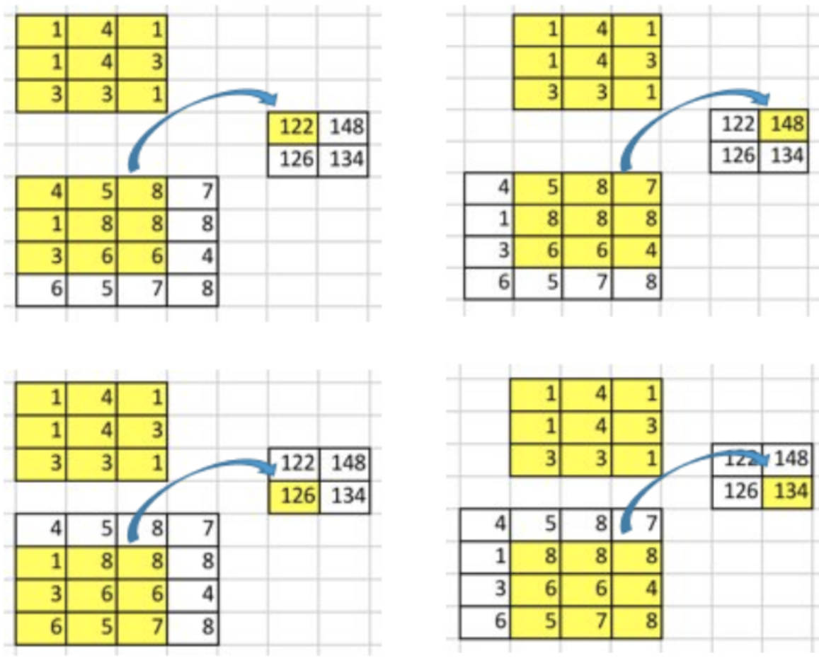
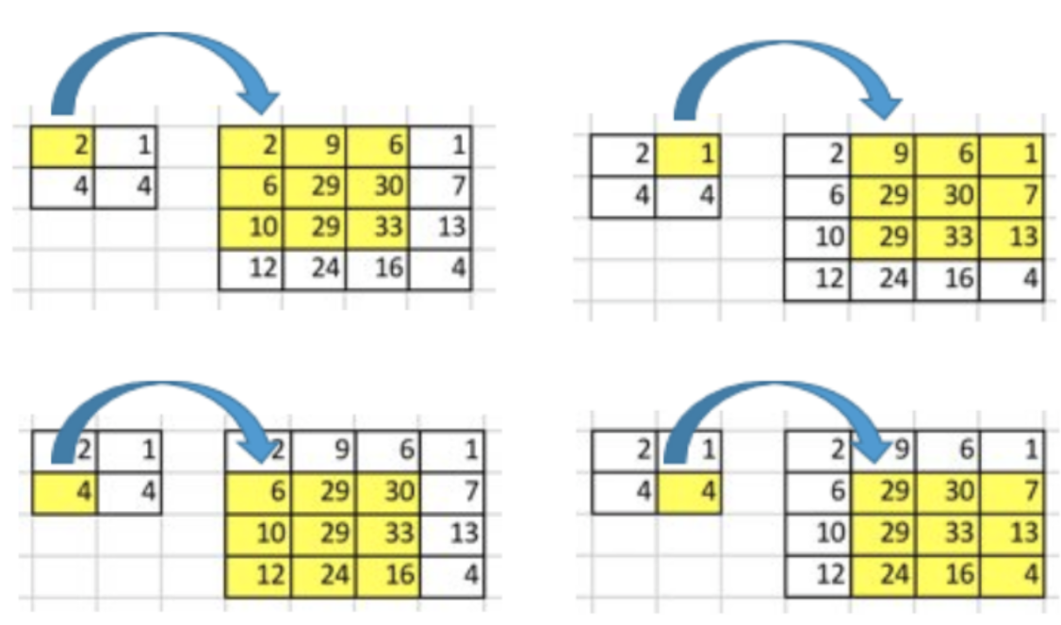
Step2 – original convolution vs up convolution
Sunwoo Kim
May 03, 2019

Slide 11
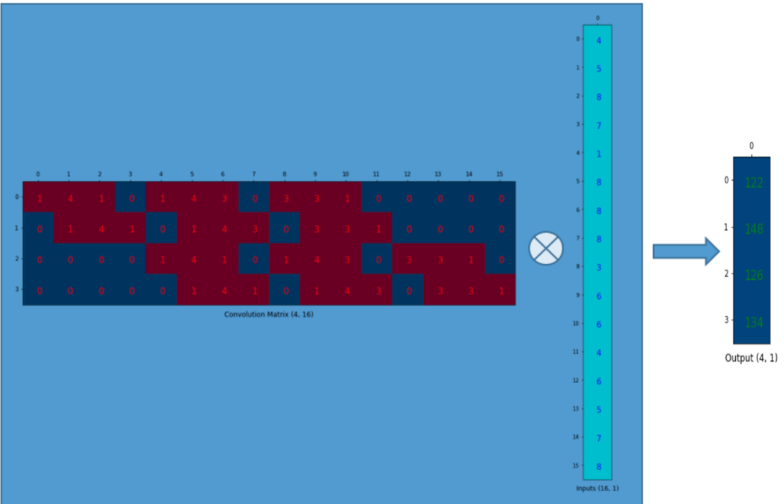
Step3 – dot( Flatten(K) , Flatten(F) )
Sunwoo Kim
May 03, 2019

Slide 12
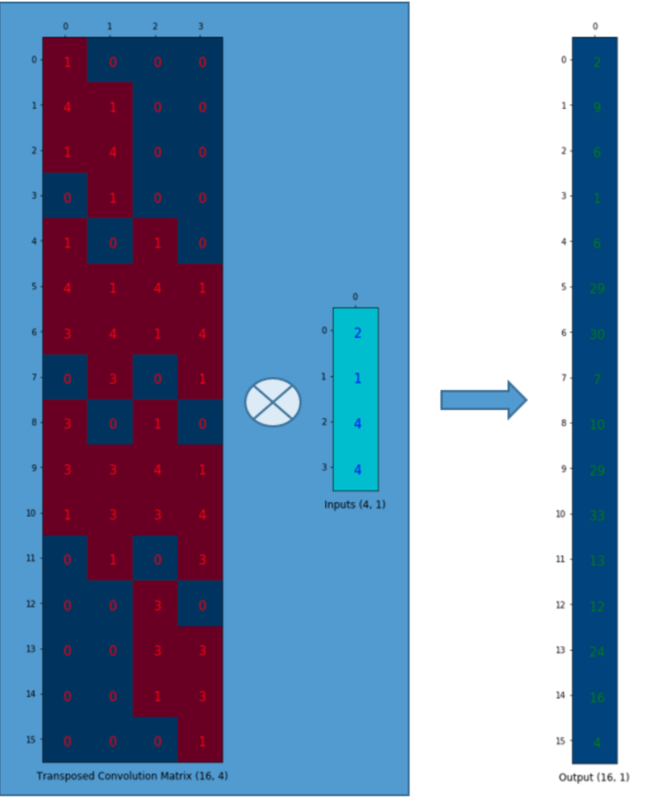
Step4 – dot ( Flatten(KT) , Flatten(Out) )
Sunwoo Kim
May 03, 2019

Slide 13
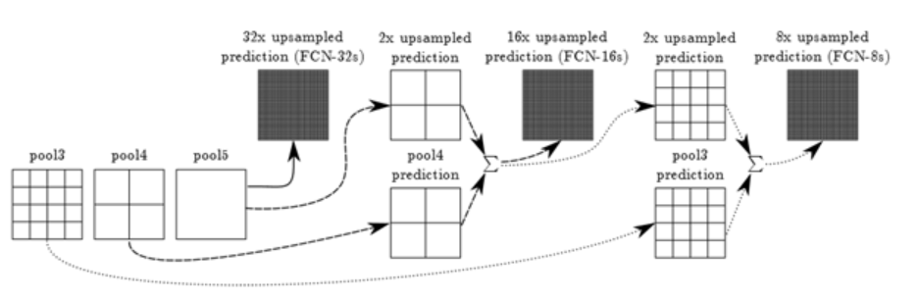
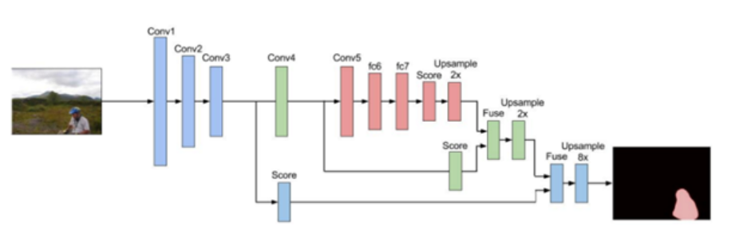
See skip connection
Sunwoo Kim
May 03, 2019

Slide 14
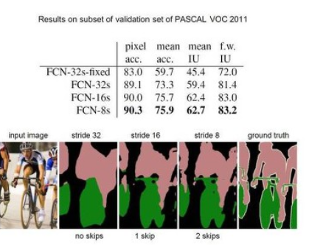
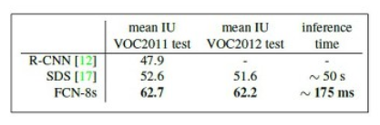
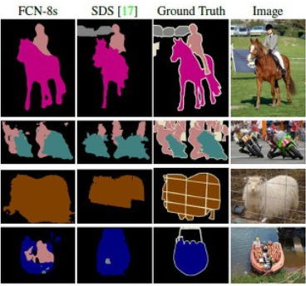
Results
Sunwoo Kim
May 03, 2019

Slide 15
Thanks

