Slide 1
Mutual Information Neural Estimation
KANG SU HYEON
shqk023@gmail.com

Slide 2
Content
Introduction
Background
The Mutual Information Neural Estimator
Empirical Comparisons
Applications
Conclusion

Slide 3

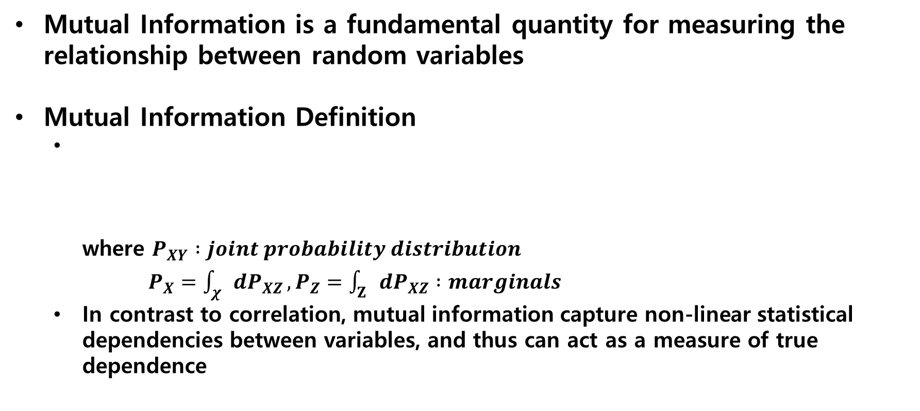
Introduction
Mutual Information is a fundamental quantity for measuring the relationship between random variables
Mutual Information Definition
where $P_{XY} :joint probability distribution$ $P_{X}=\int_{χ}{dP_{XZ}}, P_{Z}=\int_{Ζ}{dP_{XZ}} :marginals$
In contrast to correlation, mutual information capture non-linear statistical dependencies between variables, and thus can act as a measure of true dependence

Slide 4
Introduction
Mutual Information has historically been difficult to compute
Exact computation is only tractable for discrete variables, or for a limited family of problems where the probability distribution
For more generalmis is not possible
Common approaches are non-parametric or rely on approximate gaussianity of data distribution
Unfortunately, these estimators typically do no scale well with sample size or dimension

Slide 5
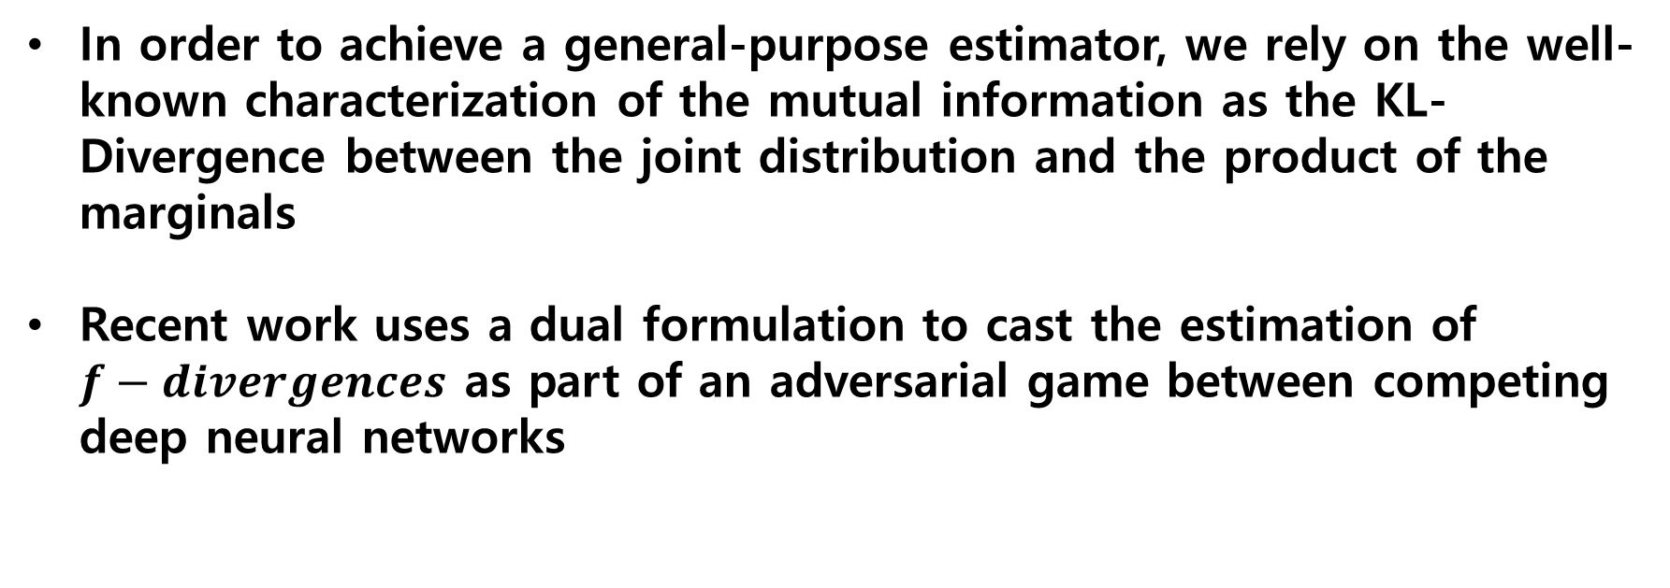
Introduction
In order to achieve a general-purpose estimator, we rely on the well-known characterization of the mutual information as the KL-Divergence between the joint distribution and the product of the marginals
Recent work uses a dual formulation to cast the estimation of $f−divergences$ as part of an adversarial game between competing deep neural networks

Slide 6
Introduction
In this paper we demonstrate that exploiting dual optimization to estimate divergences goes beyond the minimax objective as formalized in GANs
We leverage this strategy to offer a general-purpose parametric neural estimator of mutual information based on dual representations of the KL-divergence

Slide 7
Introduction
The contributions of this paper
We introduce the Mutual Information Neural Estimator(MINE), which is scalable, flexible, and completely trainable via back-prop
We show that the utility of this estimator transcends the minimax objective as formalized in GANs
We apply MINE to palliate mode-dropping in GANs and to improve reconstructions and inference in Adversarially Learned inference

Slide 8

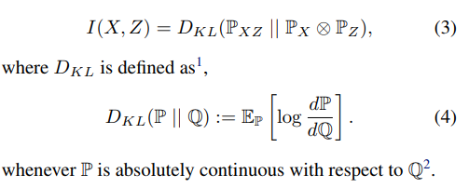
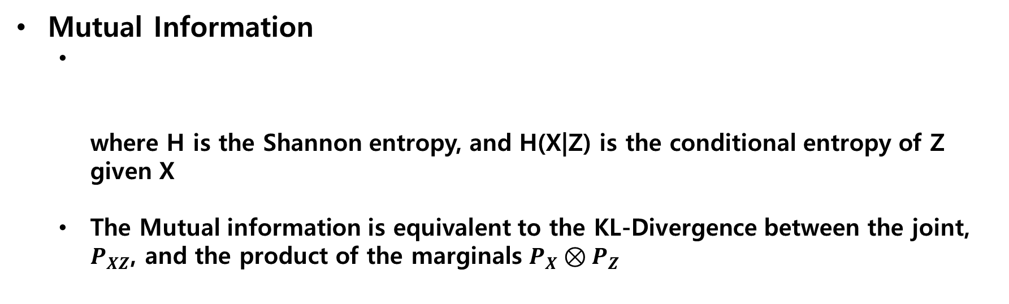
Background
Mutual Information
where H is the Shannon entropy, and H(X|Z) is the conditional entropy of Z given X
The Mutual information is equivalent to the KL-Divergence between the joint, $P_{XZ}$, and the product of the marginals $P_{X}⊗P_{Z}$

Slide 9
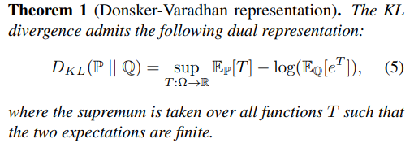
Background
Dual representations of the KL-Divergence
A key technical ingredient of MINE are dual representations of the KL-Divergence
The Donsker-Varadhan representation

Slide 10
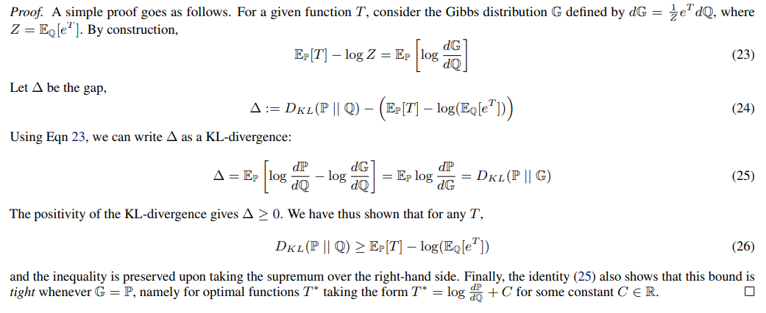
Background
Dual representations of the KL-Divergence
The Donsker-Varadhan representation

Slide 11
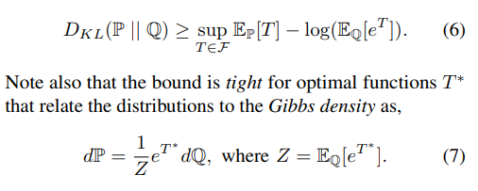
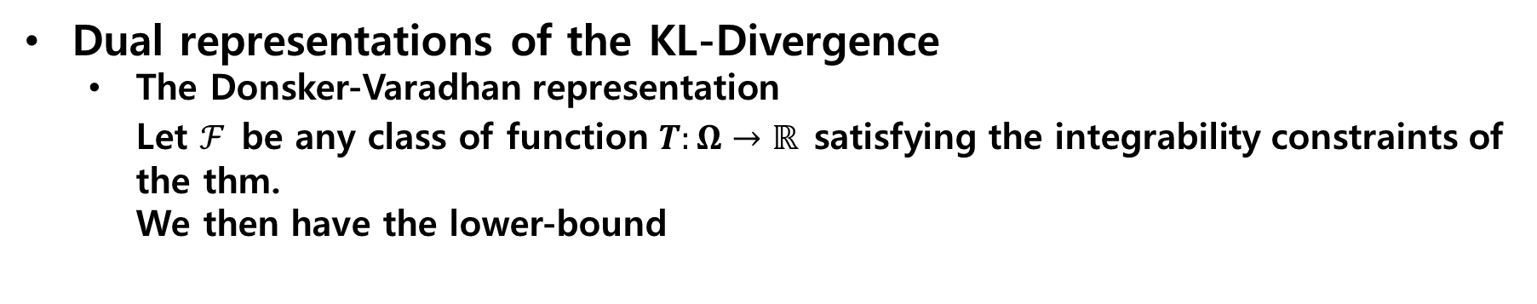
Background
Dual representations of the KL-Divergence
The Donsker-Varadhan representation Let $ℱ$ be any class of function $T:Ω→ℝ$ satisfying the integrability constraints of the thm. We then have the lower-bound

Slide 12
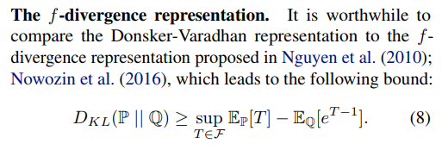
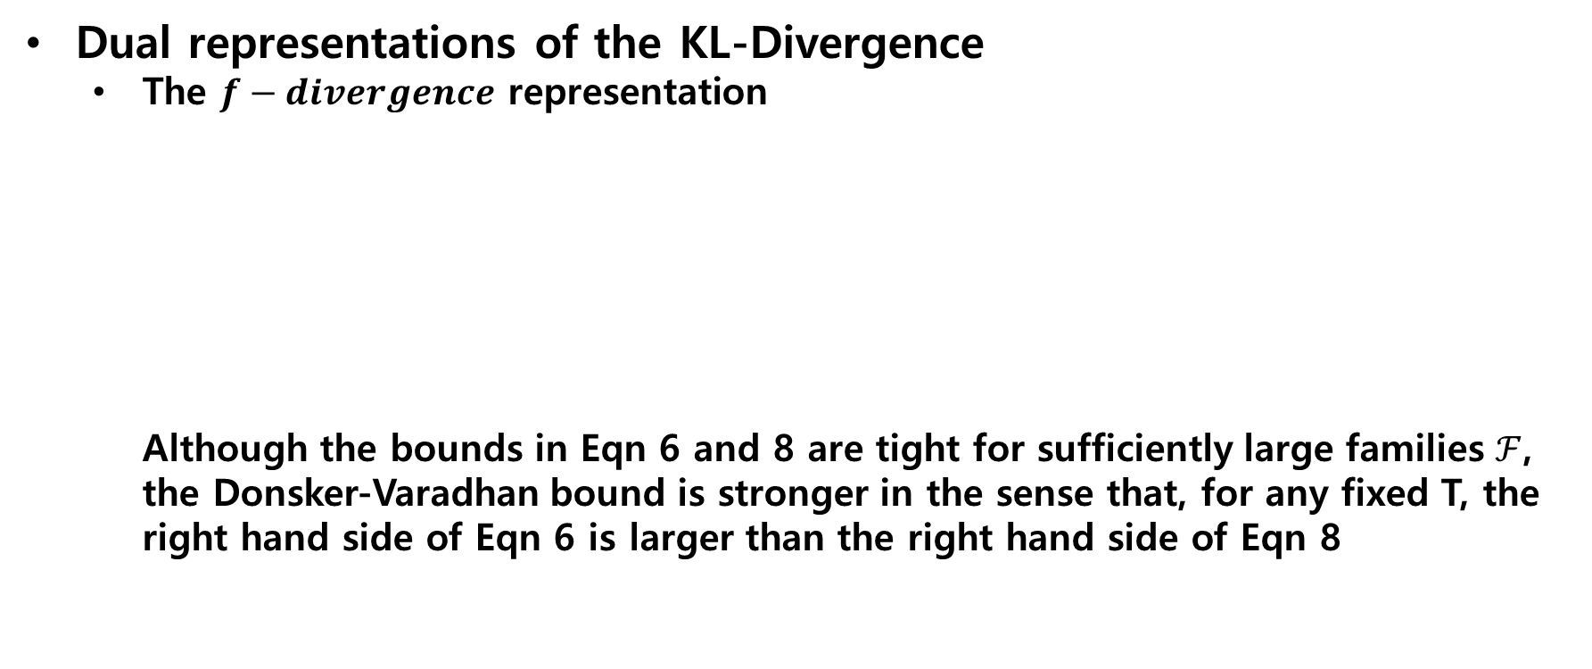
Background
Dual representations of the KL-Divergence
The $f−divergence$ representation Although the bounds in Eqn 6 and 8 are tight for sufficiently large families $ℱ$, the Donsker-Varadhan bound is stronger in the sense that, for any fixed T, the right hand side of Eqn 6 is larger than the right hand side of Eqn 8

Slide 13
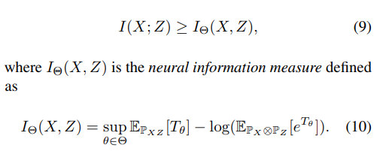
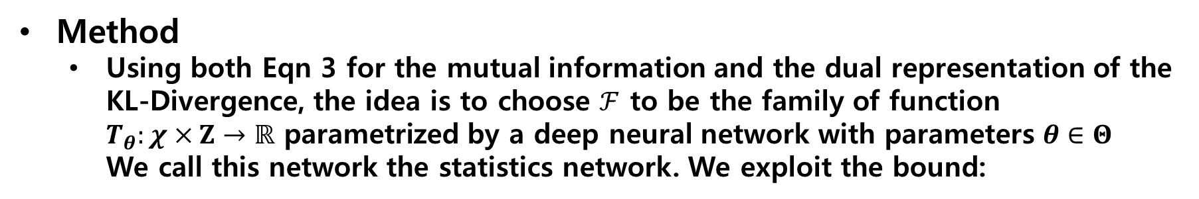
The Mutual Information Neural Estimator
Method
Using both Eqn 3 for the mutual information and the dual representation of the KL-Divergence, the idea is to choose $ℱ$ to be the family of function $T_{θ}:χ×Ζ→ℝ$ parametrized by a deep neural network with parameters $θ∈Θ$ We call this network the statistics network. We exploit the bound:

Slide 14
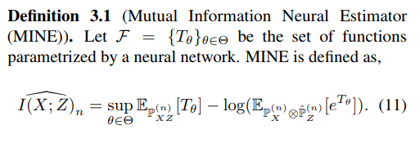
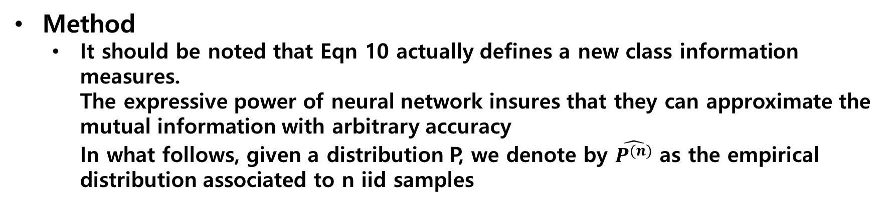
The Mutual Information Neural Estimator
Method
It should be noted that Eqn 10 actually defines a new class information measures. The expressive power of neural network insures that they can approximate the mutual information with arbitrary accuracy In what follows, given a distribution P, we denote by $\hat{P^{(n)}}$ as the empirical distribution associated to n iid samples

Slide 15
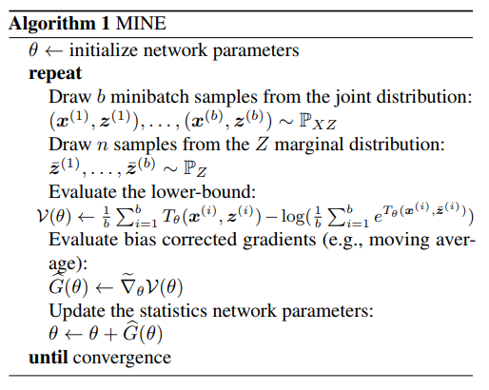
The Mutual Information Neural Estimator
Method
Details on the implementation of MINE are provided in Algorithm 1. An analogous definition and algorithm also hold for the f-divergence formulation in Eqn 8, which we refer to as MINE-f. Since Eqn 8 lower-bounded Eqn 6, it generally leads to a looser estimator of the mutual information, and numerical comparisons of MINE with MINE-f can be found in later

Slide 16
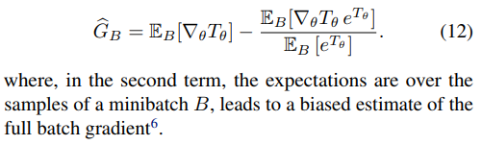
The Mutual Information Neural Estimator
Correcting the bias from the stochastic gradients
A naive application of stochastic gradient estimation leads to the gradient estimate
Fortunately, the bias can be reduced by replacing the estimate in the denominator by an exponential moving average

Slide 17
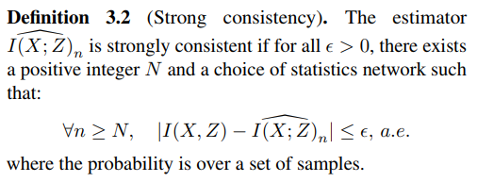

The Mutual Information Neural Estimator
Theoretical properties
Consistency In a nutshell, the question of consistency is divided into two problems
An approximation problem related to the size of family, $ℱ$
An estimation problem related to the use of empirical measures

Slide 18
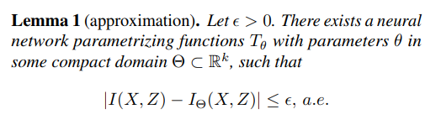

The Mutual Information Neural Estimator
Theoretical properties
Consistency The first lemma states that the neural information measures $I_{θ}\left(X,Z\right)$, defined in Eqn 10, can approximate the mutual information with arbitrary accuracy

Slide 19
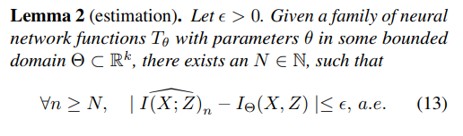

The Mutual Information Neural Estimator
Theoretical properties
Consistency The second lemma states that the almost sure convergence of MINE to a neural information measure as the number of samples goes to infinity
Combining the two lemmas with the triangular inequality, we have

Slide 20
The Mutual Information Neural Estimator
Theoretical properties
Consistency The second lemma states that the almost sure convergence of MINE to a neural information measure as the number of samples goes to infinity
Combining the two lemmas with the triangular inequality, we have

Slide 21

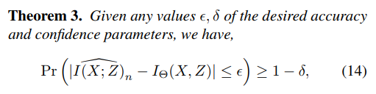
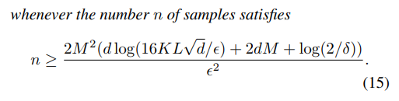
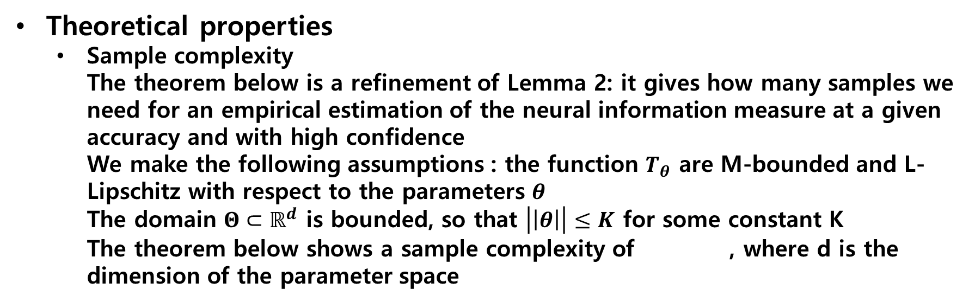
The Mutual Information Neural Estimator
Theoretical properties
Sample complexity The theorem below is a refinement of Lemma 2: it gives how many samples we need for an empirical estimation of the neural information measure at a given accuracy and with high confidence We make the following assumptions : the function $T_{θ}$ are M-bounded and L-Lipschitz with respect to the parameters $θ$ The domain $Θ⊂ℝ^{d}$ is bounded, so that $\left|\left|θ\right|\right|≤K$ for some constant K The theorem below shows a sample complexity of , where d is the dimension of the parameter space

Slide 22
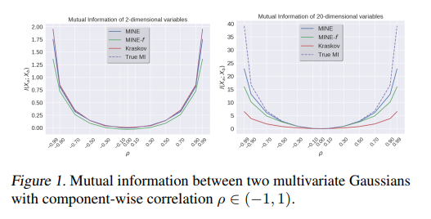
Empirical comparisons
Comparing MINE to non-parametric estimation
We compare MINE and MINE-f, KNN based non-parametric estimator found in Kraskov et al(2004)

Slide 23
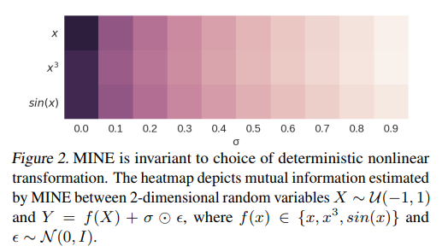

Empirical comparisons
Capturing non-linear dependencies
An important property of mutual information between random variables with relationship $Y=f\left(X\right)+σ⨀ε$, where $f$ is a deterministic non-linear transformation and $ε$ is random noise, is that it is invariant to the deterministic nonlinear transformation, but should only depend on the amount of noise, $σ⨀ε$. This important property, that guarantees the quantification dependence without bias for the relationship, is called equitability

Slide 24
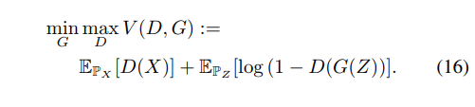

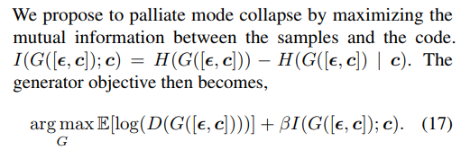
Applications
Maximizing mutual information to improve GANs
Computation with MINE

Slide 25
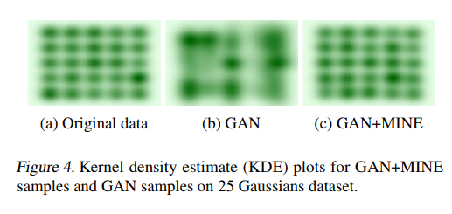
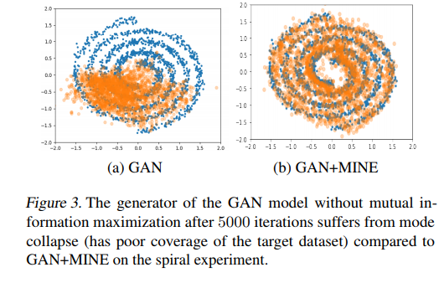
Applications
Experiments: Spiral, 25-Gaussians datasets

Slide 26
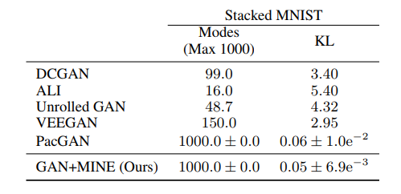
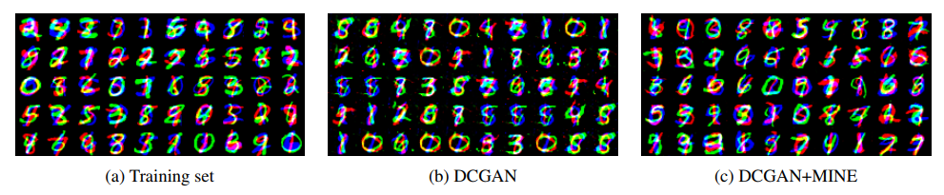
Applications
Experiments: Stacked MNIST

Slide 27
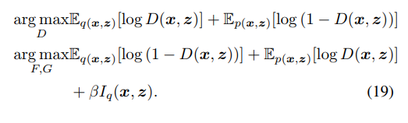
Applications
Maximizing mutual information to improve inference in bi-directional adversarial models
Computation with MINE

Slide 28
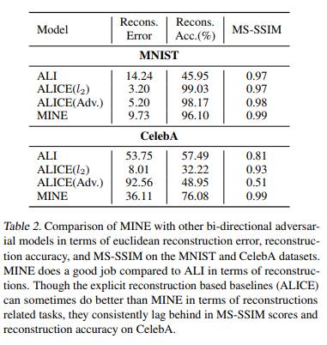
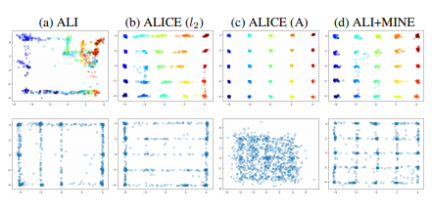
Applications
Experiment : ALI+MINE

Slide 29
Conclusion
We proposed a mutual information estimator, which we called the mutual information neural estimator(MINE), that is scalable in dimension and sample-size
We demonstrated the efficiency of this estimator by applying it in a number of settings
A term of mutual information can be introduced alleviate mode-dropping issue in GANs
Mutual information can also be used to improve inference and reconstructions in ALI
We showed that our estimator allows for tractable application of Information bottleneck methods

Slide 30
THANK YOU
Q & A

