Slide 1

Jenkins and CI
03/10/2015
Notes:
Some background on our CI oriented platform and some ‘plugs’ for Jenkins – our selected CI tool of choice.

Slide 2

Continuous Integration
Monitor build status
Process build meta-data
Invoke Rally execution
Aggregate post-processing
Send CI notifications
Collect and post trend data
Implementing many conventional CI tool capabilities “out-of-the-box”
Notes:
CI encompasses a broad scope of build and agile-related tasks. Choosing Jenkins, based from a well established and supported community, enables early implementation of many of tasks required to build an effective agile/scrum environment. (Conventional uses)}

Slide 3
Jenkins/Rally Integration
Plug-In specs, etc.
View Jenkins job status by project
Easily link to Jenkins build page
Tools for building custom dashboards
Associate build related issues with stories
Notes:
Our Rally DB offers direct plug-in capability with Jenkins services – making integration fast and simple…
- immediately adds mature, multi generation app within an app.
- provides framework to develop familiar correlations between legacy data with real time CI feedback

Slide 4
Jenkins Extended
Operations sync’d with Build meta-data
Build ID conventions
CM branch info
Provides support for build/workspace hierarchy
Build ID environment tracking variables
Notes:
There are some 400+ plug-in’s available to Jenkins – with multiple variations available from every well known life cycle tool. But furthermore, Jenkins provides a flexible, custom job stack that can be easily exposed to external events, has built in prioritization and dynamic windowing job sequencing controls. At its lowest form, Jenkins manages at least ten internal, data persistent environment variables related to project and build id tracking – these can be used for maintaining manually-scripted binding of tracking data between dependent and remote jobs.

Slide 5
GitHub Depo
Rally DB
Monitor CM Notifications
Rally
Test Execution
Engine
Submit Test Requests
Jenkins Pipeline
Submit Build Requests
Build Platform
Notes:
There are some 400+ plug-in’s available to Jenkins – with multiple variations available from every well known life cycle tool. But furthermore, Jenkins provides a flexible, custom job stack that can be easily exposed to external events, has built in prioritization and dynamic windowing job sequencing controls. At its lowest form, Jenkins manages at least ten internal, data persistent environment variables related to project and build id tracking – these can be used for maintaining manually-scripted binding of tracking data between dependent and remote jobs.

Slide 6
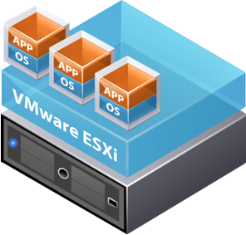
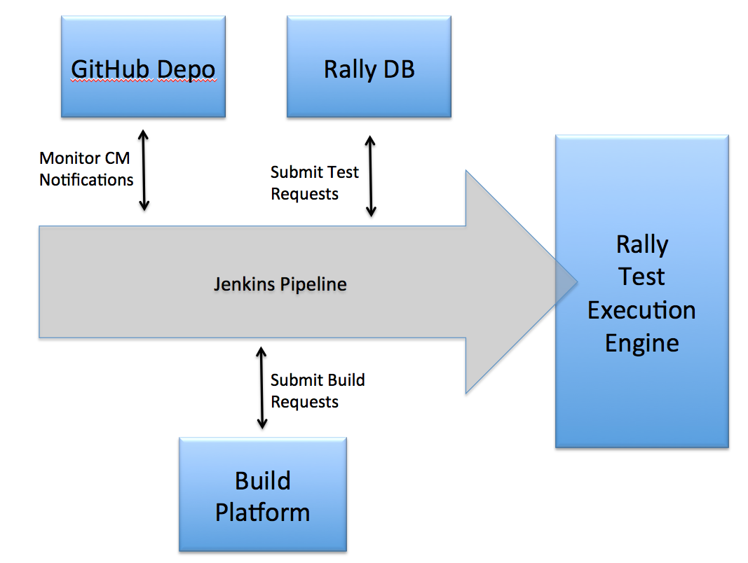
CM Branches/Product Versions
Deployment Library
Jenkins Pipeline
Notes:
There are some 400+ plug-in’s available to Jenkins – with multiple variations available from every well known life cycle tool. But furthermore, Jenkins provides a flexible, custom job stack that can be easily exposed to external events, has built in prioritization and dynamic windowing job sequencing controls. At its lowest form, Jenkins manages at least ten internal, data persistent environment variables related to project and build id tracking – these can be used for maintaining manually-scripted binding of tracking data between dependent and remote jobs.

Slide 7
Jenkins Extended
JENKINS Build-Related ENVIRONMENT VARIABLES
internally managed, persistent, etc
$BUILD_NUMBER: 32
$BUILD_ID: 2012-10-05_18-57-17
$JOB_NAME: PollJenkinsMaster
$BUILD_TAG: jenkins-PollJenkinsMaster-32
$EXECUTOR_NUMBER: 0
$NODE_NAME: master
$NODE_LABELS: master
$WORKSPACE: /Users/Shared/Jenkins/Home/jobs/PollJenkinsMaster/workspace
$JENKINS_HOME: /Users/Shared/Jenkins/Home
$JENKINS_URL: http://localhost:8080/
$BUILD_URL: http://localhost:8080/job/PollJenkinsMaster/32/
$JOB_URL: http://localhost:8080/job/PollJenkinsMaster/
Notes:
A list of Jenkins internal environment variables – related to project and build id tracking.

