Slide 1
Q&A Tool in Retail Industry
Presented by :
Raykar Shital Sanjay

Slide 2
Introduction
It is a Generative AI based application developed for answering questions related to T-shirt retail data.My project uses a MySQL database that contains information such as brand, color, size, price, stock quantity and discounts.Normally, to get this information from the database, a user needs to write SQL queries. In my project, the user does not need to write SQL manually. The user can simply ask a question in natural language.The main purpose of my project is to make it easier for users to get retail database information without writing SQL queries manually.

Slide 3
Problem Statement
“The main problem is that employees who do not know SQL may find it difficult to access database information. Therefore, my project allows them to ask questions in natural language and get the required T-shirt data without writing SQL queries manually.”

Slide 4
Technologies Used
Python – Application development and backend logic
MySQL – T-shirt retail data storage and SQL query execution
Ollama – Running and connecting the local LLM
Llama 3.2 – Understanding user questions and generating SQL queries
Streamlit – Building the interactive web interface and displaying results

Slide 5
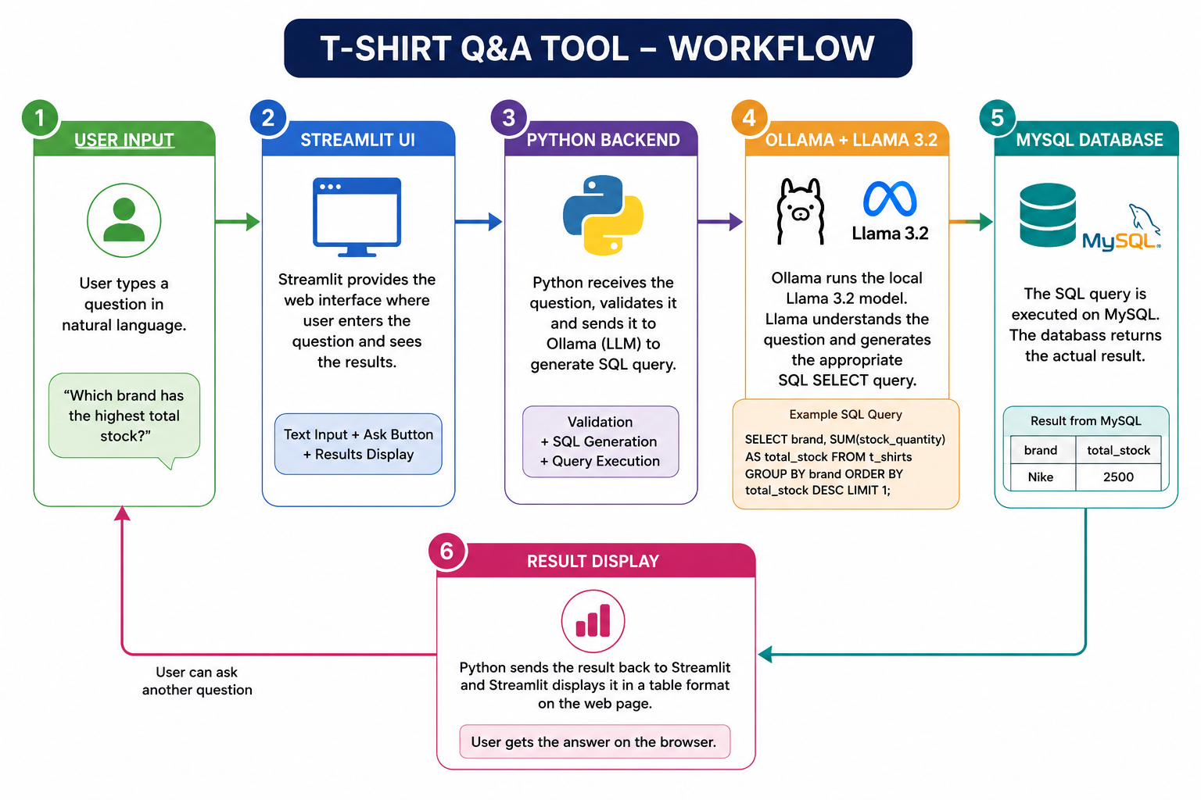
Project Workflow

Slide 6
Future Scope
In the future, this project can be improved by adding RAG for better information retrieval, support for multiple databases, conversational chat history, advanced data visualization, voice-based queries, and multiple LLM models.These improvements will make the system more flexible, user-friendly, and useful for real-world retail data analysis

Slide 7
Conclusion
The Retail Q&A Tool allows users to access T-shirt database information using natural language. It reduces the need for manual SQL queries and makes database access easier for non-SQL users.

