Slide 1
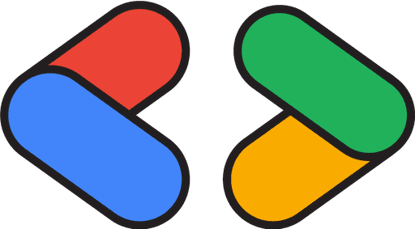
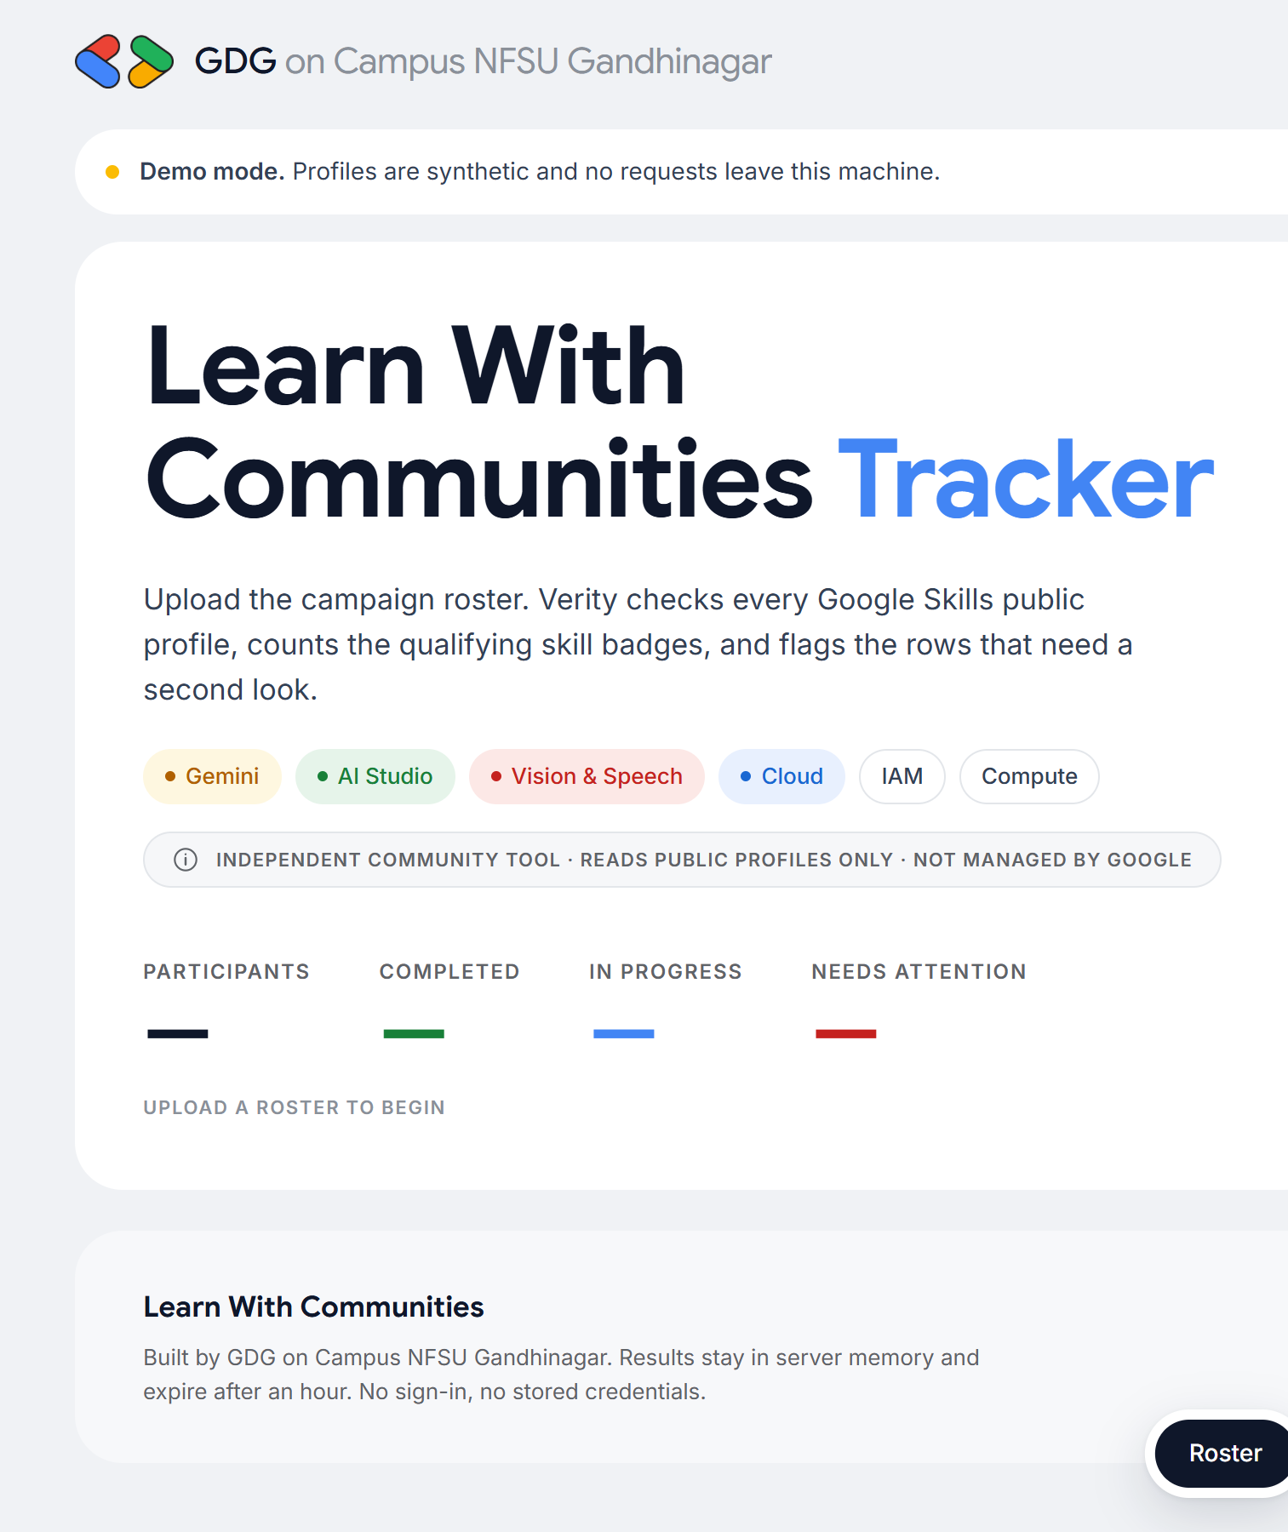
GDG on Campus NFSU Gandhinagar
Learn With Communities Tracker
Verity: a secure, rate-limited verifier for Google Skills public profiles
Web dashboard
CLI
Secure by design
Rate-limited
TECH & DEVELOPMENT · LEAD TASK
Problem · need · logic · tech stack · process · impact
Notes:
Introduce Verity: the tracker built for the Learn With Communities campaign lead task. One engine, two front ends: a web dashboard and a CLI. The talk covers the problem, why we need it, how it decides who completed, the security controls, the stack and the impact.

Slide 2
Checking badges by hand does not scale
Every participant submits a public profile. Today an organiser opens each one and counts.
1,000
1
2
Slow and repetitive
Error-prone counts
badge checks for a 100-person cohort (100 profiles × 10 required badges), repeated every time someone asks “am I done?”
Open a profile, scroll, count, record. Then repeat for every row in the sheet.
Arcade and course badges sit next to skill badges. Easy to count the wrong ones.
3
4
Estimate at about 45 to 60 s per profile: 75 to 100 minutes of clicking per review round.
Easy to game
No campaign picture
Two students can submit the same profile, or a profile that is not theirs.
Organisers cannot see which badge is the bottleneck in time to help.
Notes:
The lead task asks us to count completed skill badges from public profiles. Done by hand, a 100-person cohort means about a thousand checks per review round. The 45 to 60 seconds per profile figure is our estimate, not a measurement. Beyond time, manual counting mixes badge types, misses shared profiles and gives no campaign-level view.

Slide 3
What the campaign needs from a tracker
Requirements from the problem statement, plus what organisers told us matters.
Customisable roster
Who uses it
Accept the CSV shared on Discord, whatever its column order or headers.
Leads and organisers verify the whole cohort in minutes and export a sheet for certificates.
Accurate completion
Count only the 10 campaign skill badges, not every badge on the page.
Facilitators see the badge most people are stuck on and plan a help session for it.
Polite, reliable fetching
Rate limiting, retries and clear errors so a bad row never stops the run.
Participants get a consistent, explainable answer: which badges counted, which are missing.
Safe to run and share
Treat every CSV cell and every fetched page as untrusted input.
Notes:
These are the four requirements we designed against. The CSV structure is only shared on Discord, so the parser detects columns by content. Completion counts only the campaign badges. Fetching has to be polite and resilient. And because the tool reads files and web pages it did not write, everything is treated as untrusted.

Slide 4
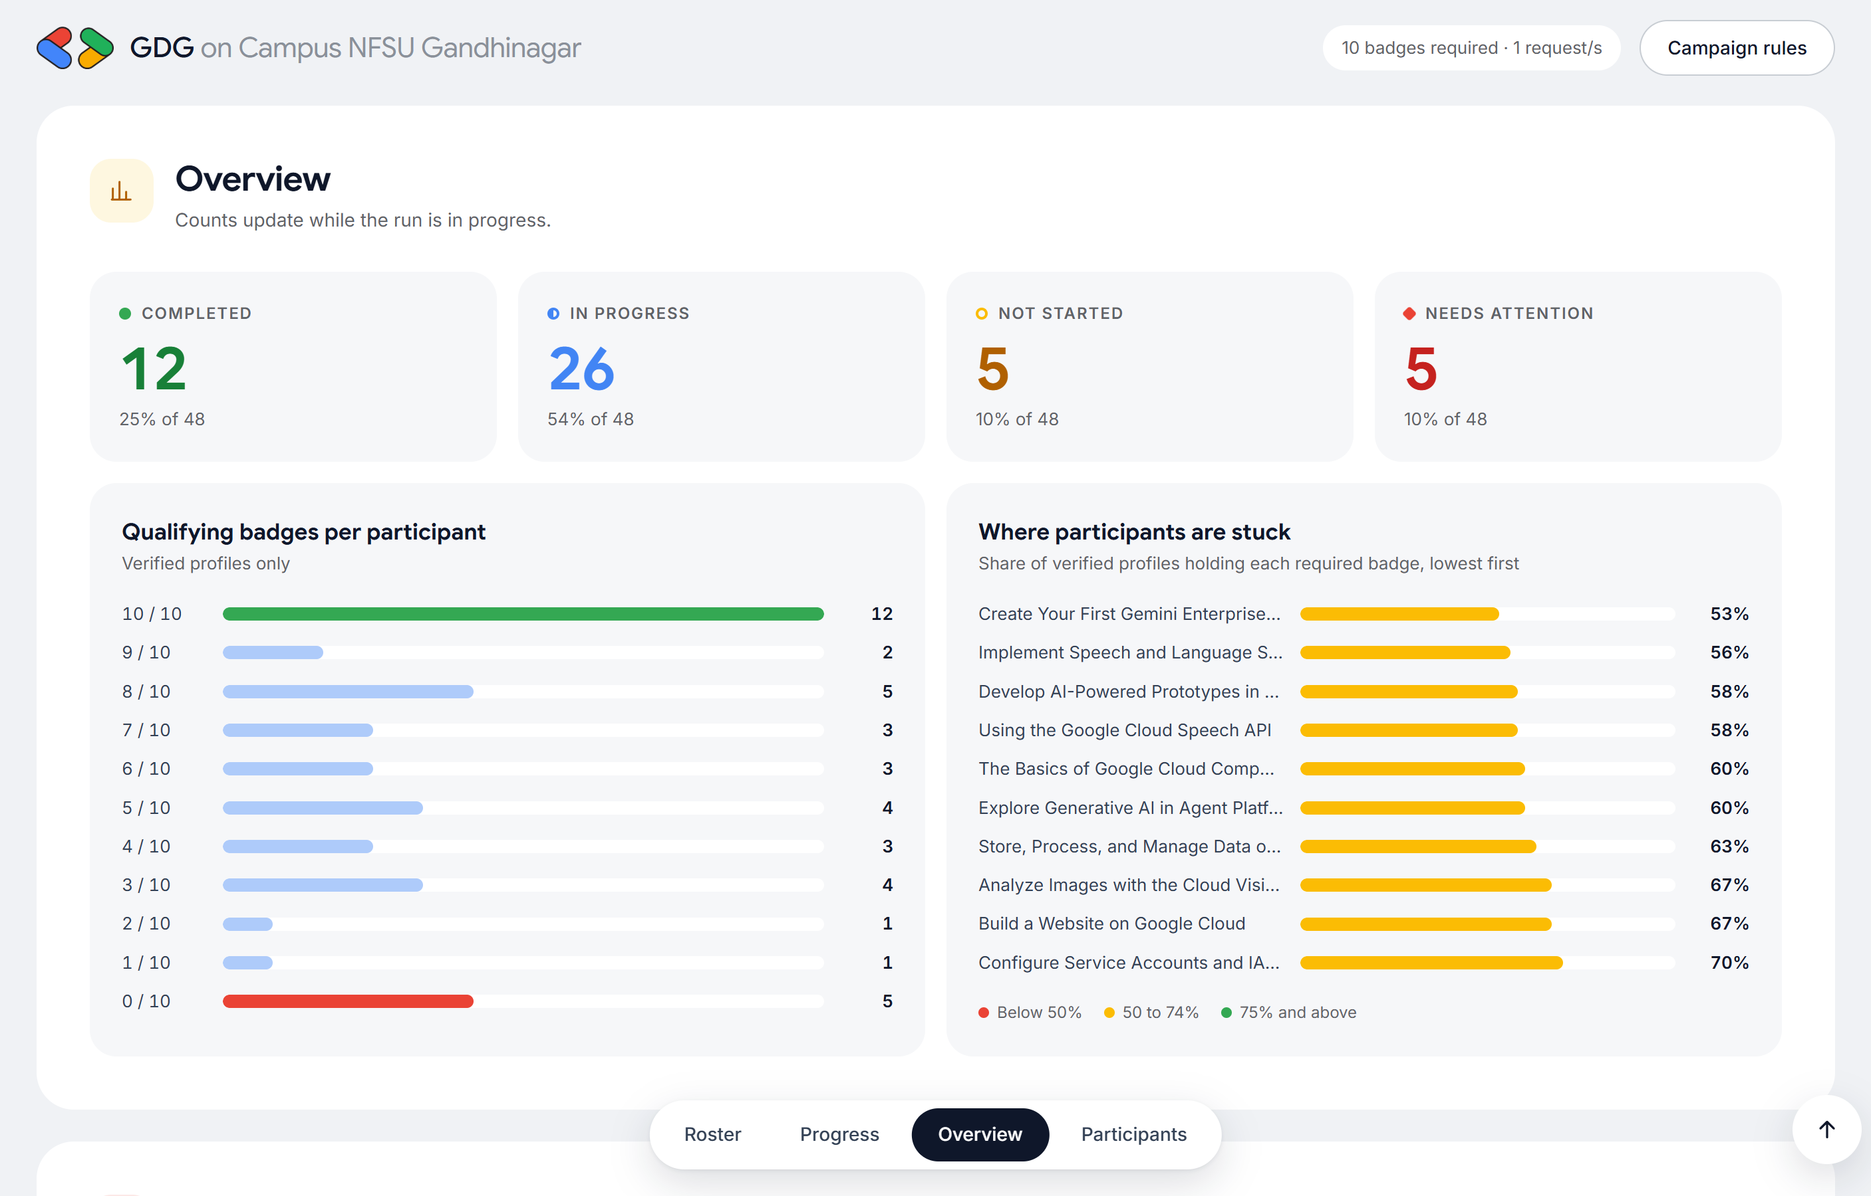
Verity: one engine, two front ends
A web dashboard for organisers and a CLI for scripts, sharing the same verified logic.
1
Upload or paste
CSV with auto column detection, or paste links. Bad rows are listed before any request is sent.
2
Live verification
Progress, rate and ETA while profiles are checked; results stream in row by row.
3
Campaign insight
Badge distribution and “where participants are stuck”, lowest badge first.
4
Integrity flags
Shared profiles, name mismatches and invalid links surface in a Needs attention filter.
Notes:
Verity is a Python package with a FastAPI web app and a Rich command line tool on top of the same engine. The screenshot is the live overview from a demo run of 48 rows.

Slide 5
From CSV to verified results in six steps
No profile is requested until its link has passed validation.
1
2
3
4
5
6
Upload
Validate
De-duplicate
Fetch
Parse and match
Report
CSV or pasted links; size and row limits checked first
Extract the profile ID; reject other sites, ports and paths
Each unique profile fetched once; shared ones flagged
Token bucket pacing, retries, timeouts, size cap
Read badge titles and dates; match the 10 campaign badges
Live dashboard, filters, detail view, CSV and JSON export
Statuses Completed 10 of 10 In progress 1 to 9 Not started 0 Needs attention invalid link, not found, fetch or parse error
Notes:
Walk the pipeline left to right. The key design choice is that validation happens before any network request, and de-duplication means a shared profile costs one request but gets flagged on every row that uses it.

Slide 6
How Verity decides who completed
Rules live in campaign.toml on the server, so a browser cannot change them.
Matching rules
Integrity flags
Only the 10 configured skill badges count. Other badges are listed as “not counted”.
Titles are normalised: case, spacing, punctuation and dash styles do not matter.
Aliases map renamed badges to their current title, so older earners still count.
Optional campaign window: badges earned outside it are shown but not counted.
Leave the list empty and every badge counts: the same tool works for other campaigns.
Shared profile
The same profile ID appears in more than one roster row. Fetched once, flagged on every row.
Name mismatch
The roster name shares no word with the name on the profile: check the link belongs to the student.
Outside window
Some badges were earned before the campaign started.
Notes:
Completion means at least 10 qualifying badges after normalisation and aliases. The flags do not change the count. They point an organiser at rows worth a human look, which keeps the tool explainable rather than accusatory.

Slide 7
Polite to the source, resilient to failure
Defaults from campaign.toml; every value is clamped to a safe range at start-up.
1 req/s
3
3 retries
8 failures
global token bucket, burst of 2, shared by every run
parallel workers, so slow pages do not block the queue
for timeouts, 5xx and 429, with exponential backoff and jitter
in a row open the circuit breaker and stop the run cleanly
Outbound requests
Inbound and errors
Retry-After is honoured and pauses every worker, not just one
5 s connect and 15 s read timeouts; 2 MB response cap
Redirects are never followed: a redirect means “not found”
Parsed profiles cached for 15 minutes; failures are never cached
Per-client limits: 20 uploads, 10 runs, 300 polls a minute
One bad row becomes a status, never a crashed run
Retry only the unfinished rows; finished rows carry over
Errors shown in plain words; stack traces stay in server logs
Notes:
Rate limiting works in both directions. Outbound, a token bucket keeps us at one request per second across all runs, and a 429 pauses everyone. Inbound, a sliding window stops anyone flooding the server. Failures are classified so only transient ones are retried.

Slide 8
Secure coding: threat by threat
Each control is covered by an automated test.
THREAT | CONTROL IN VERITY
SSRF through a crafted link | Never request user input. Extract a UUID, check it, rebuild the URL on an allowlisted host
CSV / formula injection | Cells starting with = + - @ are escaped in every export
Cross-site scripting | Untrusted text written with textContent only; strict CSP, no inline scripts
CSRF and DNS rebinding | Custom request header, Origin check, Host allowlist
Upload and request abuse | 1 MB / 5,000-row limits, Content-Length required, inbound rate limits
Hostile or oversized pages | Streamed 2 MB cap, no script execution, bounded parser, worker isolation
Exposure and data leaks | Binds to localhost; access token required beyond it; masked logs; no API docs
Notes:
This is the secure coding slide. The most important line is the first: the fetcher can only ever request https://www.skills.google/public_profiles/ followed by a validated UUID, so SSRF is designed out rather than filtered. Every row here has a matching test in the 74-test suite.

Slide 9
Tech stack
Small, boring dependencies chosen for auditability.
Python 3.14
FastAPI + Uvicorn
requests
BeautifulSoup
Core engine, standard-library TOML config and CSV parsing
Web API with security middleware; API docs disabled
Streaming HTTP with timeouts, no proxies from the environment
With lxml: HTML parsing that never runs page scripts
Vanilla JS + CSS
Rich
pytest
Headless Chrome
No framework, no third-party scripts; Google Sans and Inter
CLI progress bars and result tables
74 tests across validation, fetching, rules and the web API
Scripted UI checks and the screenshots in this deck
Notes:
The stack is deliberately small. The front end loads no third-party JavaScript, which keeps the content security policy strict. Fonts come from Google Fonts only.

Slide 10
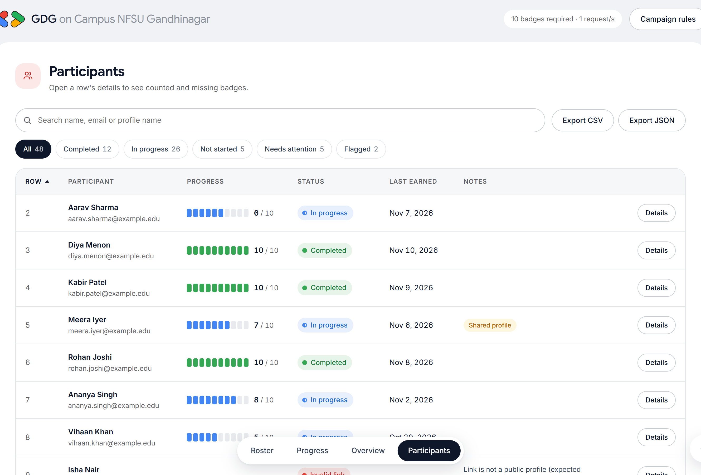
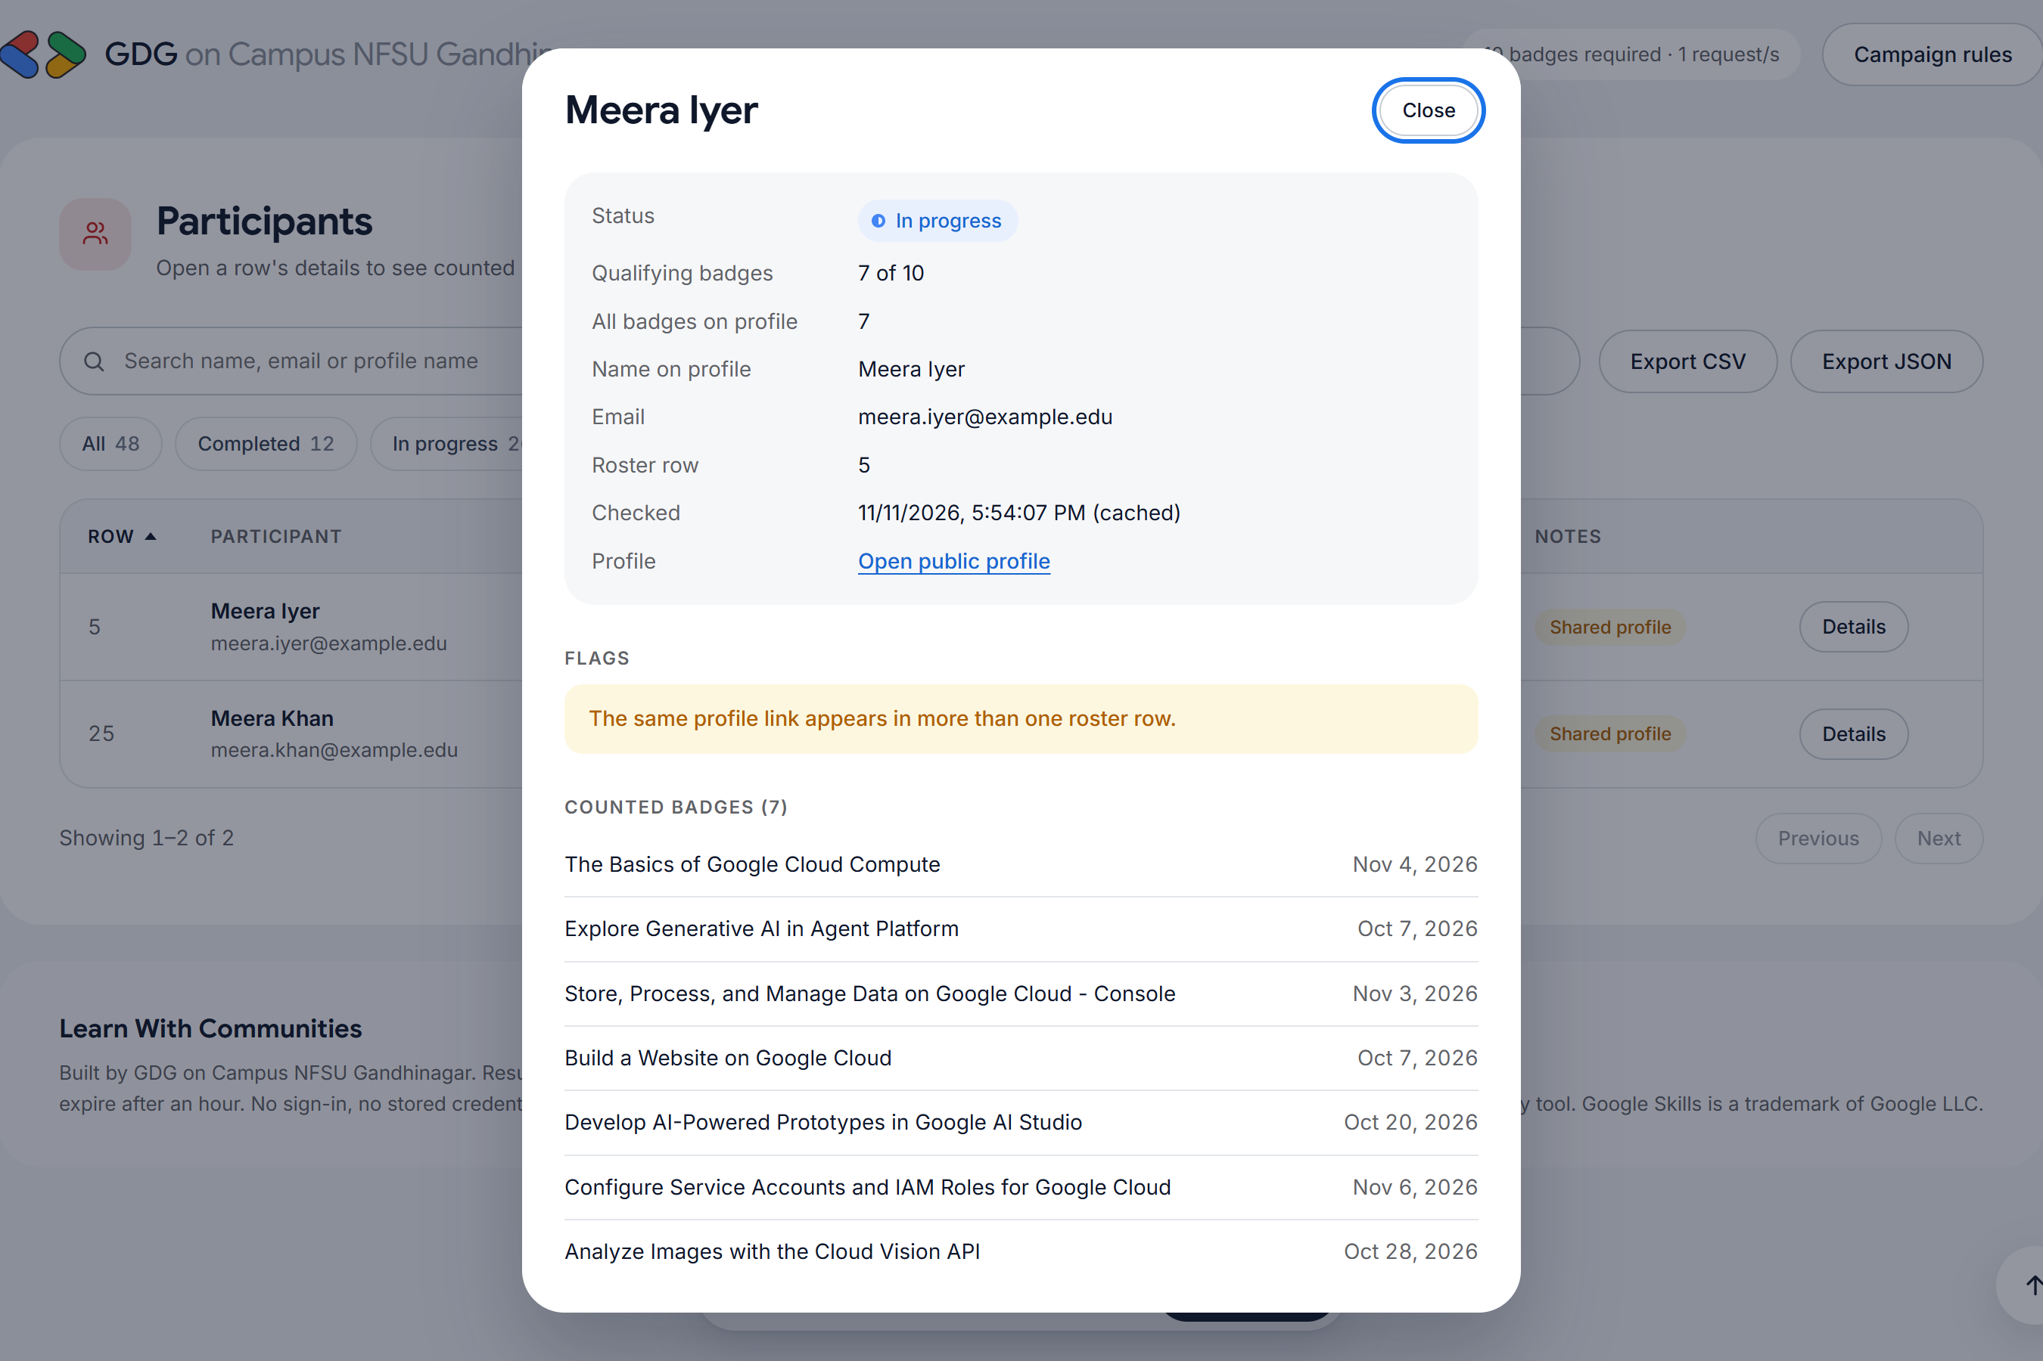
Dashboard tour
Filter, search, sort, then open any row to see exactly why it got its status.
Every row explains itself: counted badges with dates, the ones still needed, flags and errors in plain language.
Notes:
Left: the participants table with status filters and the 10-segment progress meter. Right: the detail dialog for a flagged row, showing the shared-profile flag and counted badges.

Slide 11
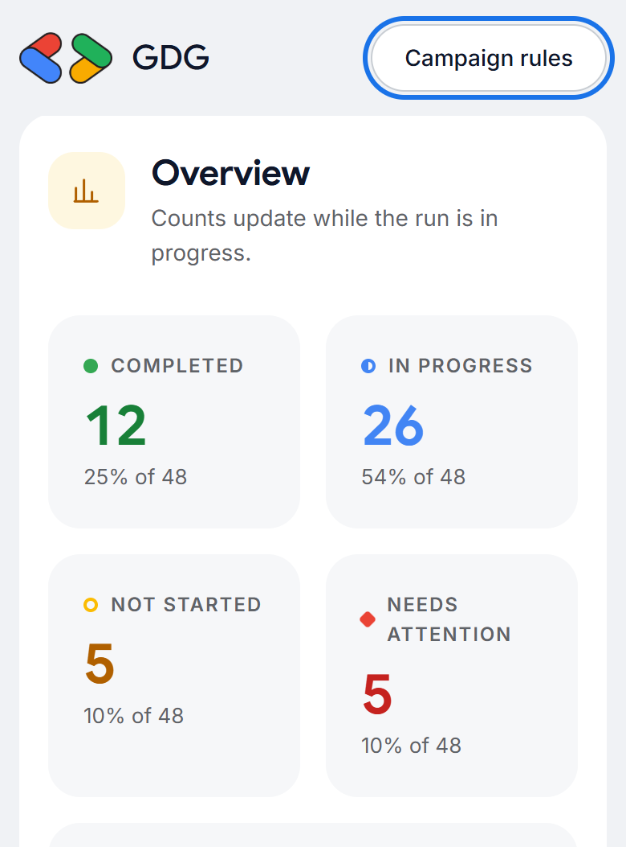
Tested, accessible, responsive
Quality checks we ran before calling it done.
74
Accessibility
Visible 3 px focus ring on every control
Full keyboard use: tabs, sorting, dialogs
Status uses shape and text, never colour alone
Live region announces run progress
Text colours meet WCAG AA contrast
Respects reduced-motion settings
automated tests, all passing
28 link-validation and output-encoding cases
Retries, 429, timeouts, circuit breaker
CSRF, Host, upload, auth and rate-limit tests
End-to-end run with a safe CSV export
Notes:
The test count is the real number from the suite. The phone screenshot is a 390 px wide viewport; the focus ring on the Campaign rules button is from a keyboard Tab press.

Slide 12
Practical impact
What changes for the chapter once the tracker is in use.
≈ 2 min
0
Day 1
to verify 100 profiles at the polite 1 request/s pace, against an estimated 75 to 100 minutes by hand
manual counting errors: only the 10 campaign badges are counted, the same way every time
visibility of the bottleneck badge, so facilitators can run a targeted help session
Beyond this campaign
Fairer certificates: shared or mismatched profiles are caught before rewards go out
Reusable: a new campaign is a new badge list in campaign.toml, no code changes
Safe to hand over: next year's leads inherit a tested tool, not a spreadsheet ritual
Notes:
The two-minute figure follows from the configured pace: 100 requests at one per second plus retries. The manual figure is our estimate. The zero-error claim is about counting logic: the tool applies the same rule to every profile.

Slide 13
Run it, and what comes next
Everything below works offline with the built-in demo mode.
Quick start
Next steps
Install
Load the official roster and badge list from Discord into campaign.toml
pip install -r requirements.txt
Dry-run a roster
python -m lwc_tracker validate roster.csv
Scheduled nightly re-checks with a change log of new completions
Verify from the terminal
python -m lwc_tracker check roster.csv -o out.csv
Optional Google Sheets export for the certificates team
Open the dashboard
python -m lwc_tracker serve
Offline demo
Discord webhook to celebrate each new 10 of 10
python -m lwc_tracker serve --demo
Notes:
Demo with serve --demo and the Load demo roster button: synthetic profiles, including injected 429 and 503 responses so the audience can see retries happen. Next steps are proposals, not built features.

Slide 14
Thank you
Verity · Learn With Communities Tracker
Questions
Live demo
Feedback
GDG on Campus NFSU Gandhinagar · Independent community project, not managed by Google
Notes:
Close and open for questions or the live demo.

