Slide 1

Placement Sahaay
Secure, policy-driven placement management for the Student Placement Cell, NFSU Gandhinagar
Problem Statement 2 · ISFCR Hackathon · 2026–27 placement session
Notes:
Placement Sahaay is a working prototype for Problem Statement 2: a secure, policy-driven placement management system for NFSU's five computing programmes. In the next few minutes: the problem, why it matters, how the rule engine works, the technology and security design, and the impact.

Slide 2
Placement records are managed by hand today
THE PROBLEM
01
02
Scattered records
Rules applied manually
Student data, offers and attendance live in spreadsheets and email threads, with history overwritten on every update.
Category switching, I / F / I+F limits and debarment are checked by memory, inconsistently, under deadline pressure.
03
04
Sensitive data exposed
Statistics you cannot trust
Phone numbers and salary figures are shared in files with no access control, no encryption and no record of who saw them.
Offers are counted as placements, stipends are mixed with CTC, and nobody can prove a figure was not edited.
Notes:
Today the Placement Cell works from spreadsheets. Four problems follow: records are scattered and overwritten; complex rules are applied manually; sensitive contact and compensation data is unprotected; and the resulting statistics cannot be trusted or verified.

Slide 3
Every rule, for every student, for every drive
THE NEED
5
4
3
24 h
programmes
company categories
offer types
to accept an offer
M.Tech. CS, M.Tech. AIDS, B.Tech.–M.Tech. CSE, M.Sc. CS, M.Sc. DFIS
A+, A, B and C, each with its own switching rule
Internship, FTE and Internship + PPO/FTE restrictions
or the company's timeline, whichever is earlier
What the Placement Cell needs: one system of record that applies the 2026–27 guidelines automatically, explains every decision, keeps contact and salary data confidential, and produces statistics that can be audited — while leaving exceptions and discipline to the Placement Cell.
Notes:
The rule space is large: five programmes, four categories, three offer types, attendance debarment and acceptance deadlines. Students also process personal contact and salary data, so privacy and integrity are requirements, not extras.

Slide 4
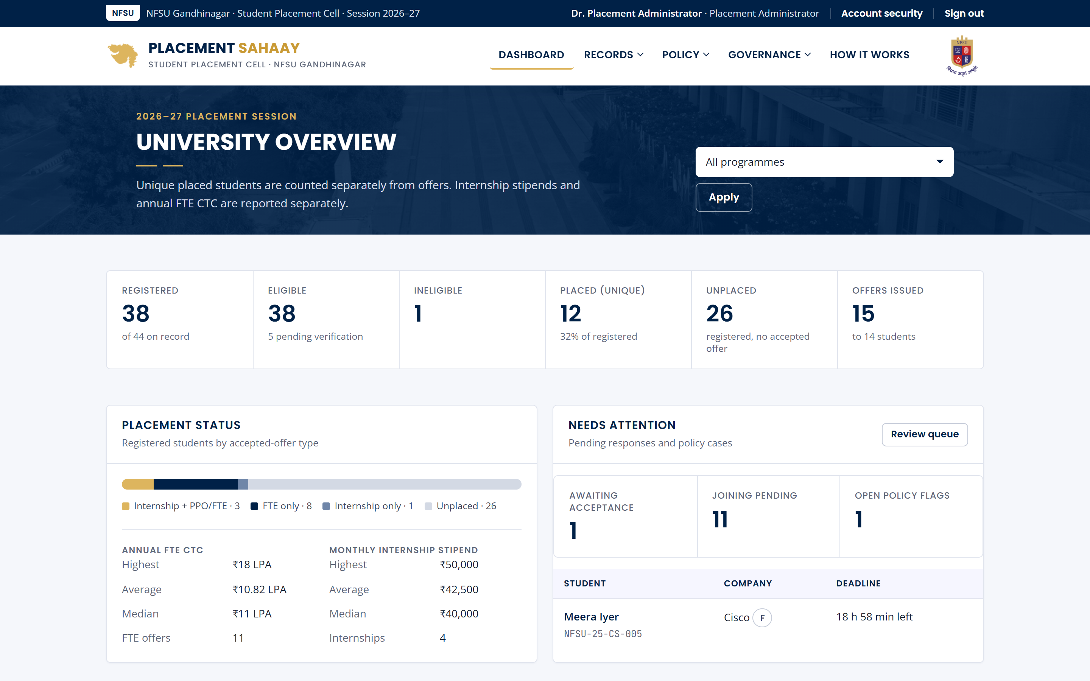
Placement Sahaay at a glance
OUR SOLUTION
Student register
Search, filter, import and archive records; offer history is never overwritten.
Policy rule engine
Seven explainable rules decide allow, review or block for every drive.
Offer management
I, F and I+F offers, PPOs, off-campus NOCs, deadlines and joining.
Dashboards and reports
Course- and batch-wise outcomes; unique students separated from offers.
Security by design
MFA, RBAC, encryption, hash-chained audit and controlled export.
University dashboard, demo data
Notes:
Placement Sahaay has five parts: the student register, the policy engine, offer management, reporting, and security controls that run through all of them. The screenshot is the live dashboard on demonstration data.

Slide 5
The guidelines, encoded as configurable rules
POLICY LOGIC
Category | Annual CTC | Switching rule
A+ | ≥ ₹16 LPA | No switching — selected students exit the process
A | ₹10–16 LPA | May switch only to A+ companies
B | ₹6–10 LPA | New package must be ≥ 1.5× the current one
C | < ₹6 LPA | Eligible for higher-category opportunities
Holds | Blocked from
Internship (I) | Another internship-only role
FTE (F) | Another FTE-only role
I+F or PPO accepted | Any I, F or I+F role at another organisation
Configurable, not hard-coded. Thresholds, the 1.5× multiplier, the three-drive debarment, the 24-hour window and conflict handling are policy settings. Changes need a guideline reference and are audited with before and after values.
Notes:
The category table and offer-type restrictions come straight from the problem statement. Boundaries are inclusive at the lower end: 16.0 LPA is A+. Every threshold is an administrator setting, and changes are audited.

Slide 6
Seven checks, one explained decision
RULE ENGINE
R1
R2
R3
R4
R5
R6
R7
Record
Registration
Eligibility
Company criteria
Attendance
Offer type
Switching
active, not archived
registered for 2026–27
verified by coordinator
programme and CGPA
no absence debarment
I / F / I+F limits
A+ / A / B / C rules
Most severe outcome decides
Allow
Manual review
Block
All seven checks pass. The student may apply.
A guideline conflict or missing data. Referred to the Placement Cell with the reason.
A rule forbids participation. The exact rule and figures are shown.
Conflict detection: an FTE holder may satisfy the switching rule while the offer-type rule forbids another FTE-only role. The engine flags this instead of guessing.
Notes:
Every check runs and reports, even after a failure, so the explanation is complete. The worst outcome wins. The engine also detects a real conflict in the guidelines — F to F upgrades — and routes it to manual review by default.

Slide 7
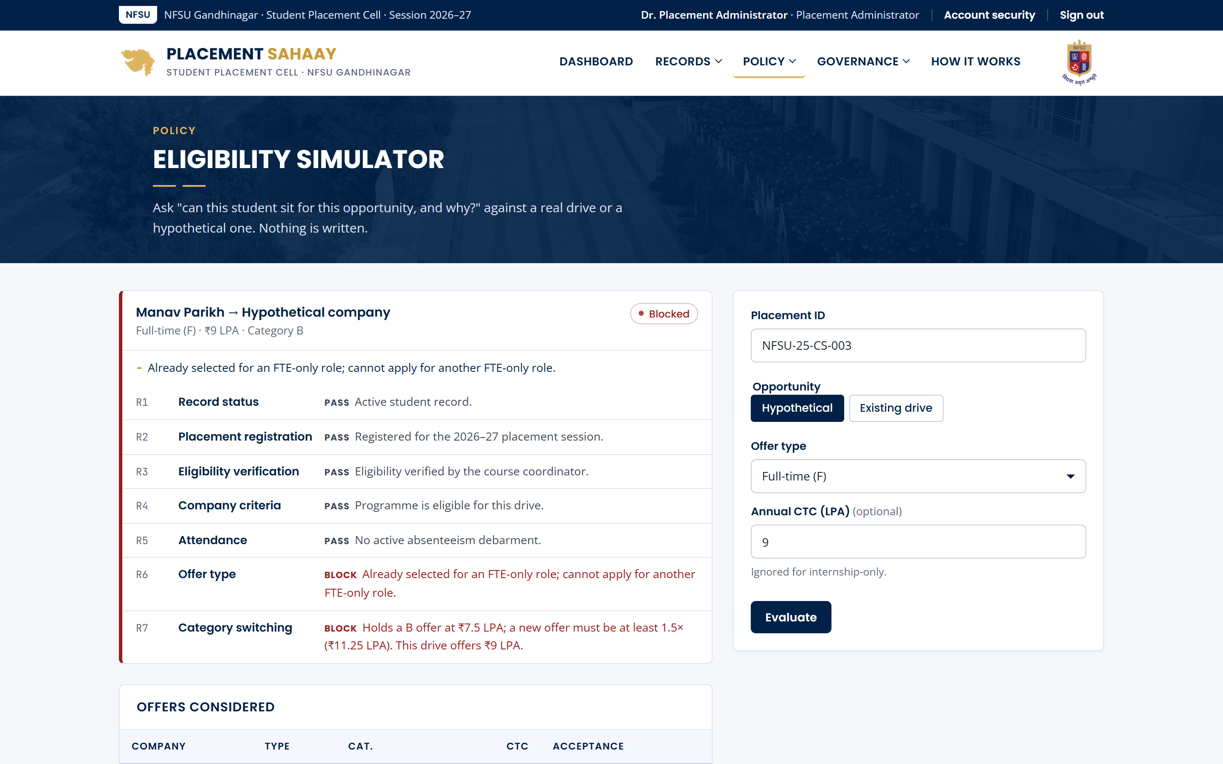
Every decision shows its reasons
EXPLAINABILITY
Example: NFSU-25-CS-003
Holds an FTE offer at ₹7.5 LPA (category B).
₹9 LPA drive: blocked — below 1.5× (₹11.25 LPA) and a second FTE-only role.
₹20 LPA I+F drive: allowed — all seven checks pass.
₹24 LPA F drive: manual review — guideline conflict surfaced to the Placement Cell.
Students see the same explanation in their portal, so decisions are transparent and disputes fall.
Notes:
Here is the simulator for a real demo student. The same engine runs when a student clicks Apply, when an officer registers a student, and when an offer is entered. The explanation is identical in every place.

Slide 8
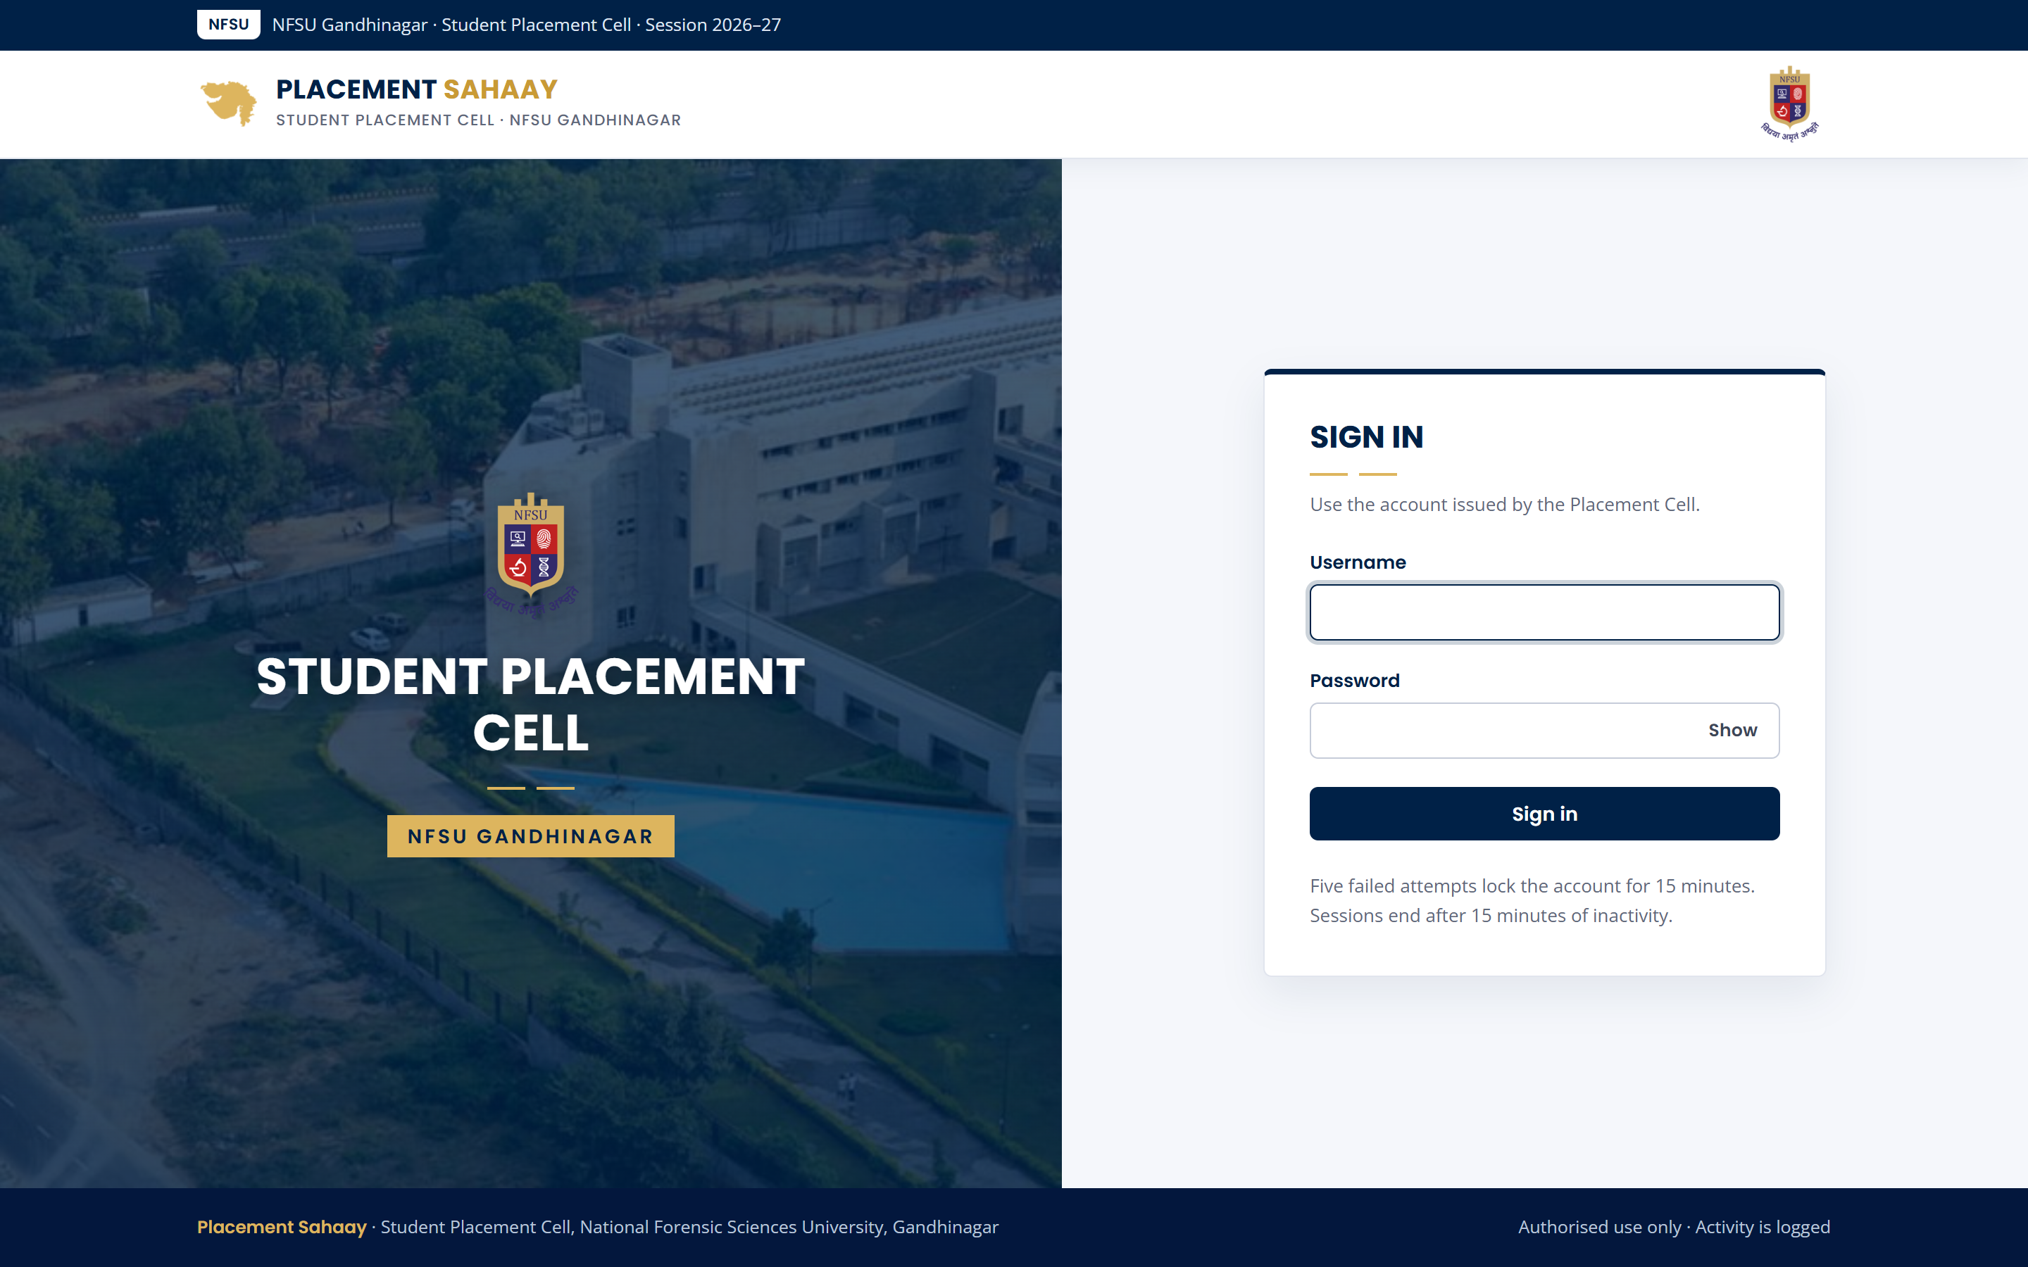
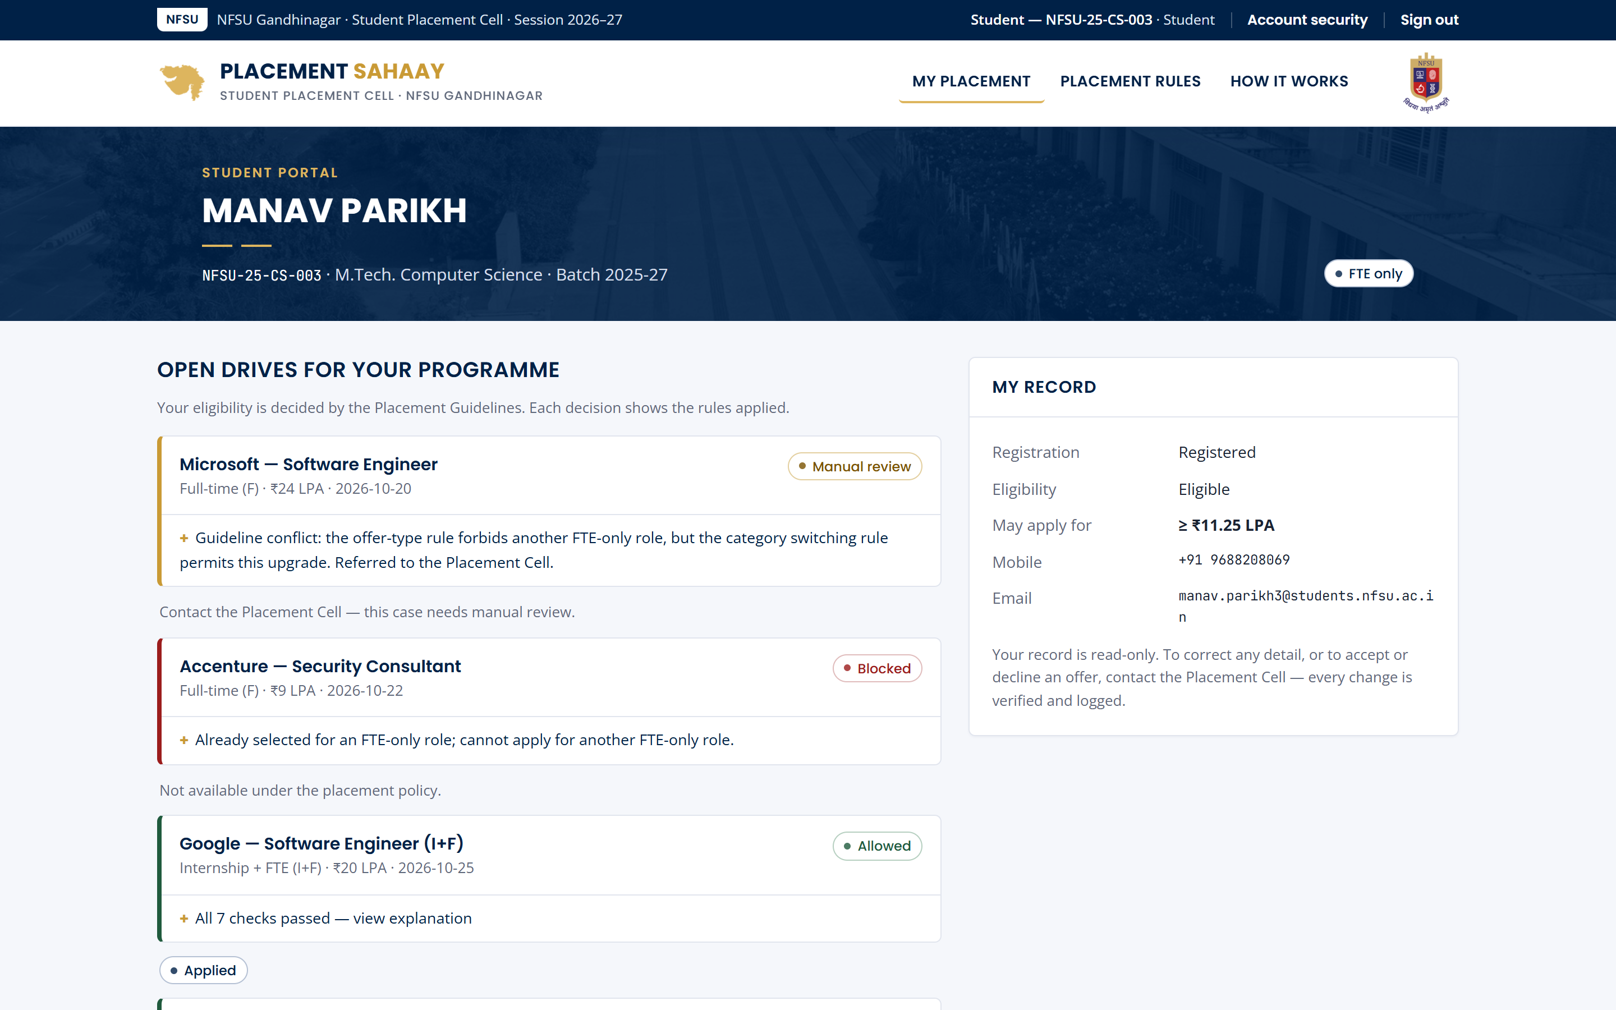
Designed in the NFSU visual language
INTERFACE
Sign-in: campus photograph, NFSU emblem, Student Placement Cell branding
Student portal: every drive with an explained decision
Keyboard focus rings, skip link, labelled forms, responsive down to phone width, and an in-app “How it works” guide for every role.
Notes:
The interface follows the NFSU website: navy utility bar, white masthead, navy page banners and gold accents, with Poppins headings. It is accessible: visible focus, keyboard navigation, labelled forms, and it works on phones. Every role also has a built-in guide.

Slide 9
End-to-end placement workflow
PROCESS
1
2
3
4
5
Register and import
Verify eligibility
Run drives
Record offers
Report and audit
Validated Placement ID, programme and contact; duplicates rejected by blind index; all-or-nothing CSV import.
Coordinators confirm academic eligibility for their programme only.
Applications pass the engine; attendance is recorded per event; absences bar the next three drives.
Category and deadline derived on the server; conflicts flagged for review; history preserved.
Live dashboards, course reports, controlled export and a verifiable audit trail.
Students apply from their portal; recruiters shortlist only their own applicants; the Placement Cell records offers and resolves flags.
Notes:
This follows the workflow suggested in the problem statement. Each step has a responsible role, and every step writes to the audit trail.

Slide 10
Small, auditable stack with security at every layer
ARCHITECTURE AND TECH STACK
Browser
Server-rendered HTML · strict CSP · no inline script · CSRF tokens
Layer | Technology
Language | Python 3.12+
Web framework | Flask 3 · Jinja2 (auto-escaping)
Cryptography | cryptography — AES-GCM, HMAC-SHA256
Passwords | scrypt (memory-hard)
MFA | TOTP, RFC 6238
Database | SQLite (PostgreSQL-ready SQL)
Testing | pytest — 86 tests
UI | NFSU style · Poppins, Open Sans · WCAG-minded
Flask application
Routes · session manager · RBAC and object-level checks · validation
Domain services
Students · drives · offers · reporting · audit writer
Policy engine
Pure Python function — no I/O, fully unit-tested
SQLite store
Parameterised SQL · AES-256-GCM fields · append-only audit triggers
Keys (field, index, audit, backup, session) are held outside the database and injected from the environment in production.
Notes:
The stack is deliberately small: fewer dependencies means a smaller attack surface and easier review. The policy engine is a pure function, which makes it deterministic and easy to test. SQLite keeps the prototype self-contained; the SQL is portable to PostgreSQL.

Slide 11
Every required control, implemented
CYBERSECURITY AND PRIVACY
Requirement | Control in Placement Sahaay
Authentication | scrypt hashing, TOTP MFA with replay protection, 5-attempt lockout, per-IP rate limit, uniform timing
Access control | Five roles; programme-scoped coordinators; company-scoped recruiters; object-level checks on every record
Confidentiality | AES-256-GCM for contact data bound to record and column; masked by default; reveal is logged; HTTPS + HSTS
Input and query security | Server-side allow-list validation, parameterised SQL only, auto-escaped templates, strict CSP
Audit and integrity | HMAC hash-chained, append-only log; unique IDs; blind-index duplicate detection; optimistic locking
Sessions | Server-side, hashed tokens; rotation on login; 15-min idle and 8-h limits; UA binding; SameSite=Strict
Backup and export | Encrypted, authenticated backups with restore test; exports role-gated, reasoned, fingerprinted, formula-safe
Privacy and retention | Minimal fields; recruiters see masked email only; retention-based anonymisation keeps statistics
Notes:
This maps each security area in the problem statement to what we built. Highlights: contact data is encrypted with AES-GCM and bound to its record, so ciphertext cannot be swapped; sessions are server-side and revocable; and the audit log is a keyed hash chain.

Slide 12
A student cannot game the system
THE SECURITY CHALLENGE
Change own status or package
Students have no write permission on records or offers. Placement status is derived from offer history, never stored as an editable field.
403, logged
Bypass switching rules with a forged request
Every application is re-evaluated on the server. The Apply button is a convenience, not a control.
Refused, logged
Read another student's record (IDOR)
The portal takes the student's identity from the session, never from the URL. Staff routes enforce object-level scope.
403, logged
Mass assignment or tampering
Each role has a field allow-list; Placement IDs are immutable; category and deadline are computed server-side.
Ignored
Notes:
The problem statement's security challenge, answered attack by attack. Each of these is an automated test in the suite, so the protection cannot silently regress.

Slide 13
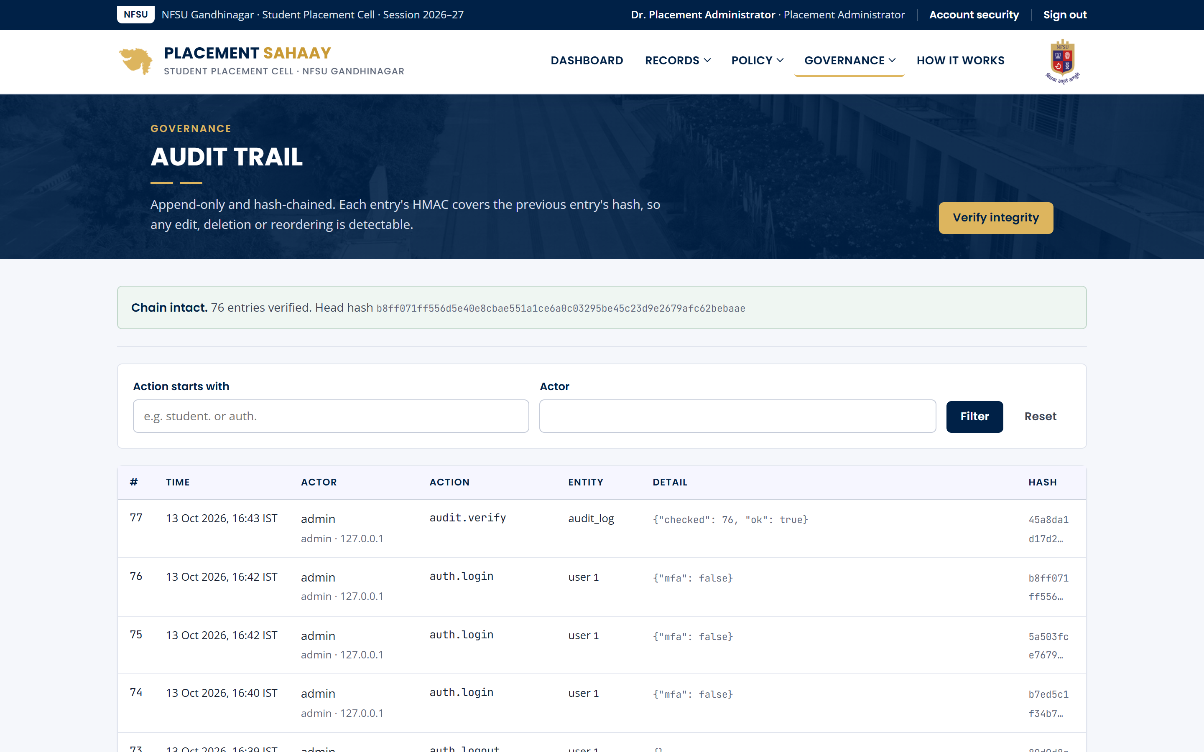
Tamper-evident audit trail
INTEGRITY
#51 auth.login
#52 offer.update
#53 policy.update
#54 export.csv
actor · time · before/after
actor · time · before/after
actor · time · before/after
actor · time · before/after
HMAC(key, prev ‖ entry)
HMAC(key, prev ‖ entry)
HMAC(key, prev ‖ entry)
HMAC(key, prev ‖ entry)
Detects
Editing, deleting, inserting or reordering any entry breaks every later link.
Prevents
Database triggers reject UPDATE and DELETE on the log table.
Resists forgery
The HMAC key lives outside the database, so file access alone cannot rebuild the chain.
Notes:
Each audit entry includes the actor, time, action and before/after values. Its MAC covers the previous hash, so tampering anywhere is detected by the Verify integrity button. Our tests drop the trigger, edit row 5 and confirm the verifier pinpoints entry 5.

Slide 14
Five roles, each scoped to what it needs
LEAST PRIVILEGE
Capability | Administrator | Officer | Coordinator | Recruiter | Student
View student records | All | All | Own programme | Own applicants | Own record
View contact details | Reveal, logged | Reveal, logged | Reveal, logged | Masked email | Own
Verify eligibility | Yes | Yes | Own programme | — | —
Record offers and attendance | Yes | Yes | — | — | —
Shortlist candidates | Yes | Yes | — | Own drives | —
Export data | With contact | Without contact | — | — | —
Edit policy, users, backups | Yes | — | — | — | —
Apply to drives | — | — | — | — | Engine-checked
Notes:
Permissions are checked on the server for every request, then narrowed again by scope: coordinators see only their programme, recruiters only their own applicants, students only themselves. Denied attempts are written to the audit log.

Slide 15
86 automated tests, all passing
TESTING
Attacks tested
SQL injection in login, search and filters
Stored XSS and markup in names
CSRF and cross-origin requests
IDOR, privilege escalation and mass assignment
Session fixation, replay, idle timeout, hijack
Brute force, lockout and rate limiting
MFA code replay
CSV formula injection and oversized uploads
Audit-log tampering and backup corruption
Ciphertext swapping between records
Notes:
The suite runs in under ten seconds. Policy tests cover every boundary, including 11.25 versus 11.24 LPA for the B-category multiplier. Security tests exercise real attacks against the running application, not mocks.

Slide 16
What changes for the Placement Cell
PRACTICAL IMPACT
Before
With Placement Sahaay
Rule checks
Manual, inconsistent
Automatic, explained, identical for every student
Policy disputes
Argued from memory
Settled by a rule-by-rule explanation
Sensitive data
Shared in open spreadsheets
Encrypted, role-scoped, every view logged
Placement statistics
Offers counted as placements
Unique students, CTC and stipend kept separate
Accountability
No record of changes
Verifiable audit trail with before/after values
Deadlines and absences
Tracked by hand
Automatic expiry, debarment and review flags
Notes:
The impact is practical: fewer errors, faster decisions, fewer disputes, protected student data, and statistics the university can stand behind in accreditation and rankings submissions.

Slide 17
Limitations and next steps
HONEST SCOPE
Prototype limitations
Next steps
SQLite and an in-process rate limiter suit a single server
Compensation fields are protected by access control, not field encryption
Development keys are generated locally; production needs a secrets manager
Email and SMS notifications are not yet integrated
Move to PostgreSQL with TDE and Redis-backed rate limits
Institutional SSO (SAML / OIDC) with mandatory MFA for staff
Key management service with scheduled key rotation
Deadline reminders and recruiter self-service drive requests
External penetration test before rollout
The design does not change on the path to production — components are swapped for institution-grade equivalents.
Notes:
We are explicit about what a prototype does not yet do, and about the path to production. None of the next steps change the design; they replace components with institution-grade equivalents.

Slide 18
Rules applied consistently. Data protected by design.
Run it: pip install -r requirements.txt · python scripts/seed.py · python run.py
Demo accounts: admin · officer · coord.dfis · recruiter.microsoft · student.cs003
Notes:
To summarise: Placement Sahaay applies the 2026–27 guidelines consistently and explains every decision, while keeping student data confidential and every change accountable. Thank you — we are happy to take questions or run the live demo.

