Slide 1
Expressive Performance as a Gaussian Process on a Musical Score Graph
Raynaldi Lalang · Kyoto University · October 2026
1

Slide 2
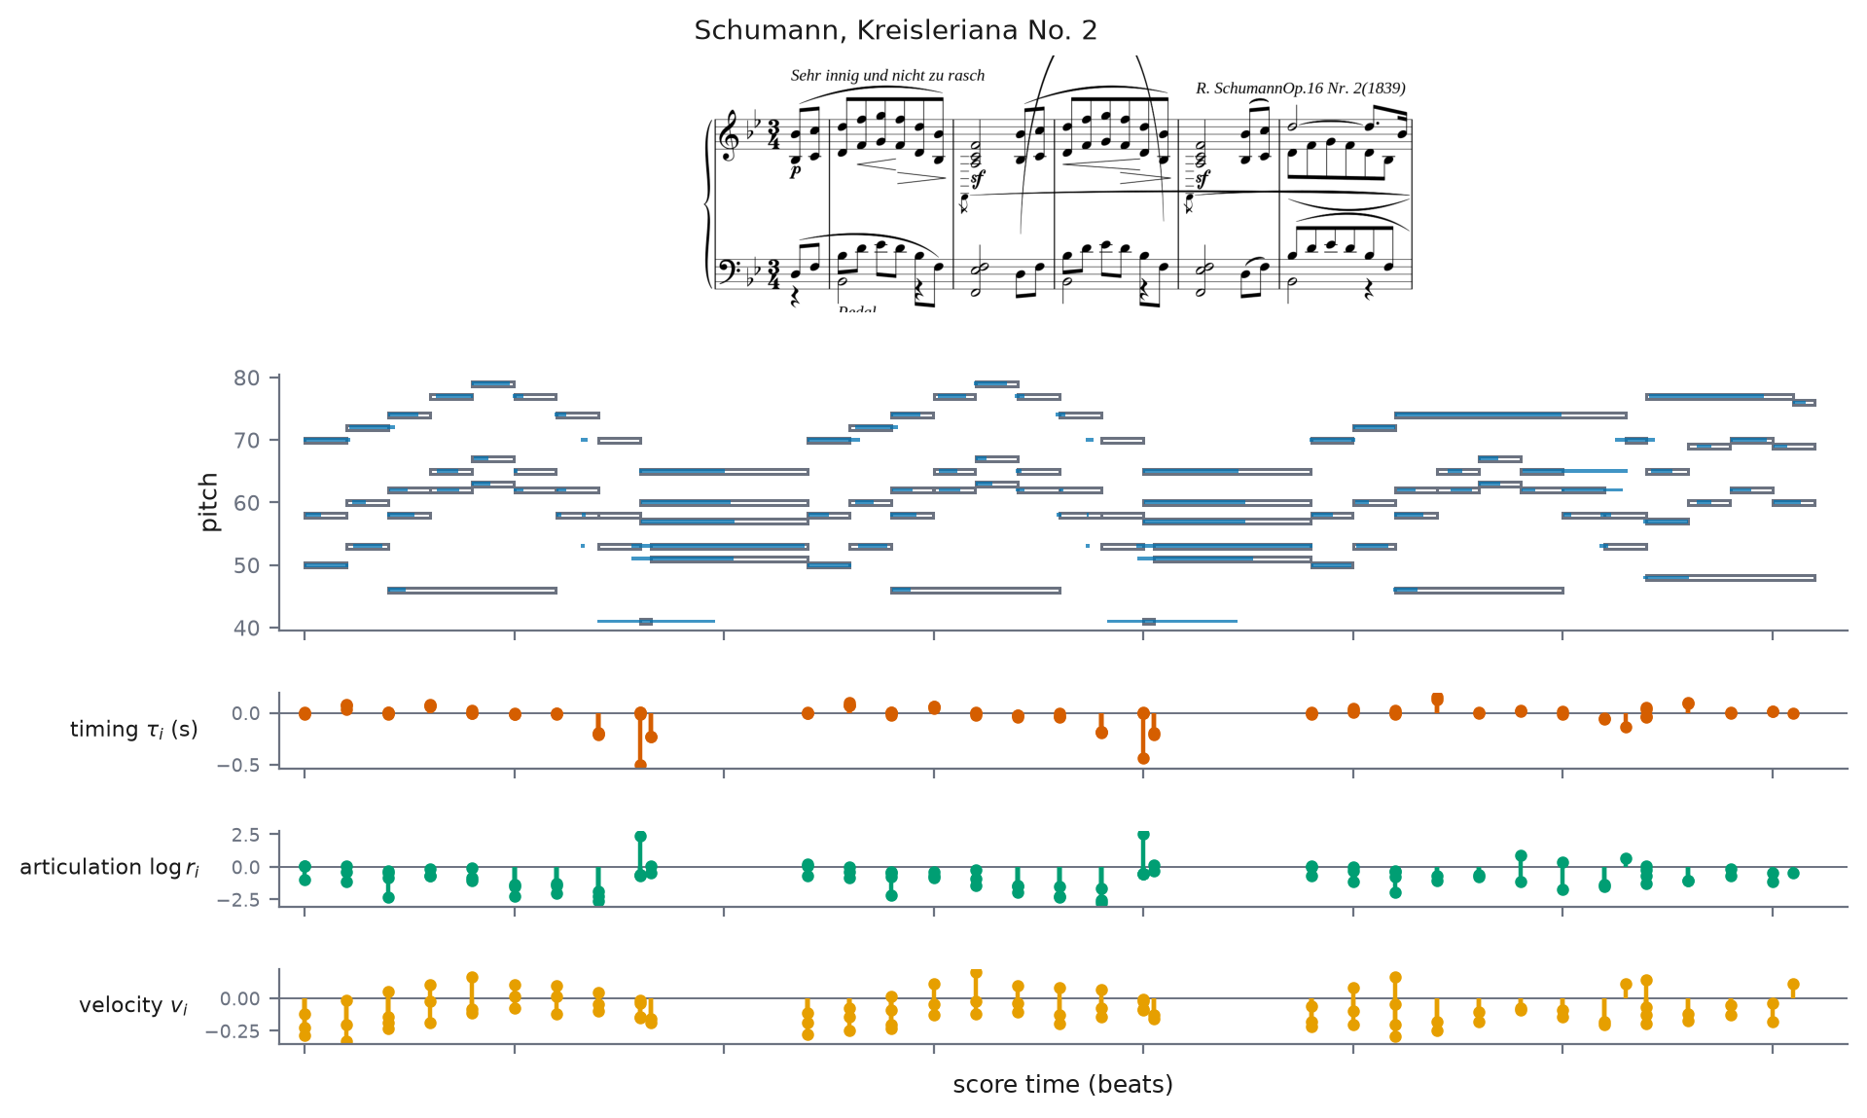

Expressive performance
• The score fixes pitches and note values. Performers add the rest: when, how long, how loud, and how the pitch moves inside the note. These deviations are the expression.
flat (score) | expressive (a real performance) — click to play
2
Notes:
Play flat, then expressive. Same bars, sine synthesis, so timing and dynamics carry the contrast. Not transcription: the score is known.

Slide 3
The thesis, and the three problems
• Thesis: one Gaussian process on the score graph turns a known score and a performance into per-note expressive variables, each with an error bar you can trust.
• Piano: timing, articulation, velocity, read directly from aligned MIDI. Are the error bars calibrated?
• Strings and winds: six variables, now with intonation and vibrato, estimated from audio, noisily. Does the same prior still work?
• Audio directly: no pitch tracker at all. Can the waveform itself be the observation?
3
Notes:
Say the thesis sentence verbatim. One problem per phase; every later slide answers one of the three.

Slide 4
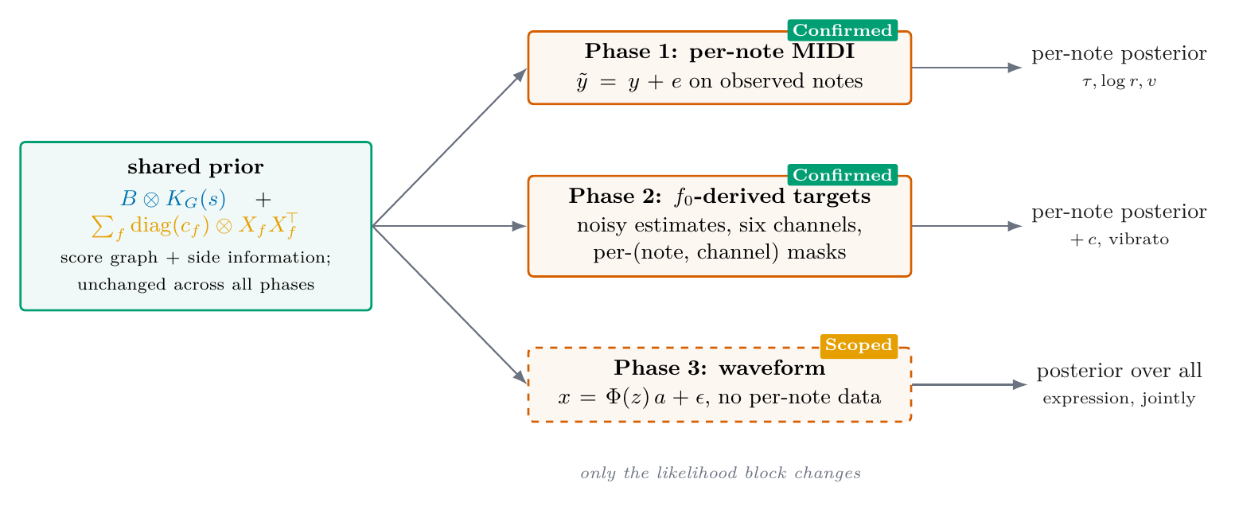
Approach: one prior, three kinds of observation
• One GP prior over per-note expressive fields, on a graph built from the score. Only the observation changes per phase: MIDI, f0 targets, or the waveform.
4
Notes:
The shared prior with three swappable likelihood blocks; badges show status.

Slide 5
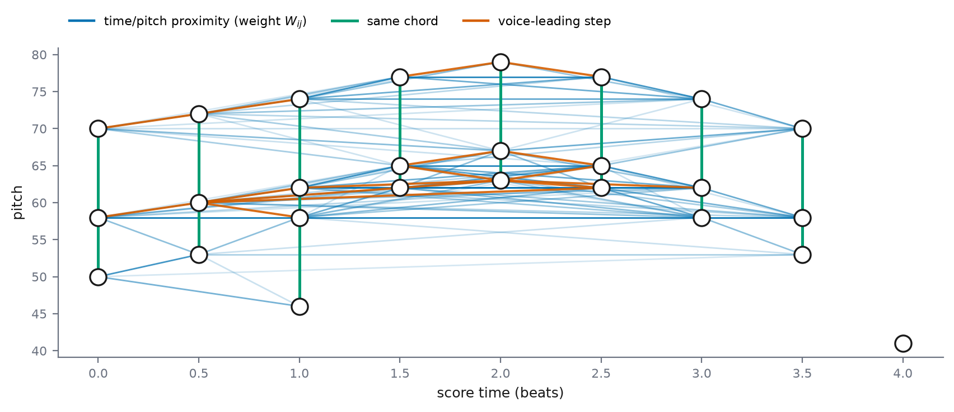
The model (1): the score graph
Wᵢⱼ = exp( −(bᵢ−bⱼ)²/2ℓ_b² − (pᵢ−pⱼ)²/2ℓ_p² ), L_G = D − W
• Nodes: the written notes (pitch, beat onset, duration).
• Edges: close in score time and pitch — neighbours are played similarly.
5
Notes:
L_G is the graph Laplacian; it carries the score geometry.

Slide 6
The model (2): a GP on the graph, channels coupled
K_G(s) = U g(ν; s) Uᵀ, g(ν; s) = 1/(1+sν) ; Cov[y] = B ⊗ K_G(s)
• Shape the Laplacian spectrum with one parameter s: smooth-on-the-graph patterns keep their variance, rough ones are shrunk (graph Matérn).
• The channels are correlated: a learned coupling matrix B shares the graph, so an observed channel at one note informs the others at neighbouring notes.
6
Notes:
U, nu: eigenvectors/values of the Laplacian. B is learned per piece.

Slide 7
The model (3): the covariance of one performance
K = B⊗K_G(s) + Σ_f diag(c_f)⊗X_f X_fᵀ + diag(ς²)⊗I
• Graph term + side-information terms + noise: the whole model is one per-piece covariance matrix.
• Feature weights are re-inferred for every piece — the measured source of the accuracy gain.
• Sixteen numbers per piece, fit by exact evidence; prediction is conjugate, closed form.
7
Notes:
X_f: per-note features (score descriptors, music-model embeddings). Baselines are exact special cases.

Slide 8
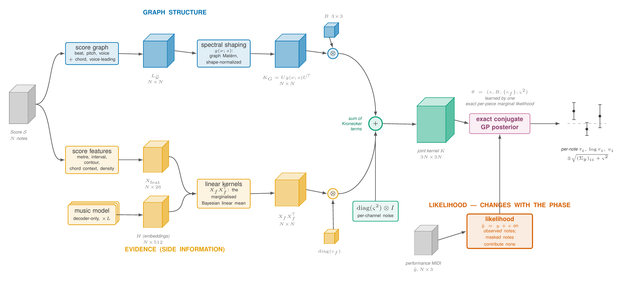
The model, in one picture
Blue: score graph → L_G → K_G. Amber: features as linear kernels. Vermilion: the likelihood, the only block that changes across the phases.
8
Notes:
Walk the colors left to right.

Slide 9
Phase 1: the setting (piano, aligned MIDI)
yᵢ = [ τᵢ (onset timing), log rᵢ (articulation), vᵢ (velocity) ]
• A Disklavier records exactly what the pianist controlled: three variables per note, read directly, no estimation.
• The question: on held-out notes, how good are the estimates, and can the error bars be trusted?
9
Notes:
The concept picture was exactly this data.

Slide 10
Phase 1: results (piano, ASAP)
• Preregistered, scored once on 20 untouched pieces, against the two-stage pipeline the model contains.
• Accuracy: RMSE 0.376 vs 0.393 (pooled over the three channels), paired per-piece difference significant.
• Calibration: the graph's log-score contribution significant; coverage 0.925 at nominal 0.90.
• Attribution: the features carry the mean, the graph carries the calibration.
10
Notes:
One-shot discipline: the test set was never touched during development.

Slide 11
Phase 2: from audio to the cents curve
xⱼ = 1200 log₂(f₀ⱼ/440) − 100(pᵢ−69) (deviation from equal temperament)
• A pitch tracker gives frames: time, f₀, voicing confidence.
• Frame rule: voiced, confidence above the track's lowest quintile, at least 4 frames per note.
• Two curves per note — tracked: pYIN, run by us; ground truth: the corpus's own annotation of the same stem. Cleaner, but still a measurement.
11
Notes:
GT = corrected pYIN on isolated stems (46 ms / 10 ms), gross errors hand-fixed; hence 'quasi-truth'.

Slide 12
Phase 2: the pitch-curve channels
• Within one note: a sustained level plus one oscillation. Three numbers describe it.
• Intonation c (cents): the sustained offset from the written pitch. c > 0 sharp; 100 = a semitone.
• Vibrato extent γ (cents): the oscillation's amplitude.
• Vibrato rate f (Hz): its frequency; vibrato lives at roughly 4–8 Hz.
• The bundle carries log γ, log f. No oscillation found: those cells are missing, c remains.
12
Notes:
Logs: positive quantities, multiplicative errors.

Slide 13
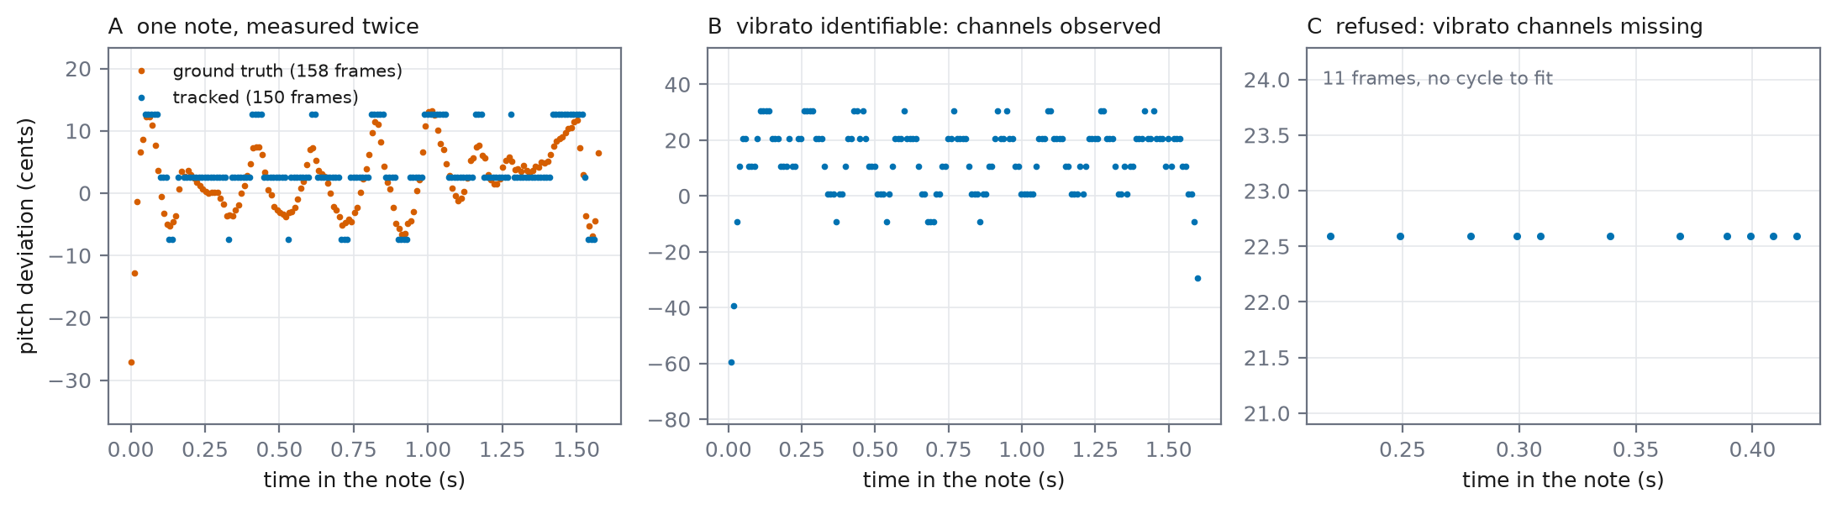
Phase 2: what the data looks like
A: the tracker quantizes and drops frames; the ground truth shows the oscillation underneath. B: identifiable. C: refused, cells missing.
13
Notes:
Real development notes, no fits drawn.

Slide 14
Estimating the channels with a Gaussian process
k(Δt) = w₁ e^(−2π²v₁Δt²) cos(2πμ₁Δt) + w₂ e^(−2π²v₂Δt²)
• The cents curve as a Gaussian process, two components: a damped cosine at the vibrato rate, plus a slow drift (a special case of the spectral mixture kernel, Wilson and Adams 2013).
• The prior states only where the curve's energy lives: a band at the rate, plus a drift band at zero.
• Fit per note by exact marginal likelihood; variances from the evidence curvature.
• Channels from the posterior: c the realized average, γ from the vibrato component, f = μ₁.
14
Notes:
Naming, say once: the kernel is a special case of the SM kernel; the method is ours (structure imposed). We also ran the SM method as intended on 9,804 notes: exact tie at curve level, vibrato band found unaided on 18%. The structure must be imposed and costs nothing.

Slide 15
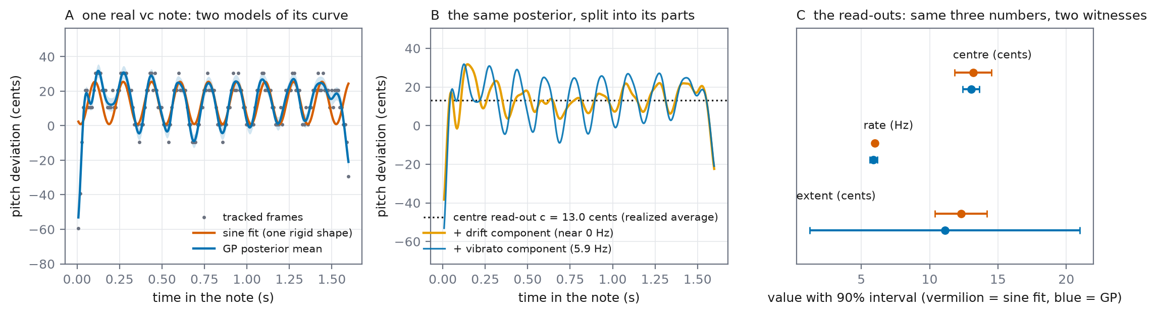
One real note: the curve and its parts
A: the GP tracks the curve (rigid sine as reference). B: the posterior split into centre, drift, vibrato. C: the read-outs.
15
Notes:
The split IS the channel read-out.

Slide 16
Phase 2: results (strings and winds, URMP)
yᵢ = [ c, log γ, log f, ℓ, τ, dᵢᵛⁱᵇ ] — six channels, estimator variances used as given
• Preregistered, scored once on 13 held-out pieces. Δ = full model − no-graph ablation, paired per piece.
• Intonation recovery: ΔRMSE −0.877 cents, significant.
• Vibrato calibration: ΔNLL −2.990 (extent), −0.564 (rate), both significant.
• Coverage 0.88–0.91 at nominal 0.90, all six channels.
• Timing calibration: no improvement (−0.030, interval includes zero). The loose end, taken up after Phase 3.
16
Notes:
Same prior as piano, unchanged.

Slide 17
Phase 3: the waveform as the observation
x = Φ(z) a + ε ⇒ p(x|z) = N(x; 0, ΦΣ_aΦᵀ + σ²I)
• The likelihood block becomes the audio itself; the harmonic amplitudes are marginalized exactly (O(mp²), whole tracks exact).
• Development studies: intonation at 2.29 cents median with no pitch tracker; beats the estimator chain on winds.
17
Notes:
x: audio samples; z: pitch deviations; a: amplitudes, never estimated.

Slide 18
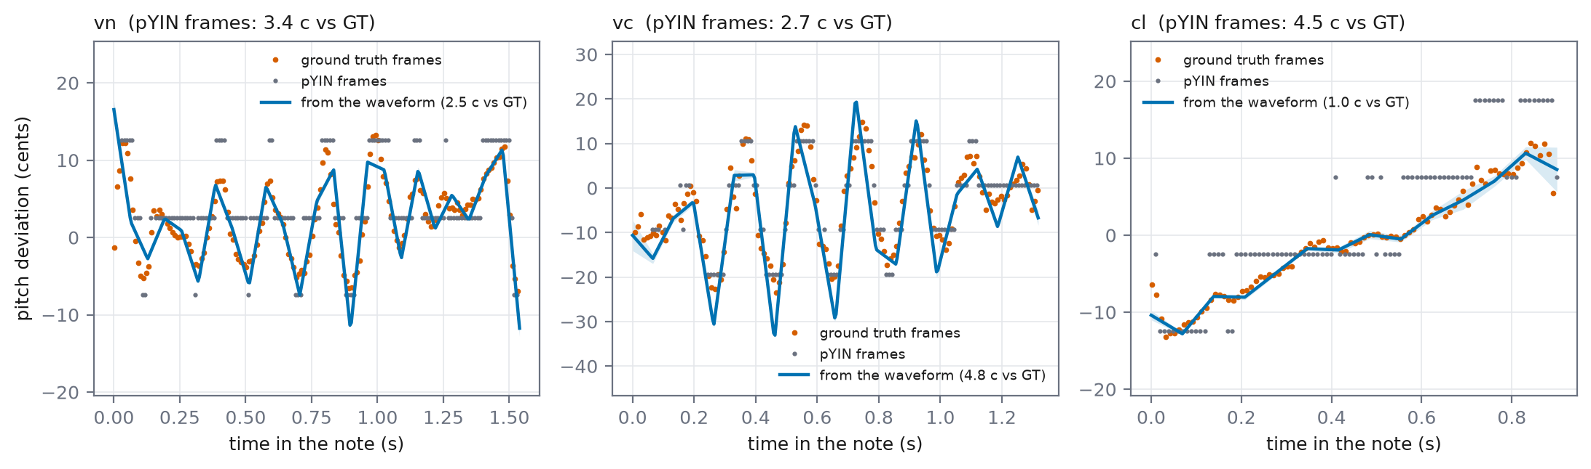
Running now: the curve straight from the waveform
Prototype (this week): the within-note GP prior meets the waveform likelihood. No tracker, no estimator. Better than the pYIN frames on two of three notes.
18
Notes:
Do not cut. Violin 2.5 vs pYIN 3.4 cents, clarinet 1.0 vs 4.6, cello 4.8 vs 2.7 (the miss, say it plainly). Knots must beat Nyquist for 5-6 Hz vibrato: 16 knots/s.

Slide 19
Timing noise is correlated across notes
Σᵗᵢⱼ = ς_{τ,i} ς_{τ,j} ρ^|i−j| — one parameter ρ, chosen per piece by the evidence
• Why timing did not calibrate: alignment error is correlated along score time; a diagonal noise row cannot represent it.
• The evidence detects the correlation on 97–100% of pieces (median ρ 0.45–0.60).
• Calibration improves (ΔNLL −0.111, significant); timing error falls ~20% (99 → 80 ms).
• Reproduced three ways: original masks, fresh masks, joint refit.
19
Notes:
Say 'correlated timing noise across notes', never bare 'AR(1)'.

Slide 20
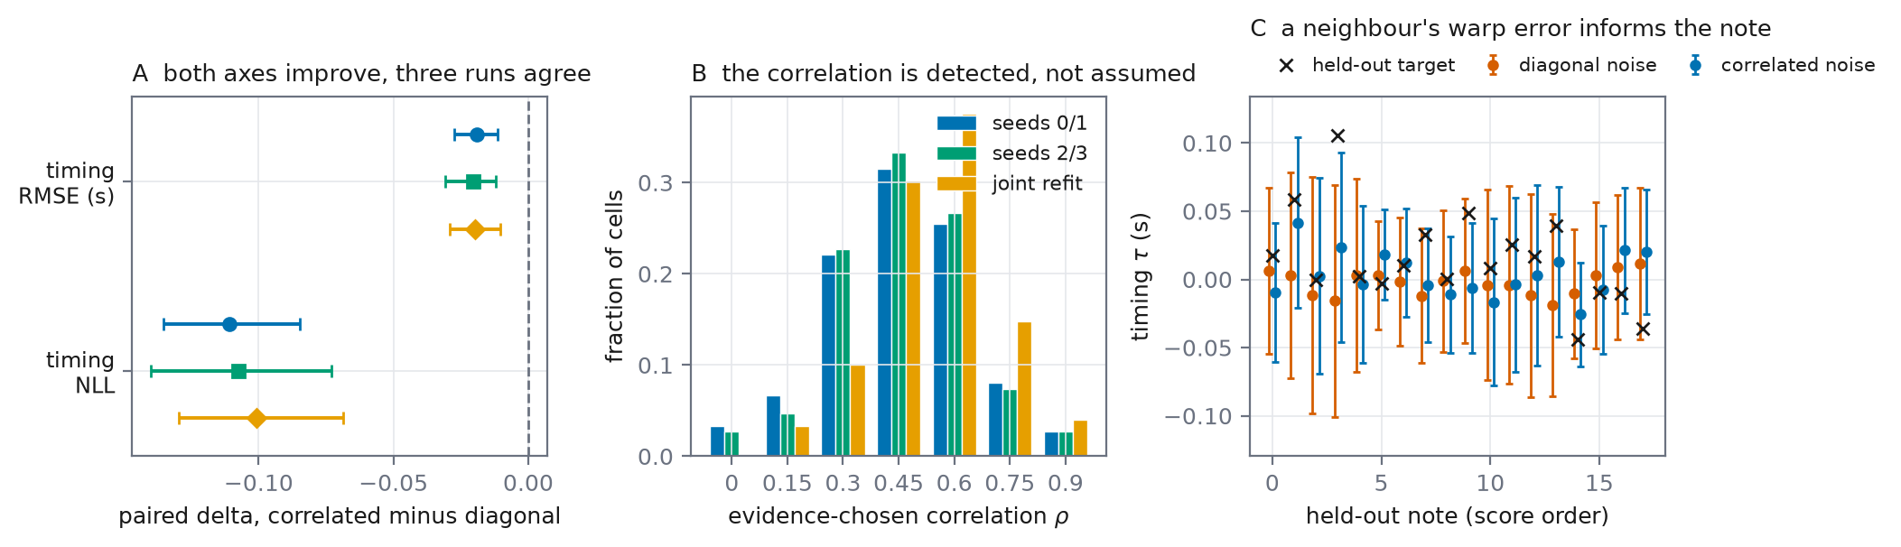
Held-out timing, with and without the correlation
Left: paired deltas, three runs. Middle: the chosen correlation per piece. Right: one track's held-out timing.
20
Notes:
A neighbour's warp error predicts yours; the correlated row lets the model subtract it.

Slide 21
From here (proposed sequencing)
now | integrate the full-corpus learned-spectrum run (done this week)
next 2 weeks | freeze the timing-noise registration once the pool is decided; batch-evaluate the curve-from-waveform prototype
November | decide the channel design (scalars vs curve level); run the timing confirmation, one shot
December on | Phase 3 at scale; consolidate thesis chapters
21
Notes:
Sequencing, not dates; gated by the open questions.

Slide 22
Open questions
• Which corpus to confirm the timing result on: a new one (Bach10), a disclosed re-use, or both?
• Keep the channels as three scalars per note, or move them to curve level (the prototype's direction)?
• Should the new robustness options become defaults?
22
Notes:
End here; invite discussion.

