Slide 1
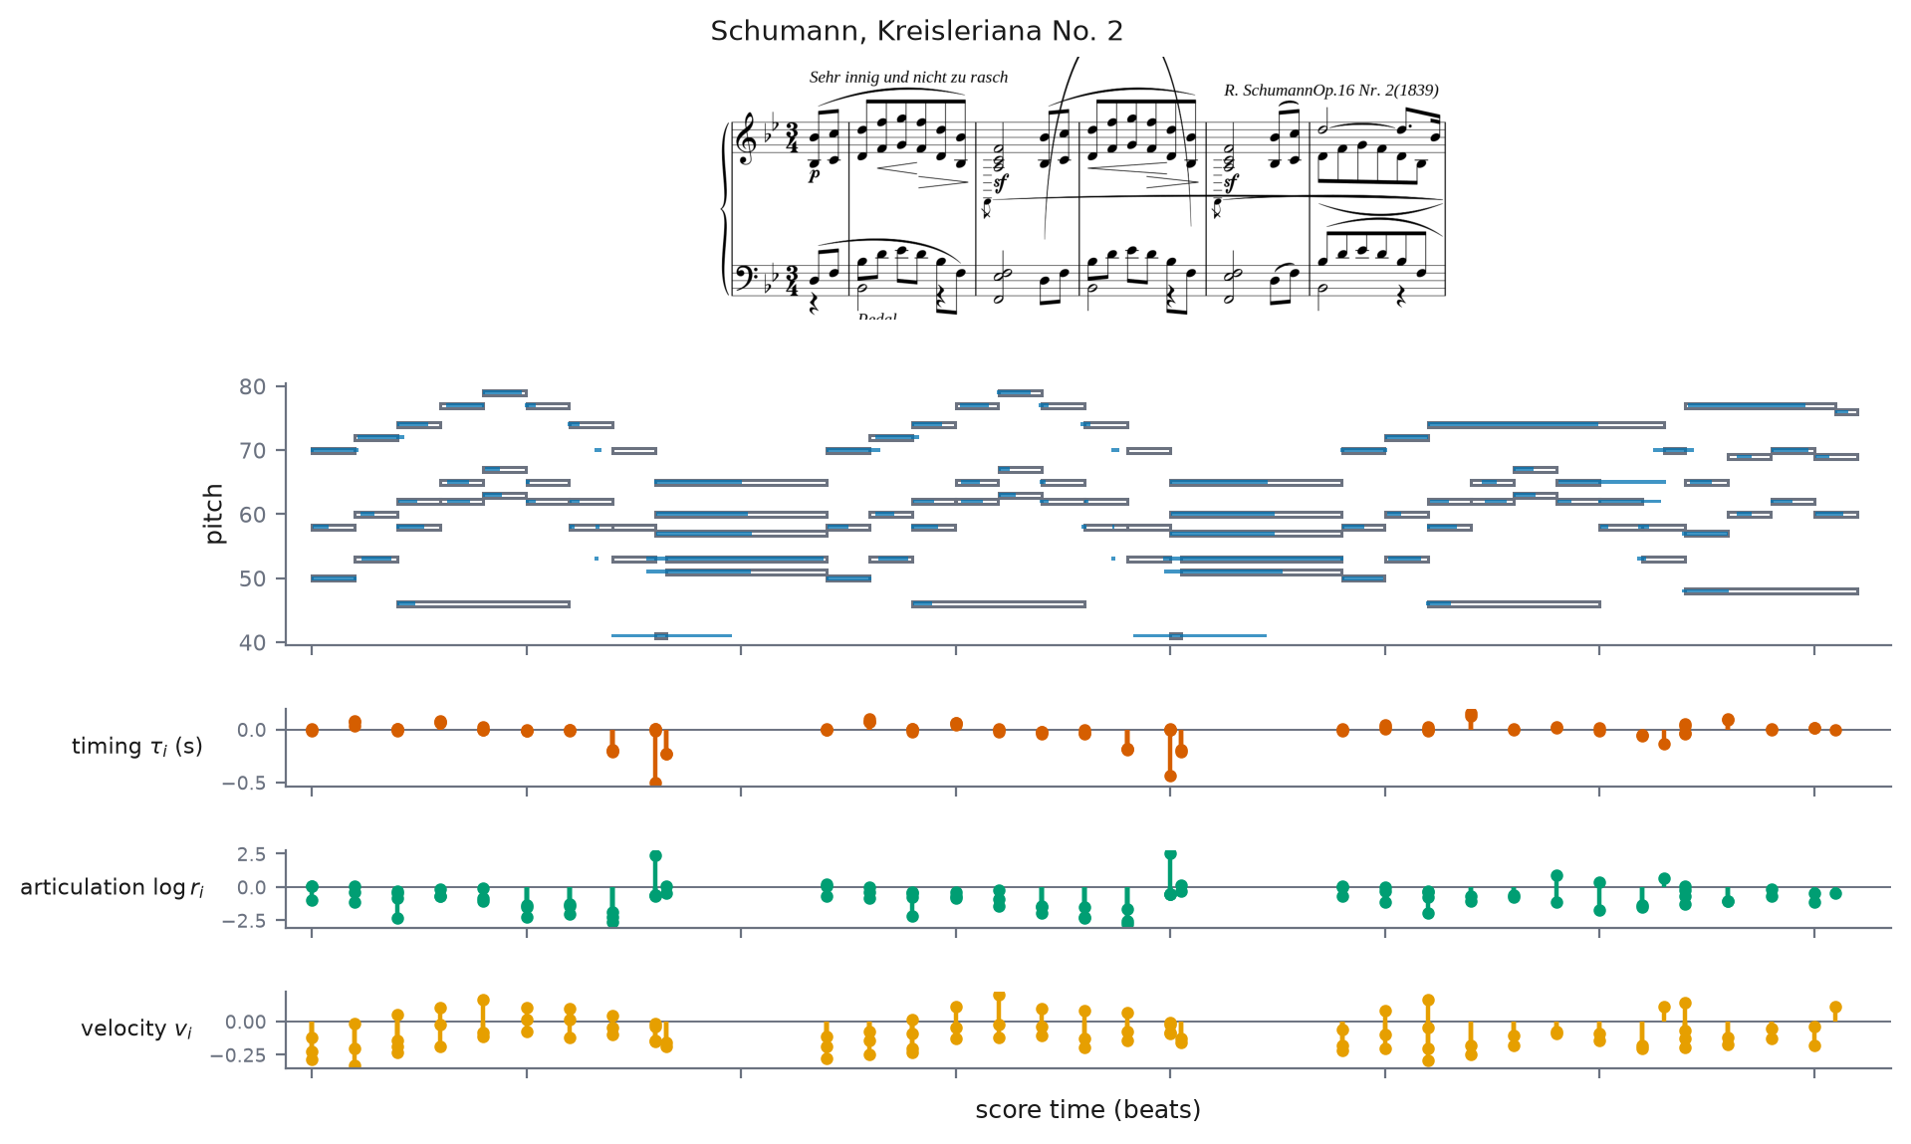

Expressive performance: the same bars, flat vs played
flat (score)
expressive (performance)

