Slide 1
Introduction to Text Mining
Feature Selection
Babatunde K Olorisade
This study was supported by the NIHR Biomedical Research Centre at the University Hospitals Bristol NHS Foundation Trust and the University of Bristol. The views expressed in this presentation are those of the author(s) and not necessarily those of the NHS, the National Institute for Health Research or the Department of Health and Social Care.

Slide 2
Recap of last session
Classification
  Machine Learning Algorithms (Brief Insight)
    Naïve Bayes
    SVM
  Preprocessing
    Missing data investigation
    Label encoding
    Tokenization And feature representation
  Fit Tm Model With:
    Naïve Bayes
    SVM

Slide 3
This session
Model (performance) assessment
Performance improvement
  Feature selection

Slide 4
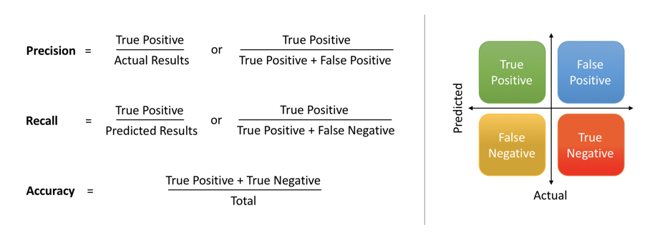
Model assessment
Basic performance metrics
There are numerous others
  More can be found at:
Confusion matrix
https://scikit-learn.org/stable/modules/model_evaluation.html

Slide 5
Performance improvement
Feature selection
Parameter tuning
Cross validation*
  More useful to ensure performance reliability

Slide 6
Feature selection
Remember :
  Garbage
  In
  Garbage
  Out?
In ML, model performance ∝ quality of training features

Slide 7
Feature selection
Irrelevant or partially relevant features can negatively impact model performance.
  How can we determine relevant features?

Slide 8
Future selection approaches
There are three major approaches:
  Filter Methods: apply statistical measure to score and rank features. Often univariate and consider each feature independently or with output label.
  Wrapper Methods: generate models with a subsets of feature and gauge their model performances.
  Embedded Methods: based on some machine learning models.

Slide 9
Benefits of feature selection
Reduce overfitting: reduces the possibility of making decisions based on noise
Improves accuracy
Reduces training time and resources

Slide 10
Specific methods for feature selection
Univariate selection: using statistical test to chose features with strongest relationship to the target output.
  The SelectKBest class in ‘sklearn’ can be used with some statistical tests (e.g. chi²) to select a specific number of features (also KPercentile)

Slide 11
Specific methods for feature selection
Feature importance: Tree based models have in-built feature importance property.
  ExtraTreeClassifier
  RandomForest

Slide 12

Practical in Jupyterlab

Slide 13
Supporting materials
https://towardsdatascience.co m/feature-selection-techniques-in-machine-learning-with-python-f24e7da3f36e
https://machinelearningmastery.com/feature-selection-machine-learning-python/

