Slide 1
Introduction to Text Mining
Cross Validation
Babatunde K Olorisade
This study was supported by the NIHR Biomedical Research Centre at the University Hospitals Bristol NHS Foundation Trust and the University of Bristol. The views expressed in this presentation are those of the author(s) and not necessarily those of the NHS, the National Institute for Health Research or the Department of Health and Social Care.
<number>

Slide 2
Recap of last session
Model assessment
Basic performance metrics
Model assessment with sklearn
Feature selection
Approaches to feature selection
Filter method
wrapper method
Embedded method
Practical
Chi square feature selection method
ExtraTreeClassifier
<number>

Slide 3
This session
Topic: Cross validation
Outcomes:
learn the benefits of cross validation in building models
Learn how to conduct cross validation using sklearn
<number>

Slide 4
Cross validation (CV)
Recall,
our chi-square reduced feature model achieved a 100% recall performance
How confident are we that the model will re-produce this performance in future data?
<number>

Slide 5
Cross validation
CV is a machine learning technique in which a model is trained and tested on every data in the dataset.
<number>

Slide 6
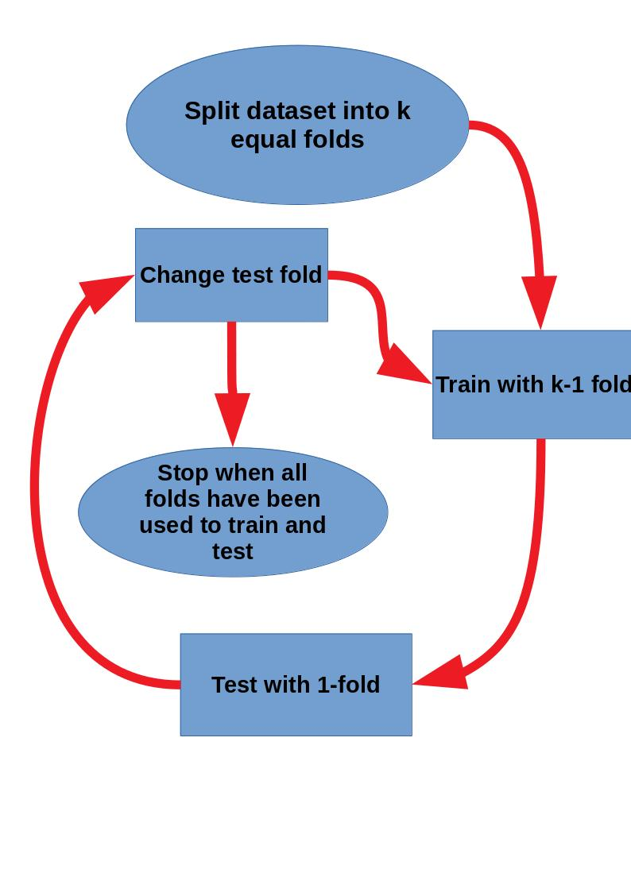
Cross validation
<number>

Slide 7
Methods of cross validation
Leave-p-Out CV: p-number of dataset is set aside to test a model trained on n-p data.
Leave One Out CV (LOOCV) - All but one data is used to train the model.
K-Fold - Dataset is divided into k number of folds. All but one fold is used to train model at a time.
Stratified K-Fold: A form of K-Fold ensuring class representation is like as it is in the original dataset
<number>

Slide 8
Materials
https://www.geeksforgeeks.org/cross-validation-machine-learning/
https://machinelearningmastery.com/k-fold-cross-validation/
https://www.analyticsvidhya.com/blog/2018/05/improve-model-performance-cross-validation-in-python-r/
<number>

