Slide 1
Introduction to Text Mining
Parameter Tuning
Babatunde K Olorisade
This study was supported by the NIHR Biomedical Research Centre at the University Hospitals Bristol NHS Foundation Trust and the University of Bristol. The views expressed in this presentation are those of the author(s) and not necessarily those of the NHS, the National Institute for Health Research or the Department of Health and Social Care.

Slide 2
Recap of last session
Cross validation
Meaning and types of cross validation
Importance of cross validation
Implementation

Slide 3
Concepts learnt so far
Brief intro to machine learning
Text mining basics
Text classification steps:
Data retrieval
Data exploration
Text preprocessing – cleaning
Text representation
Dimensionality reduction
Text classification – models
Model assessment
Cross validation

Slide 4
This session
Parameter tuning
Grid searching
Cross validation
Pipelining

Slide 5
Parameter tuning (justification)
Each algorithm has multiple parameters
Each parameter can (in most cases) take on multiple options
Optimal combination of these parameters is key to obtaining an optimal model
But all possible combination of these parameter choices is practically in-exhaustible

Slide 6
Parameters example
An example of the support vector machine implementation in sklearn
class sklearn.svm.SVC(C=1.0, kernel=’rbf’, degree=3, gamma=’auto_deprecated’, coef0=0.0, shrinking=True, probability=False, tol=0.001, cache_size=200, class_weight=None, verbose=False, max_iter=-1, decision_function_shape=’ovr’, random_state=None)

Slide 7
Parameters example
C : float
kernel : string
degree : int
gamma : float
coef0 : float
shrinking : boolean
random_state : int
probability : boolean
tol : float
cache_size : float
class_weight : {dict, ‘balanced’}
verbose : bool
max_iter : int
decision_function_shape : ‘ovo’, ‘ovr’

Slide 8
Grid search
An extensive multi-parameter search approach used in machine learning to determine an optimal combination of given parameter values.
The search develops models with the different parameters combined and evaluate against each other

Slide 9
Grid search and cross validation
The grid search process is usually combined with cross validation (already covered)

Slide 10
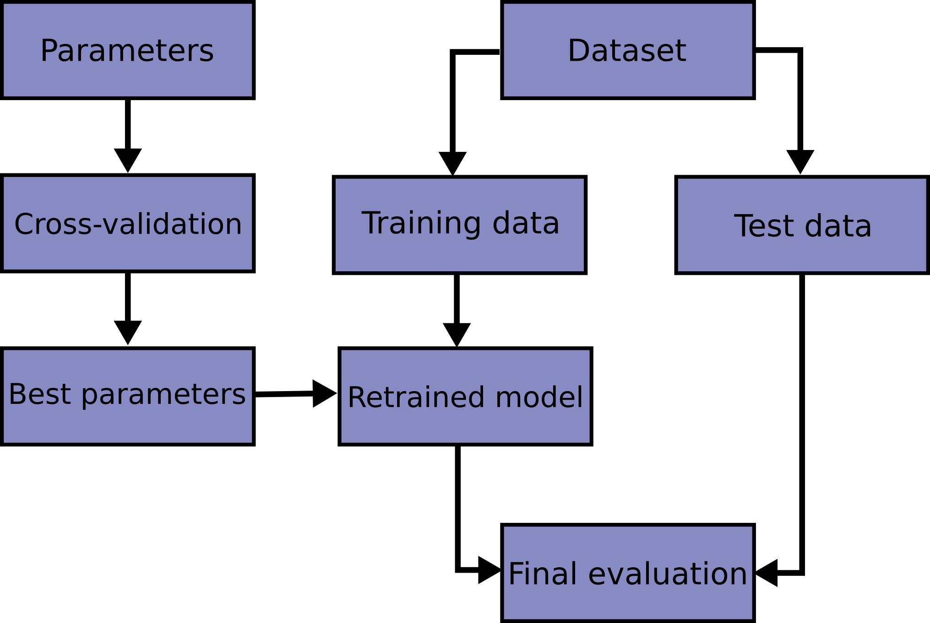
Grid search work flow
www.scikit-learn.org

