Slide 1



Real Time Ray Tracing of Implicit Surfaces Utilizing GPGPU Computing
Raymond L. Imber
Department of Computer Science, University of Nevada Las Vegas
Dr. Donald Spickler
Department of Mathematics, Salisbury University
Dr. Enyue Lu
Department of Computer Science, Salisbury University

Slide 2
Abstract
Ray Tracing is ideal for GPGPU architecture
GPU architecture has recently become powerful enough to allow for Ray Tracing
Embarrassingly parallel
Each Ray can be computed independently
Major Caveat
I/O Bottleneck – 3D geometry is costly to store and transfer

Slide 3
Abstract
Ray Tracing Implicit Surfaces
Implicit Surfaces can be compactly stored and transferred
Low I/O Cost / High compute cost – Ideal for GPU
Implicit Surfaces have wide applications
Implicit Surfaces have received little research attention
One of the only papers is from Singh (2007)
The basis for my research

Slide 4
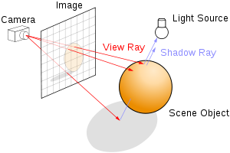
Ray Tracing Theory
Simulate the path light rays take through a scene
Check if the ray has intersected any surfaces
Reflective and Refractive properties of the surface determine the ‘color’ of the ray.

Slide 5




Implicit Surface Theory
Level Set / Level Surface
The set of all points where
This set describes a surface in
Checking for a ray intersection
can be reduced to finding a point on the ray that is in the level set for
This is equivalent to finding the root of when projected onto the ray, , a.k.a

Slide 6
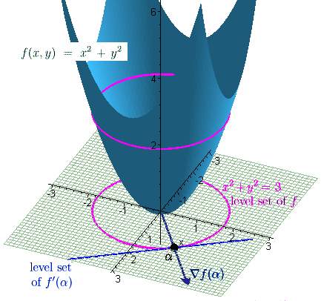
Level Set Diagram

Slide 7
Ray Marching
Two step algorithm proposed by Singh
Step 1) “March” down the ray at set intervals
At each interval check for the existence of a root
Accomplished with an interval extension test
When an interval is found to contain a root proceed to step 2
Step 2) Use some numerical approximation method to determine the value of the root

Slide 8
Interval Extension Tests
Sign Test
Check for a change in sign between the end points
Pros: Fast and Simple
Cons: May produce false negatives
If an even number of roots exist inside the interval
Taylor Test
Use First order Taylor series expansion centered at each end point extended to the midpoint
Sign test both the end points and the Taylor expansion of those points
Pros: More robust than Sign test
Cons: Requires a derivative calculation

Slide 9

Numerical Approximation Methods
Bisection Method
Iteratively subdivide the interval in half
The midpoint of the previous iteration becomes an end point of the next iteration
The midpoint of each iteration approaches the root
Pros: Computationally simple, very robust
Cons: Asymptotically slow
Ridders’ Method
The values of at each end point and the midpoint are transformed into a straight line
The root of this line is used as an end point for the next iteration
The root of the transformed line approaches the root
Pros: Asymptotically fast, very robust
Cons: Computationally complex

Slide 10
Implementation
Supersonic Pineapple (First Attempt)
NVIDIA Optix library short comings
Large and cumbersome to use
Not optimized for implicit surfaces
Frame rates were not real time
For Ray Marching, less than 4 FPS
Unacceptable results!

Slide 11
Implementation
Wild Doughnut (Second Attempt)
Custom Ray Tracer
Explored the limit of implementing inheritance on GPGPU architecture
Frame rates on the same order of magnitude as Singh’s results
Caveat: Took a lot of time to build, and there was little time left
Implementation is unstable, and would often crash the GPU

Slide 12
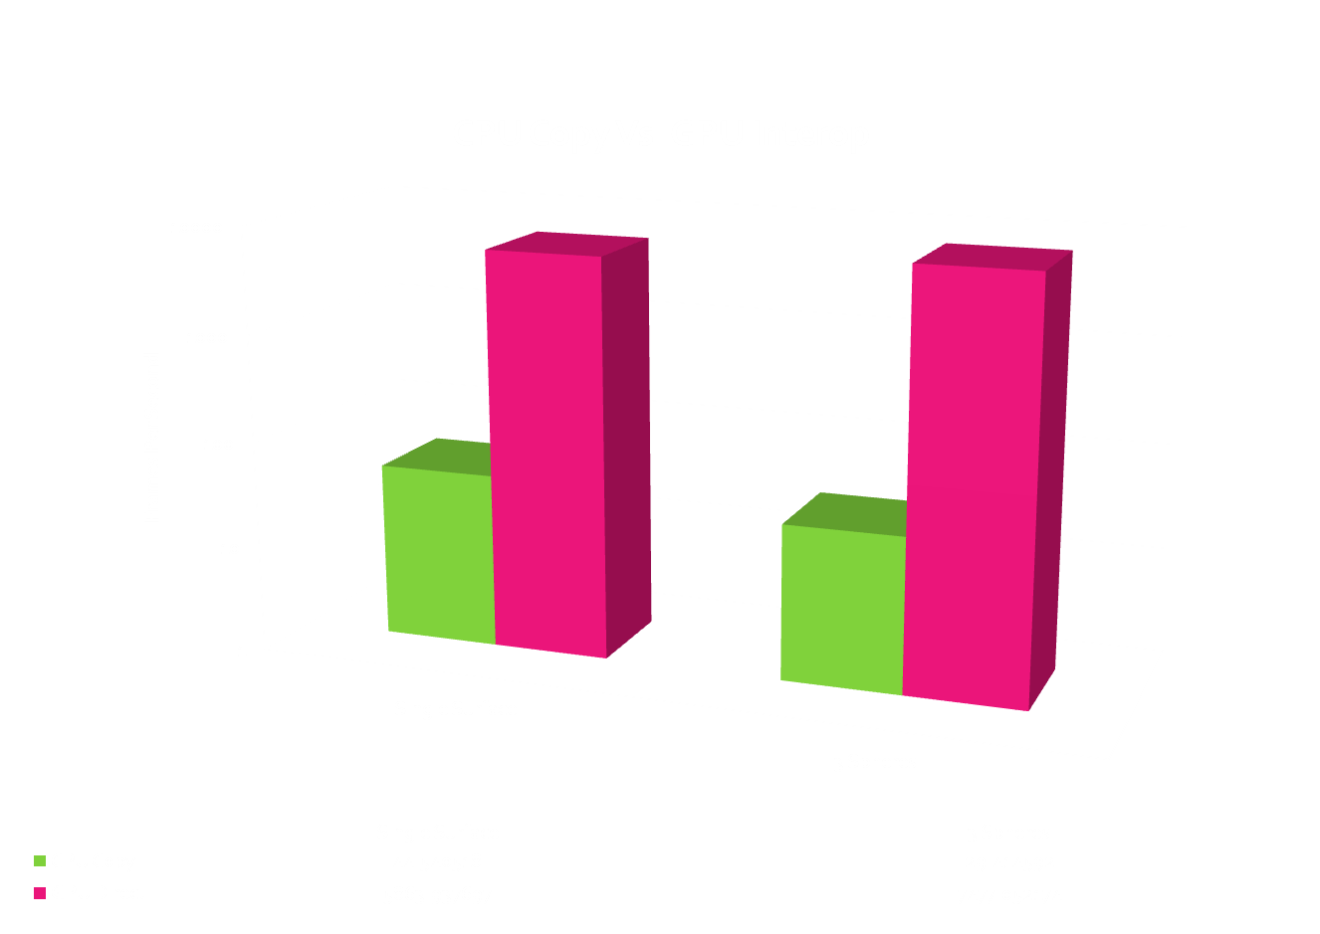
Results
Preliminary test
Measure Difference in FPS between CPU copy and direct OpenGL interop (no CPU copy)

Slide 13
Results
All Four possible configurations of Ray Marching were tested, on Four surfaces
Sphere
Torus (Quartic form)
Barth Decic
Non-Algebraic Blobby

Slide 14
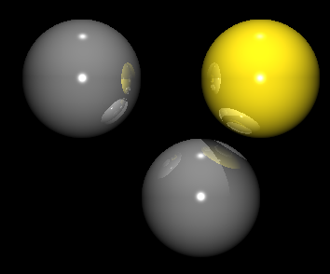
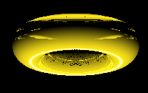
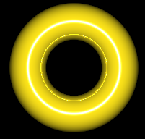
Results
(a) 3 Sphere Scene, analytically solved
(b) Torus, Ridders’ / Taylor method
step size 0.3

Slide 15
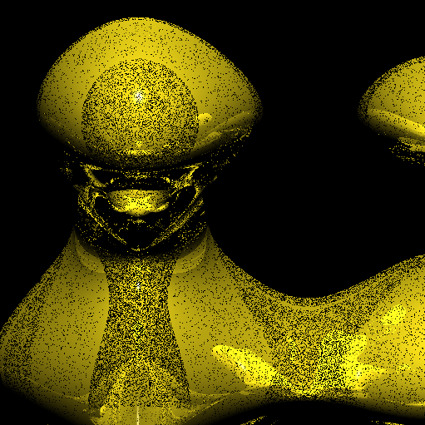
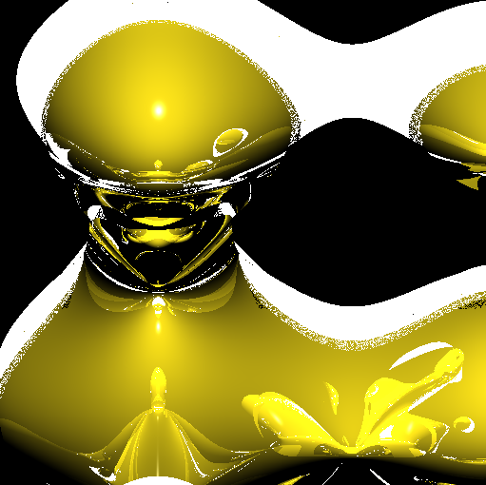
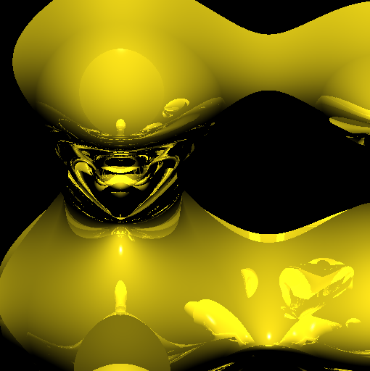
Results
(c) Non-Algebraic Blobby
Left: Ridders’ / Taylor method, step size: 0.5
Middle: Ridders’ / Taylor method with invalid roots highlighted
Right: Bisection / Taylor method, step size 0.5

Slide 16
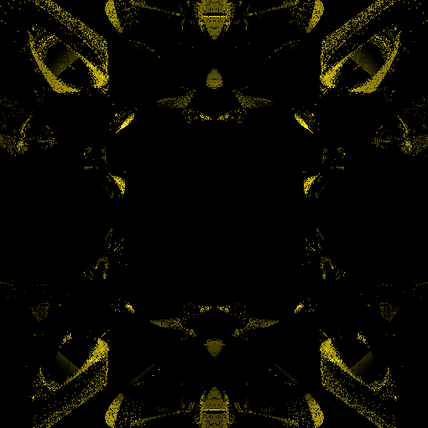
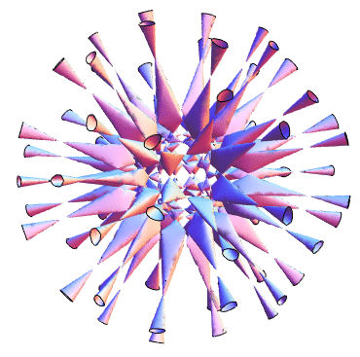
Results
Barth Decic was not as successful
Wild Doughnut Result
Wolfram Math World Rendering

Slide 17
Results
Average FPS as a measure for performance
Note: FPS was measured as time to fill the GPU buffer, not time to display on screen
Standard Deviation as a measure of robustness
Low Standard Deviation would indicate a consistent GPU work load

Slide 18
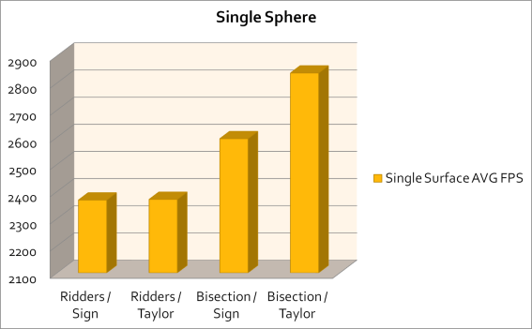
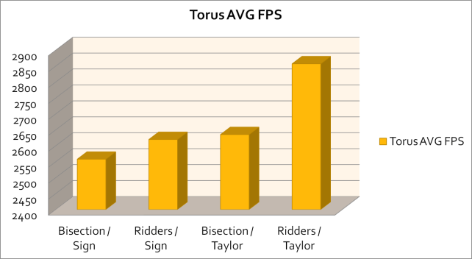
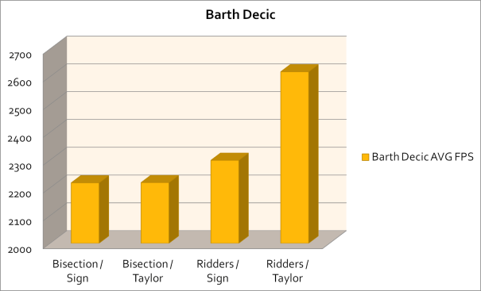
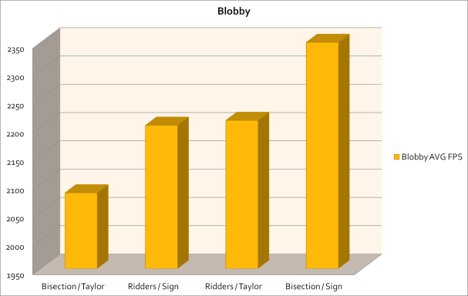
Results

Slide 19
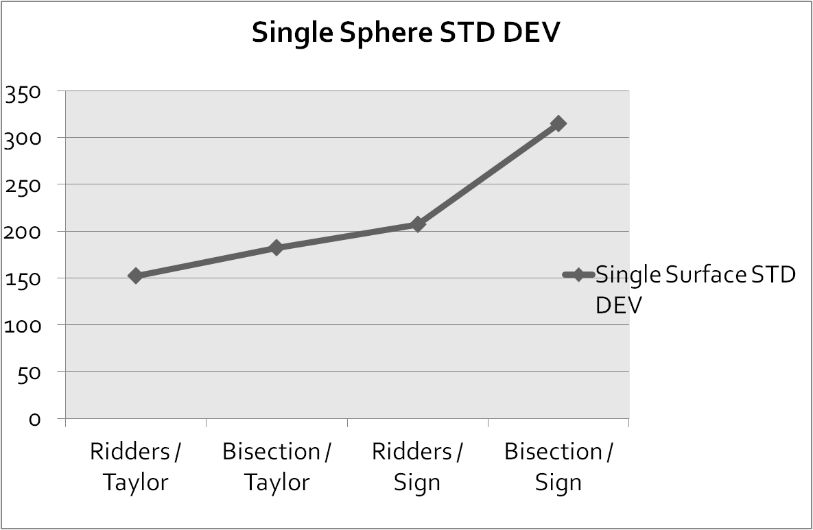
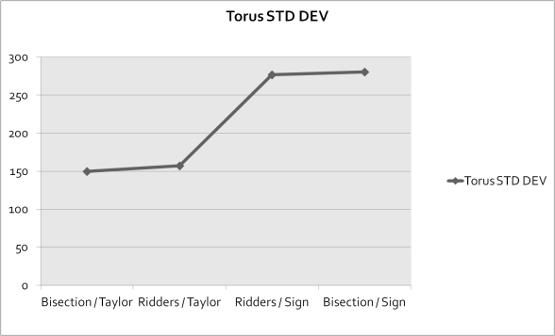
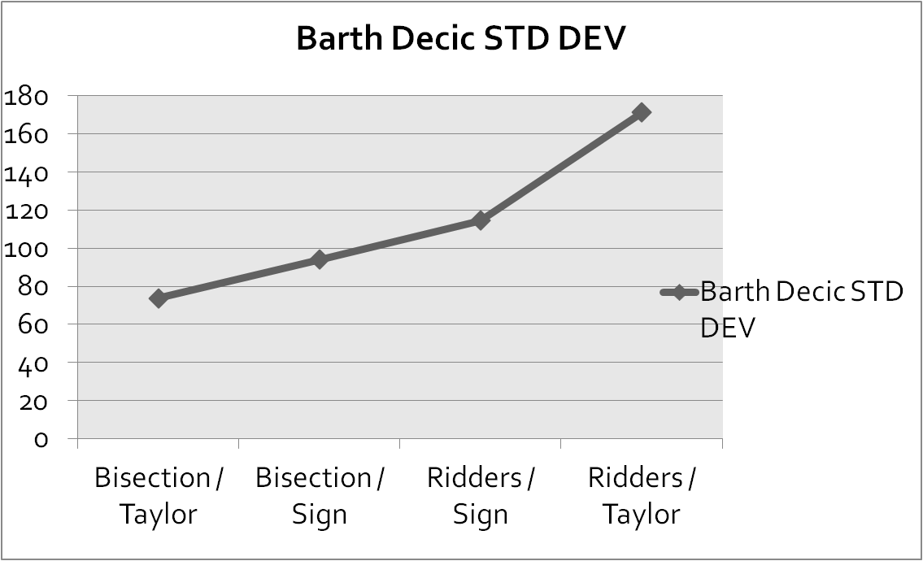
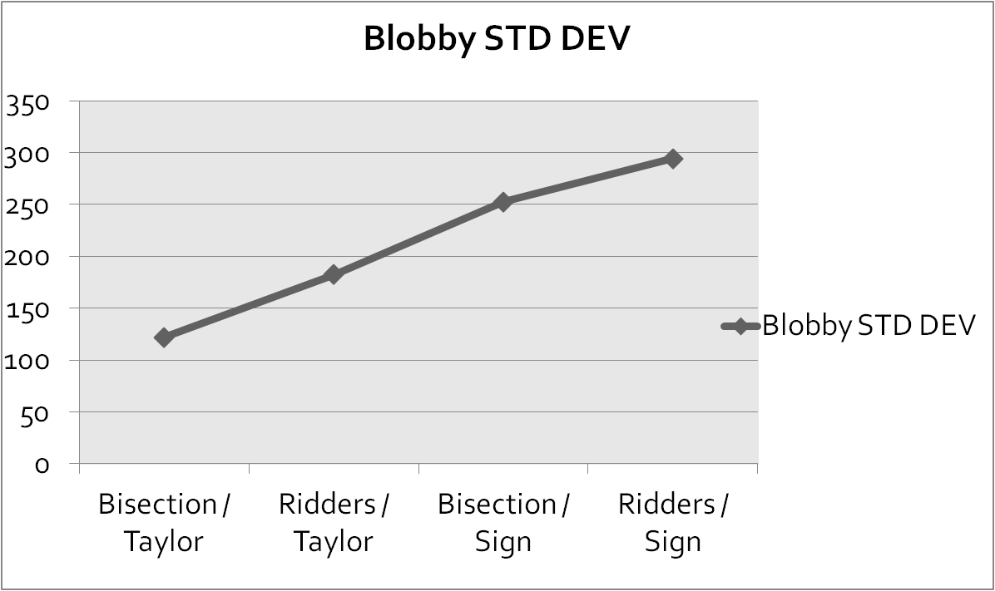
Results

Slide 20
Conclusions
Performance is highly dependant on the surface
The interval extension test used had the most significant impact on performance and robustness
Taylor test consistently out performed other configurations
Both Average FPS and Standard Deviation
Counterintuitive to the algorithmic complexity
Evidence that Taylor test is well suited for GPGPU architecture

Slide 21
Conclusions
Ridders’ method had less performance impact than expected
The asymptotic convergence speed did not overcome the computational complexity costs
Square roots are very expensive to evaluate
Simplicity of Bisection is well suited to GPU
Visual inspection of the Blobby suggests Ridders’ method may produce more accurate roots.
More rigorous accuracy tests are needed

Slide 22
Results
(c) Non-Algebraic Blobby
Left: Ridders’ / Taylor method, step size: 0.5
Middle: Ridders’ / Taylor method with invalid roots highlighted
Right: Bisection / Taylor method, step size 0.5

Slide 23
Future Work
Optimize and Stabilize the code
Minimize the memory footprint of the device code
Split calculation into smaller kernels – ‘sub kernels’
Either tile in screen space, or possibly depth tiling
Develop more rigorous root accuracy tests
Instead of an image, output an array of root values for statistical analysis
Implement other Ray Marching Schemes
Singh Adaptive Marching algorithm
Recursive Marching algorithm

Slide 24
References
[1] Ridders, C. (1979). "A new algorithm for computing a single root of a real continuous function". IEEE Transactions on Circuits and Systems 26: 979–980. doi:10.1109/TCS.1979.1084580
[2] Jag Mohan Singh, P.J. Narayanan, "Real-Time Ray Tracing of Implicit Surfaces on the GPU," IEEE Transactions on Visualization and Computer Graphics, vol. 99, no. RapidPosts, pp. 261-272, , 2009

