Slide 1
PAYSWIFT
End-to-End Pipeline: Synthetic Data to Actionable Insights

Slide 2
Project Overview
Objective: Detect fraud in 10K transactions (13% fraud rate).
Pipeline: Synthetic data → Postgres → EDA → RandomForestClassifier → Tableau → Report.
Impact: Flagged 203/255 frauds, saved N38K per catch.

Slide 3
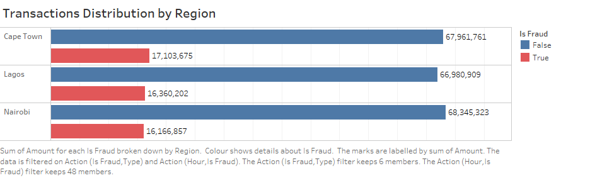
Fraud Exposure by Region
Key Takeaways:
Cape Town: N17,103,675 fraud amount of (1,761 total transactions)—highest fraud intensity per transaction.
Lagos: N16,360,202 fraud amount of (3,909 total transactions), Nairobi: N16,166,857 amount of fraud (3,323 total transactions)—larger markets, spread risk.
Recommendation:
Deploy advanced fraud detection rules in Cape Town to curb high-value fraud.

Slide 4
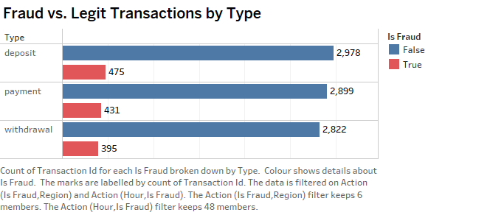
Fraud Patterns by Transaction Type
Key Takeaways:
Deposits lead fraud with 475 cases (36.5% of frauds), despite only 3,454 total transactions.
Payments show 431 frauds (2,889 total), while withdrawals have 395 (2,822 total)—more balanced.
Recommendation:
Implement stricter verification for deposit transactions to reduce fraud exposure.

Slide 5
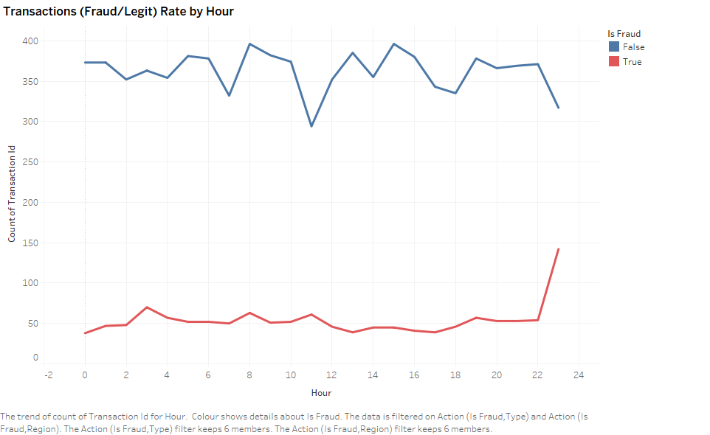
Transactions (Fraud/Legit) Rate by Hour
Key Takeaways:
23:00 fraud peak: 31% fraud rate, 142 fraud transactions—nighttime is riskiest.
7:00 fraud low: 5% rate—daytime transactions safer.
Recommendation:
Increase fraud detection vigilance from 20:00 to 02:00 to target peak hours.

Slide 6
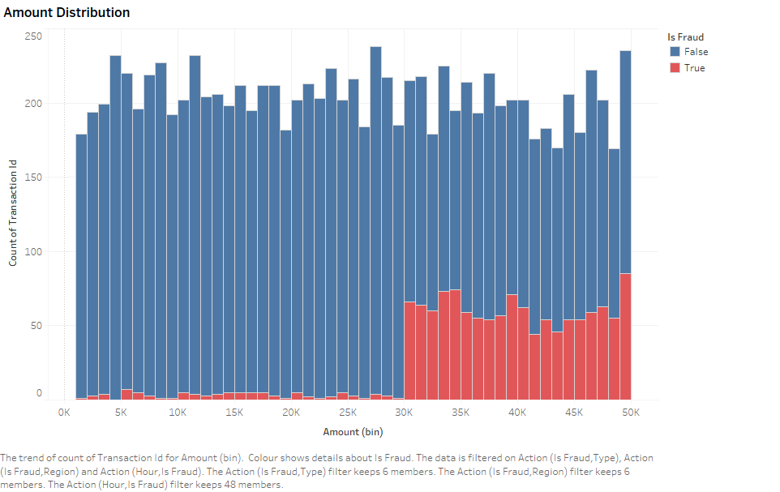
Transaction Amount Patterns: Fraud vs. Legit
Key Takeaways:
Fraud transactions peak at ~N38K, while legit transactions average N23K—distinct separation.
90% of frauds exceed N30K (vs. 20% legit.
Recommendation: Set automated alerts for transactions >N30K to catch 60% of fraud cases.

Slide 7
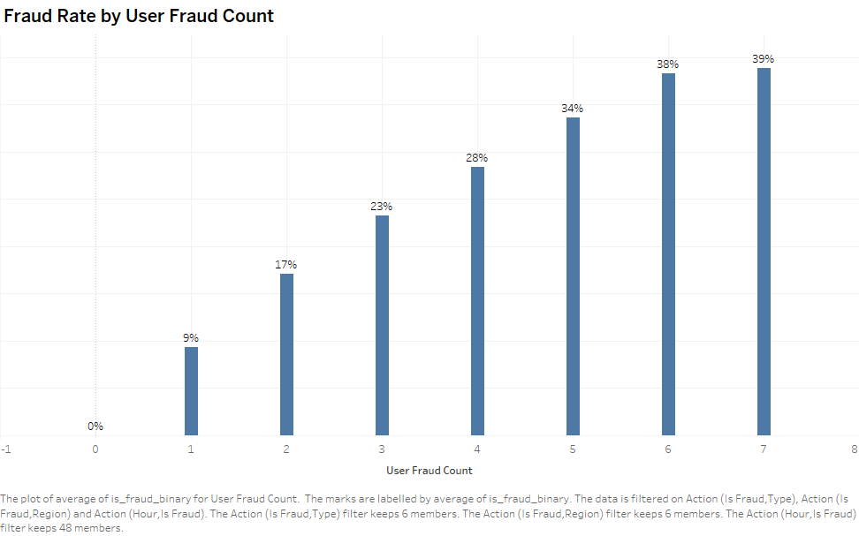
Fraud Rate by User Fraud Count
Key Takeaways:
Users with 7 prior frauds: 39% fraud rate; 5 priors: 34%—repeat offenders are high-risk.
Zero prior frauds: 0% fraud rate—clean users stay clean.
Recommendation: Auto-block users with 5+ prior frauds to prevent 34%+ fraud likelihood.

Slide 8
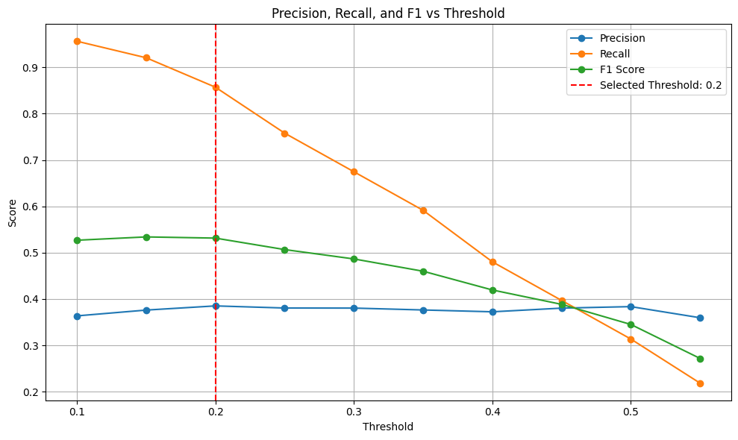
Random Forest (SMOTE): 86% Fraud Recall Saves N8.208M
The Random Forest model with SMOTE achieved an 86% recall at threshold 0.20, catching 216 out of 252 fraud transactions in the test set, saving N8.208M at N38K per fraud. With 39% precision, it balances fraud detection with 345 false positives—optimized for fraud capture.
Key Takeaways:
86% recall captures 216/252 frauds, saving ~N8.208M; reliable performance (AUC ~0.88).
39% precision results in 345 false positives—manageable for ops, saves N570K vs. catching fewer frauds.

