Slide 1
Joint Attention, Computer Vision, and Foundation Models: How State-of-the-art AI approaches can analyze instances of early childhood development
Priscilla Zhao, Raymond Zhang
Faculty Advisors: Phil Fisher, Nick Haber, Silvio Savarese, Jeannette Bohg

Slide 2
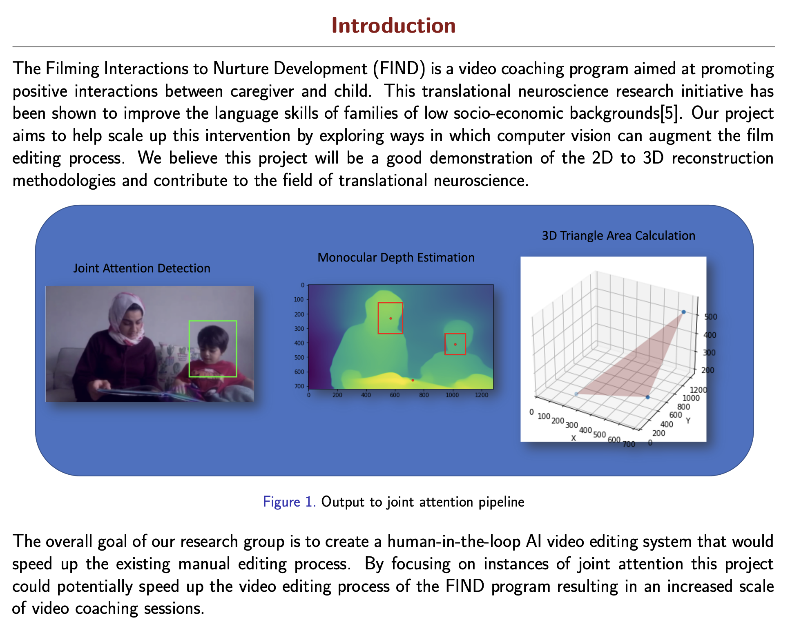

Slide 3
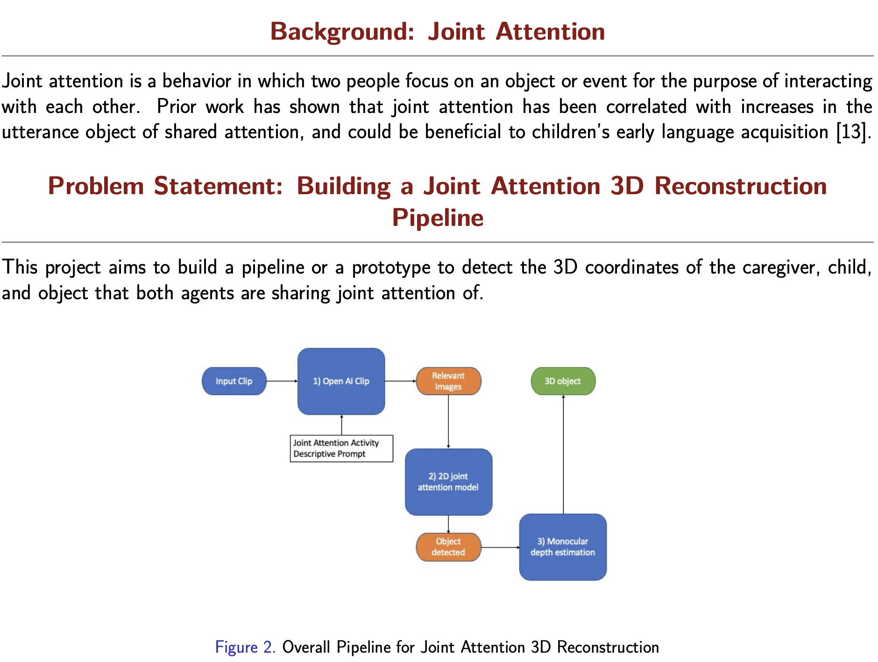

Slide 4
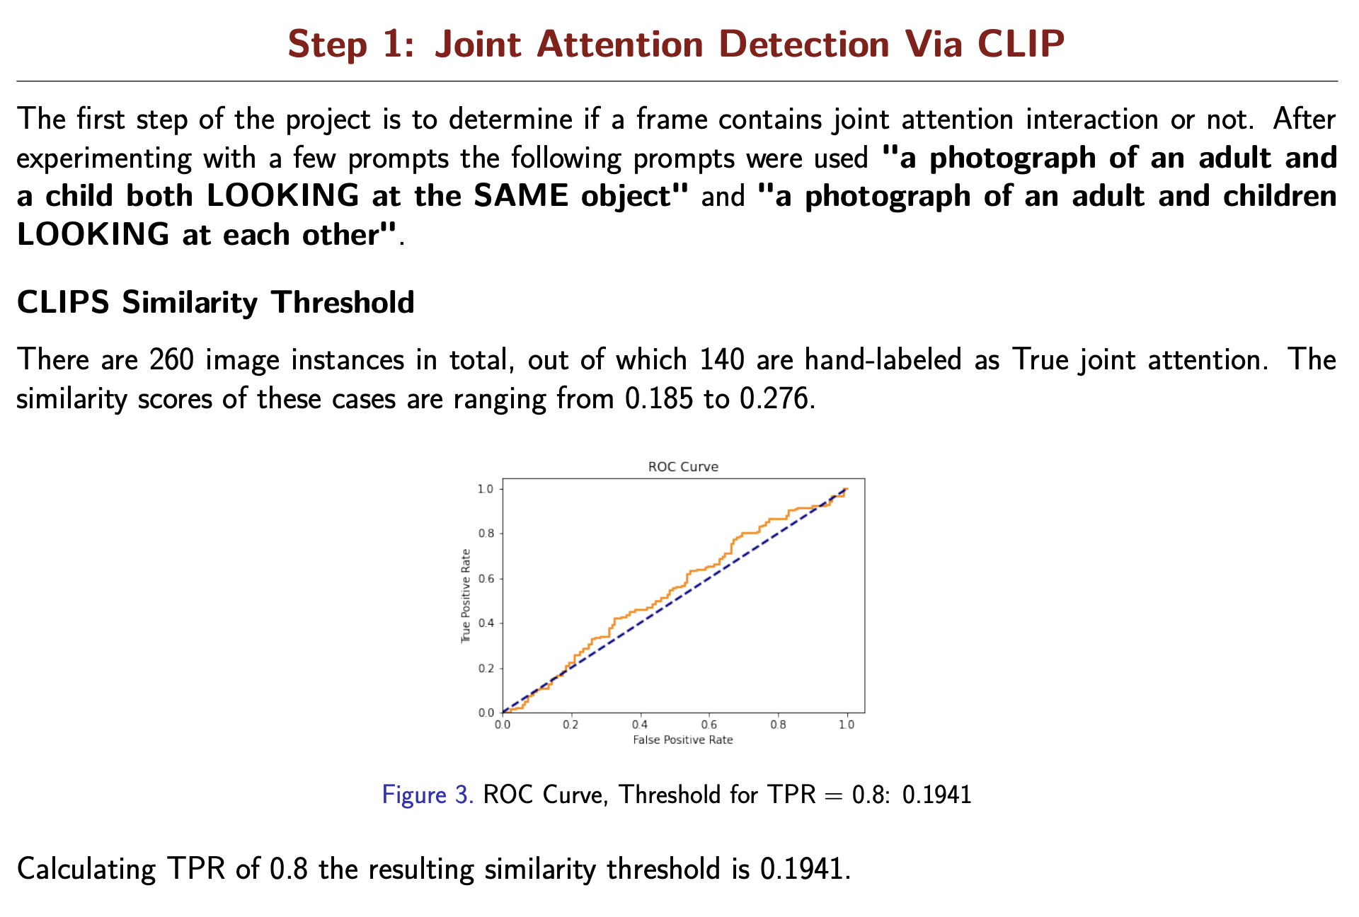

Slide 5
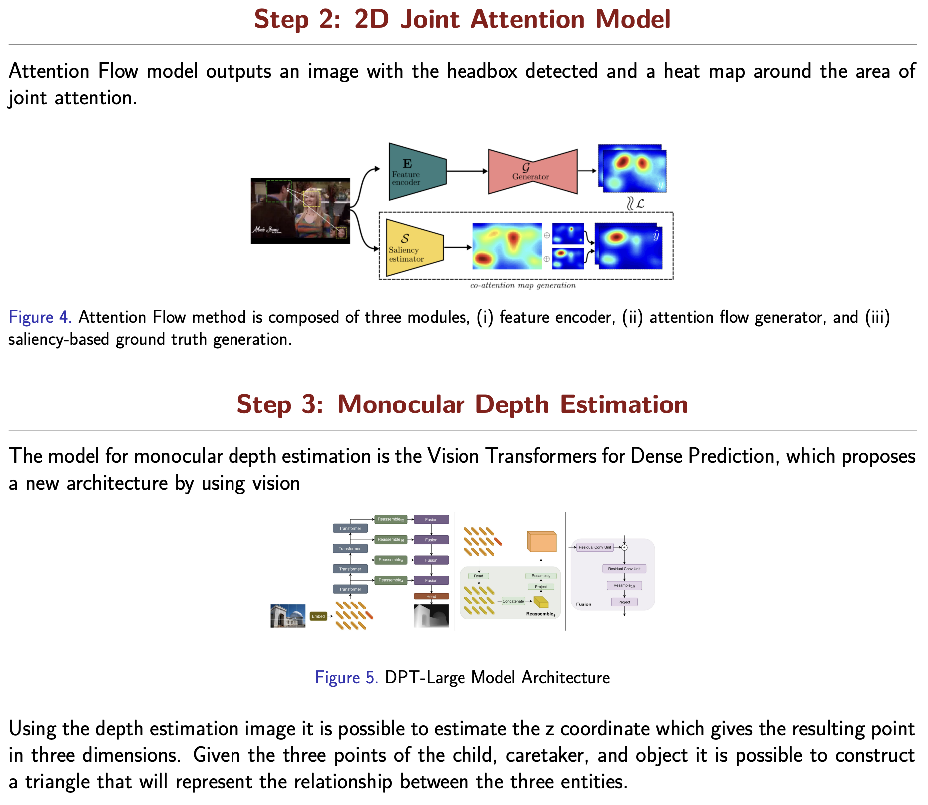

Slide 6
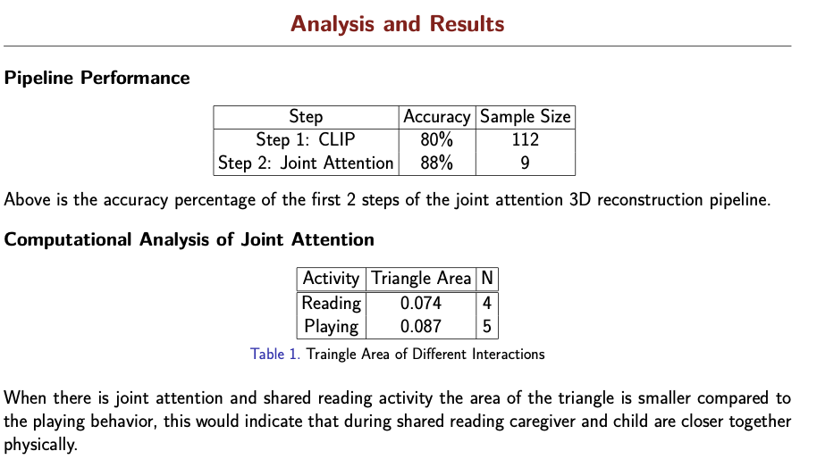

Slide 7
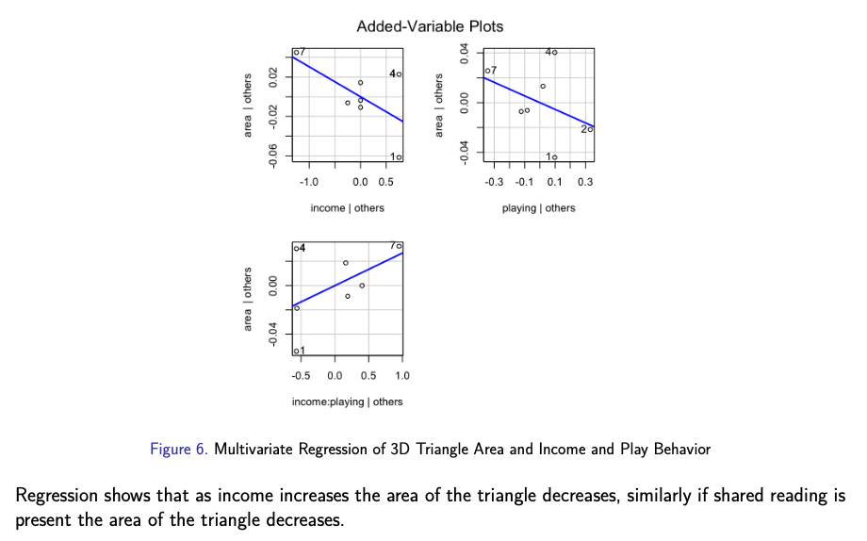

Slide 8
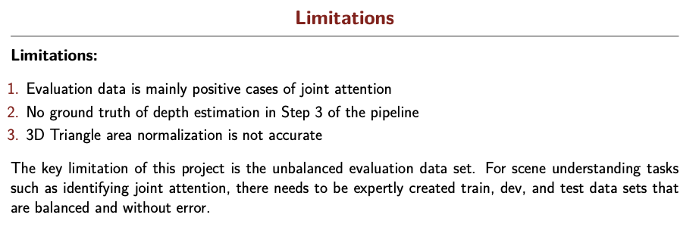
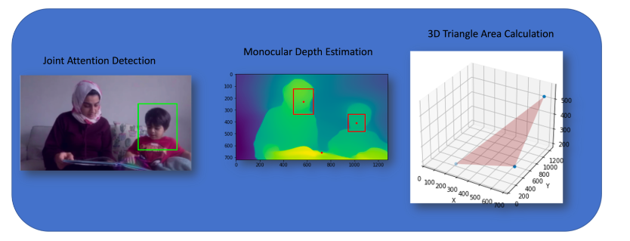

Slide 9
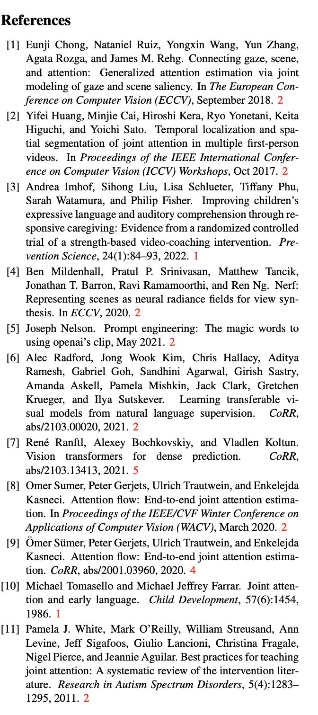
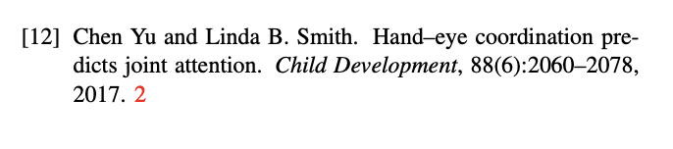

Slide 10
Thank you!

