Slide 1
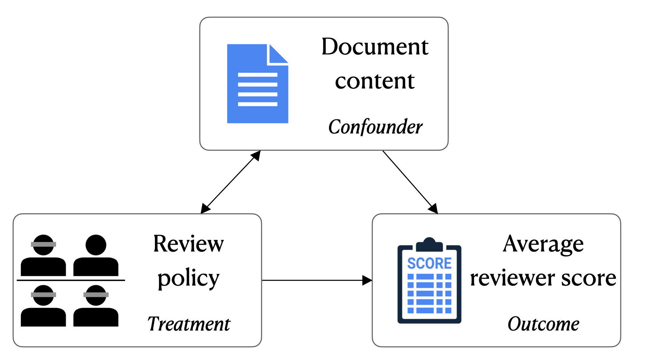
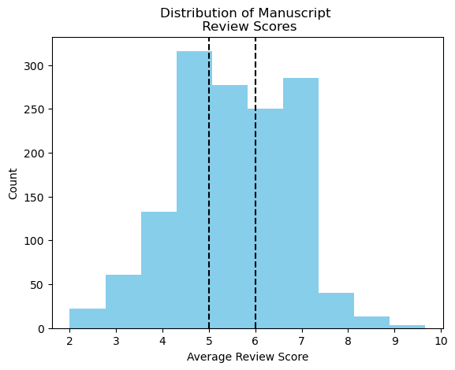
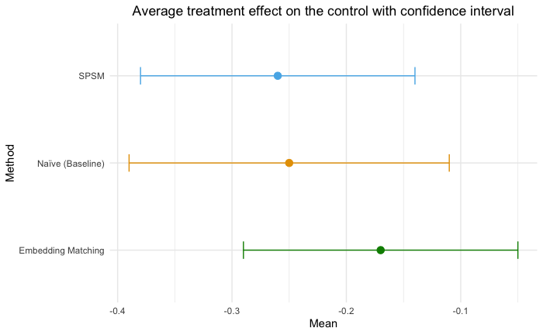
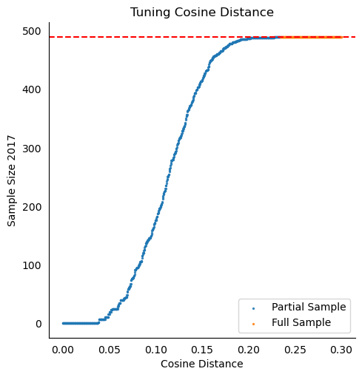
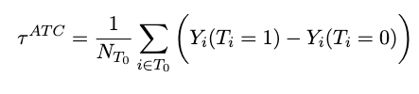
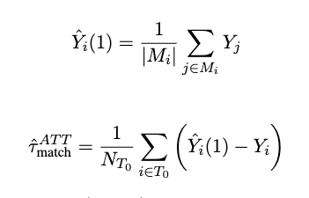


Does double-blind review policy matter?
Findings from leading machine learning conference shows a small and relevant decrease in review score.
Title: Subtitle
Leeroy Jenkins, author2, author3, author4
INTRODUCTION
Peer review is the cornerstone of scientific evaluation. Double-blind review is argued to be the gold standard of peer review processes because anonymity results an a more objective review outcome. However, few studies have examined the causal effects of double-blind review policies because of the complexities of dealing with textual data. We present a new procedure that allows for handling different distribution of textual confounds. This study contributes in two important ways, first we provide a new procedure for analyzing causal inference with text data, second, we provide a case study of how this method can be used to analyze changes in a leading machine learning conference.
BACKGROUND
ICRL, a leading machine learning conference, experienced a policy shift from single-blind review to double-blind review during the years 2017 to 2018. This event sets up a natural experiment to analyze how double-blind review caused changes in scientific evaluation.
RESEARCH QUESTION
What is the effect on review score of changing review policies from single to double blind review?
How can a method control for textual confounds while estimating the causal effect of the policy?
EXPERIMENTAL SETUP
PROCEDURE
Potential Outcome Matching Estimator
SPECTER Word Embedding
KNN-Matching
Additional Information
RESULTS
ATU is -0.17 with 95% confidence interval [-0.29,-0.05]
Human evaluation shows 71% prefer our method
DISCUSSION/LIMITATIONS
An important limitation of this study is that we only control for textual confounders while other confounding factors exist. Additionally, this study focuses on the average effect of the policy and does not analyze for whom is the policy most effective for. If double-blind review is supposed to be more objective, we would expect certain privileged authors (I.E., famous authors) to experience a larger reduction in review score. While our study provides a new method for analyzing text-based policy changes, and a provides a meaning result to better understanding peer review, much work still needs to be done in order to move towards a more objective scientific evaluation process. Future work include looking at treatment heterogeneity and impact on acceptance/rejection.
Conference Year | Data Size
ICLR 2017 | 490
ICLR 2018 | 910
Potential Outcome Matching Estimator
Raymond Zhang | Advisor Dan McFarland
Submitted to Annual Meeting of Association for
Computational Linguistics (ACL)
Notes:
Not sure where the review score decrease is.
The problem isn’t clear.
Broadline papers matters –histogram of the number of papers on the board

