Slide 1

Intro to Machine Learning
Thank you Professor Eric Eaton

Slide 2
What is Machine Learning?
“Learning is any process by which a system improves performance from experience.”
- Herbert Simon
Definition by Tom Mitchell (1998):
Machine Learning is the study of algorithms that
improve their performance P
at some task T
with experience E.
A well-defined learning task is given by <P, T, E>.
3

Slide 3
Traditional Programming
Data Program
Computer
Output
Machine Learning
Data Output
Computer
Program
4
Slide credit: Pedro Domingos

Slide 4



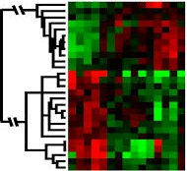
When Do We Use Machine Learning?
ML is used when:
Human expertise does not exist (navigating on Mars)
Humans can’t explain their expertise (speech recognition)
Models must be customized (personalized medicine)
Models are based on huge amounts of data (genomics)
Learning isn’t always useful:
There is no need to “learn” to calculate payroll
Based on slide by E. Alpaydin
5

Slide 5
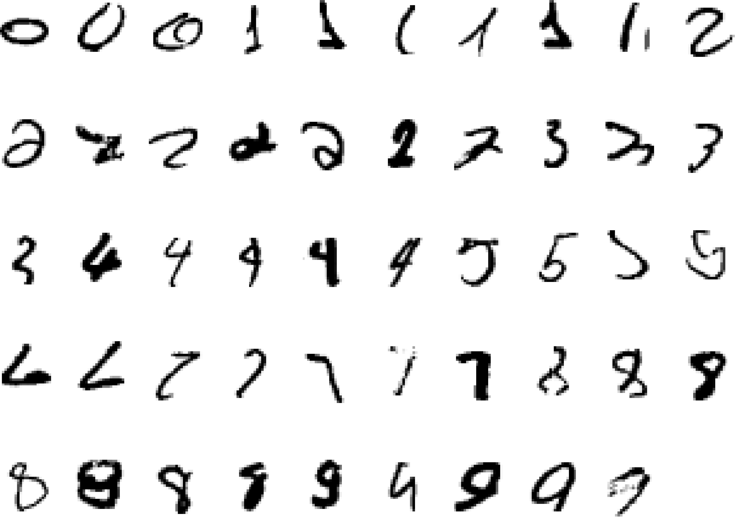
A classic example of a task that requires machine learning: It is very hard to say what makes a 2
Slide credit: Geoffrey Hinton

Slide 6
Some more examples of tasks that are best solved by using a learning algorithm
Recognizing patterns:
Facial identities or facial expressions
Handwritten or spoken words
Medical images
Generating patterns:
Generating images or motion sequences
Recognizing anomalies:
Unusual credit card transactions
Unusual patterns of sensor readings in a nuclear power plant
Prediction:
Future stock prices or currency exchange rates
Slide credit: Geoffrey Hinton

Slide 7
Sample Applications
Web search
Computational biology
Finance
E-commerce
Space exploration
Robotics
Information extraction
Social networks
Debugging software
[Your favorite area]
Slide credit: Pedro Domingos

Slide 8
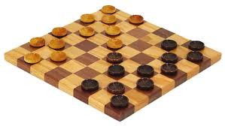
Samuel’s Checkers-Player
“Machine Learning: Field of study that gives computers the ability to learn without being explicitly programmed.” -Arthur Samuel (1959)
9

Slide 9
Defining the Learning Task
Improve on task T, with respect to performance metric P, based on experience E
T: Playing checkers
P: Percentage of games won against an arbitrary opponent E: Playing practice games against itself
T: Recognizing hand-written words
P: Percentage of words correctly classified
E: Database of human-labeled images of handwritten words
T: Driving on four-lane highways using vision sensors
P: Average distance traveled before a human-judged error
E: A sequence of images and steering commands recorded while observing a human driver.
T: Categorize email messages as spam or legitimate. P: Percentage of email messages correctly classified. E: Database of emails, some with human-given labels
10
Slide credit: Ray Mooney

Slide 10
Types of Learning

Slide 11
Types of Learning
Supervised (inductive) learning
Given: training data + desired outputs (labels)
Unsupervised learning
Given: training data (without desired outputs)
Semi-supervised learning
Given: training data + a few desired outputs
Reinforcement learning
Rewards from sequence of actions
24
Based on slide by Pedro Domingos

Slide 12



Supervised Learning: Regression
Given (x₁, y₁), (x₂, y₂), ..., (x_{n}, y_{n})
Learn a function f(x) to predict y given x
– y is real-valued == regression
9
8
7
6
5
4
3
2
1
0
1970 1980
September Arctic Sea Ice Extent (1,000,000 sq km)
1990 2000
2010
2020
Year
Data from G. Witt. Journal of Statistics Education, Volume 21, Number 1 (2013)
26

Slide 13










Supervised Learning: Classification
Given (x₁, y₁), (x₂, y₂), ..., (x_{n}, y_{n})
Learn a function f(x) to predict y given x
– y is categorical == classification
Breast Cancer (Malignant / Benign)
1(Malignant)
0(Benign)
Tumor Size
27
Based on example by Andrew Ng

Slide 14







Supervised Learning: Classification
Given (x₁, y₁), (x₂, y₂), ..., (x_{n}, y_{n})
Learn a function f(x) to predict y given x
– y is categorical == classification
Breast Cancer (Malignant / Benign)
1(Malignant)
0(Benign)
Tumor Size
Tumor Size
Based on example by Andrew Ng

Slide 15






Supervised Learning: Classification
Given (x₁, y₁), (x₂, y₂), ..., (x_{n}, y_{n})
Learn a function f(x) to predict y given x
– y is categorical == classification
Breast Cancer (Malignant / Benign)
1(Malignant)
0(Benign)
Tumor Size
Predict Benign Predict Malignant
Tumor Size
Based on example by Andrew Ng

Slide 16









Supervised Learning
x can be multi-dimensional
– Each dimension corresponds to an attribute
Clump Thickness
Uniformity of Cell Size
Uniformity of Cell Shape
…
Age
Tumor Size
30
Based on example by Andrew Ng

Slide 17















Unsupervised Learning
Given x₁, x₂, ..., x_{n} (without labels)
Output hidden structure behind the x’s
– E.g., clustering
31

Slide 18
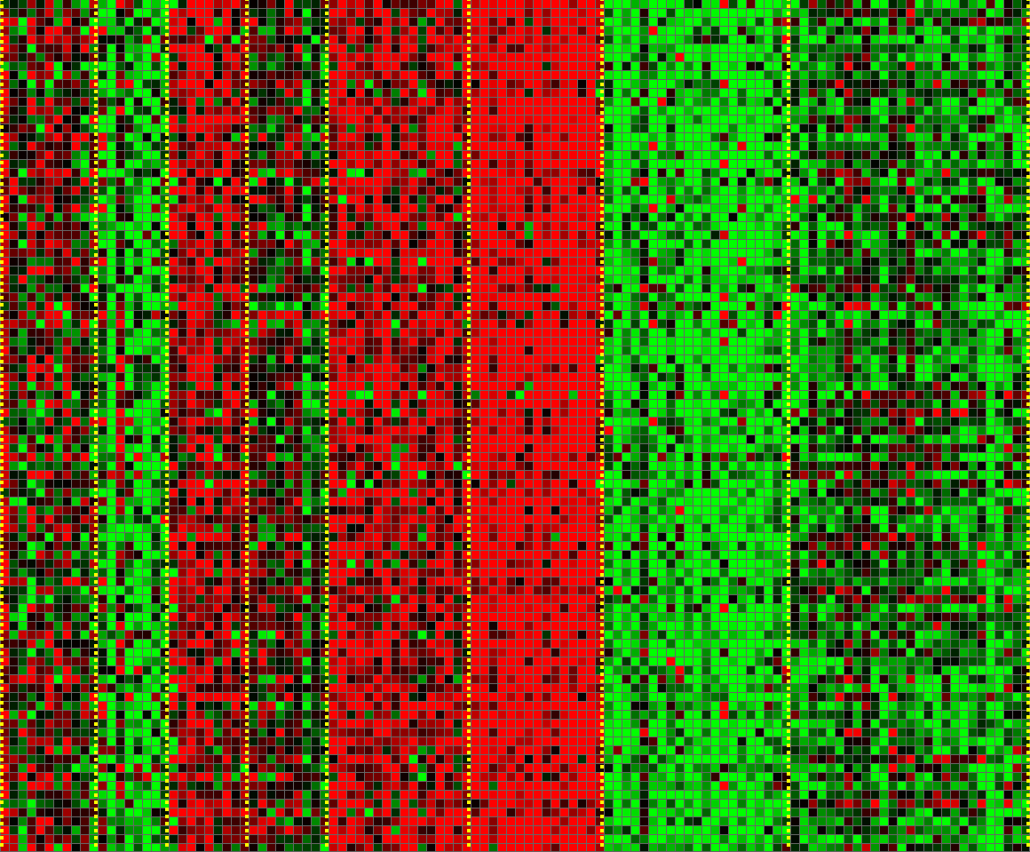
Unsupervised Learning
Genomics application: group individuals by genetic similarity
Genes
Individuals
32
[Source: Daphne Koller]

Slide 19









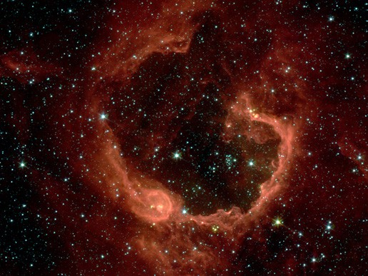


Unsupervised Learning
Organize computing clusters
Social network analysis
Market segmentation
Slide credit: Andrew Ng
Image credit: NASA/JPL-Caltech/E. Churchwell (Univ. of Wisconsin, Madison)
Astronomical data analysis
33

Slide 20
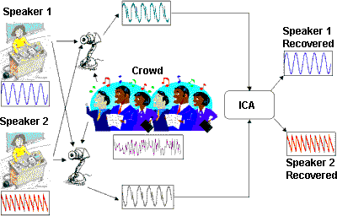


Unsupervised Learning
Independent component analysis – separate a combined signal into its original sources
Image credit: statsoft.com Audio from http://www.ism.ac.jp/~shiro/research/blindsep.html

Slide 21
Unsupervised Learning
Independent component analysis – separate a combined signal into its original sources
Image credit: statsoft.com Audio from http://www.ism.ac.jp/~shiro/research/blindsep.html

Slide 22

Learning Regression
Thank you:
Yibi Huang
Department of Statistics University of Chicago

Slide 23
Simple Linear Regression Models

Slide 24
Example: Pearson’s Father-and-Son Data
Father-son pairs are grouped by father’s height, to the nearest inch.
Son's height (inches)
60 62 64 66 68 70 72 74 76 78
●
●
●
●
●
●
●
●
●
●
How do the
mean of son’s height (SH),
SD of SH, and
distribution of SH (histogram of SH)?
within each group change with father’s height (FH)?
●
●
●
●
●
●
●
●
●
●
●
●
●   
●
●  
● 

●
●
●
●
●   
●
●
●   
● 
●
●
●
●
●
●
●
●      
● 
●   
●  
  
●
● 
●
●
●
●
●
●
●   
●  
● 
      
●   

●
● 
● 
● 
● 
●   
●
● 
● 
●  
● 
●
●
●
●  
     
● 
●   
●
●   
●
●
●
●
        
●
●
● 
●   
●
●  
●
●
● 
●  
●  
● 

●
●
●   
●      
●  
● 
●
●
●   
 
●

    
●  
●
            
● 
●
●    
● 
●   
●

● 
●
●    
● 
  
  
●
●    
 
●    
●
●
●
●
●
●
●   
●  
●
●
●
       
●  
● 
●  

●    
●
●
● 
● 
●        
●
● 
●   
●      
● 
●
●
●    
●         
●
●  
●   
●  
●   
●
●  
●     
●        
●
● 
 
●             
● 
●             

● 
●
● 
●   
● 
●     
●
●             
●
●
●
●              
●   
●     
●   

●  
●
●
●      
●  
●   

● 
●
 
● 
●
● 
      
 
●
●  
●  
●  
●  
●
●
●
●           


● 
●     
●
●  
●   
●
  
●   
● 

● 
●
● 
●        
● 
●   
●
    
●  
● 
       
● 
● 
●
●  
●   
●  
●       
●
●  
●
●
●    
   
● 
● 
●
●
●        
●      
● 
●
●  
●
●  
●
●

● 
●     
●
●
●
● 
●
   
●
●
●
●
●    
  
● 
● 
●     
● 
●
● 
●
●
●
● 
● 
●  
●
● 
●
●
● 
  
●
●
●
● 
●
●
●
●
●
●
●
●
●      

●
●
●

● 
●
● 
●
●


●
● 
● 
● 
●
●
●
●
●
60 62 64 66 68 70 72 74 76
Father's height (inches)
1

Slide 25
64−inch fathers
60 62 64 66 68 70 72 74 76 78 80
Son's Height (inches)
67−inch fathers
60 62 64 66 68 70 72 74 76 78 80
Son's Height (inches)
70−inch fathers
60 62 64 66 68 70 72 74 76 78 80
Son's Height (inches)
2

Slide 26
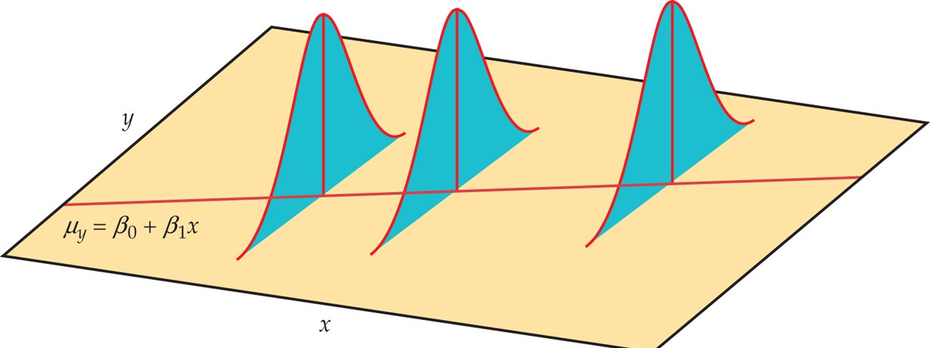
Simple Linear Regression Model
Pearson’s father-and-son data inspire the following assumptions for the simple linear regression (SLR) model:
The means of Y is a linear function of X , i.e.,
E(Y | X = x) = β₀ + β₁x
The SD of Y does not change with x, i.e.,
SD(Y | X = x) = σ for every x
(Optional) Within each subpopulation, the distribution of Y is normal.

Slide 27
Simple Linear Regression Model
Equivalently, the SLR model asserts the values of X and Y for individuals in a population are related as follows
Y = β₀ + β₁X + ε,
the value of ε, called the error or the noise, varies from observation to observation, follows a normal distribution
ε ∼ N(0, σ)
In the model, the line y = β₀ + β₁x is called the population regression line.

Slide 28
Inference for Simple Linear Regression Models

Slide 29
Data for a Simple Linear Regression Model
Suppose we have a SRS of n individuals from a population. From individual i we observe the response y_{i} and the explanatory variable x_{i} :
(x₁, y₁), (x₂, y₂), (x₃, y₃), . . . , (x_{n} , y_{n} )
The SLR model states that
y_{i} = β₀ + β₁x_{i} + ε_{i}
Recall in the previous lecture, the least square line of the data above is
y = b₀ + b₁x
in which
.
s
y
(x − x)(
y − y)
b = r =
i
i
i
, b₀ = y − b₁x
1
.
s_{x}
(x − x)
2
i i
We can use b₁ to estimate β₁ and b₀ to estimate β₀.

Slide 30
Caution: Sample v.s. Population
Note the population regression line
y = β₀ + β₁x
is different from the least square regression line
y = b₀ + b₁x
we learned in the previous lecture.
The latter is merely the least square line for a sample, while the former is the least square line for the entire population.
The values of b₀ and b₁ will change from sample to sample.
.
s
y
(x − x)(y − y)
b = r =
.
i i i
, b₀ = y − b₁x
1
sx (x − x)
i i
2
We are interested in the population intercept β₀ and slope β₁, NOT the sample counterparts b₀ and b₁.

Slide 31
How Close Is b₁ to β₁?
Recall the slope of the least square line is
_{b1 =} ._{i} (x_{i} − x)(y_{i} − y)
.
(x − x)
2
i i
Under the SLR model: y_{i} = β₀ + β₁x_{i} + ε_{i} , replacing y_{i} in the formula above by β₀ + β₁x_{i} + ε_{i} , we can show after some algebra that
_{b1 = β1 +} ._{i} (x_{i} − x)ε_{i}
.
(x − x)
2
i i
From the above, one can get the mean, the SD, and the sampling distribution of b₁.
E(b₁) = β₁ . . . . . . . . . . . . . . . . (b₁ is an unbiased estimate of β₁)
SD(b₁) = ?. . . . . . . . . . . . . . . . . . . . . . . . . . . . . . .(See the next slide)

Slide 32
Variability of b₁
One can show that
σ
σ
SD(b ) =
,
.
= √
,
1
(x − x) s n − 1
2
i x
,
.
where s =
(x −x)
2
is the sample SD of x ’s.
x
i
i
n−1
How to reduce the SD of b₁ (and make b₁ closer to β₁):
increase the sample size n
increase the range of x_{i} ’s (and hence s_{x} is increased)
But σ is unknown, we need to estimate it.
8

Slide 33
Estimate of σ
We want to estimate σ, SD of the error ε_{i} .
An intuitive estimate of σ is the sample SD of the errors ε_{i}
,
.
(ε − ε)
2
σ =
ˆ
i
where ε_{i} = y_{i} − β₀ − β₁x_{i}
n − 1
However, this is not possible β₀ and β₁ are unknown.
We can estimate β₀ and β₁ with b₀ and b₁ and approximate the errors ε_{i} with the residuals
e_{i} = y_{i} − (b₀ + b₁x_{i} ) = y_{i} − ˆy_{i}
We use the “sample SD” of the residuals e to estimate σ:
i
,
.
e
2
s_{e} =
i
n − 2

Slide 34
Estimate of σ
We use the “sample SD” of the residuals e_{i} to estimate σ:
,
,
.
.
(e − e)
2
e
2
s_{e} =
i
=
i
n − 2
n − 2
.
Recall that the mean of residuals is 0, e = e /n = 0
i i
Note here we divide by n − 2, not n − 1. Why?
We lose two degrees of freedom because we estimate two parameters, β₀ and β₁.

Slide 35
Standard Error of b₁
Recall that
σ
SD(b ) =
,
.
.
1
(x − x)
2
i
But σ is unknown, we estimate it with s_{e} . The estimated SD of b₁
is called the standard error (SE) of b₁
s
e
SE(b ) =
,
.
1
(x − x)
2
i

Slide 36
Sampling distribution of β₁
The sampling distribution of b₁ is normal



σ
b₁ − β₁
b ∼ N β ,
 .
z =
, →
~ N(0, 1)
1
1
(x_{i} − x)²
σ/ ,.(x_{i} − x)²
This is (approx.) valid
either if the errors ε_{i} are i.i.d. N(0, σ)
or if the errors ε_{i} are independent and the sample size n is large
As σ is unknown, if replaced with s_{e} , the t -statistic below has a
t -distribution with n − 2 degrees of freedom
b − β
b − β
1 1 1 1
T = = ∼ t_{n−2},
s_{e} / ,.(x_{i} − x)²
SE(b₁)

Slide 37
Confidence Intervals for β₁
The (1 − α) confidence interval for β₁ is given as
b₁ ± t ∗SE(b₁)
where t ∗ is the critical value for the t_{(n−2)} distribution at confidence level 1 − α.

Slide 38


Tests for β₁
To test the hypothesis H₀ : β₁ = a, we use the t -statistic
b − a
t =
1
~ tn−2
SE(b₁)
The p-value can be computed using the t -table based on the H_{a} :
H_{a} | β₁ | ≠ | a | β₁ < a | β₁ > a
P-value | −|t| | |t| |  | t | t
Observe that testing H₀ : β₁ = 0 is equivalent to testing whether x
is useful in predicting y linearly.
It is possible that r is small but β₁ is significantly different from 0.

Slide 39
Inference for the Intercept β₀
Though the population intercept β₀ is rarely of interest, all the results for the population slope β₁ have their counterparts for β₀.
_{b0 = β0 + ε −} ._{i} x(x_{i} −x)ε_{i}
.
(x −x)
2
i
i
E(b₀) = β₀ . . . . . . . . . . . . . . . (b₀ is an unbiased estimate of β₀)
,
SD(b ) = σ +
1 x
2
0
.
,
n (x_{i} −x)²
2
SE(b₀) = s_{e}
1 x
n (x_{i} −x)²
+
.
The sampling distribution of b₀ (when n is large) is

,

_{x}2

1
b ∼ N β , σ + .

0

0


n
(x − x)
2

i
(1 − α) C.I. for β₀: b₀ ± t ∗SE(b₀)
b − a
The test statistic for H : β = a is t =
0
~ t and the
0 0
SE(b₀)
n−2
P-value can be computed similarly as for β₁
15

Slide 40
Example: Restaurant Tips
The owner of a bistro called First Crush in Potsdam, NY, collected 157 restaurant bills over a 2-week period that he believes provide a good sample of his customers.
15
●
10
●
●
●
He wanted to study the payment and tipping patterns of its patrons.
  
Tip ($)
●
●
●
  
●
  
●  
5
●   
● 
● 
● 
●
●   
 
  
●
●  
   

●  
● 
0
0
20
40
Bill ($)
60

Slide 41
Regression in R
Regression in R is as simple as lm(y ˜ x), in which “lm” stands for “linear model”
tips = read.table("RestaurantTips.txt",h=T)
lm(Tip ˜ Bill, data=tips)
Call:
lm(formula = Tip ˜ Bill, data = tips)
Coefficients: (Intercept)
-0.2923
Bill 0.1822
It is better to save the model as an object,
lmtips = lm(Tip ˜ Bill, data=tips)
and then we can get a more detailed output by viewing the summary() of the model object. The output is shown in the next slide

Slide 42
Regression in R
summary(lmtips) Coefficients:
Estimate Std. Error t value Pr(>|t|)
(Intercept) | -0.292267 | 0.166160 -1.759 | 0.0806 .
Bill | 0.182215 | 0.006451 28.247 | <2e-16 ***
---
Residual standard error: 0.9795 on 155 degrees of freedom Multiple R-squared: 0.8373,Adjusted R-squared: 0.8363
F-statistic: 797.9 on 1 and 155 DF, p-value: < 2.2e-16
The column “Estimate” gives the LS estimate for the intercept
b₀ = −0.292267 and the slope b₁ = 0.182215
The column “Std. Error” gives SE(b₀) and SE(b₁):
SE(b₀) = 0.166160, SE(b₁) = 0.006451

Slide 43
Example: Confidence Interval for β₁
Estimate Std. Error t value Pr(>|t|)
(Intercept) -0.292267
Bill 0.182215
0.166160 -1.759 0.0806
0.006451 28.247 <2e-16
As df = n − 2 = 157 − 2 = 155, t ∗ for a 95% CI is 1.975 (between
1.97 and 1.98).
one tail | 0.1 | 0.05 | 0.025 | 0.01 | 0.005
two tails | 0.2 | 0.10 | 0.050 | 0.02 | 0.010
df 150 | 1.29 | 1.66 | 1.98 | 2.35 | 2.61
200 | 1.29 | 1.65 | 1.97 | 2.35 | 2.60
Hence the 95% CI for β₁ is
b₁ ± t ∗SE(b₁) = 0.182215 ± 1.975 × 0.006451
= 0.182215 ± 0.01274 ≈ (0.169, 0.195).
Interpretation: With 95% confidence, for each additional dollar in
the bill, the customers gave 16.9 cents to 19.5 cents more tips on average.
19

Slide 44
Coefficients:
Estimate Std. Error t value Pr(>|t|)
(Intercept) -0.292267 | 0.166160 -1.759 | 0.0806 .
Bill 0.182215 | 0.006451 28.247 | <2e-16 ***
Note t -values b_{i} /SE(b_{i} ) are simply the ratio of the numbers in the “Estimate” column and the numbers in the “Std. Error” column, e.g.,
−0.292267 _{28.247 =} 0.182215
0.166160 0.006451
−1.759 =
,
Testing H₀ : β₁ = 0 is equivalent to testing whether the amount of tips is linearly related to the amount of the bill. The small P-value < 2 × 10⁻¹⁶ asserts that the relation is significant
20

Slide 45
Example: Test for the Slope β₁
A general rule for waiters is to tip 15 to 20% of the pre-tax bill. That is,
β₀ = 0 and β₁ is between 0.15 to 0.20.
Estimate Std. Error t value Pr(>|t|)
(Intercept) -0.292267
Bill 0.182215
0.166160 -1.759 0.0806
0.006451 28.247 <2e-16
R tests β₀ = 0 for us: t -statistic = −1.759, 2-sided p-value = 0.0806
To test H₀ : β₁ = 0.2 v.s. H_{A} : β₁ < 0.2. The t -statistic is
b − 0.2 0.182215 − 0.2
t =
1
= = −2.757
SE(b₁) 0.006451
with df = 155, the one-sided p-value is < 0.005.
one tail | 0.1 | 0.05 | 0.025 | 0.01 | 0.005
two tails | 0.2 | 0.10 | 0.050 | 0.02 | 0.010
df 150 | 1.29 | 1.66 | 1.98 | 2.35 | 2.61
200 | 1.29 | 1.65 | 1.97 | 2.35 | 2.60
Conclusion: Customers of this restaurant gave less than 20% the bill as tips on average.
21

Slide 46
How to Read R Outputs for Regression?
Residual standard error: 0.9795 on 155 degrees of freedom Multiple R-squared: 0.8373,Adjusted R-squared: 0.8363
F-statistic: 797.9 on 1 and 155 DF, p-value: < 2.2e-16
Residual standard error: 0.9795 on 155 degrees of freedom
This gives the estimate s_{e} of σ, which is 0.9795. df = n − 2 = 157 − 2 = 155
Multiple R-squared: 0.8373 gives r ² = 0.8373, Bill size explained 83.73% of the variation in tipping amount.
The correlation between bill size and tips is
r = √r ² = √0.8373 = 0.915.
Adjusted R-squared: Ignore this.
F-statistic: 797.9 on 1 and 155 DF, p-value: < 2.2e-16 Skip.

Slide 47
Checking Conditions for Simple Linear Regression Model

Slide 48
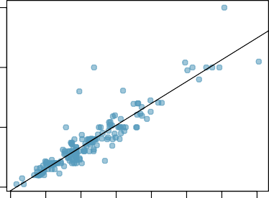
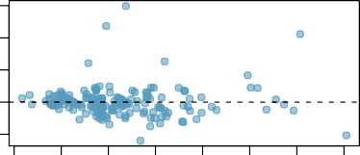
Conditions for Simple Linear Regression Model
15
Linearity
Constant variability
(Optional) Nearly normal residuals
Tip ($)
10
5
0
Tools for checking conditions:
Residual plot
If conditions are satisfied, points should scatter evenly around the zero line in the residual plot.
0 10 20 30 40 50 60 70
Bill ($)
Residuals
−2 0 2 4 6
0 10 20 30 40 50 60 70
Bill ($)

Slide 49
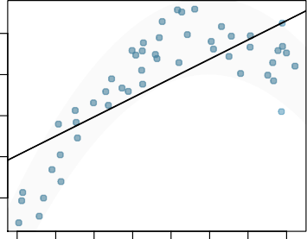
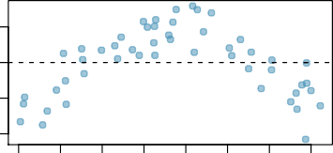
Checking Conditions – Linearity
What condition is this linear model obviously violating?
Constant variability
Linear relationship
Linear relationship
y
0.1 0.2 0.3 0.4 0.5
Normal residuals
No extreme outliers
0.0 0.2 0.4 0.6 0.8 1.0 1.2 1.4
x
Residuals
0.0
Note the correlation between the residuals and x remains zero, but zero correlation ≠ no association. It can be a non-linear association
−0.2
0.0 0.2 0.4 0.6 0.8 1.0 1.2 1.4
x

Slide 50
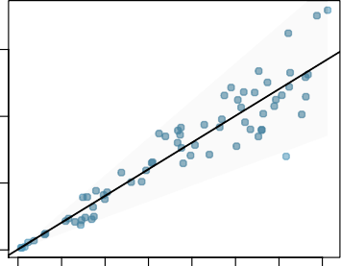
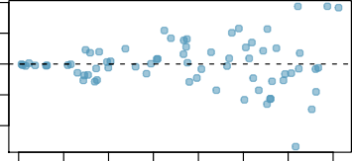
Checking Conditions – Constant Variability
1.5
y
1.0
0.5
0.0
0.0 0.2 0.4 0.6 0.8 1.0 1.2 1.4
x
0.4
Residuals
−0.4 0.0
The variability of points around the least-squares line should be roughly constant, implying the variability of residuals around the 0 line should be roughly constant as well, called homoscedasticity.
If not, called heterocedasticity, predictions made in areas of larger variability will be worse. May try weighted least-square method or transforming the response.
0.0 0.2 0.4 0.6 0.8 1.0 1.2 1.4
x

Slide 51
Conditions: Nearly Normal Residuals
8
Less relevant than the first two conditions
Diagnosis: Check the histogram or boxplot of residuals
If the linearity or constant variability condition is clearly violated, there is no need to check the normality of residuals.
6
frequency
4
2
0
−15 −10
−5 0 5 10 15 20
Residuals
−15 −10
−5 0 5 10 15 20
Residuals

Slide 52

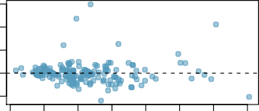
Checking Conditions for the Restaurant Tip Data
15
50
frequency
10 20 30 40
Tip ($)
10
5
0
0 10 20 30 40 50 60 70
Bill ($)
0
−2
0
2
Residuals
4
6
6
Residuals
4
2
● 
● 
● 
●
0
−2
0 10 20 30 40 50 60 70
Bill ($)
−2 0
2
Residuals
4
6
The constant variability condition seems to be violated. The size of residual seems to increase with Bill.

Slide 53
Types of Outliers

Slide 54
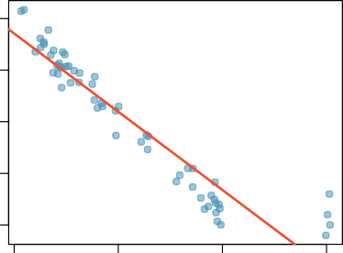
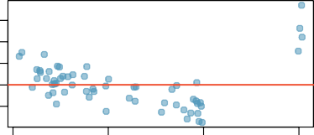
Types of Outliers
How do outliers influence the least squares line in this plot?
0
−5
−10
To answer this question think of where the regression line would be with and without the outlier(s).
y
−15
−20
Without the outliers the regression line would be steeper, and lie closer to the larger group of observations. With the outliers the line is pulled up and away from some of the observations in the larger group.
0.0
0.5
1.0
1.5
x
6
4
2
0
−2
Residual
0.0
0.5
1.0
1.5
x

Slide 55
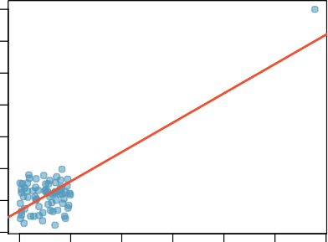
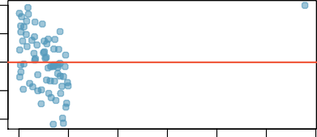
Types of Outliers — Influential Points
12
10
8
6
4
2
0
−2
y
How do outliers influence the least squares line in this plot?
Without the outlier there is no evident relationship between x and y.
0 | 1 | 2 | 3 x | 4 | 5 | 6
0 | 1 | 2 | 3 x | 4 | 5 | 6
2
1
0
−1
−2
Residual
29

Slide 56
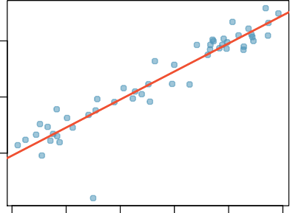
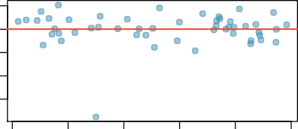
Types of Outliers — Outlier but Not Influential
10
5
0
y
Does this outlier influence the slope of the regression line?
Not much...
0.0
0.2
0.4
0.6
0.8
1.0
x
2
0
−2
−4
−6
Residual
0.0
0.2
0.4
0.6
0.8
1.0
x

Slide 57
Some Terminology
Outliers are points that lie away from the cloud of points.
Outliers that lie away from the center of the cloud in the
x-direction are called high leverage points.
A point is influential if including or excluding the point would considerably change the slope of the regression line.
Influential points must be outliers with high leverages.

Slide 58
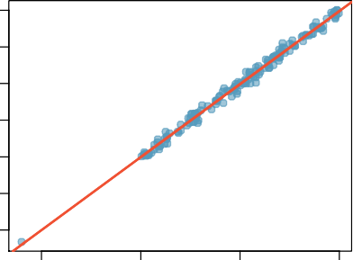
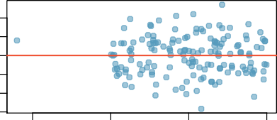
Types of Outliers
40
30
20
10
0
−10
−20
−0.5 |  | 0.0 | 0.5 |  | 1.0
Which of the below best de- scribes the outlier?
(a) influential
y
high leverage
high leverage
none of the above
there are no outliers
x
2
1
0
−1
−2
−3
Residual
−0.5
0.0
0.5
1.0
x

Slide 59
Recap
Which of following is true?
Influential points always change the intercept of the regression line. . . . . . . . . . . . . . . . . . . . . . . . . . . . . . . . . . . . . . . . . change the slope
Influential points always reduce R². . . False. See the next slide
It is much more likely for a low leverage point to be influential, than a high leverage point.
When the data set includes an influential point, the relationship between the explanatory variable and the response variable is always nonlinear.
None of the above.
None of the above.
x
x

Slide 60
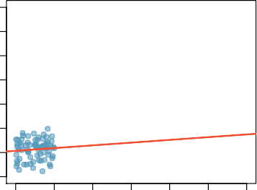

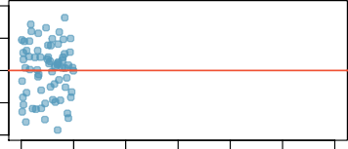
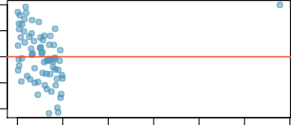
Recap (cont.)
Influential point may also increase R²
r = 0.08, R² = r ² = 0.0064
12
10
8
6
4
2
0
−2
2 2
r = 0.
79, R = r ≈ 0
.627
12
10
8
6
4
2
0
−2
y
y
0 1 2
3 4 5 6
x
0
1
2
3
x
4
5
6
2
1
0
−1
−2
2
1
0
−1
−2
Residual
Residual
0
1
2
3
4
5
6
0
1
2
3
4
5
6
x
x

Slide 61
More Examples

Slide 62
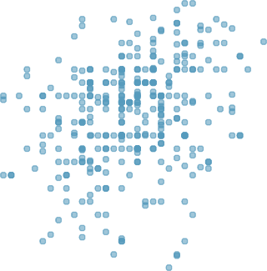
Example: GPA and MathSAT
The scatter plot below shows the GPA and MathSAT of a random sample of 345 students in a college.
r = 0.28
4.0
3.5
GPA
3.0
2.5
2.0
400 500
600 700 800
MathSAT
The correlation r = 0.28 is weak.
Can the slope β₁ of the line be significantly different from 0?
35

Slide 63
summary(lm(GPA ˜ VerbalSAT, data=stu))
Estimate Std. Error t value Pr(>|t|) (Intercept) 2.1466877 0.1867166 11.497 < 2e-16 ***
MathSAT 0.0016544 0.0003036 5.449 9.68e-08 ***
To test H₀ : β₁ = 0 v.s. H₁ : β₁ ≠ 0, the t -statistic is
_{t =} b₁ ₌ 0.0016544 _{= 5.449}
SE(b₁) 0.0003036
with df = 345 − 2 = 343. Two-sided P-value = 9.68 × 10⁻⁸.
There is strong evidence that students’ GPA is linearly related with their MathSAT, despite of their small correlation r = 0.28.
It is possible that r is small but β₁ is significantly different from 0, especially when the sample size n is large.
Students with higher MathSAT indeed have significantly higher GPA on average, despite of the huge variability in GPA.
As R² = r ² = (0.28)² = 0.0784, MathSAT merely explains 7.84% of the variation in GPA.
36

Slide 64
Example: GPA and MathSAT – 95% CI for β₁
Estimate Std. Error t value Pr(>|t|) (Intercept) 2.1466877 0.1867166 11.497 < 2e-16 ***
MathSAT 0.0016544 0.0003036 5.449 9.68e-08 ***
df = 345 − 2 = 343. The t ∗ for a 95% CI is 1.97.
one tail | 0.1 | 0.05 | 0.025 | 0.01 | 0.005
two tails | 0.2 | 0.10 | 0.050 | 0.02 | 0.010
df 300 | 1.28 | 1.65 | 1.97 | 2.34 | 2.59
400 | 1.28 | 1.65 | 1.97 | 2.34 | 2.59
So a 95% confidence interval for β₁ is
b₁±t ∗SE(b₁) = 0.0016544±1.97×0.0003036 ≈ (0.00106, 0.00225)
Interpretation: We have 95% confidence that for students with 100
more points in their MathSAT scores, their GPA are 0.106 to 0.225 higher on average.
37

Slide 65
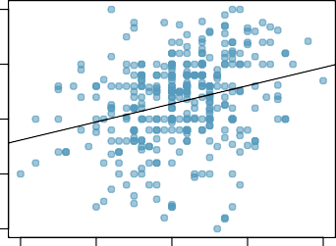
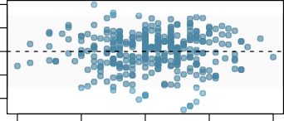
Example: GPA and MathSAT – Checking Conditions
4.0
50
3.5
40
MathSAT
3.0
frequency
10 20 30
2.5
2.0
400
500
600
GPA
700
800
0
−1.0
−0.5
0.0
0.5
1.0
1.0
Residuals
Residuals
0.0
●  
−1.0
400 500
600 700 800
MathSAT
−1.0 −0.5
0.0 0.5
1.0
Residuals
The linearity and constant variability conditions are fine.
The slight left-skewness of residuals is fine because of the large sample size
38

Slide 66
Example: Fire Damage and Distance to Fire Station
A fire insurance company wanted to relate the amount of fire damage in major residential fires to the distance between the burning house and the nearest fire station. The study was
Distance Damage
(mile) ($1000)
conducted in a large suburb of a major city; a sample of 15 recent fires in this suburb was selected. The amount of damage and the distance between the fire and the nearest fire station were recorded in each fire.
0.7
1.1
1.8
2.1
2.3
2.6
3.0
3.1
3.4
3.8
4.3
4.6
4.8
5.5
6.1
14.1
17.3
17.8
24.0
23.1
19.6
22.3
27.5
26.2
26.1
31.3
31.3
36.4
36.0
43.2
Damage ($1000)
●
35
●
●
● 
25
●
● 
● 
●
●
●
●
15
●
1 2 3 4 5 6
Distance (miles)

Slide 67
fire = read.table("fire.txt",h=T)
summary(lm(damage ˜ dist, data=fire)) Coefficients:
Estimate Std. Error t value Pr(>|t|)
(Intercept) 10.2779
dist 4.9193
1.4203 7.237 6.59e-06 ***
0.3927 12.525 1.25e-08 ***
estimate for the intercept b₀ = 10.2779 and the slope b₁ = 4.9193
SE(b₀) = 1.4203, SE(b₁) = 0.3927
one tail two tails |  | 0.1 0.2 | 0.05 0.10 | 0.025 0.050 | 0.01 0.02 | 0.005 0.010
df | 13 | 1.35 | 1.77 | 2.16 | 2.65 | 3.011
So a 95% confidence interval for β₁ is
b₁ ± t ∗SE(b₁) = 4.9193 ± 2.16 × 0.3927 ≈ 4.919 ± 0.848 ≈ (4.071, 5.767)
Interpretation: We have 95% confidence that every extra mile from the nearest fire station increases the amount of damage by $4071 to $5767.

Slide 68
Example: Test for the Slope β₁
Coefficients:
Estimate Std. Error t value Pr(>|t|)
(Intercept) 10.2779
dist 4.9193
1.4203 7.237 6.59e-06 ***
0.3927 12.525 1.25e-08 ***
To test H₀ : β₁ = 4 v.s. H₁ : β₁ > 4, the t -statistic is
_{t =} b₁ − 4 ₌ 4.9193 − 4 _{= 2.3409}
SE(b₁) 0.3927
Looking at the t -table for the row with df = 13, the one-sided
P-value is between 0.01 and 0.025.
one tail two tails |  | 0.1 0.2 | 0.05 0.10 | 0.025 0.050 | 0.01 0.02 | 0.005 0.010
df | 13 | 1.35 | 1.77 | 2.16 | 2.65 | 3.011
Conclusion: At 5% level, the extra amount of damage for every extra mile from the nearest fire station is significantly higher than
$4000.
41

