Slide 1
Analyzing Double Blind Peer Review Policy
Raymond Zhang | Stanford GSE
ECON 293

Slide 2
Agenda
Motivation and Background
Existing Literature
Data and Analysis
Data Structure Decisions
Descriptive Statistics
Hypothesis, ATE analysis, HTE Analysis
Limitations and Ethics
Algorithmic Bias
Future Directions
NLU/NLP

Slide 3

Peer-Review and Why it is important?
Peer review brings legitimacy and helps correct for errors in the formal scientific process
To reduce bias, review policies are put in place!
Single-blind vs Double-blind

Slide 4
Previous Work
Previous studies have shown that 50% of the reviewer quality scores were subjective at NeurIPS (Cortes 2021)
Study has shown the timing of review comments may predict the review score (Gao et al, 2019)
Studies have shown gender gap, and bias towards certain institutions within the ICLR conference (Tran et al, 2021)
Finally previous work suggests that double blind review process reduces the scores of prestigious authors (Sun et al, 2022)

Slide 5
Contribution
I expand on the work of Sun et al, 2022
Previous studies have not focused on racial identity
Research Question:
What is the effect on review score when changing from single blind to double blind review policy for authors of different racial identities?

Slide 6
Data and Analysis

Slide 7
ICLR - International Conference on Learning Representations
ICLR changed review policies in 2018 to double blind
Collected data from 2017-2019 from open review API
Structured the data by hand
Dataset:
2820 manuscript submissions
6992 authors
8586 reviews
Notes:
Confidence scale is 1 to 5
Review Scale is 1 to 10.

Slide 8
Data Structure: Submission Level
Forum (submission ID)
Year
Review length (average, average quantile length)
Rating length
Reviewer confidence
If there is senior author (author that submitted in 2017 – 2019)
Racial Identity inferred through rethnicity r package
Unit of analysis is submission

Slide 9
Data Structure: Interaction Level
Each review, submission, author are now connected
For example if a submission has 3 reviews, 2 authors it would be represented by 6 rows of data in this data set
This represent how each review interacts with each author
Unit of analysis is interaction

Slide 10
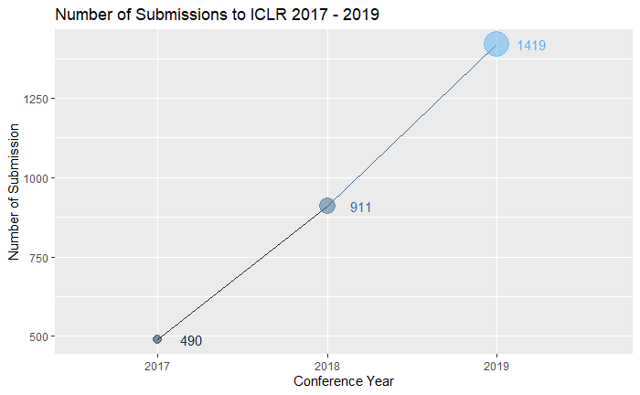
Descriptive Statistics: ICLR has increase in size each year

Slide 11
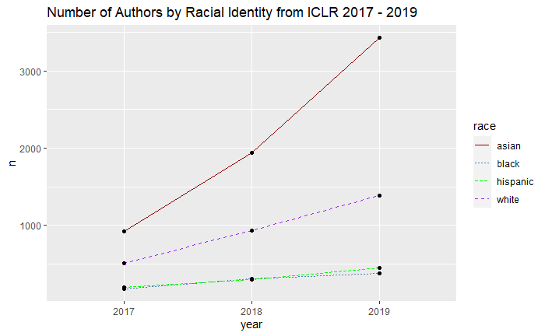
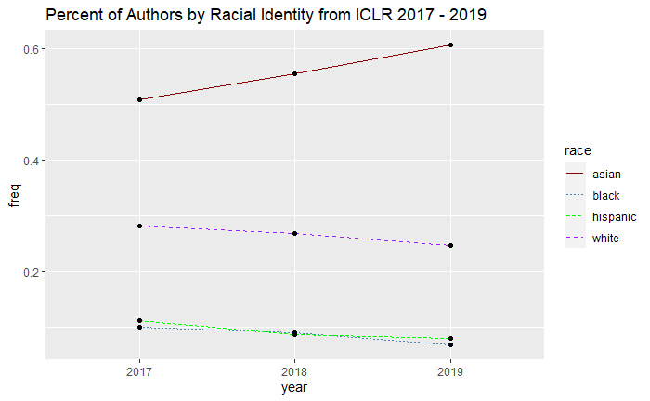
Descriptive Statistics
The number of racial minority authors has increased each year
Percentage of racial diversity has decreased

Slide 12
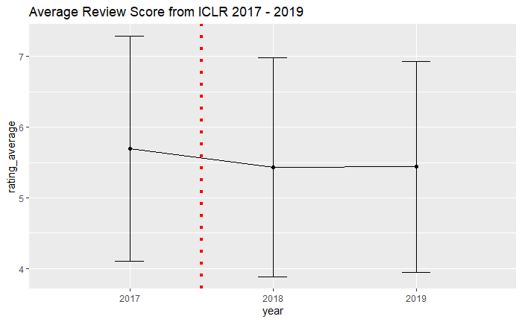
Descriptive Statistics: Average review score goes down every year

Slide 13
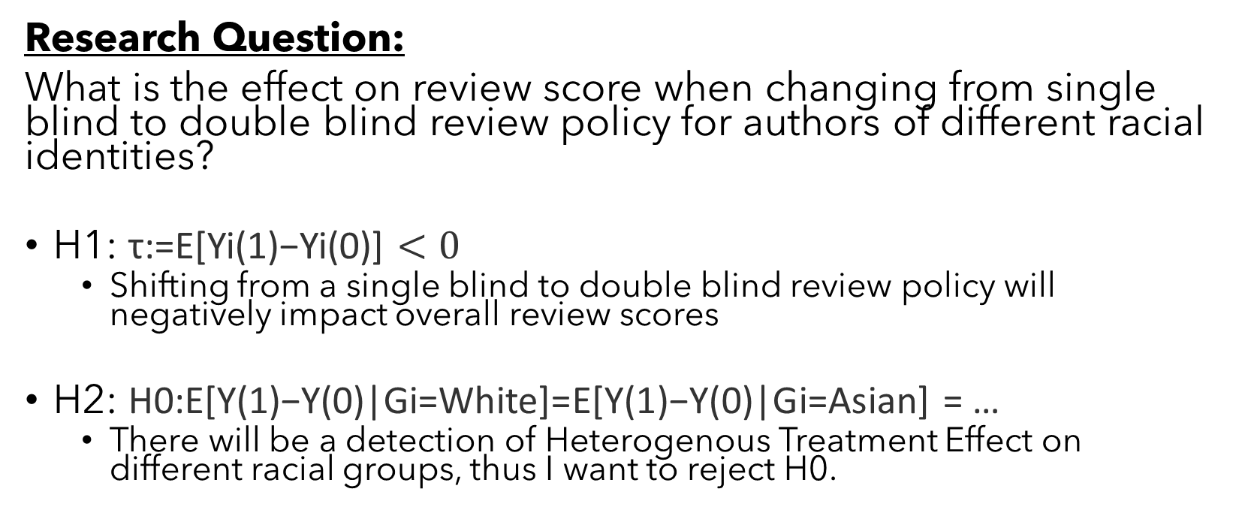
Hypothesis
Research Question:
What is the effect on review score when changing from single blind to double blind review policy for authors of different racial identities?
H1: τ:=E[Yi(1)−Yi(0)] $<0$
Shifting from a single blind to double blind review policy will negatively impact overall review scores
H2: H0:E[Y(1)−Y(0)|Gi=White]=E[Y(1)−Y(0)|Gi=Asian] = …
There will be a detection of Heterogenous Treatment Effect on different racial groups, thus I want to reject H0.

Slide 14
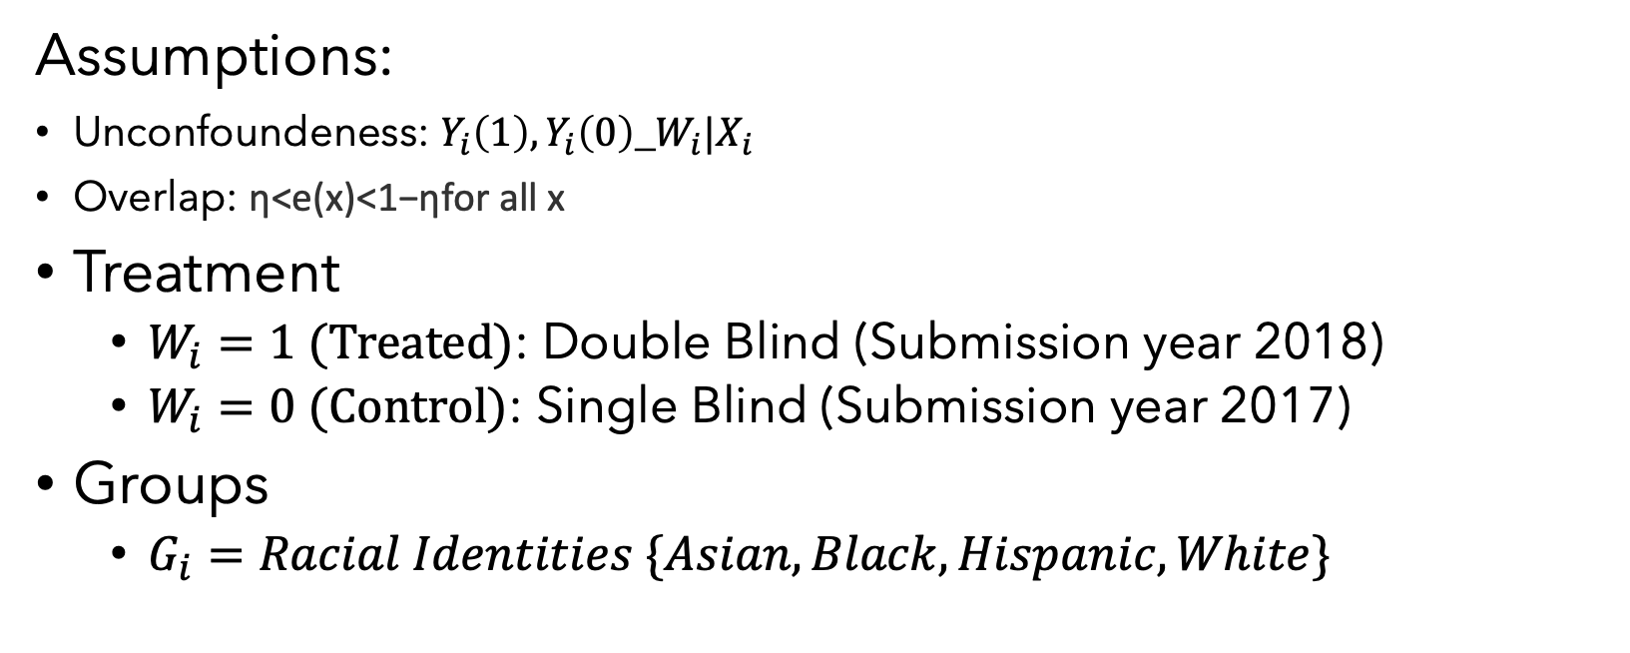
Experimental Setup
Assumptions:
Unconfoundeness: $Y_{i}\left(1\right),Y_{i}\left(0\right)\text{_}W_{i}|X_{i}$
Overlap: η<e(x)<1−ηfor all x
Treatment
$W_{i}=1 (Treated)$: Double Blind (Submission year 2018)
$W_{i}=0 (Control)$: Single Blind (Submission year 2017)
Groups
$G_{i}=Racial Identities \{Asian, Black, Hispanic, White\}$
Notes:
The confoundedness assumption is violated because of the fact we are in an observational setting, and confounders due to time are at play here mainly that the review quality went down b/c conference expanded.

Slide 15
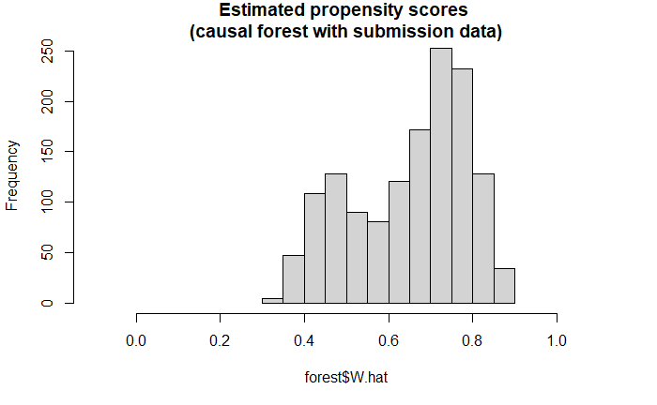
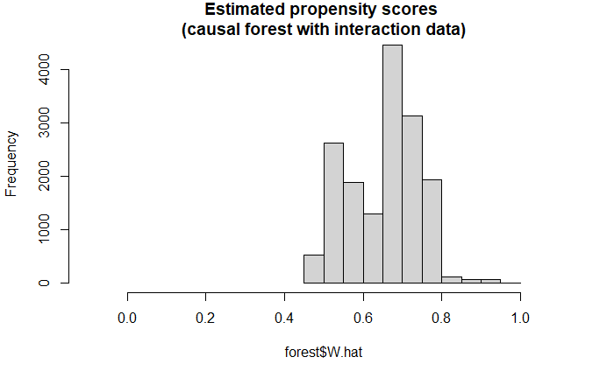


Experiment 1: ATE using AIPW
Submission Level Data using Causal Forest (Preferred)
Interaction Level Data using Causal Forest
$$τ=−0.2602±0.2322$$
95% confidence interval
$$τ=−0.2495 ±0.0786$$
95% confidence interval
Notes:
We prefer to use the Submission level data with causal forest because of the propensity distribution, and because of the overlap assumption in the covariate space.
Model section:
Due to collinearity I opted to stay with forest methods because it is more robust to collinearity concerns. Difference in difference analysis resulted in the same estimate but the errors were a lot bigger.

Slide 16
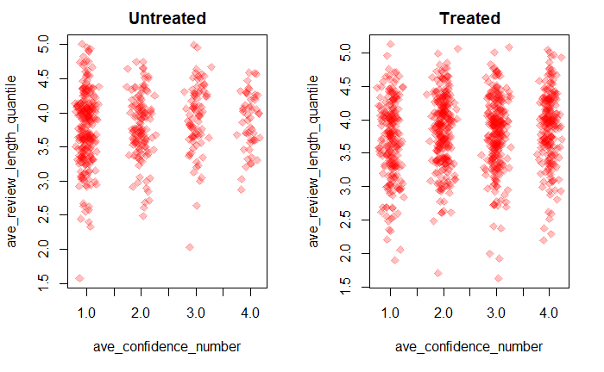
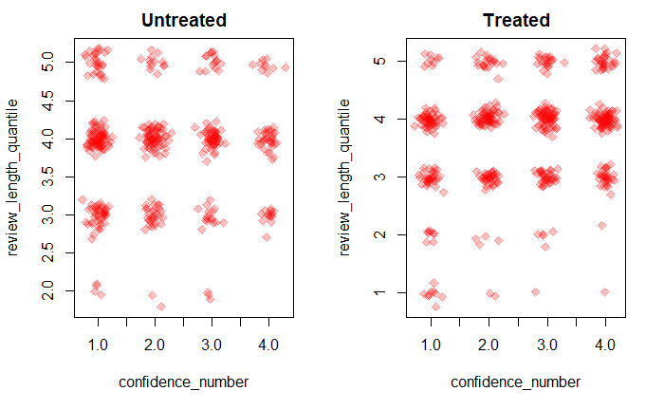
Overlap Assumptions: Covariate Space
Submission Level Data
Interaction Level Data
Notes:
We see that our overlap assumption is violated using both sets of data. There doesn’t seem to be an overlap with first quantile review comments between control and treated on the interaction level. This is a major reason why we prefer the submission level data for the ATE.

Slide 17
H1: Is confirmed!
The average treatment effect of changing from single blind to double bind is ~-0.26 on a 10 point review scale.

Slide 18
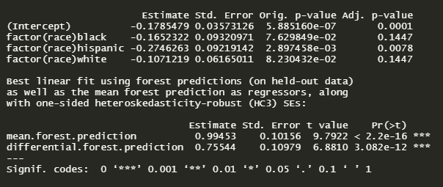
Experiment 2: HTE via CATE
Submission Level Data using Causal Forest
Interaction Level Data using Causal Forest
No detection of CATE
Test calibration shows that there is an average treatment effect however there is no CATE.
Asian: -0.18 estimate, SE 0.04
Hispanic: -0.27 estimate, SE 0.09
Calibration shows overstatement

Slide 19
Experiment 2: HTE via CATE
Interaction Level Data using Causal Forest
Statistically significant detect CATE for Asians and Hispanic authors
It appears that Hispanic authors are more affected by double blind review process than other races
Calibration shows that these tau_hats are over fit which means the effect is probably overstated

Slide 20
H2: More work to be done
Since models contradict more analysis should be done. We have reason to believe CATE exist but should be careful.

Slide 21
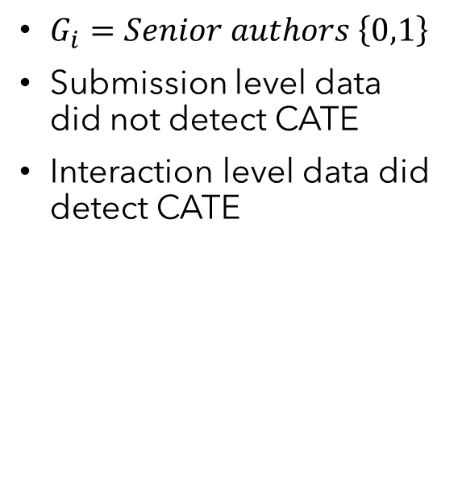
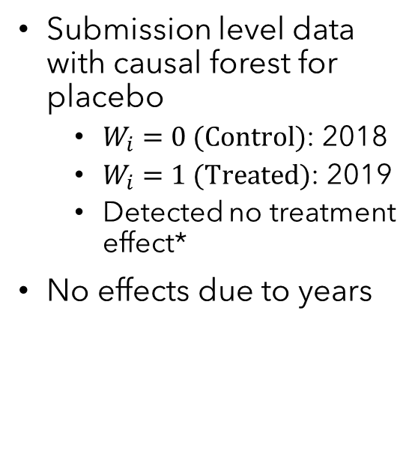
Other analysis and experiments
Effects due to time
Senior authors as a subgroup
Filter data by senior authors
Submission level data with causal forest for placebo
$W_{i}=0 (Control)$: 2018
$W_{i}=1 (Treated)$: 2019
Detected no treatment effect*
No effects due to years
$G_{i}=Senior authors \left\{0,1\right\}$
Submission level data did not detect CATE
Interaction level data did detect CATE
Only examine submissions by senior authors
Interaction level did not detect CATE
Submission level did not detect CATE

Slide 22
Summary
There is strong evidence that shifting from single blind to double blind on average reduced reviewer ratings
Experiments show time has no effect
There is some evidence of heterogenous treatment effect based on racial identity, but more analysis is necessary

Slide 23
Limitations

Slide 24
Algorithmic Bias: Issues with Inferring Identity from Names
rethnicity: An R package for predicting ethnicity from names (Xie 2022)
Baseline for training was Florida voter registration
Previous work show underestimation of black names (Kozlowski et al, 2022)
Effects on current analysis:
International author’s are not represented correctly
Lack of detection of CATE on black authors
Some mitigation of effect due to overestimation of CATE
Continue to be cautious of CATE estimates
Alternative approach is to use e-mail to infer location for analysis instead

Slide 25
Future Directions!
We did not analyze the text data
Conciseness of text
Specificity
Parts of speech parsing
Politeness
Interaction between reviewer-author rebuttal
Content domain
What is a textual counterfactual of a manuscript submission?

Slide 26
Thank you
Professor Susan Athey
Professor Stefan Wager
Professor Dan McFarland’s group

Slide 27
References
Corinna Cortes and Neil D. Lawrence. 2021. Inconsistency in conference peer review: Revisiting the 2014 NeurIPS experiment. CoRR, abs/2109.09774
Gao, Yang κ.ά. ‘Does My Rebuttal Matter? Insights from a Major NLP Conference’. Proceedings of the 2019 Conference of the North American Chapter of the Association for Computational Linguistics: Human Language Technologies, Volume 1 (Long and Short Papers). Minneapolis, Minnesota: Association for Computational Linguistics, 2019. 1274–1290. Web.
Tran, David κ.ά. ‘An Open Review of OpenReview: A Critical Analysis of the Machine Learning Conference Review Process’. 2021. Web.
Sun, M., Barry Danfa, J., & Teplitskiy, M. (2022). Does double-blind peer review reduce bias? Evidence from a top computer science conference. Journal of the Association for Information Science and Technology, 73( 6), 811– 819. https://doi.org/10.1002/asi.24582
Fangzhou Xie. rethnicity: An r package for predicting ethnicity from names. SoftwareX,17:100965, 2022.
Kozlowski D, Murray DS, Bell A, Hulsey W, Larivière V, Monroe-White T, et al. (2022) Avoiding bias when inferring race using namebased approaches. PLoS ONE 17(3): e0264270. https://doi.org/10.1371/journal.pone.0264270

