Slide 1

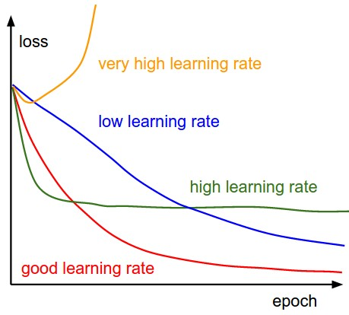
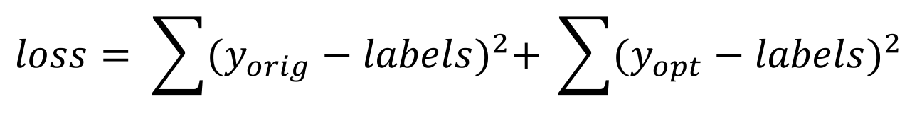
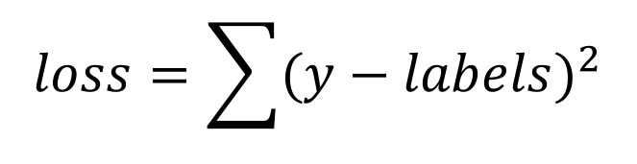
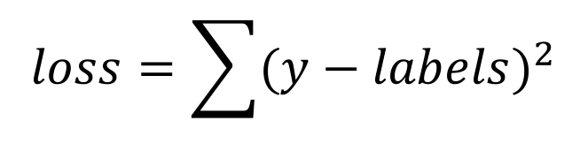
END TO END LEARNING FOR VISUAL NAVIGATION
Ute Schiehlen, Natalie Reppekus, Raymond Chua
Technichal University of Munich
Abstract
Architectures
An important component in autonomous vehicles is visual navigation. We used an ordered sequence of frames recorded at the front of the car to obtain the steering angle using an end to end approach. Based on these images, we also computed the optical flow over adjacent frames to get additional motion information as input to our network and added an LSTM cell after the convolutional layers.
Our approach is based on the network proposed in Bojarski et al.[1] consisting of five convolutional and three fully connected layers using the human steering angle as training signal. As this model did not fully exploit the temporal information of image sequences, we extended this architecture by training an additional convolutional network with optical flow calculated from the original images as input and optimizing the combined loss. As this approach yielded good results, we trained a second network consisting of a Long-Short term memory (LSTM) cell instead of the fully connected layers.
Optical Flow Model
Optical Flow + LSTM Model
Original Model
YUV Images
YUV Images
Optical Flow Images
YUV Images
Optical Flow Images
Conv1 + ReLU + Max-Pool
Conv1 + ReLU + Max-Pool
Conv1 + ReLU + Max-Pool
Conv1 + ReLU + Max-Pool
Conv1 + ReLU + Max-Pool
Conv2 + ReLU + Max-Pool
Conv2 + ReLU + Max-Pool
Conv2 + ReLU + Max-Pool
Conv2 + ReLU + Max-Pool
Conv2 + ReLU + Max-Pool
Data Preprocessing
Conv3 + ReLU + Max-Pool
Conv3 + ReLU + Max-Pool
Conv3 + ReLU + Max-Pool
Conv3 + ReLU + Max-Pool
Conv3 + ReLU + Max-Pool
Images
Conv4 + ReLU
Conv4 + ReLU
Conv4 + ReLU
Conv4 + ReLU
Conv4 + ReLU
RGB Image
Randomized Horizontal Flip
Normalization
Convert to YUV
Zero-Mean
Labels
Conv5 + ReLU
Conv5 + ReLU
Conv5 + ReLU
Conv5 + ReLU
Conv5 + ReLU
Angle in °
Angle in Radians
Training
FC1 + ReLU
FC1 + ReLU
FC1 + ReLU
FC2 + ReLU
FC2 + ReLU
FC2 + ReLU
LSTM Cell
FC3 + ReLU
FC3 + ReLU
FC3 + ReLU
FC4
FC4
FC4
FC1
Original Model
Optical Flow Model
Optical Flow + LSTM Model
Reshape to range [-pi, pi]
Reshape to range [-pi, pi]
Reshape to range [-pi, pi]
Reshape to range [-pi, pi]
Results
Loss Functions
Optical Flow Model
Optical Flow + LSTM Model
Original Model
$$loss=\sum{{(y−labels)}^{2}}$$
$$loss= \sum{{(y_{orig}−labels)}^{2}+ \sum{{(y_{opt}−labels)}^{2}}}$$
$$loss=\sum{{(y−labels)}^{2}}$$
Optimizer
We used Adam for all three models.
References
[1]
M. Bojarski, D. D. Testa, D. Dworakowski, B. Firner, B. Flepp, P. Goyal, L. D. Jackel, M. Monfort, U. Muller, J. Zhang, X. Zhang, J. Zhao, and K. Zieba. End to end learn- ing for self-driving cars. CoRR, abs/1604.07316, 2016. 1, 2

Slide 2
END TO END LEARNING FOR VISUAL NAVIGATION
Ute Schiehlen, Natalie Reppekus, Raymond Chua
Technichal University of Munich
Abstract
Architectures
An important component in autonomous vehicles is visual navigation. We used an ordered sequence of frames recorded at the front of the car to obtain the steering angle using an end to end approach. Based on these images, we also computed the optical flow over adjacent frames to get additional motion information as input to our network and added an LSTM cell after the convolutional layers.
Our approach is based on the network proposed in Bojarski et al.[1] consisting of five convolutional and three fully connected layers using the human steering angle as training signal. As this model did not fully exploit the temporal information of image sequences, we extended this architecture by training an additional convolutional network with optical flow calculated from the original images as input and optimizing the combined loss. As this approach yielded good results, we trained a second network consisting of a Long-Short term memory (LSTM) cell instead of the fully connected layers.
Optical Flow Model
Optical Flow + LSTM Model
Original Model
YUV Images
YUV Images
Optical Flow Images
YUV Images
Optical Flow Images
Conv1 + ReLU + Max-Pool
Conv1 + ReLU + Max-Pool
Conv1 + ReLU + Max-Pool
Conv1 + ReLU + Max-Pool
Conv1 + ReLU + Max-Pool
Conv2 + ReLU + Max-Pool
Conv2 + ReLU + Max-Pool
Conv2 + ReLU + Max-Pool
Conv2 + ReLU + Max-Pool
Conv2 + ReLU + Max-Pool
Data Preprocessing
Conv3 + ReLU + Max-Pool
Conv3 + ReLU + Max-Pool
Conv3 + ReLU + Max-Pool
Conv3 + ReLU + Max-Pool
Conv3 + ReLU + Max-Pool
Images
Conv4 + ReLU
Conv4 + ReLU
Conv4 + ReLU
Conv4 + ReLU
Conv4 + ReLU
RGB Image
Randomized Horizontal Flip
Normalization
Convert to YUV
Zero-Mean
Labels
Conv5 + ReLU
Conv5 + ReLU
Conv5 + ReLU
Conv5 + ReLU
Conv5 + ReLU
Angle in °
Angle in Radians
Training
FC1 + ReLU
FC1 + ReLU
FC1 + ReLU
FC2 + ReLU
FC2 + ReLU
FC2 + ReLU
LSTM Cell
FC3 + ReLU
FC3 + ReLU
FC3 + ReLU
FC4
FC4
FC4
FC1
Original Model
Optical Flow Model
Optical Flow + LSTM Model
Reshape to range [-pi, pi]
Reshape to range [-pi, pi]
Reshape to range [-pi, pi]
Reshape to range [-pi, pi]
Results
Loss Functions
Optical Flow Model
Optical Flow + LSTM Model
Original Model
$$loss=\sum{{(y−labels)}^{2}}$$
$$loss= \sum{{(y_{orig}−labels)}^{2}+ \sum{{(y_{opt}−labels)}^{2}}}$$
$$loss=\sum{{(y−labels)}^{2}}$$
Optimizer
We used Adam for all three models.
References
[1]
M. Bojarski, D. D. Testa, D. Dworakowski, B. Firner, B. Flepp, P. Goyal, L. D. Jackel, M. Monfort, U. Muller, J. Zhang, X. Zhang, J. Zhao, and K. Zieba. End to end learn- ing for self-driving cars. CoRR, abs/1604.07316, 2016. 1, 2

Slide 3
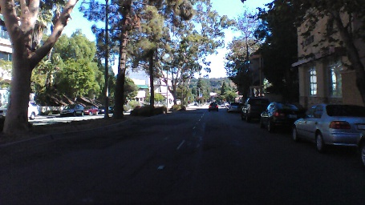
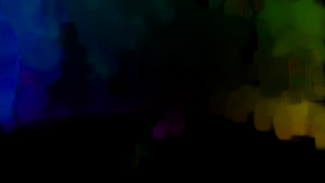
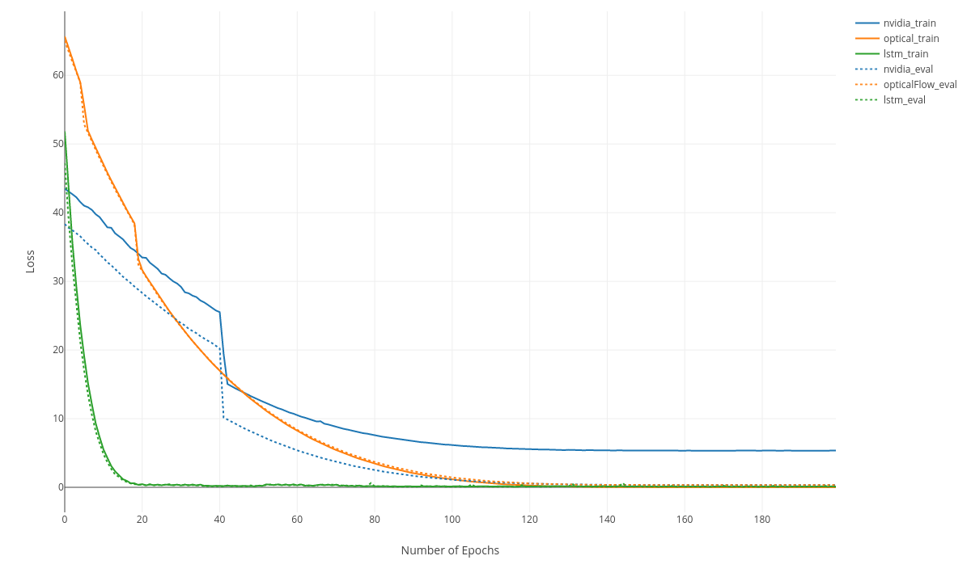
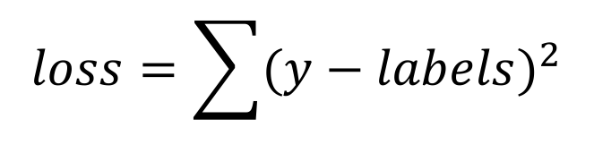
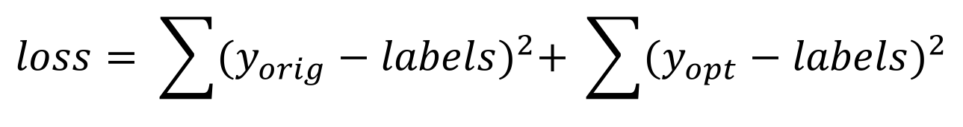
END TO END LEARNING FOR VISUAL NAVIGATION
Ute Schiehlen, Natalie Reppekus, Raymond Chua
Technical University of Munich
Abstract
Architectures
CNN + Optical Flow Model
CNN + Optical Flow + LSTM Model
An important component in autonomous vehicles is visual navigation. We used a sequence of frames recorded at the front of the car to predict the steering angle using an end to end approach.
Our network is based on Bojarski et al.[1] which consists of five convolutional and three fully connected layers using the human steering angle as the training signal. As this model did not fully exploit the temporal information of image sequences, we extended this architecture by training an additional convolutional network with optical flow computed from the original images as input and optimizing over the combined loss. As this approach yielded good results, we trained a third network consisting of a Long-Short term memory (LSTM) cell to further exploit temporal information. We achieved an improvement of 0.12 in the Mean Squared Error in our approach compared to Nvidia’s model.
YUV Images
Optical Flow Images
YUV Images
Optical Flow Images
Conv1 + ReLU + Max-Pool
Conv1 + ReLU + Max-Pool
Conv1 + ReLU + Max-Pool
Conv1 + ReLU + Max-Pool
Conv2 + ReLU + Max-Pool
Conv2 + ReLU + Max-Pool
Conv2 + ReLU + Max-Pool
Conv2 + ReLU + Max-Pool
Data Preprocessing
Conv3 + ReLU + Max-Pool
Conv3 + ReLU + Max-Pool
Conv3 + ReLU + Max-Pool
Conv3 + ReLU + Max-Pool
Images
Conv4 + ReLU
Conv4 + ReLU
Conv4 + ReLU
Conv4 + ReLU
RGB Image
Randomized Horizontal Flip
Normalization
Convert to YUV
Zero-Mean
Labels
Conv5 + ReLU
Conv5 + ReLU
Conv5 + ReLU
Conv5 + ReLU
Angle in °
Angle in Radians
Training
FC1 + ReLU
FC1 + ReLU
Loss Functions
FC2 + ReLU
FC2 + ReLU
LSTM Cell
CNN + Optical Flow Model
$$loss= \sum{{(y_{orig}−labels)}^{2}+ \sum{{(y_{opt}−labels)}^{2}}}$$
FC3 + ReLU
FC3 + ReLU
CNN + Optical Flow + LSTM
FC1
$$loss=\sum{{(y−labels)}^{2}}$$
FC4
FC4
References
Reshape to range [-pi, pi]
Reshape to range [-pi, pi]
Reshape to range [-pi, pi]
[1]
M. Bojarski, D. D. Testa, D. Dworakowski, B. Firner, B. Flepp, P. Goyal, L. D. Jackel, M. Monfort, U. Muller, J. Zhang, X. Zhang, J. Zhao, and K. Zieba. End to end learn- ing for self-driving cars. CoRR, abs/1604.07316, 2016. 1, 2
S.HochreiterandJ.Schmidhuber.Longshort-termmemory. Neural Computation, 9(8):1735–1780, 1997. 1
K. Simonyan and A. Zisserman. Two-stream convolutional networks for action recognition in videos. In Advances in Neural Information Processing Systems 27: Annual Confer- ence on Neural Information Processing Systems 2014, De- cember 8-13 2014, Montreal, Quebec, Canada, pages 568– 576, 2014. 1
Nvidia Model
Test Results
[2]
Nvidia | CNN + Optical Flow | Optical Flow + LSTM
0.19311 | 0.1910 | 0.072
[3]
This values are in radians. Compared in Degrees: 0.19 rad ~ 11°, 0.072 ~ 4°

