Slide 1

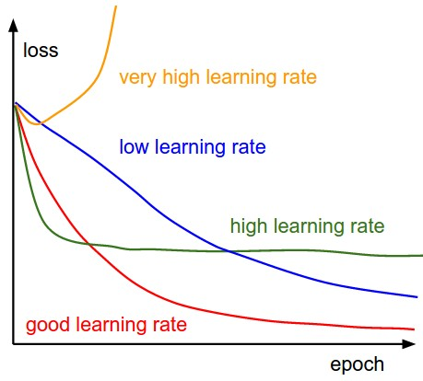
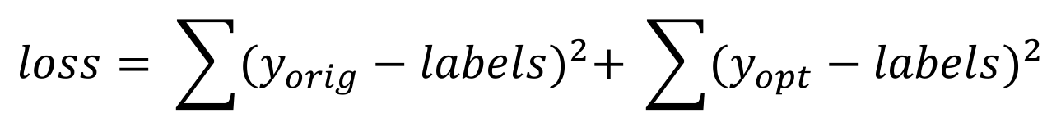
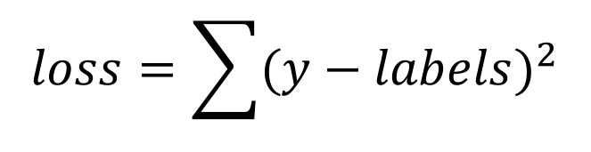
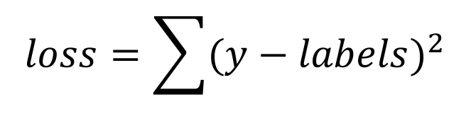
END TO END LEARNING FOR VISUAL NAVIGATION
Ute Schiehlen, Natalie Reppekus, Raymond Chua, Areeb Kamran
Technichal University of Munich
Abstract
Architectures
An important component in autonomous vehicles is visual navigation. We used an ordered sequence of frames recorded at the front of the car to obtain the steering angle using an end to end approach. Based on these images, we also computed the optical flow over adjacent frames to get additional motion information as input to our network and added an LSTM cell after the convolutional layers.
Our approach is based on the network proposed in Bojarski et al.[1] consisting of five convolutional and three fully connected layers using the human steering angle as training signal. As this model did not fully exploit the temporal information of image sequences, we extended this architecture by training an additional convolutional network with optical flow calculated from the original images as input and optimizing the combined loss. As this approach yielded good results, we trained a second network consisting of a Long-Short term memory (LSTM) cell instead of the fully connected layers.
Optical Flow Model
Optical Flow + LSTM Model
Original Model
YUV Images
YUV Images
Optical Flow Images
YUV Images
Optical Flow Images
Conv1 + ReLU + Max-Pool
Conv1 + ReLU + Max-Pool
Conv1 + ReLU + Max-Pool
Conv1 + ReLU + Max-Pool
Conv1 + ReLU + Max-Pool
Conv2 + ReLU + Max-Pool
Conv2 + ReLU + Max-Pool
Conv2 + ReLU + Max-Pool
Conv2 + ReLU + Max-Pool
Conv2 + ReLU + Max-Pool
Data Preprocessing
Conv3 + ReLU + Max-Pool
Conv3 + ReLU + Max-Pool
Conv3 + ReLU + Max-Pool
Conv3 + ReLU + Max-Pool
Conv3 + ReLU + Max-Pool
Images
Conv4 + ReLU
Conv4 + ReLU
Conv4 + ReLU
Conv4 + ReLU
Conv4 + ReLU
RGB Image
Randomized Horizontal Flip
Normalization
Convert to YUV
Zero-Mean
Labels
Conv5 + ReLU
Conv5 + ReLU
Conv5 + ReLU
Conv5 + ReLU
Conv5 + ReLU
Angle in °
Angle in Radians
Training
FC1 + ReLU
FC1 + ReLU
FC1 + ReLU
FC2 + ReLU
FC2 + ReLU
FC2 + ReLU
LSTM Cell
FC3 + ReLU
FC3 + ReLU
FC3 + ReLU
FC4
FC4
FC4
FC1
Original Model
Optical Flow Model
Optical Flow + LSTM Model
Reshape to range [-pi, pi]
Reshape to range [-pi, pi]
Reshape to range [-pi, pi]
Reshape to range [-pi, pi]
Results
Loss Functions
Optical Flow Model
Optical Flow + LSTM Model
Original Model
$$loss=\sum{{(y−labels)}^{2}}$$
$$loss= \sum{{(y_{orig}−labels)}^{2}+ \sum{{(y_{opt}−labels)}^{2}}}$$
$$loss=\sum{{(y−labels)}^{2}}$$
Optimizer
We used Adam for all three models.
References
[1]
M. Bojarski, D. D. Testa, D. Dworakowski, B. Firner, B. Flepp, P. Goyal, L. D. Jackel, M. Monfort, U. Muller, J. Zhang, X. Zhang, J. Zhao, and K. Zieba. End to end learn- ing for self-driving cars. CoRR, abs/1604.07316, 2016. 1, 2

