Slide 1


Speed = Win
2019 Datafest
A2: Deep Data

Slide 2
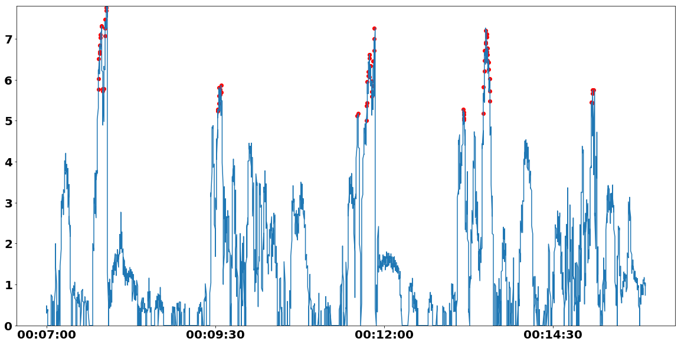

Speed Feature Extraction
Total Distance
Speed VS time
Jumps
Features of Performance Score
High Speed Sprints
Acceleration Bursts
Notes:
Speed is the most important factor

Slide 3
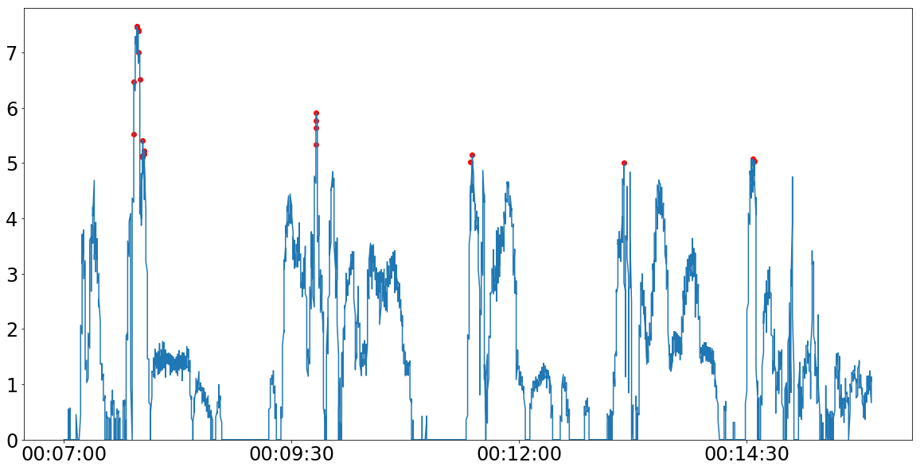
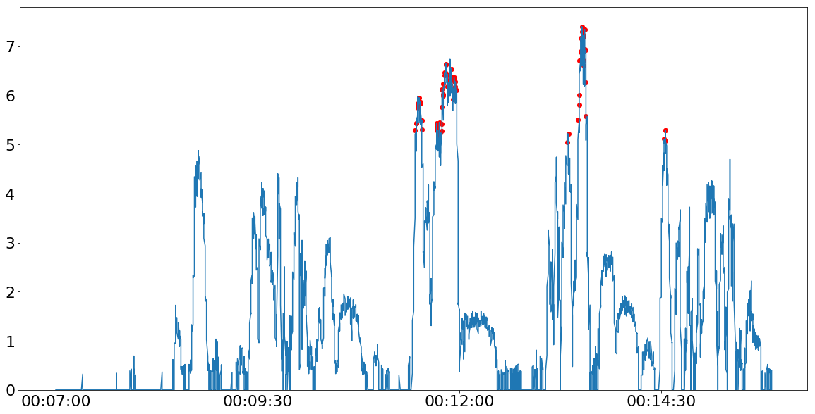
Player 11 Speed (m/s) vs Time
Identifying Fatigue
Features
Our Performance Metrics
Substitute Information
Positional Information
Objective
Real-time Player Fatigue Estimation
Used for better training routine and strategic planning
Player 16 Speed (m/s) vs Time
indicates data is missing

