Slide 1
SNAKES AND LADDERS
PRESENTED BY RAYMOND DOAN

Slide 2
SOFTWARE DEV PLAN
1
PURPOSE AND SCOPE

Slide 3
PROBLEM STATEMENT
Problem:
No existing ‘Snakes and Ladders’ / ‘Chutes and Ladders’ gem that renders a board.
Reason for Development:
Visual representation of the game for a more user-friendly experience

Slide 4
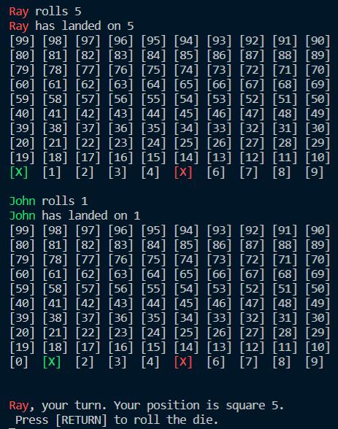
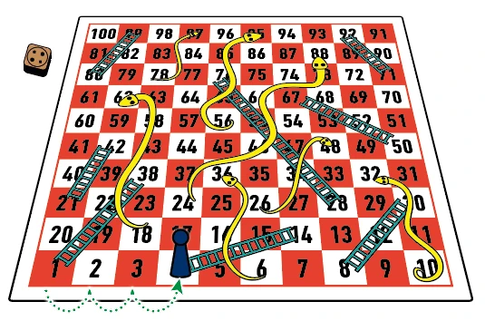
Purpose

Slide 5
TARGET AUDIENCE
People who starting to get into coding
People who want to play their favourite game for free
Or both !
To interact with the application, they will be required to clone the repo and running the shell scripts in repo

Slide 6
HIGH LEVEL LOGIC
2
FEATURES & CONTROL FLOW

Slide 7
CORE FEATURES OUTLINE
Portals
Changing the destination from one square to another, due to landing on a ‘snake’ or ‘ladder’ square.
Board Visualisation
Rendering the array of squares into a 10x10 grid format, whilst displaying the ‘location’ ID on screen
Player colour selection
Player can choose their colour of choice to represent their piece on the board.

Slide 8
INTEGRATION OF FEATURES
Board Visualisation + Rendering
Player Colour
Player Tile/Square
Squares showing ‘location’ ID
Portals for Snakes and Ladders

Slide 9
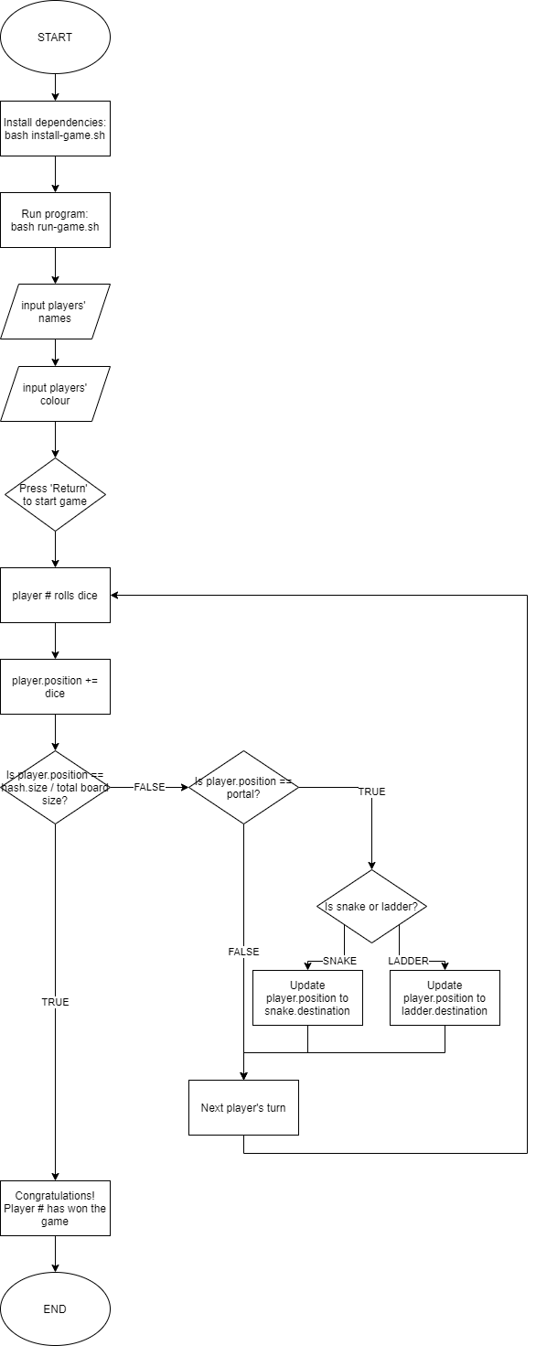
CONTROL FLOW DIAGRAM

Slide 10
DEVELOPMENT PROCESS
3
CHALLENGES, FAV PARTS & ETHICS

Slide 11
TECH STACK
Source/Version Control: Git
Language: Ruby ver. 2. 7. 1
Gem Used:
‘rspec’ for testing
‘colorize’ for colour in terminal
‘tty-table’ for board visualisation

Slide 12
DEVELOPMENT PROCESS
Challenges
Initial design vs initial coding -> Ruby is not very strong in visual aspects
Parsing variables from Game instance back to Square, hence the Square design.
Warping/Portal effect: Updating player’s position once they have landed on a snake or ladder
Favourite Parts
Adding colour to the terminal based on the player’s input
Array#unshift method-> allowed me to create the alternating rows
Warping/Portal effect ! Loved how this was made possible
Ethics
Unlikely but potential copyright infringement for creating the Snakes and Ladders game
Otherwise, none!

Slide 13
TERMINAL APP
4
INSTALLATION, WALKTHROUGH & CODE

Slide 14
How it is used ?
Clone from repo
Install the game:
Run the game:

Slide 15
Terminal Application Walkthrough
&
Behind-the-Scenes Code for Feature

Slide 16
THANKS!
ANY QUESTIONS?
You can find me at:
LinkedIn & Twitter: @raydoan94
GitHub: @whywesmurfing
gcas022037@coderacademy.edu.au

