Slide 1

SNAKES AND LADDERS
PRESENTED BY RAYMOND DOAN

Slide 2
SOFTWARE DEV PLAN
1
PURPOSE AND SCOPE

Slide 3
PROBLEM STATEMENT
Problem:
No existing ‘Snakes and Ladders’ / ‘Chutes and Ladders’ gem that renders a board.
Reason for Development:
Visual representation of the game for a more user-friendly experience

Slide 4
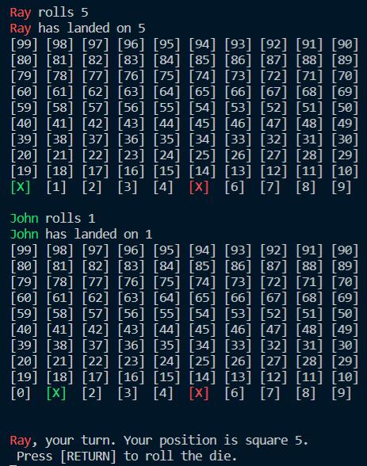
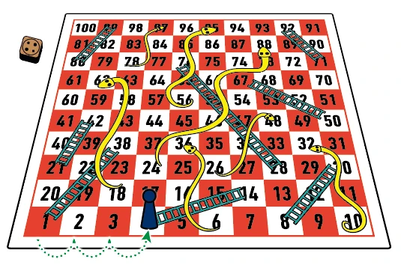
Purpose

Slide 5
TARGET AUDIENCE
People who starting to get into coding
People who want to play their favourite game for free
Or both !
To interact with the application, they will be required to clone the repo and running the shell scripts in repo

Slide 6
TERMINAL APP
2
INSTALLATION, WALKTHROUGH & CODE

Slide 7
How it is used ?
Clone from repo
Install the game:
Run the game:

Slide 8
Terminal Application Walkthrough
&
Behind-the-Scenes Code for Feature

Slide 9
HIGH LEVEL LOGIC
3
FEATURES & CONTROL FLOW

Slide 10
CORE FEATURES OUTLINE
Portals
Changing the destination from one square to another, due to landing on a ‘snake’ or ‘ladder’ square.
Board Visualisation
Rendering the array of squares into a 10x10 grid format, whilst displaying the ‘location’ ID on screen
Player colour selection
Player can choose their colour of choice to represent their piece on the board.

Slide 11
INTEGRATION OF FEATURES
Board Visualisation + Rendering
Player Colour
Player Tile/Square
Squares showing ‘location’ ID
Portals for Snakes and Ladders

Slide 12
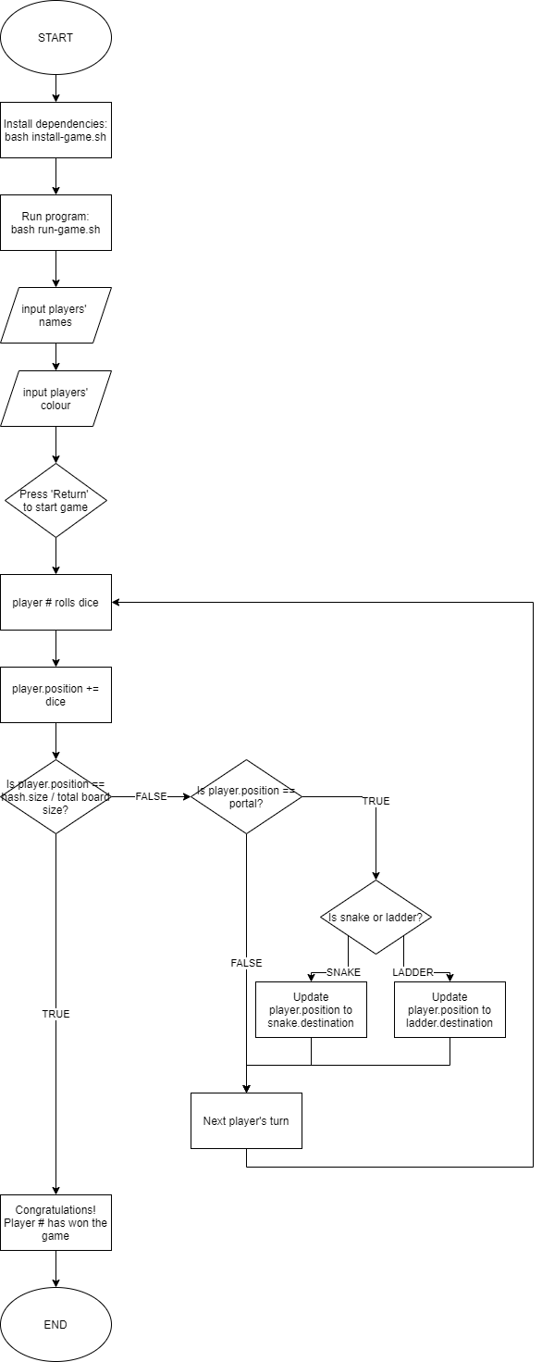
CONTROL FLOW DIAGRAM
Main Game Logic

Slide 13
DEVELOPMENT PROCESS
4
CHALLENGES, FAV PARTS & ETHICS

Slide 14
TECH STACK
Source/Version Control: Git
Language: Ruby ver. 2. 7. 1
Gem Used:
‘bundler’ for managing gems
‘rspec’ for testing
‘colorize’ for colour in terminal
‘tty-table’ for board visualisation

Slide 15
DEVELOPMENT PROCESS
Challenges
Initial design vs initial coding -> Ruby is not very strong in visual aspects, became an overly ambitious game
Parsing variables from Game instance back to Square, hence the Square design.
Warping/Portal effect: Updating player’s position once they have landed on a snake or ladder
Favourite Parts
Adding colour to the terminal based on the player’s input
Array#unshift method-> allowed me to create the alternating rows
Warping/Portal effect ! Loved how this was made possible
Ethics
Unlikely but potential copyright infringement for creating the Snakes and Ladders game
Otherwise, none!

Slide 16
THANKS!
ANY QUESTIONS?
You can find me at:
LinkedIn & Twitter: @raydoan94
GitHub: @whywesmurfing
gcas022037@coderacademy.edu.au

