Slide 1

Daniel Mayer
Farihah Haque
Brandon Lally
Anjali Patel

Slide 2
Objective
In this experiment, the life cycle of the C-fern from spore to maturing sporophyte will be analyzed and observed.
Notes:
anji

Slide 3
Background
Fern life cycle
  Sporophyte (2n) undergoes meiosis to produce spore (n)
  Spore produces a gametophyte (n) via mitosis
  Gametophyte then forms male and females gametes (n), sperm and egg, by mitosis
  Sperm fertilizes egg to yield a zygote (2n)
  Zygote undergoes mitosis to produce a sporophyte
  This is a continuous cycle
Notes:
anji

Slide 4
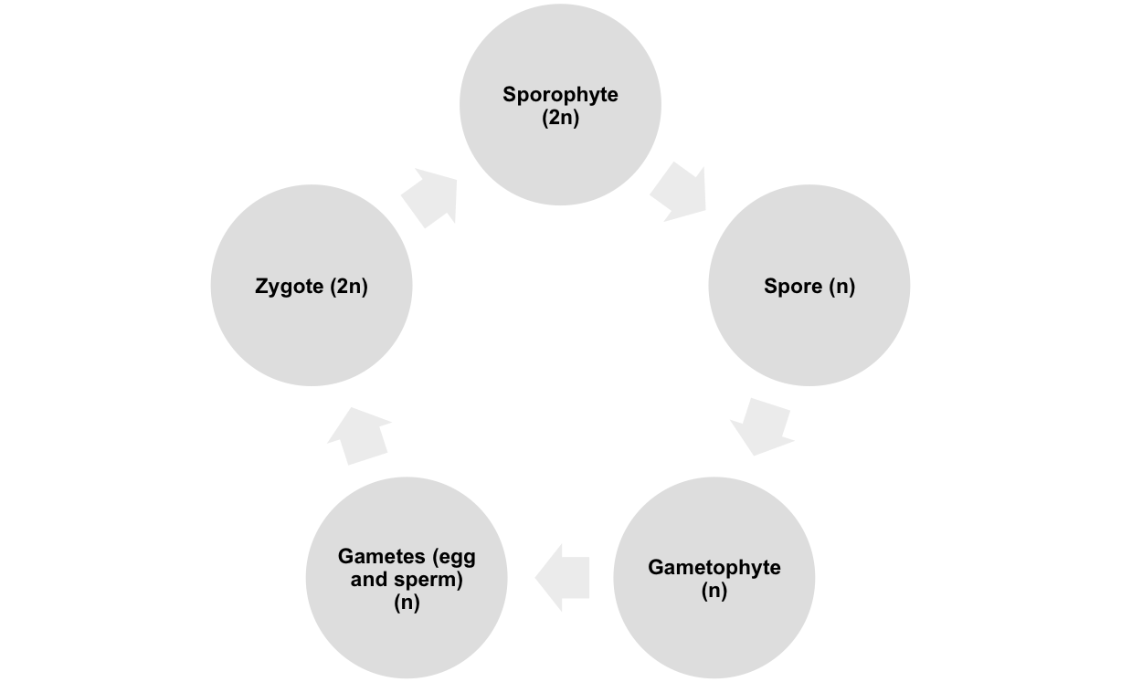
Cycle of Growth
mitosis
meiosis
fertilization
mitosis
mitosis
Notes:
anji

Slide 5
Haploid (n)—a cell with only one copy of DNA
Diploid (2n)—a cell with both sets of DNA
Spore
Gametophyte
Gametes (sperm and egg)
Sporophyte
zygote
Notes:
anji

Slide 6
Procedure
Sterilize work surfaces and materials with 70% ethanol
Soak spores in 4mL of distilled water for 15 minutes
Spread one or two drops of spore solution onto agar plates using paperclip
Notes:
farihah

Slide 7
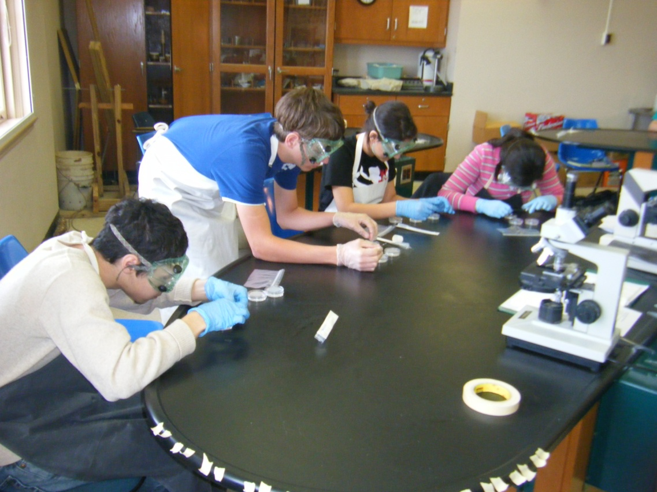
Procedure (continued)
Place Petri dishes in light box
Keep temperature constant between 28° to 30° Celsius
Notes:
farihah

Slide 8
Observations and Discussion:
Within the first week, rhizoids were observed
By the second week, gametophyte stage was visible
  There are hermaphrodite and male gametophytes
Sperm were observed in motion
Notes:
daniel

Slide 9
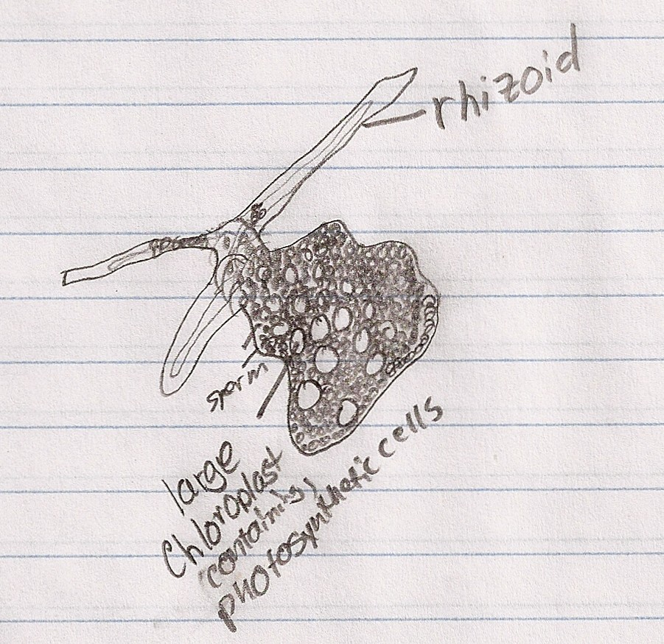
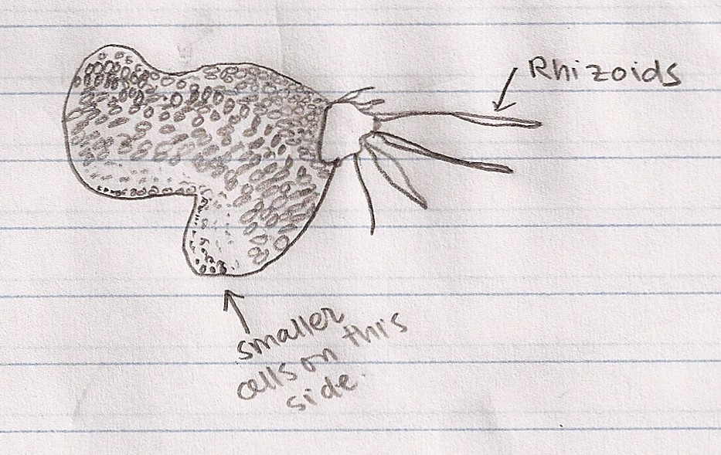
Male gametophyte
Hermaphrodite
Notes:
daniel

Slide 10
Observations and Discussion: Problems Encountered
Agar medium was damaged easily when spreading spores
Agar melted
  Likely due to overheating of the light box
All spores died except those from one plate
  More agar plates with spores were requested from Planting Science
Limited fungal growth observed on tape of Petri dish on the outside
Notes:
daniel

Slide 11
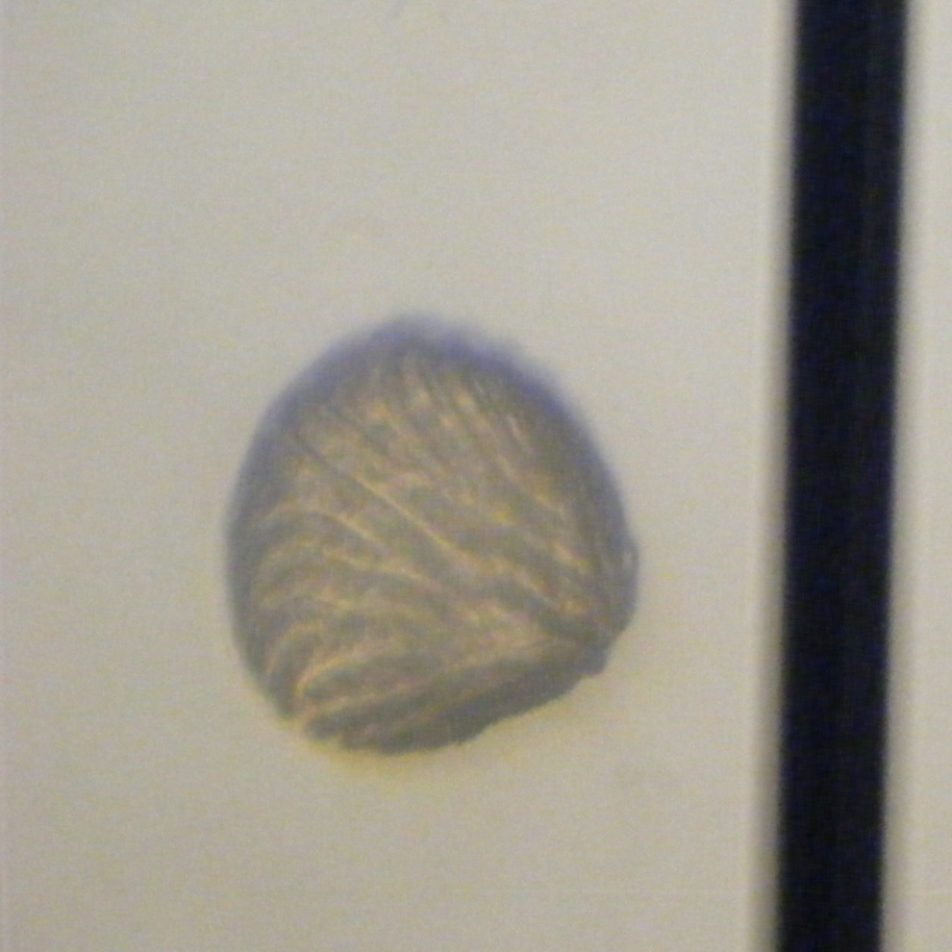
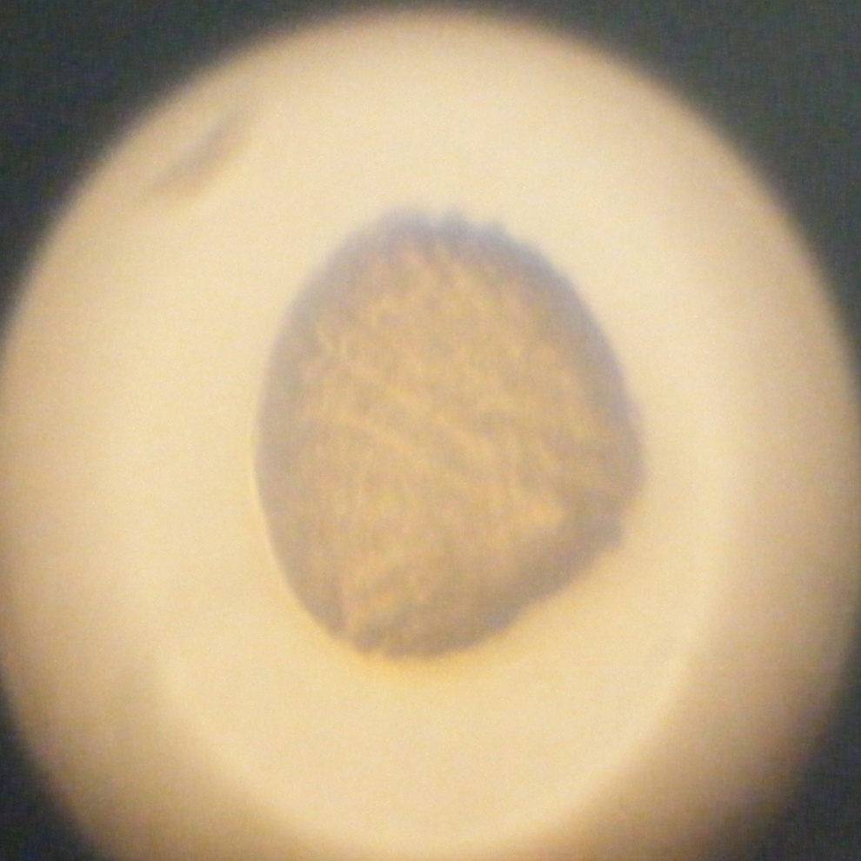
Haploid spore
Notes:
lally

Slide 12
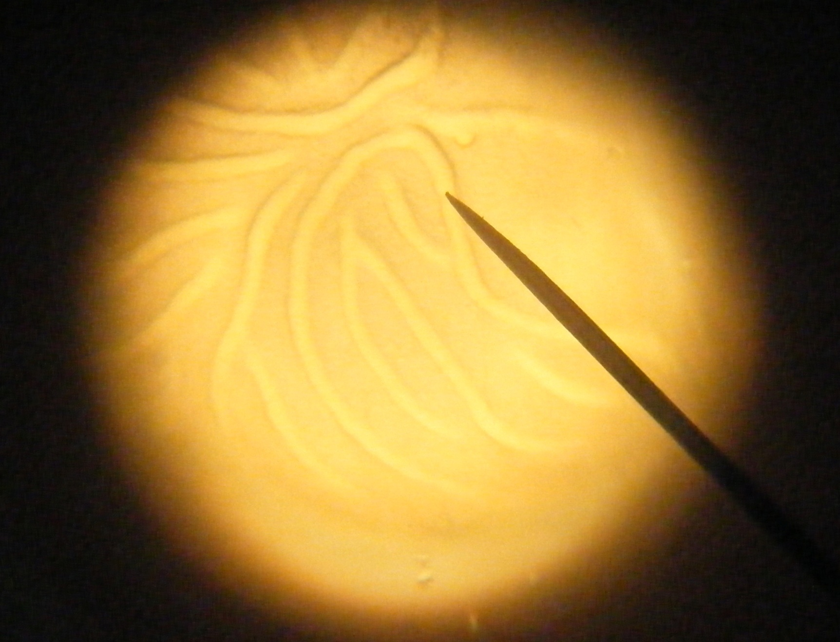
Close up of spore
Notes:
lally

Slide 13
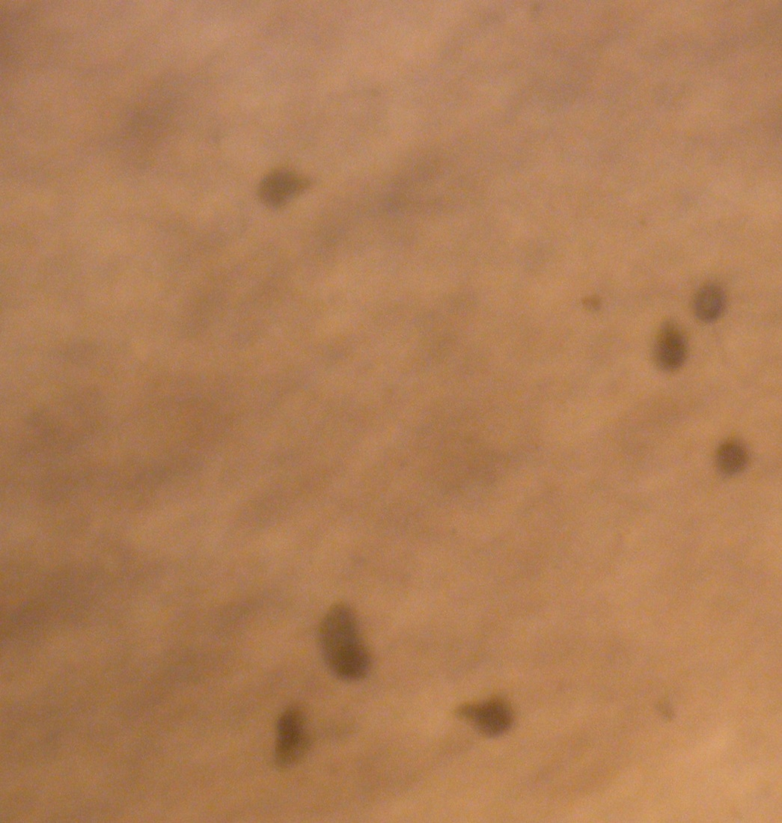
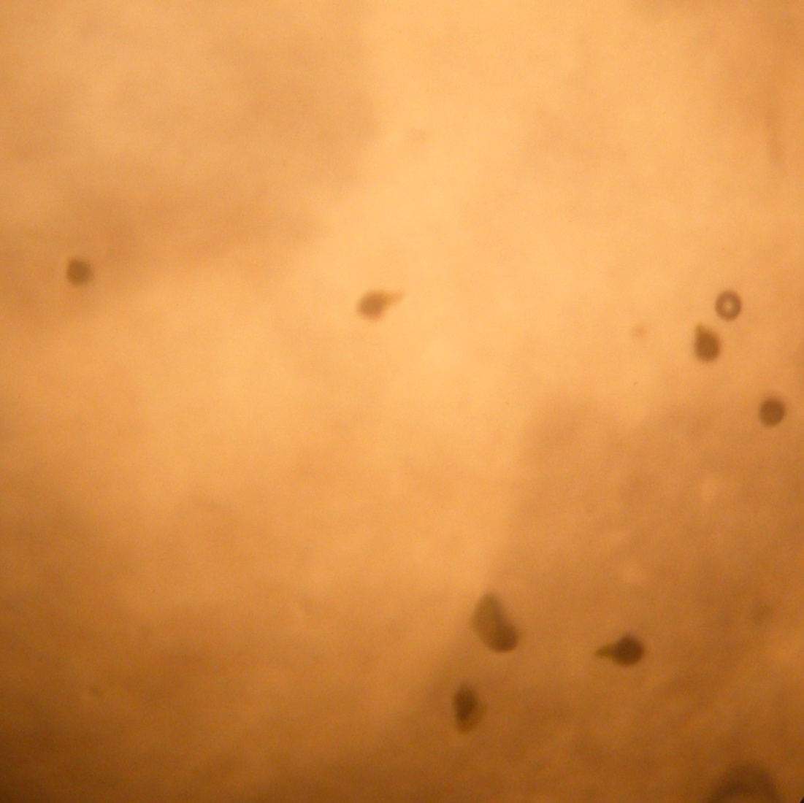
F
Rhizoids begin to project out of spores
Notes:
lally

Slide 14
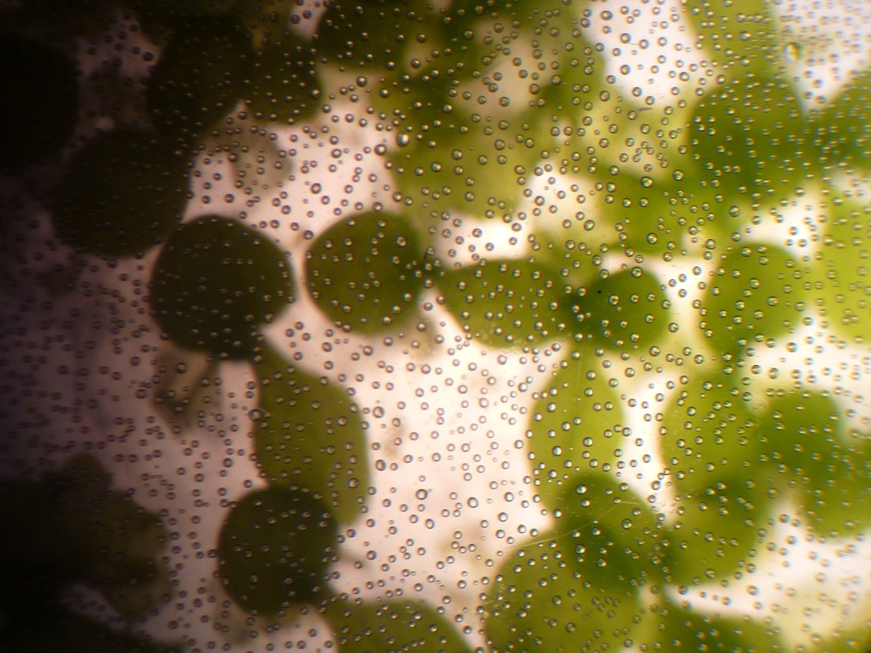
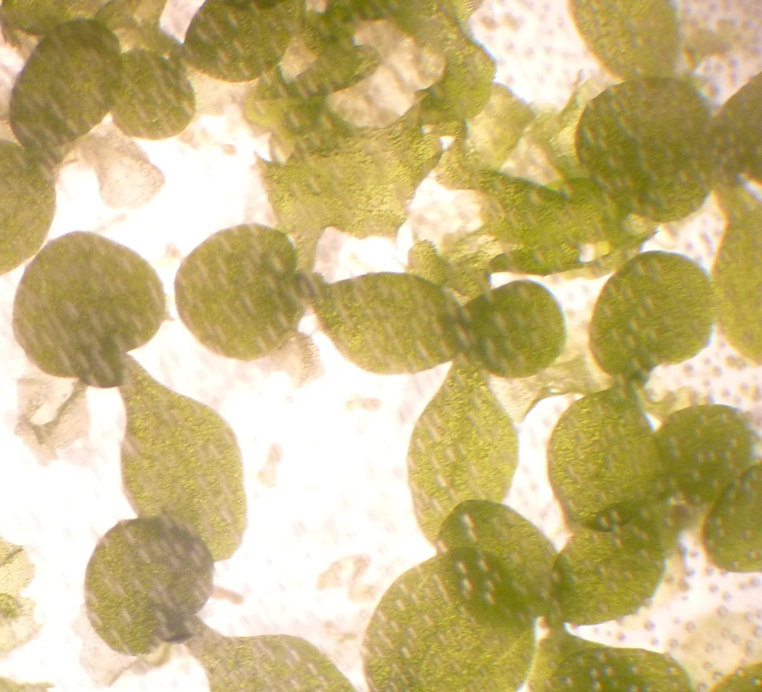
Maturing sporophytes
Notes:
lally

Slide 15
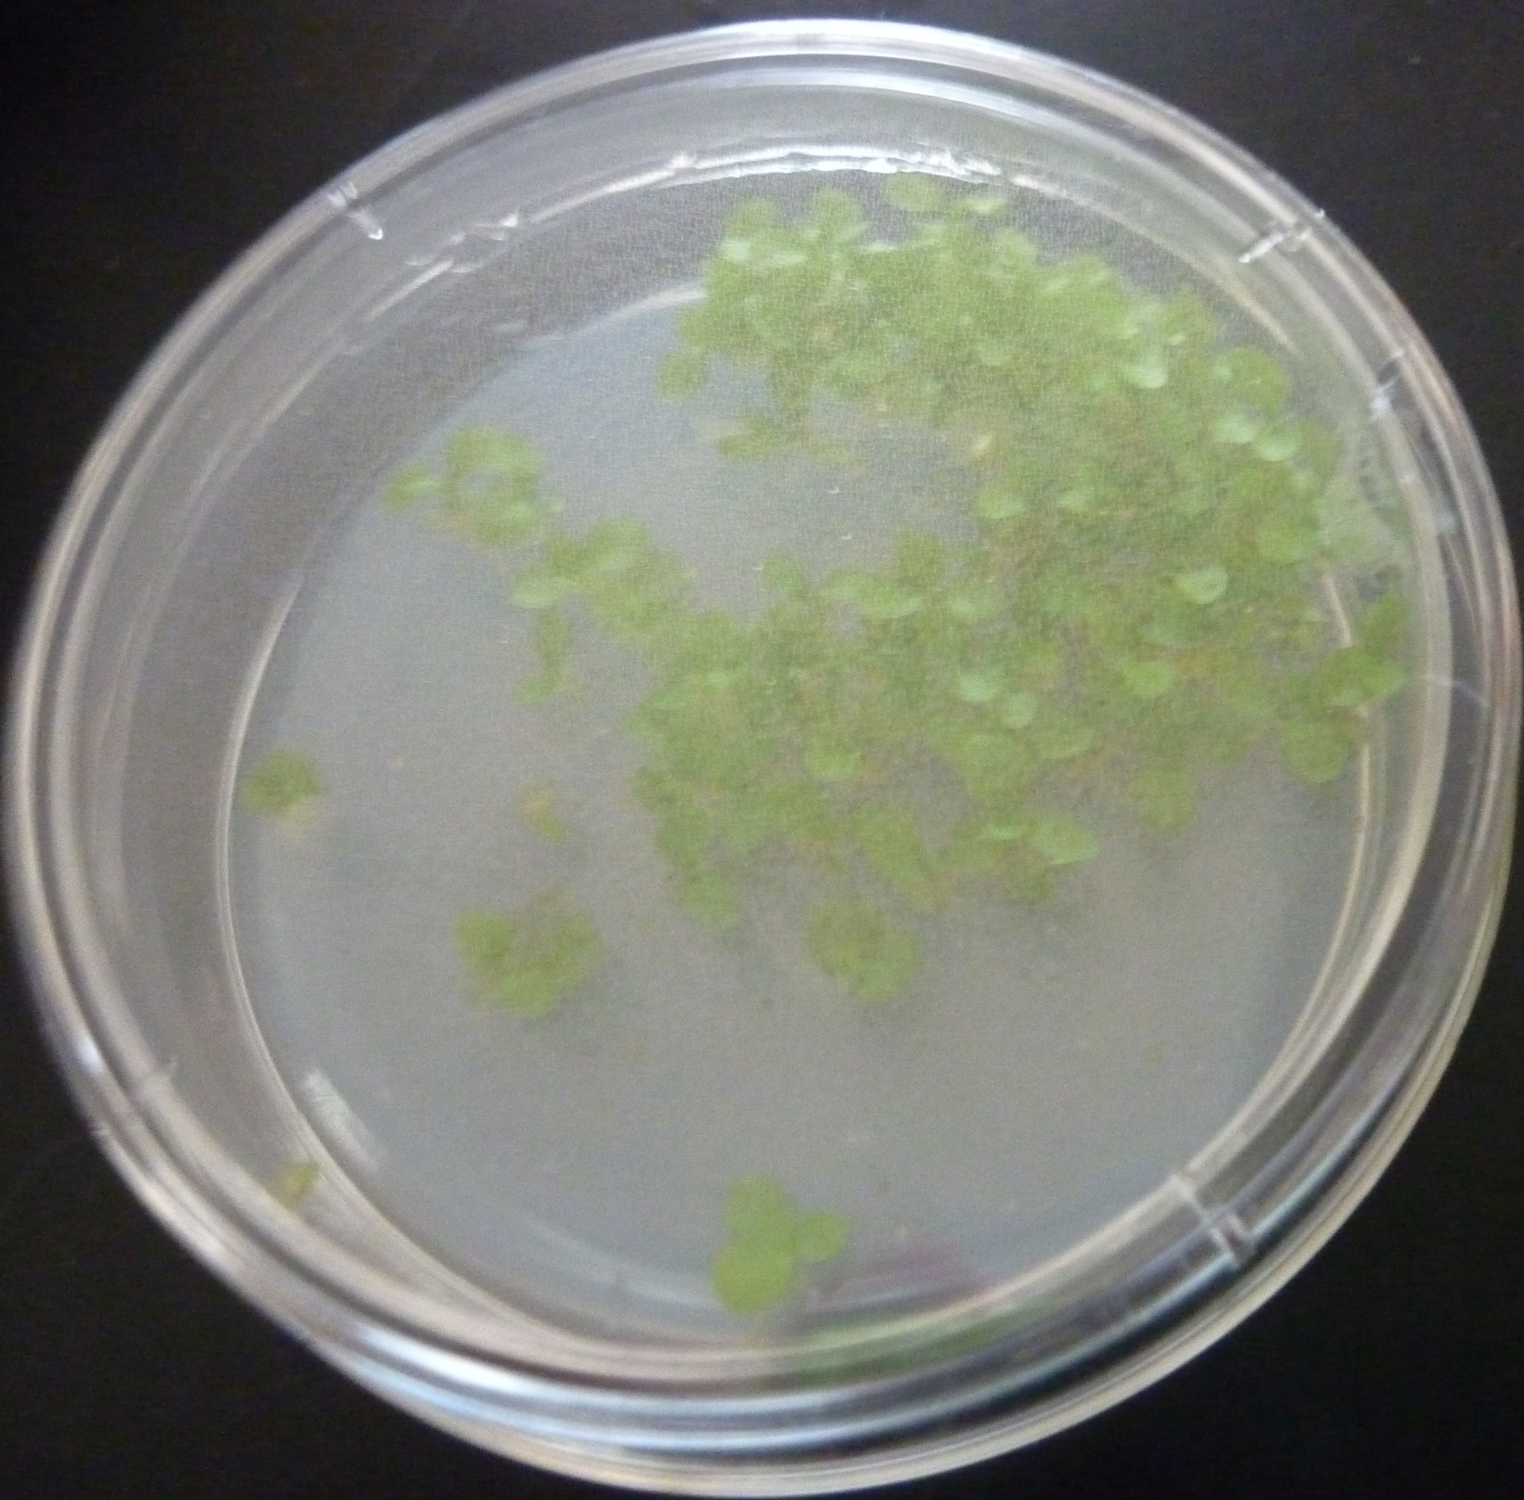
Notes:
farihah

Slide 16
Conclusion
Given that a sterile environment was provided, there was no significant, intrusive fungal growth.
Environment is very important for fern survival
  The new plates succeeded after careful attention to temperature in the light box
Although some problems occurred, the experiment successfully accomplished the goal which sets precedent to prevent complications for future students and scientists.
Notes:
farihah

