Slide 1
Traffic flow arrangement through Linear Programming
Presented by Yinan Gao, Mia Wang, Raymond Kim

Slide 2
Background
Problem: Too much air traffic flow causing ground delay and airborne delay.
Objectives: Minimizing the cost by the congestion

Slide 3
Background for the model
1. The airspace is divided into sectors.
2. Each flight passes through contiguous sectors during its route to the destination.
3. There is a restriction on the number of airplanes that may fly within a sector at a given time. This number is affected by factors including geographics and weather.
4. We will formulate this problem into a 0-1 integer programming problem.

Slide 4
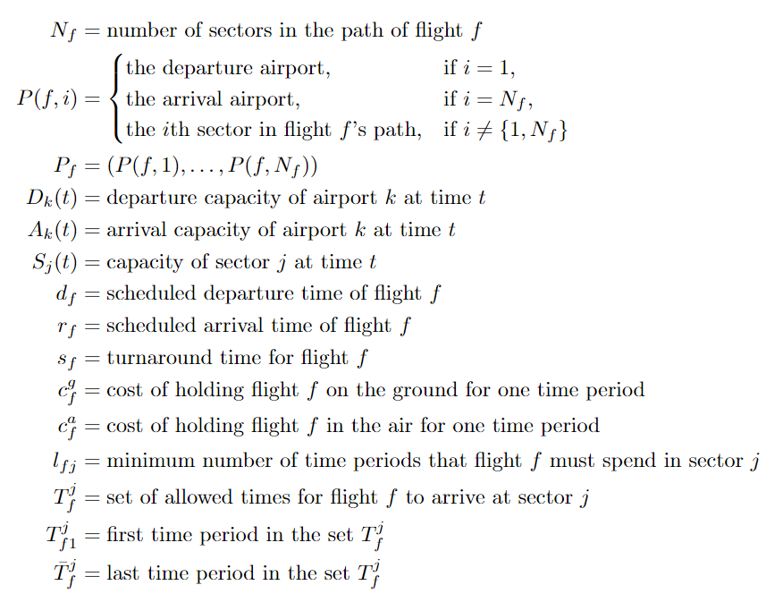
Direct input variables defined:

Slide 5
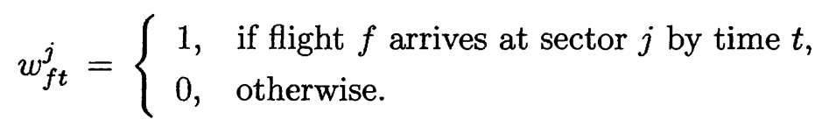

Decision Variable
If j=P(f,1), and flight f takes off from airport P(f,1) by time t, then = 1
If j=P(f,Nf), and flight f lands at airport P(f,Nf) by time t, then = 1

Slide 6
Constructing other variables

Slide 7
Reference
(Athena Scientific series in optimization and neural computation) Tsitsiklis, John N._ Bertsimas, Dimitris - Introduction to linear optimization-Athena Scientific (1997), p 544-550

