Slide 1


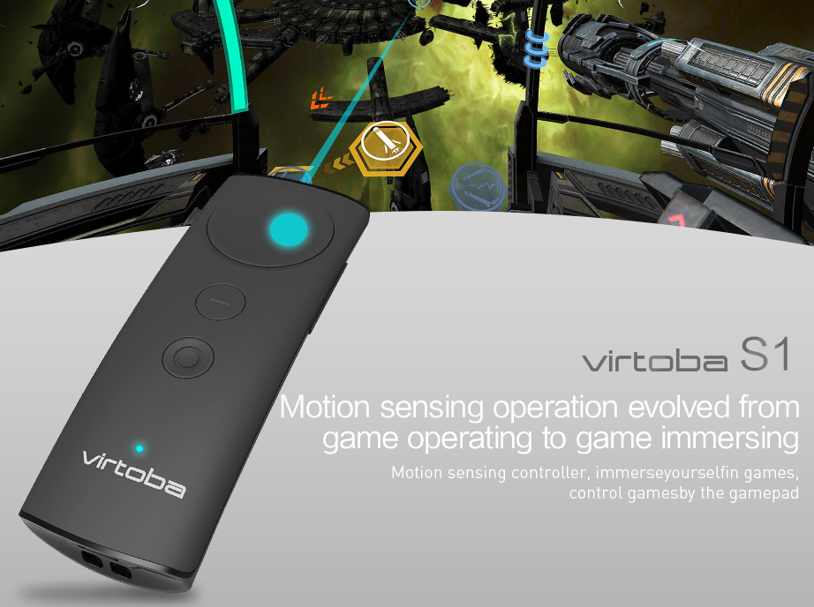
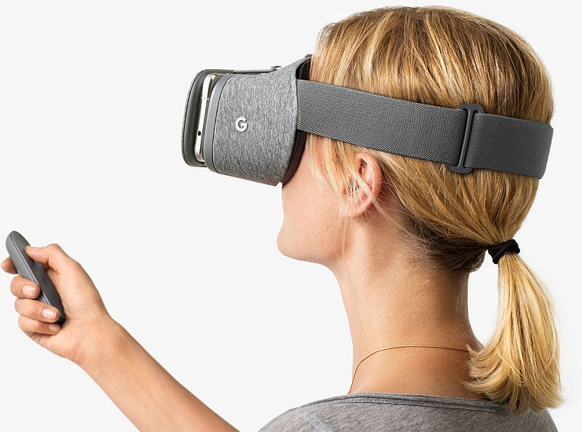
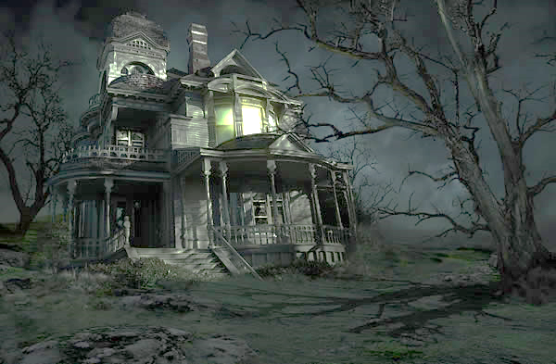
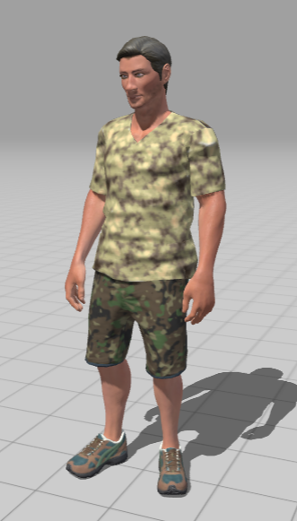
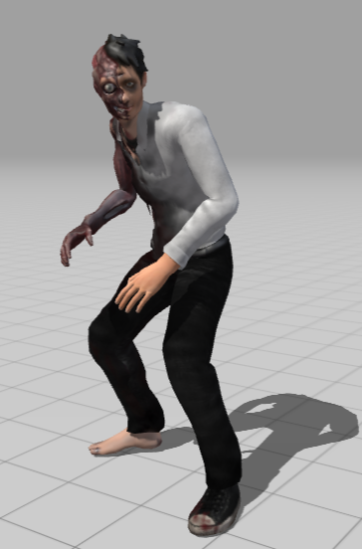
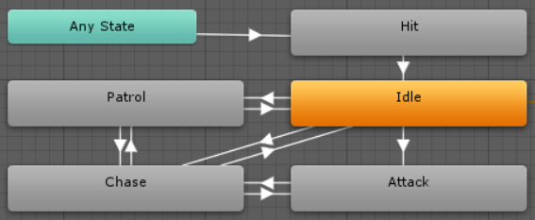
Developing Virtual Reality App Using Google Cardboard SDK
TSANG Cheuk Ling, LUI Ka Kit
Supervised by Prof. Leung Wai Ting
Overview
Virtual Reality (VR) becomes a new technology trend, and is most used in workplace training and gaming, while gaming has the largest VR market share. With Google Cardboard, people can turn their smart phone into a low-end VR device. We are going to develop a VR mobile game with horror and escape elements using Unity Game Engine and Google Cardboard SDK. Players in first person view need to escape from or eliminate the creatures or ghosts in the haunted house to win the game.
Objectives
Provide instant feedback as the player moves in different dimensions by receiving player’s physical behaviours every game frame
Improve the user interactions in the game by collecting user’s voice and input from additional controller
Methodology
Graphics Design
We used mixamo.com and Adobe Fuse to create character models and import animations needed for the game. We also used Blender3D to create a haunted house exterior model and props for players to pick up.
External Controller
Building Voice Recognition System
We will use Google Speech to Text API to add speech transcription capabilities to our game. The accuracy of the system will be tested.
Implement AI pathfinding algorithm
We want to make the creatures in the house look
smart by implementing an artificial intelligence path-
finding algorithm for different types of enemy.
Database
Information stored in database:
Game progress
Player’s profile info and statistics
Progress
Things we have done:
Haunted house exterior model
Player character model
Enemy character models
Some props (e.g. rifle, sword, health pack, etc.)
Basic AI pathfinding algorithm
Basic voice recognition system
To-do list in the coming months:
Haunted house interior design
Implement the storyline into the game
Build a database to store game records
We will use Virtoba S1 Daydream Controller for complex inputs & motion checking
Create an innovative haunted house escape VR game with novel game flow

