Slide 1
To Grok Grokking: Provable Grokking in Ridge Regression
ICML 2026 – Outstanding Paper Honorable Mention
Mingyue Xu – Purdue University, USA
Gal Vardi – Weizmann Institute of Science, Israel
Itay Safran – Ben-Gurion University of the Negev, Israel

Slide 2
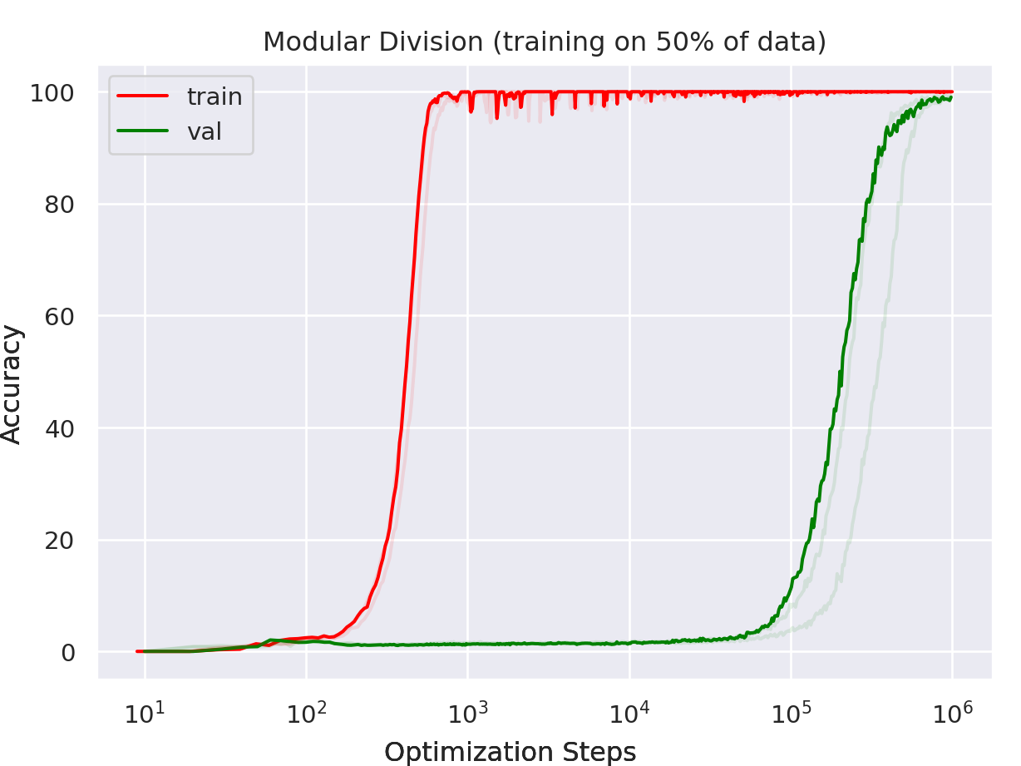
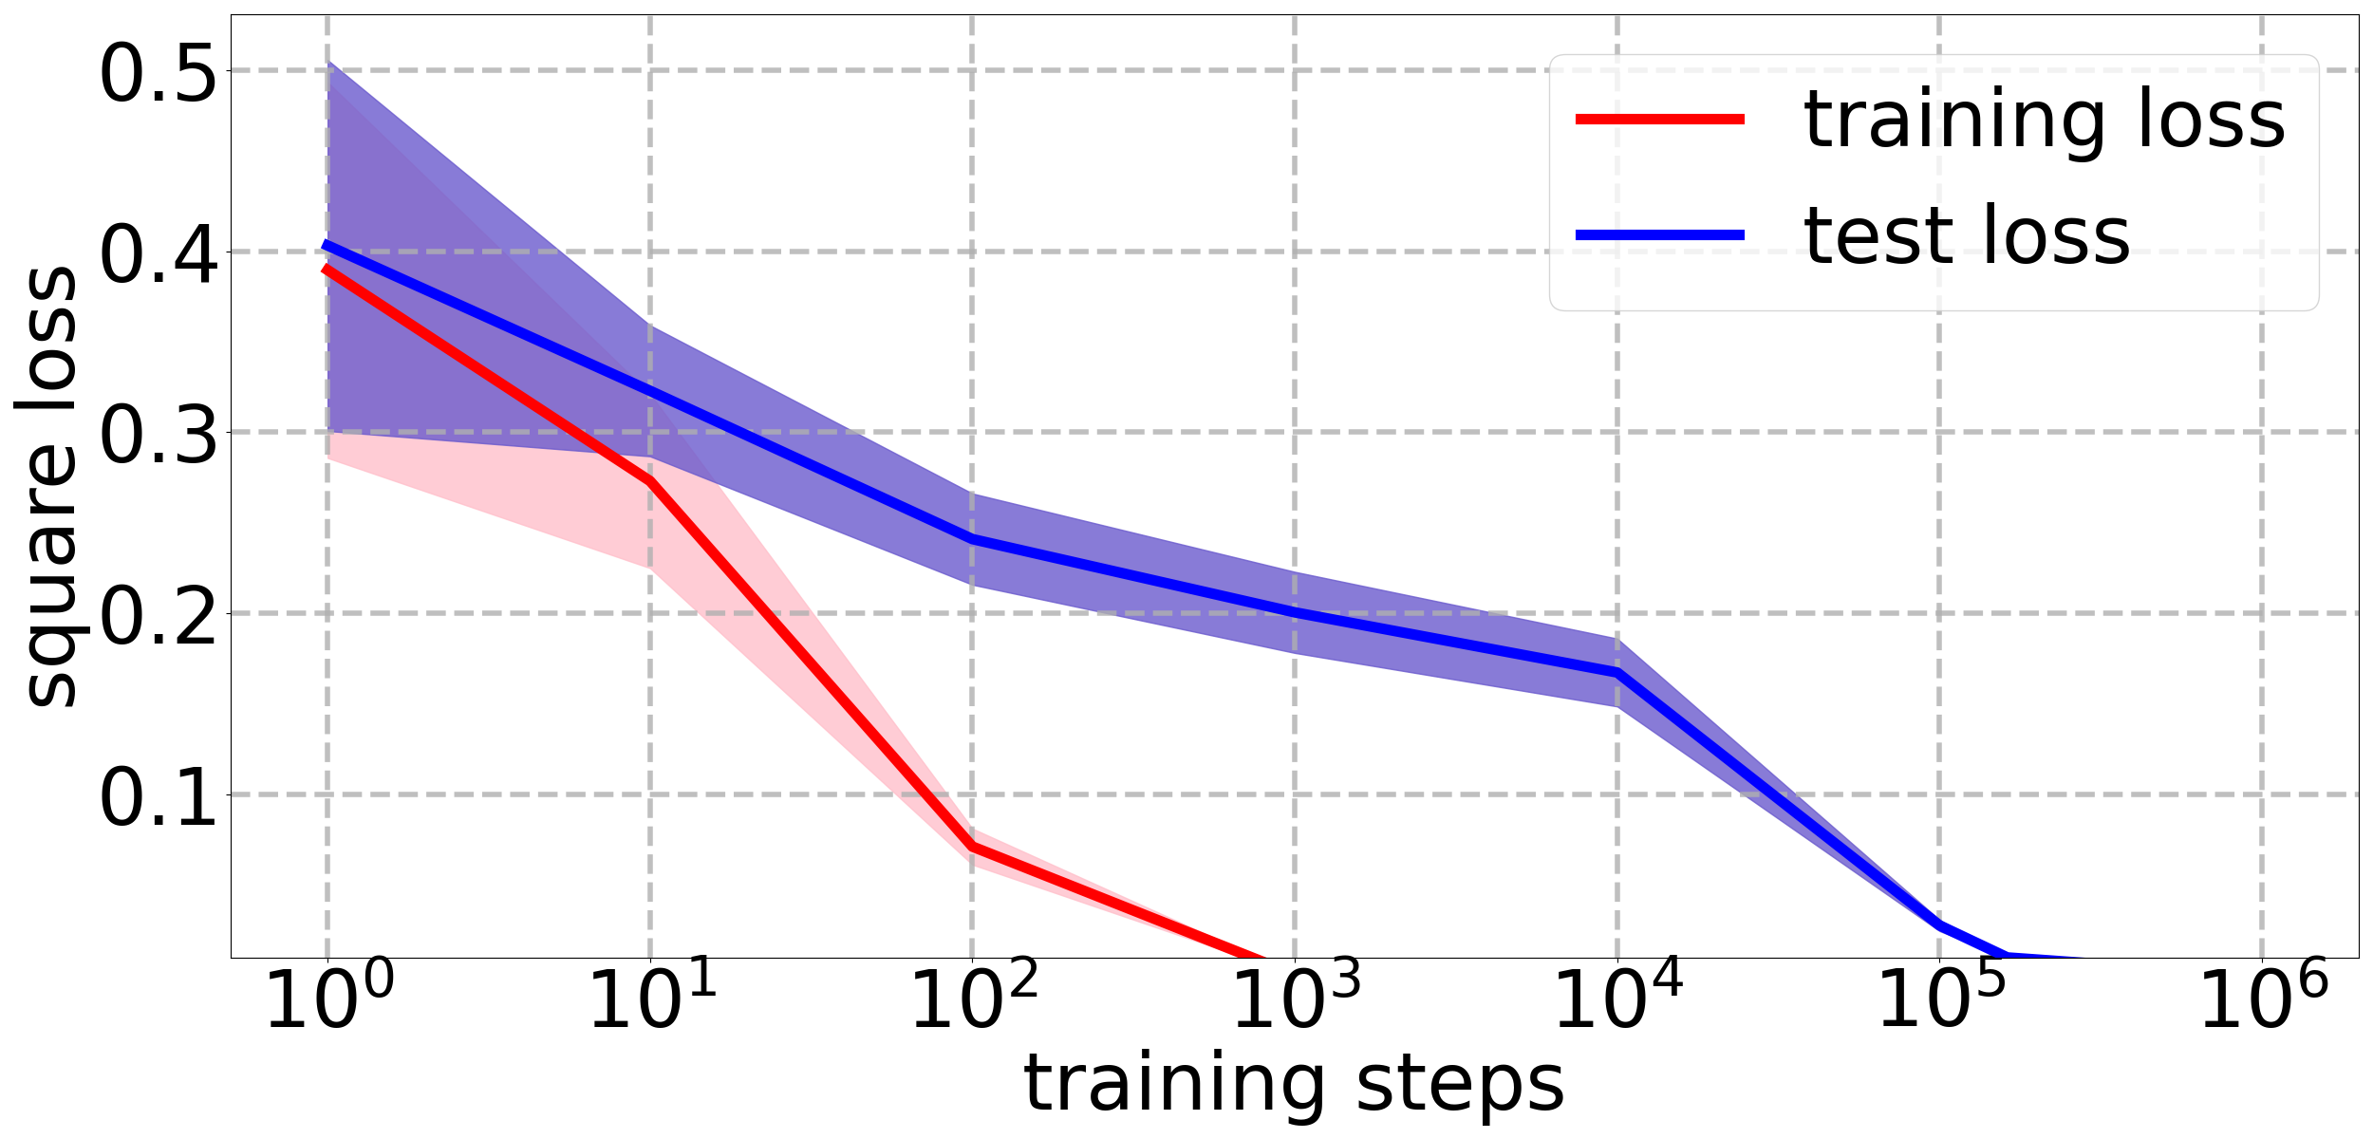
Background: what is grokking?
Counterintuitive generalization phenomenon: training is fast, generalization is delayed.
Power et at., 2022
Our work: grokking in ridge regression
Three key characteristics:
Training loss/accuracy drops/increases quickly in an early stage of training.
The trained model overfits the data, and poor generalization persists long after overfitting.
The trained model eventually generalizes.

Slide 3
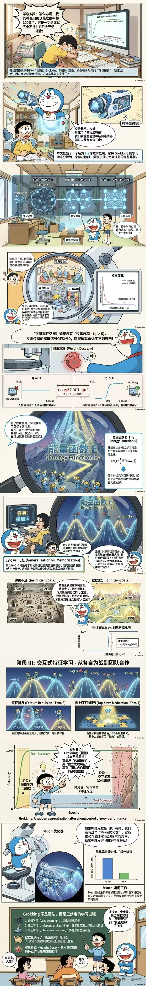
Background: why are we interested in grokking?
My model overfits the data. Should I tune hyperparameters and re-train it?
The ultimate goal is to establish a criterion: under what cases we should not stop training and what cases we have to stop and how to tune the model hyperparameters.

Slide 4
Literature review
Grokking is a popular generalization phenomenon being extensively observed empirically:
NNs: Chughtai et al. (2023); Notsawo Jr et al. (2023); Tan & Huang (2023); Fan et al. (2024); Humayun et al. (2024)
LLMs: Murty et al. (2023); Zhu et al. (2024); Wang et al. (2024); Xu et al. (2025); Singh et al. (2026); Verma et al. (2026)
But only a few rigorous theoretical guarantees exist.
Two main streams towards theoretical understanding of grokking.
1. phase transition from the neural network’s lazy (kernel) to the rich regime:
Lyu et al. (ICLR 2024); Mohamadi et al. (ICML 2024); Kumar et al. (ICLR 2024)
2. phase transition from the nearly regularizer-free to the regularizer-driven phase:
Boursier et al. (NeurIPS 2025); Tikeng Notsawo et al. (ICML 2025)
No existing works have established end-to-end provable grokking.
Missing provable guarantees for either optimization or overfitting.

Slide 5
Literature review
3. An almost end-to-end provable grokking in classification:
Benign overfitting and grokking in ReLU networks for xor cluster data. Xu et al. (ICLR 2024)
They almost proved an end-to-end grokking. Specifically, they consider training two-layer ReLU networks by GD on XOR cluster data with a constant fraction of label flipping (a binary classification problem). What they showed are:
(i) After the first step of GD, the network achieves 100% training accuracy.
(ii) At a later training step, the network achieves near-optimal test accuracy.
However, for overfitting, they only showed:
After the first step of GD, the network achieves test accuracy no better than a random guess.
Namely, a one-step overfitting.
But grokking requires a long-time overfitting.

Slide 6
Literature review and motivations
4. For linear models, several works have studied grokking:
Levi et al. (ICLR 2024); Zunkovic & Ilievski (JMLR 2024); Beck et al. (ICML 2025)
Again, they do not provide rigorous proofs.
Why is grokking in linear regression interesting?
(i) Completely proving grokking in linear regression can be viewed as a first step towards a more rigorous understanding of grokking.
(ii) Grokking is identified and usually observed in complicated deep learning settings. A provable grokking in simple linear regression is thus more surprising.
(iii) In simple settings like linear regression, clean theoretical bounds could be expected without making additional assumptions.

Slide 7
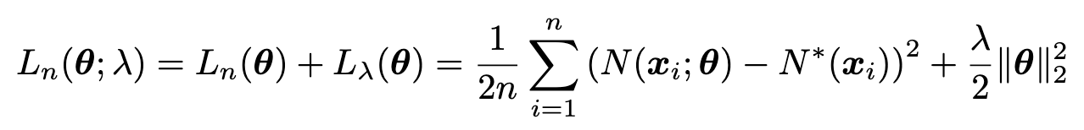




Preliminaries
Linear regression:
Loss objective:
Gradient descent update:
Data generation and target function:
Additional notations
Data feature maps:
Population squared loss:
Population covariance matrix:

Slide 8
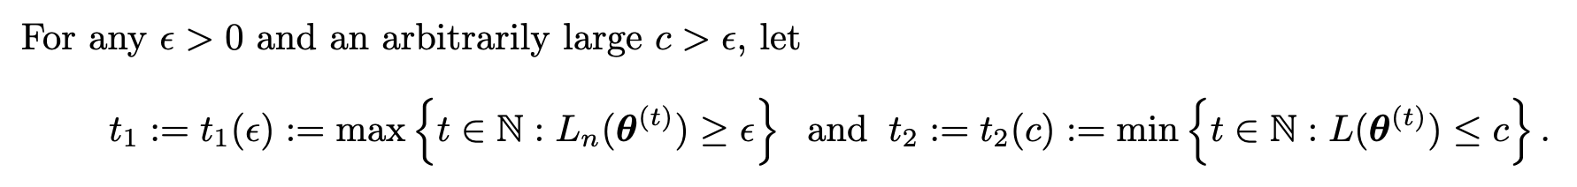
Definitions
How to formally define grokking?
t1– how long the model takes at most to fit the training data;
t2 – how fast the model is possible to generalize.
If t2>t1, the model overfits before generalization;
If t2>>t1, an explicit grokking occurs.
We call the gap (t2-t1), the “grokking time”.
For arbitrary large c, can we find hyperparameter configurations that realize grokking?

Slide 9
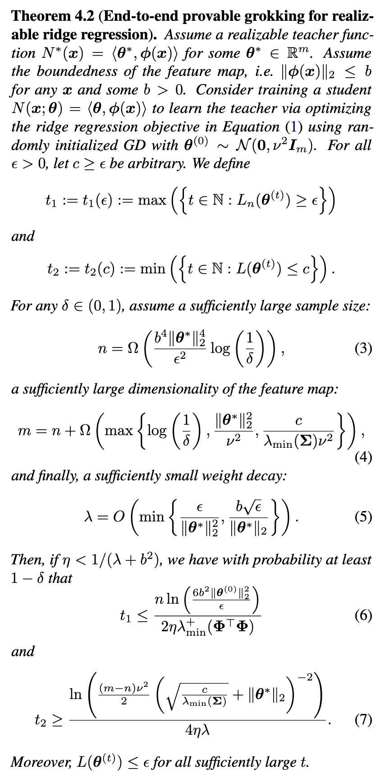
Our contributions
We give the first end-to-end provable grokking result in ridge regression.

Slide 10
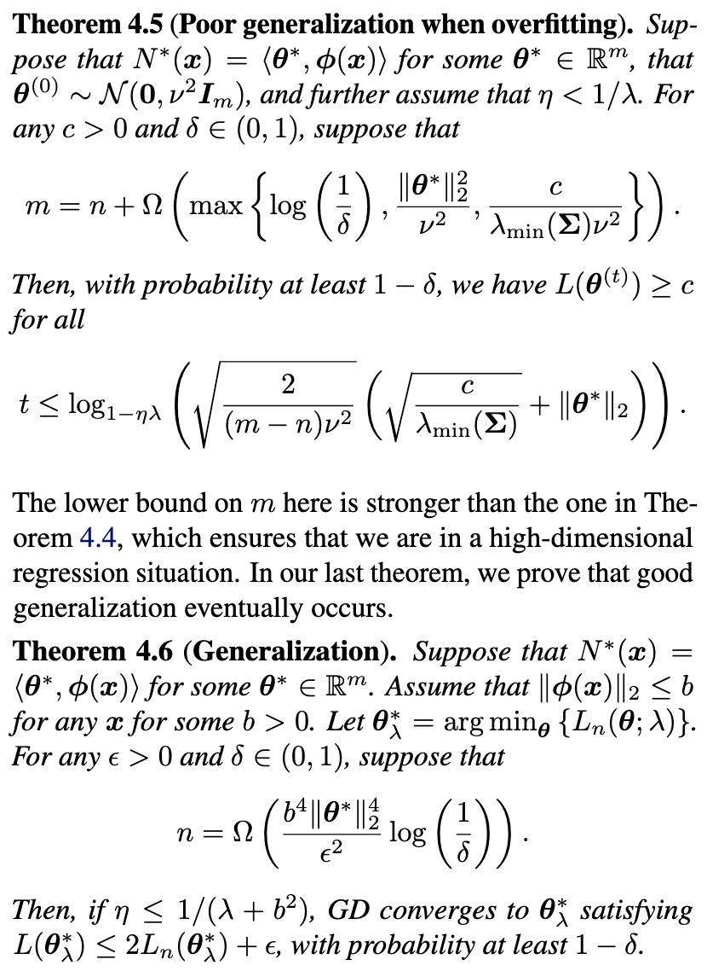
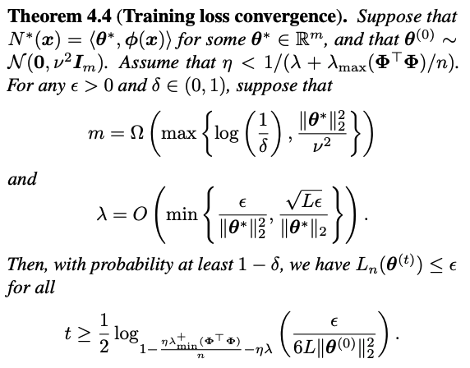
Our contributions
We prove the three components of grokking separately.

Slide 11

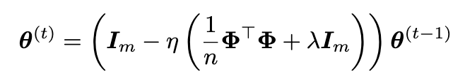
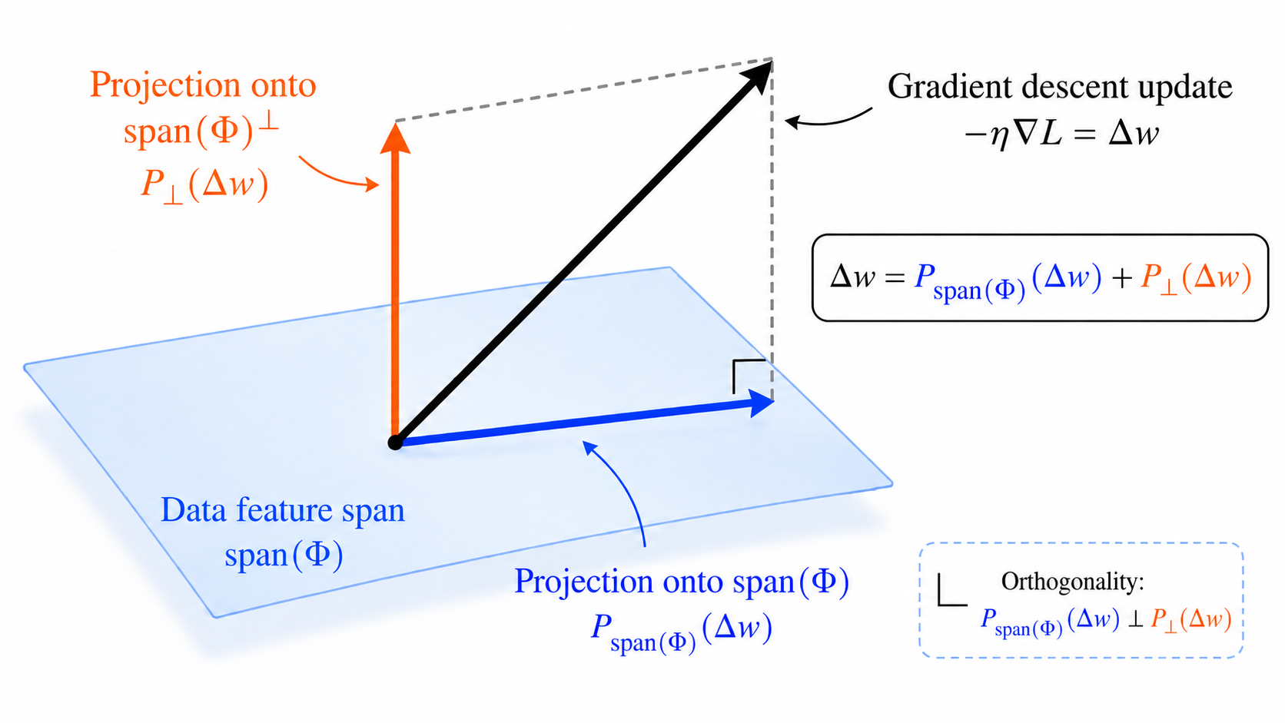
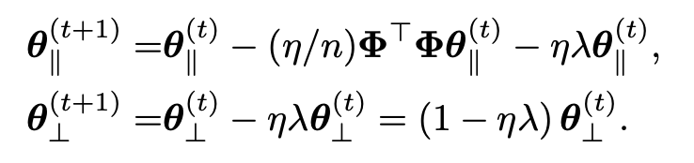
High-level proof ideas
To summarize: an overparametrized model gives a high-dimensional regression.
Let us assume for simplicity:
Data feature span: the row space of
Decompose the GD by projecting into
the span and its orthogonal component:

Slide 12
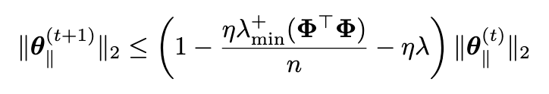

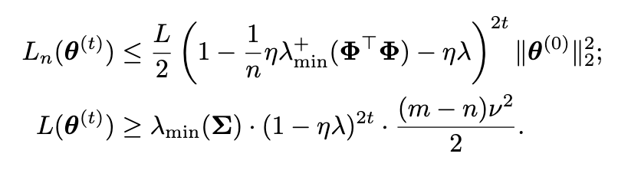
High-level proof ideas
Fit the training data efficiently:
on the data span, its update is at least
Overfits data arbitrarily long:
on the orthogonal complement
When randomly initialized, concentration inequality yields norm lower bounds.

Slide 13
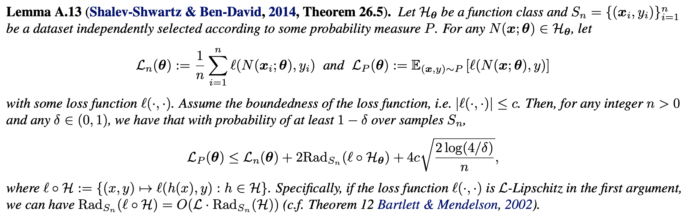
High-level proof ideas
The trained model eventually generalizes:
by standard arguments of uniform convergence and Rademacher complexity.
Long time weight decay reduces the complexity of the model class and eventually guarantees the uniform convergence.

Slide 14
Our contributions
We quantitatively state the sufficient conditions of the hyperparameters to realize grokking.
We also give the first rigorous quantitative bounds on the grokking time in terms of model/training hyperparameters.

Slide 15
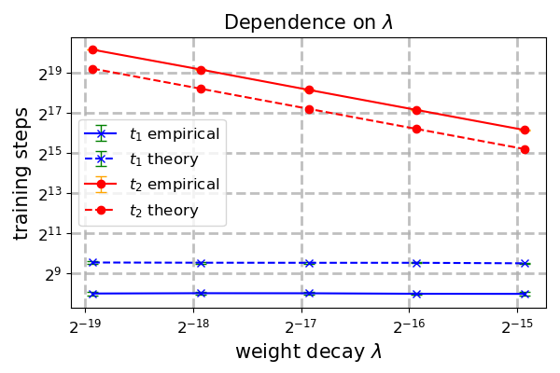
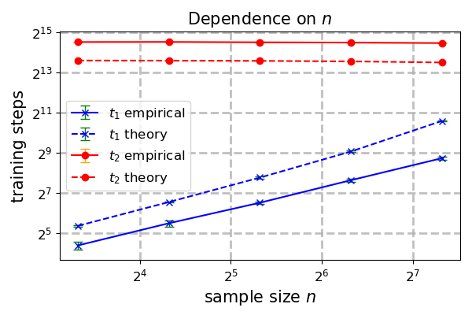
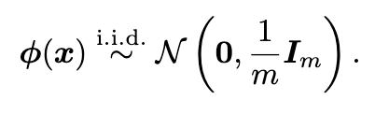
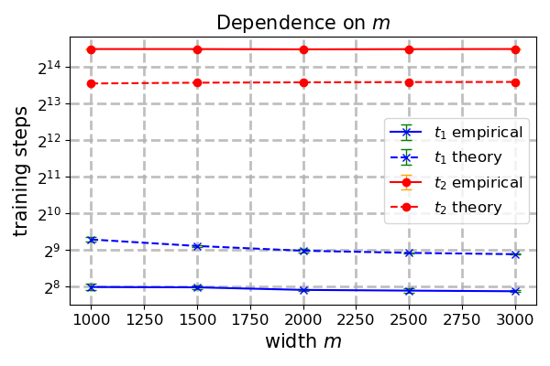
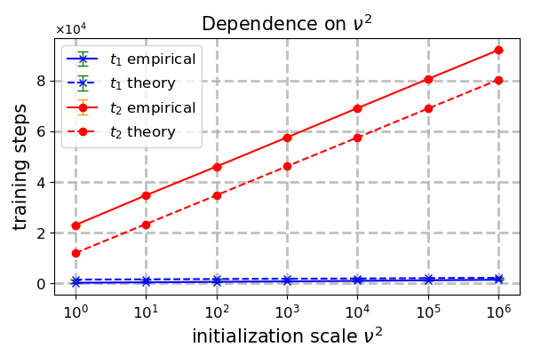
Experiments: hyperparameters affect the grokking time
Tested specifically on Gaussian features:

Slide 16
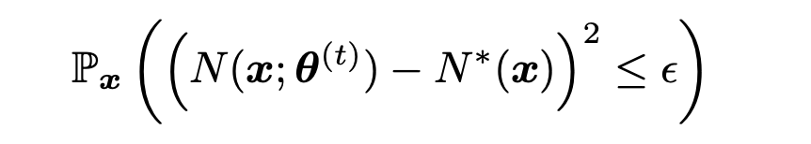
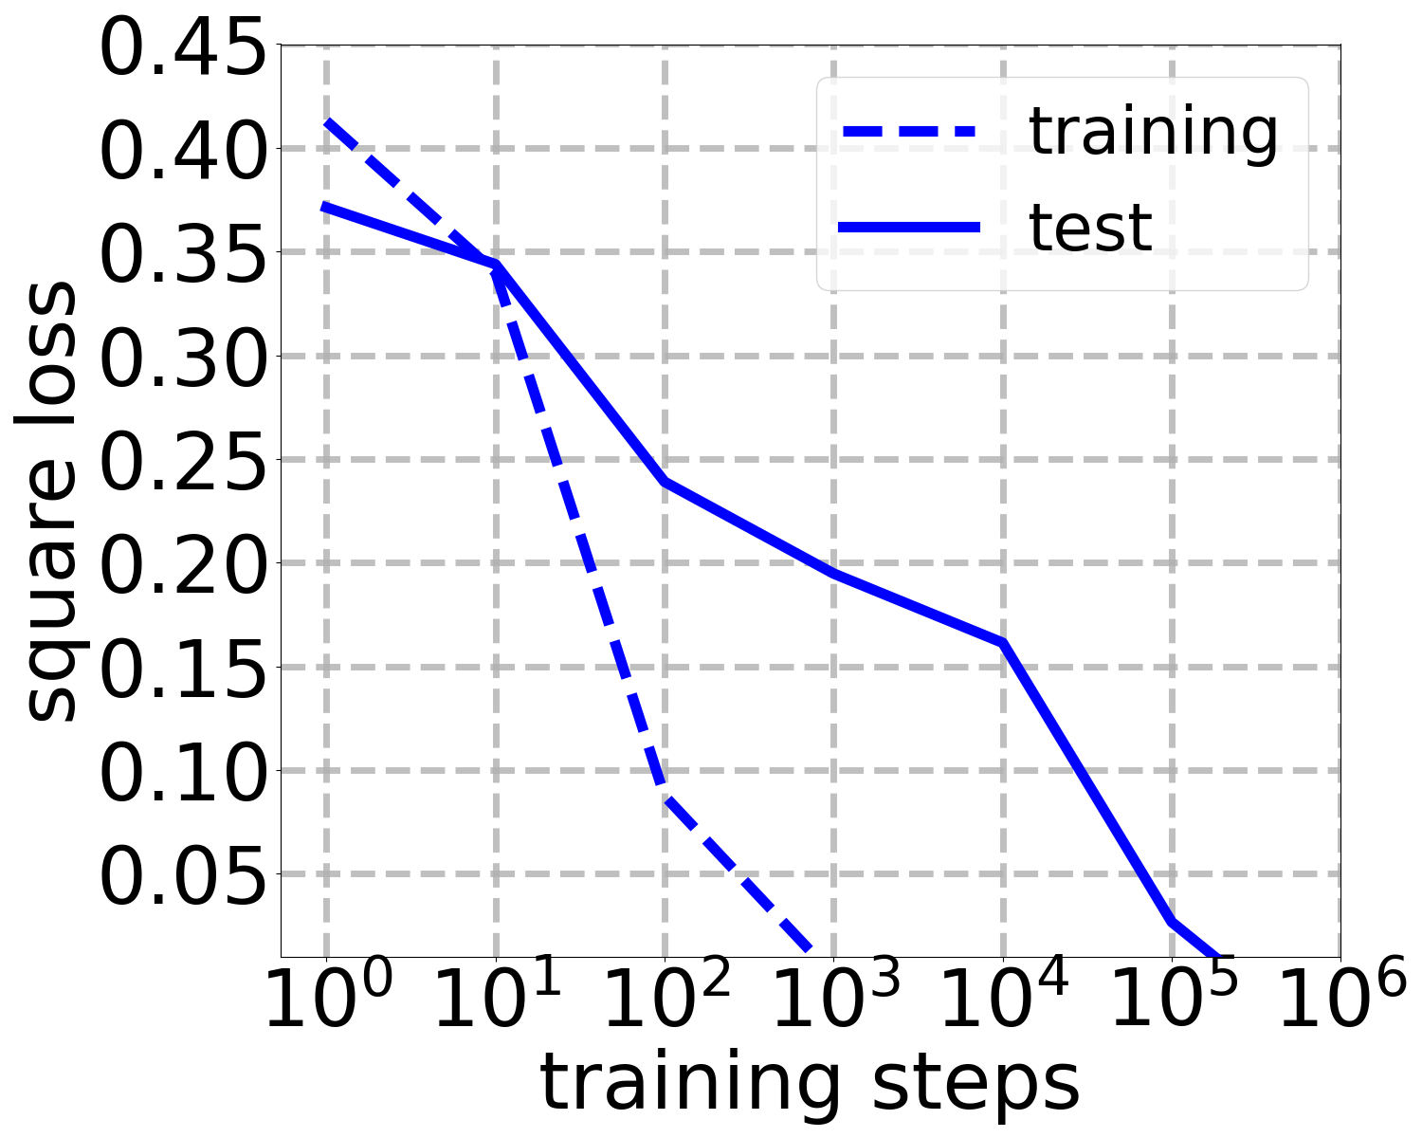
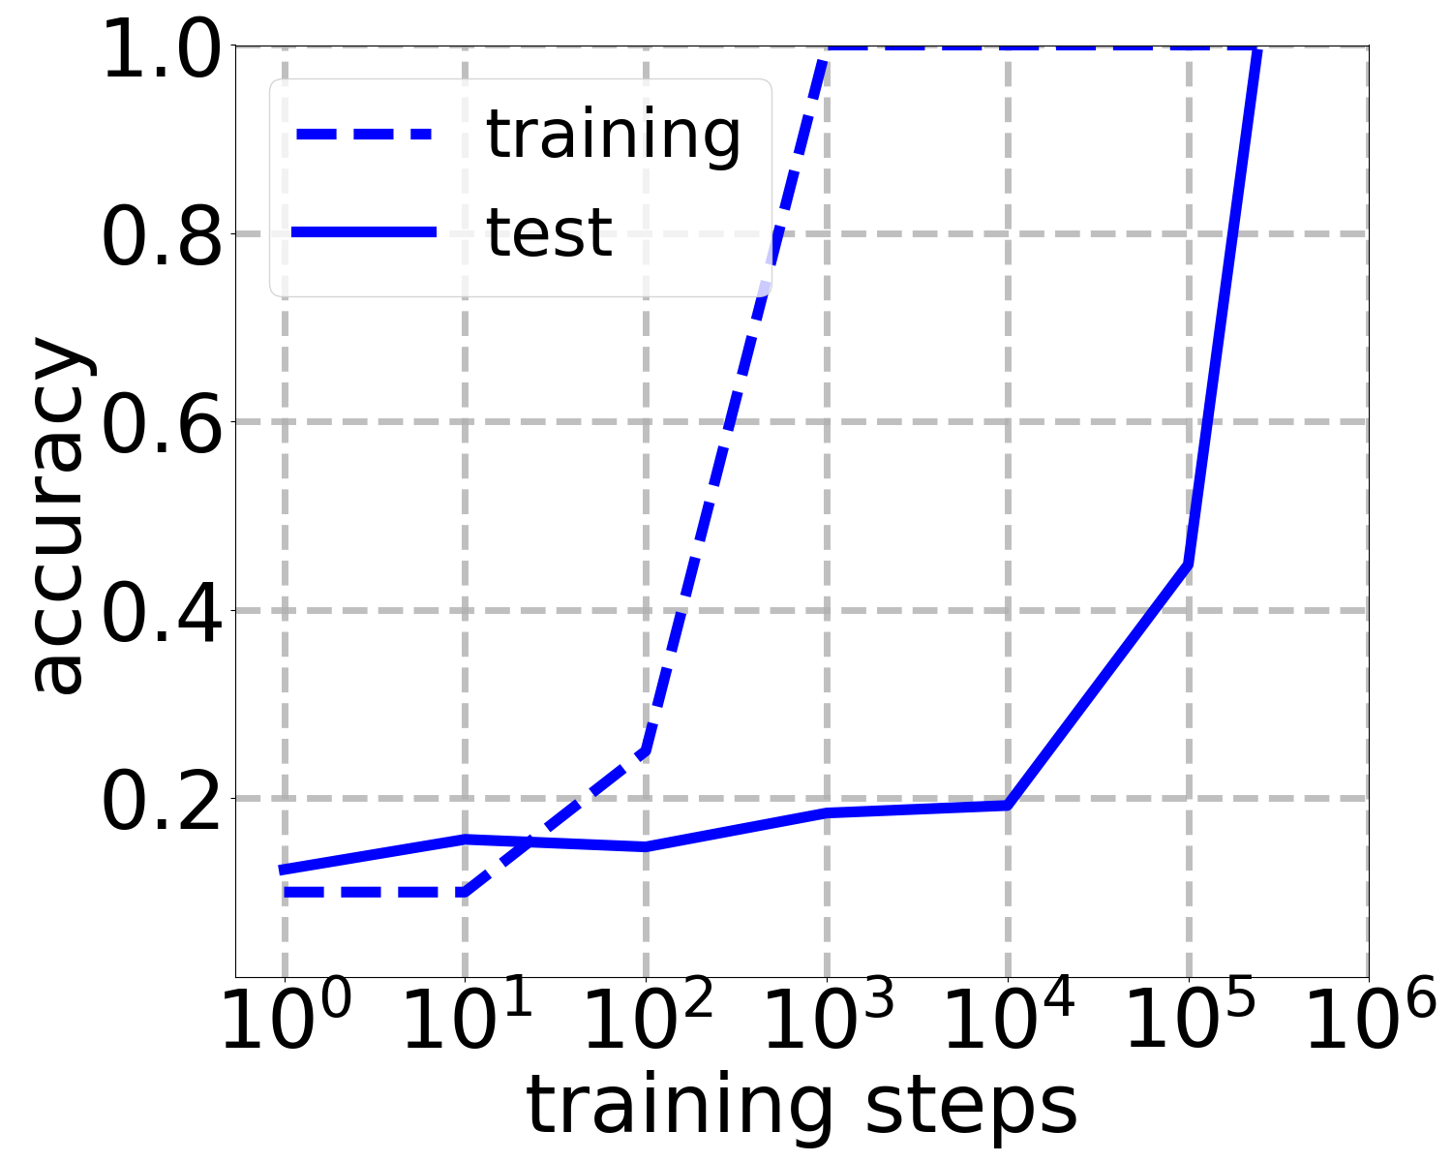
Experiments: recovering the plateau phenomenon
Instead of evaluating the actual squared loss, let us evaluate the following surrogate loss:

Slide 17
Future directions
The most related follow-up questions:
(1) Can we prove end-to-end grokking for agnostic ridge regression?
The proof strategy for the realizable case extends by incorporating an additional approximation guarantee. The challenge is to find a hyperparameter configuration to realize grokking.
(2) Can we prove end-to-end grokking for training non-linear neural networks?
New proof techniques are required, especially for the component that overfitting persisting long.
(3) Can we prove end-to-end grokking without using explicit regularization?
This requires utilizing existing/developing new implicit bias theory.

Slide 18
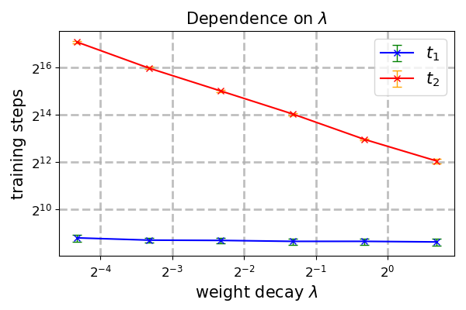
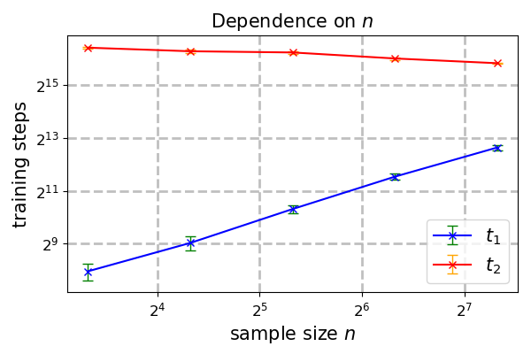
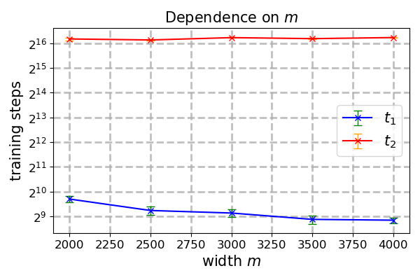
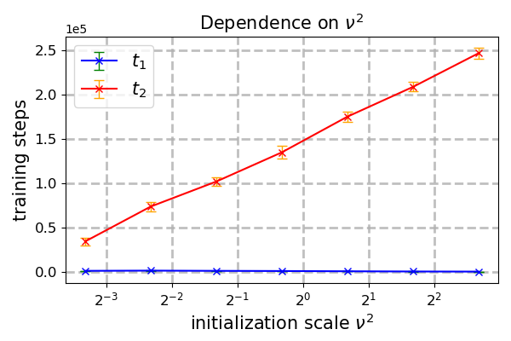
Experiments: hyperparameter effects of two-layer ReLU nets
Qualitatively match the linear case

Slide 19
Future directions: other sibling strange generalization phenomena
Double descent
Belkin et al. (PNAS 2019)
Ungrokking & semi-grokking
Varma et al. (2023)

Slide 20
Thank you!

