Slide 1
Deploying Models as Web Service using Plumber
A walkthrough with RStudio, Heroku and Amazon Web Services
By Ooi Wen Fong
https://github.com/raymondowf/rconf-2020

Slide 2
Overview
Data Science Life Cycle
What is Web API and Plumber?
Plumber Syntax and Examples
Demos

Slide 3
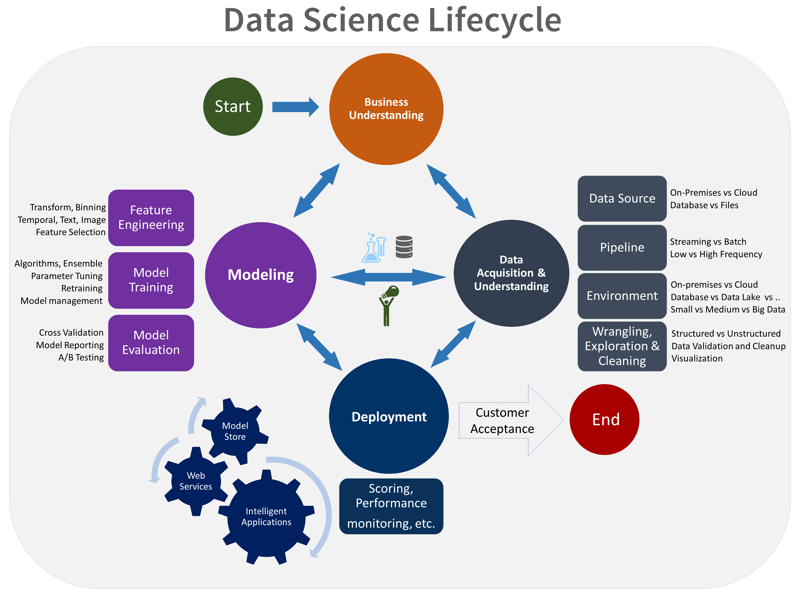
Data Science Life Cycle
Source: https://docs.microsoft.com/en-us/azure/machine-learning/team-data-science-process/lifecycle

Slide 4

Data Science Life Cycle with stakeholders
B
PM
DE
DA
Legends:
B: Business Users
PM: Project Manager
DA: Data Analyst
DE: Data Engineer
DS: Data Scientist
ME: ML Engineer
DS
ME
Diagram from: https://docs.microsoft.com/en-us/azure/machine-learning/team-data-science-process/lifecycle

Slide 5
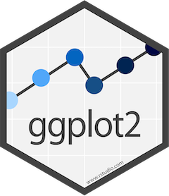




Communication
Enable data to be summarized in charts and diagrams.
Enable the development of interactive dashboards from R
Transform analyses into documents, reports, presentations and dashboards.
Transform R functions into web APIs

Slide 6
Plumber
Turn R functions into REST API endpoint
Use special comments and decorators
#* - plumber comments
@ - endpoint attributes / details.

Slide 7
API
Application Programming Interface
Web API
HTTP
Representational State Transfer (REST)
A software architectural style for creating web services
6 guiding constraints
Focus on performance and scalability
Enable developers using other programming languages (php, node.js, Swift, etc) to connect to R models via web APIs.

Slide 8
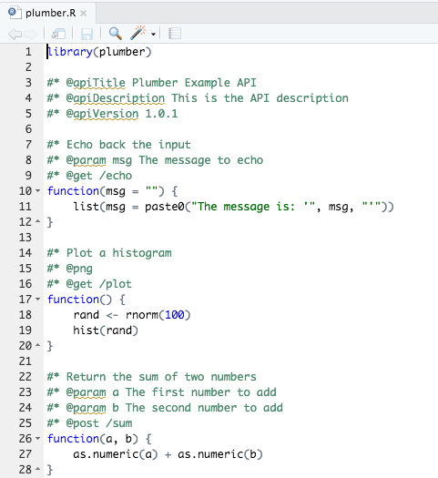
Building REST API using RStudio

Slide 9
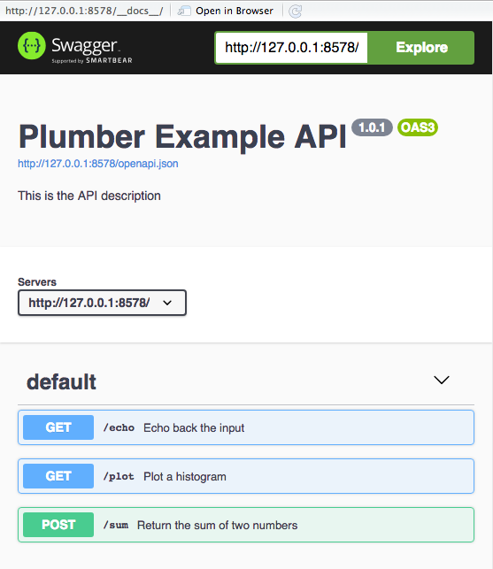
Building REST API using RStudio

Slide 10
Demo #1 (Local Machine)
Create new Web APIs using Plumber and RStudio
Publish the Web APIs using RStudio on local machine
Test the Web APIs and observe the output

Slide 11
Demo #2: More “Plumbing” work…
How does the output look like if a Web API returns a data.frame?
Can a Web API return an output in formats, such as HTML, CSV, etc?
Can I build a ”pipeline” in handling incoming request?

Slide 12
Demo #3: Connecting a ML model with Web API
Train a model using random forest that classifies species of iris (flower)
Save the model
Setup a Web API that returns the prediction of the species given sepal’s length and width, and petal’s length and width.
Figure from: https://medium.com/@Nivitus./iris-flower-classification-machine-learning-d4e337140fa4

Slide 13
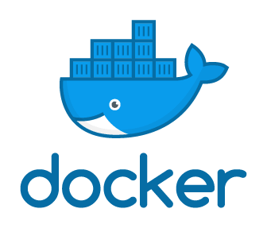
Deploying Web APIs to a Docker Container
What is Docker? An open platform for developing, shipping, and running applications.
What is Docker Container? A standard unit of software that packages up code and all its dependencies
What do you need?
Docker program
Dockerfile – a recipe for building a Docker image.

Slide 14
Demo #4 (Deploying Web APIs to Docker Container)
Demonstrate the working folder
Prepare a Dockerfile
Build a Docker image
Run the image as Docker Container
Test the Web APIs on local machine (using web browsers, e.g. Chrome)
Publish the Docker Image to Docker Hub (Docker Hub’s account is required)

Slide 15

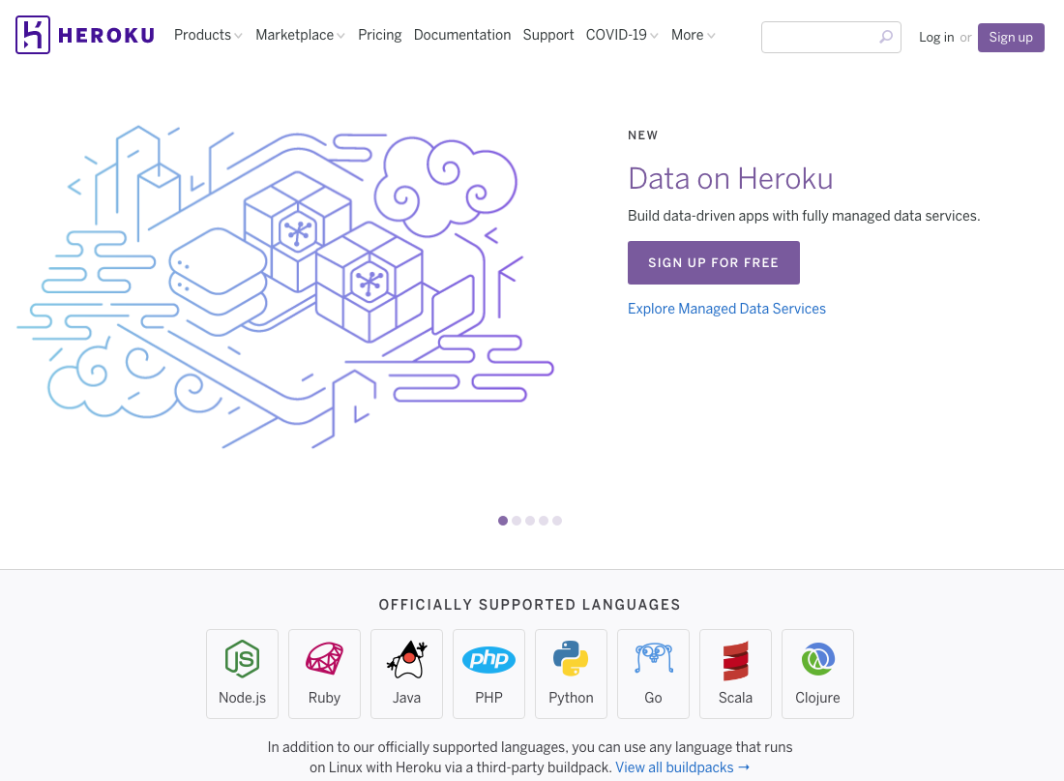
Deploying Web APIs to Heroku
Heroku is a cloud platform as a service (PaaS) supporting several programming languages.
To deploy web APIs, you need to
create an account (Free and Hobby), and
install Heroku Command Line Interface (CLI).

Slide 16
Demo (Deploying Web APIs to. )
Open Terminal
Login Heroku using CLI
Create a new web application
Push a docker container as a web application
Test the web APIs using any web browser
View the log files

Slide 17


Deploying Web APIs to
One of the services offered by AWS
Provide a serverless compute engine for containers
Removes the need to provision and manage servers

Slide 18
Demo (Deploy API to Amazon Web Services)
Login the AWS Console
Choose “Elastic Container Service”
Create a cluster
Choose the option powered by AWS Fargate
Create a new task definition and select ”Fargate”
Specify task size – choose the smallest for memory and vCPU
Add container
Select the task and “Run Task” from “Actions”
Choose VPC and Security Group
Update Security Group so that the inbound rules include the permission for accessing the port 8000

Slide 19
Summary (I)
Transforming R functions into web APIs is easy using Plumber.
Making R functions accessible beyond local host could be challenging as it requires knowledge beyond R programming.
Docker Container is a convenient way to package code and required dependencies into an executable unit and be deployed in multiple platforms, being on premise or public cloud platforms.
Deployment of web APIs connecting to R models/functions via Plumber was demonstrated using Docker, Heroku and AWS.

Slide 20
Summary (II)
A few important aspects deserve attentions but not discussed in this presentation. These include
Measures protecting web APIs
Possible security issues
Denial Of Service (DoS)
Sanitization & Injection
Cross-Origin Resource Sharing (CORS)
Scalability of web APIs
Model monitoring and update
Deployment of models using ML platforms, such as Microsoft Azure ML, AWS Sagemaker.
More information: https://www.rplumber.io/articles/security.html

Slide 21
Useful Links
https://www.rplumber.io/index.html
https://www.youtube.com/watch?v=pCXYzN0HbwA

Slide 22
Thank you!

