Slide 1
Harry Potter Trivia Maze
Triple Threat
Fearless Leader – Daylyn Hoxie
Code Monkey – Spencer Curley
Moral Support – Raymond Shiner

Slide 2
Overview
Console Based Application
Modular Maze
5x5 by default
Start in top left, exit is bottom right
3 Question Types
True False
Multiple Choice
Short Answer

Slide 3
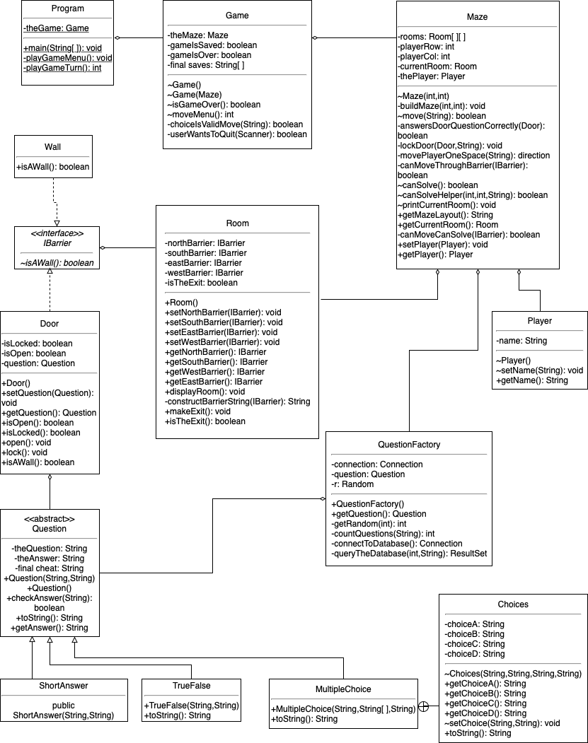
UML DIAGRAM
UML HERE
Design Patterns
-Simple Factory
-Strategy
OO Principles
-SOLID

Slide 4
Demo

Slide 5
THANK YOU
Team Lead - Daylyn Hoxie
Spencer Curley
Raymond Shiner

