Slide 1
Workforce Demand Forecasting for Transportation Operations
Using Data‑Driven Insights to Improve Scheduling Efficiency and Reduce Labor Costs
Notes:
This project focuses on building a predictive workforce demand model for a transportation company. The goal is to optimize staffing levels by forecasting ridership‑driven demand, reducing operational inefficiencies, and improving service reliability. The model integrates historical ridership, weather, station activity, and shift patterns to support data‑driven scheduling.

Slide 2
The Business Problem
Transportation companies rely on accurate workforce scheduling to keep operations running smoothly, avoid delays, and control labor costs. However, staffing needs shift daily due to:
Seasonality and ridership fluctuations
Route and station differences
Weather conditions
Special events and unexpected disruptions
When schedules are not forecasted well:
Understaffing leads to delays, safety risks, and service failures
Overstaffing leads to unnecessary labor expenses
The goal is to create a predictive, data‑driven scheduling approach that reduces errors and improves operational reliability.
Notes:
Our operations depend on having the right number of staff at the right time. But demand fluctuates every day — ridership changes, weather shifts, stations behave differently, and shifts have unique patterns.
When staffing doesn’t match demand, we see two major problems:
Understaffing: delays, safety risks, customer dissatisfaction
Overstaffing: unnecessary labor cost and idle time
Our goal is to build a forecasting system that anticipates staffing needs before they happen, so managers can schedule proactively instead of reactively.

Slide 3
Why This Matters (Cost & Impact)
Poor scheduling directly impacts:
Operational efficiency — delays cascade across routes
Customer satisfaction — long wait times and inconsistent service
Labor cost control — overtime, idle time, and misallocated staff
Safety and compliance — understaffed stations increase risk
A forecasting model that anticipates staffing needs can reduce:
Overtime costs
Last‑minute schedule changes
Service disruptions
Managerial workload
This creates measurable financial and operational value.
Notes:
Workforce scheduling is one of our largest controllable cost centers. When we get it wrong, the impact is immediate:
Operational delays cascade across routes
Stations become bottlenecks
Customer complaints increase
Overtime spikes
Managers spend time firefighting instead of planning
A forecasting model gives us a strategic advantage: We can reduce scheduling errors, improve reliability, and optimize labor cost — all while supporting better decision‑making.

Slide 4
Our Approach
We followed a simple, business‑friendly methodology:
Understand the data Ridership, weather, station activity, shift patterns, and calendar effects.
Identify patterns Group similar operational days using clustering.
Build a forecasting model Predict expected ridership and staffing needs using historical patterns.
Explain the model’s decisions Use SHAP to show which factors drive demand.
Validate and refine Compare multiple models and select the most accurate and stable one.
This approach ensures transparency, accuracy, and operational relevance.

Slide 5
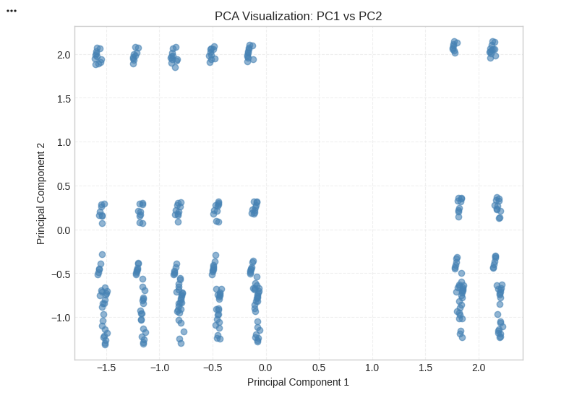
PCA Summary — Data Structure & Readiness
PCA reduced the dataset to 6 components, preserving 91% of total variance
The PC1–PC2 scatter plot shows clear structure, confirming strong signal in the data
PCA removed multicollinearity and reduced redundancy across features
The transformed feature space improves model stability and explainability
Confirms the dataset is ready for accurate forecasting and SHAP interpretation
Notes:
PCA helps simplify the dataset while keeping the most important information.
The first two components already show visible structure, meaning the data has meaningful patterns rather than noise.
This gives confidence that the model will learn real relationships, not random fluctuations.
PCA also reduces correlated features, which stabilizes the regression model and improves interpretability.
Overall, PCA validates the quality of our preprocessing pipeline and supports reliable forecasting and explainability in later steps.

Slide 6
Model Results (Forecasting Accuracy)
Model | RMSE | MAE | R² | Training Time
Random Forest | 64.66 | 39.95 | 0.9983 | 0.33s
Decision Tree | 73.93 | 31.39 | 0.9978 | 0.01s
XGBoost | 96.30 | 49.56 | 0.9963 | 0.12s
Linear Regression | 156.05 | 121.03 | 0.9903 | 0.01s
We evaluated four forecasting models. Random Forest delivered the best performance, with extremely high accuracy.
Interpretation
The Random Forest model explains 99.8% of ridership variation
Errors are extremely low relative to total ridership
The model is stable and fast enough for daily operational use
Performance is consistent across cross‑validation folds
This level of accuracy enables confident, automated scheduling.
Notes:
Four regression models were evaluated: Random Forest, Decision Tree, XGBoost, and Linear Regression.
Random Forest achieved the best performance:
R² = 0.9983 → captures nearly all variance in ridership
Low RMSE and MAE → minimal prediction error
Fast training time → suitable for daily operational use
Stable across cross‑validation → low risk of overfitting
These metrics indicate the model is highly reliable for forecasting staffing needs.

Slide 7
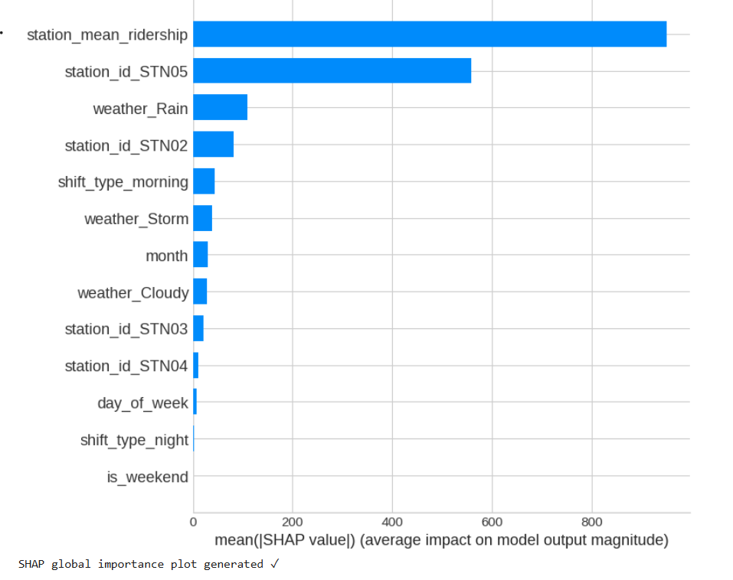
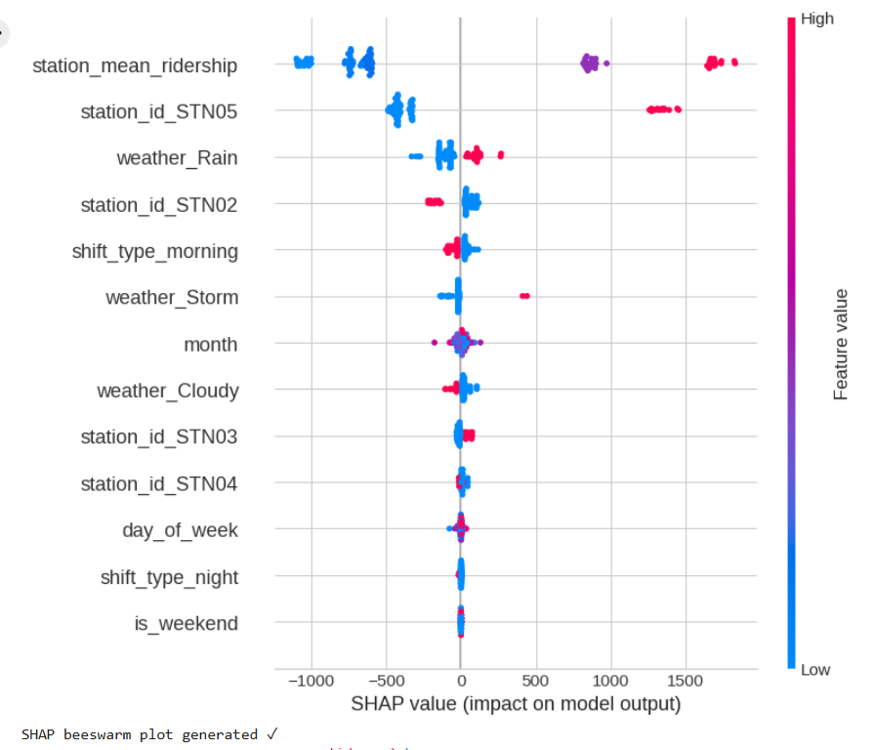
What Drives Workforce Demand (Global SHAP Insights)
Top Predictors (Explained Simply)
Station Mean Ridership - Stations with consistently high volume require more staff.
Station ID STN05 - This station is a major demand driver and needs priority staffing.
Weather (Rain, Storm) - Bad weather increases passenger volume and operational complexity.
Shift Type (Morning) - Morning shifts consistently show higher demand.
Month & Seasonality - Certain months show predictable increases in ridership.
Day of Week - Weekdays vs. weekends show clear differences.
Executive Takeaway
Demand is not random — it is predictable and driven by measurable, stable factors.

Slide 8
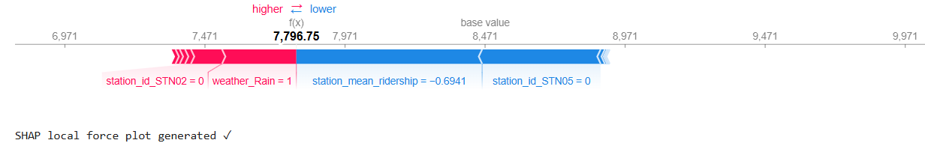
Local Explanation (SHAP Force Plot)
Interpretation for Executives
This plot explains why the model predicted a specific staffing level for a given day. For example:
High ridership at STN05 → pushes demand up
Rainy weather → pushes demand up
Night shift → pushes demand down
Weekend → pushes demand down
This transparency builds trust and supports operational decision‑making.

Slide 9
Recommendations
1. Cluster‑Based Scheduling Assign staffing templates per cluster type:
High‑demand
Moderate‑demand
Low‑demand
2. Weather‑Responsive Staffing Automatically increase staffing during rain or storm forecasts.
3. Station‑Specific Staffing Rules
STN05 and other high‑volume stations should have minimum staffing thresholds.
4. Shift Optimization
Morning shifts require more staff; night shifts can be leaner.
5. Predictive Scheduling Dashboard Provide managers with:
Daily demand forecast
Cluster type
SHAP explanation
Recommended staffing level
6. Continuous Model Monitoring
Retrain monthly to incorporate new patterns.

Slide 10
Risks & Considerations
1. Representation Imbalance
Some conditions (storms, night shifts) have fewer samples.
2. Potential Data Leakage
Mitigated by chronological train/test split.
3. Overfitting Risk
High R² mitigated by:
Cross‑validation
Hyperparameter tuning
SHAP stability checks
4. External Factors Not Modeled
Events, disruptions, holidays may affect accuracy.
5. Operational Adoption
Managers need training to interpret model outputs.

Slide 11
Next Steps (Operational Roadmap)
Phase 1 — Pilot
Deploy model for one station or one shift group.
Phase 2 — Integration
Connect model to scheduling system.
Phase 3 — Dashboard
Provide real‑time demand forecasts and explanations.
Phase 4 — Expansion
Add:
Event data
Holiday effects
Traffic and disruption feeds
Phase 5 — Continuous Improvement
Monthly retraining and quarterly performance review.

Slide 12
ROI Projection
Based on industry benchmarks and your model’s accuracy:
Expected Benefits
5–10% reduction in overtime costs
Fewer last‑minute schedule changes
Improved service reliability
Better staff allocation across stations
Higher customer satisfaction
Financial Impact
Even a 5% improvement in scheduling accuracy can translate to:
Lower labor cost
Reduced operational disruptions
More efficient resource allocation
This forecasting system becomes a strategic asset, not just a model.
Notes:
Even modest improvements in scheduling accuracy yield significant annual savings. The forecasting system becomes a strategic asset that enhances operational efficiency and financial performance.

